Slide 1
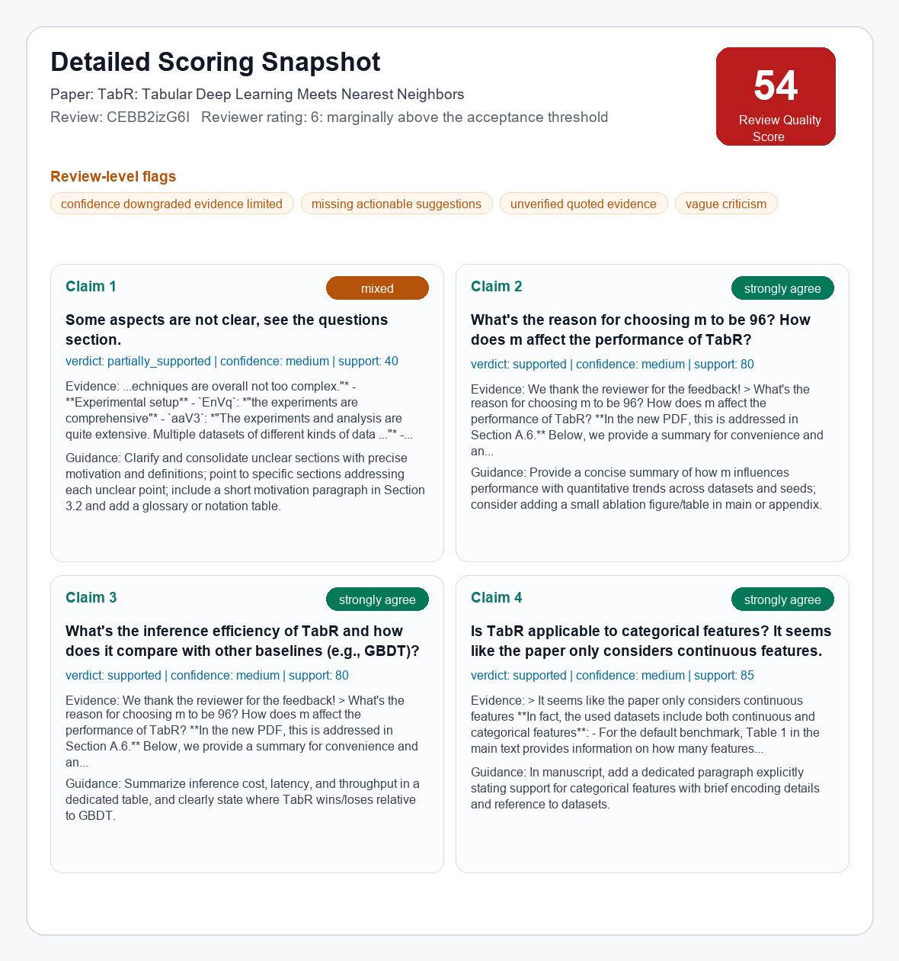
SecondOpinion: From Review Signals to Evidence-Grounded Audit
One-slide update: pilot motivation, actual data cleaning flow, and a concrete scoring result
1. Pilot review-quality signals
2. Actual cleaning flow
3. Current scoring result
Examples from public ICLR 2024 OpenReview data
Example trace: TabR review CEBB2izG6I
Detailed snapshot for the same review
Reviewer conflict
Modelling Microbial Communities with GNNs
"poorly justified and weak on novelty"
"Novel problem setup and the first use of GNN"
Raw reviewer comments
Weakness: unclear aspects
Questions: m=96, inference efficiency, categorical features
v
normalize fields
Cleaned review chunks
source_field: weaknesses / questions
rating normalized: 6/10
source_sentence preserved exactly
openreview.net/forum?id=cXs5md5wAq
v
Vague / low-actionability
Visuo-emotional perception and GenAI
"The presentation of the paper is chaotic"
"Please refer to Weaknesses"
extract claims
Extracted claims
1. Some aspects are not clear
2. Why choose m=96?
3. Inference efficiency vs GBDT
4. Categorical feature support
v
retrieve evidence chunks
openreview.net/forum?id=eR4W9tnJoZ
Matched evidence
Author response: addressed in Section A.6
Extended results: Section E, p.30
Tone risk
TinyTrain
"I have no idea..."
"why bother writing down..."
v
judge + reliability gate
Scored output
RQS: 54/100
m=96 claim: strongly_agree / supported
Guidance: add an m-ablation summary/table
openreview.net/forum?id=xNdE7RiRyP
Takeaway: the motivation is not only that some reviews are negative. The issue is whether feedback is specific, evidence-grounded, actionable, and professionally phrased.
Links
Demo report: reports/mvp_demo_three_papers.html
Repo: github.com/Yongwen12/SecondOpinion
RQS = Review Quality Score. Current scores are preliminary MVP outputs for calibration, not final ground truth.

