Slide 1
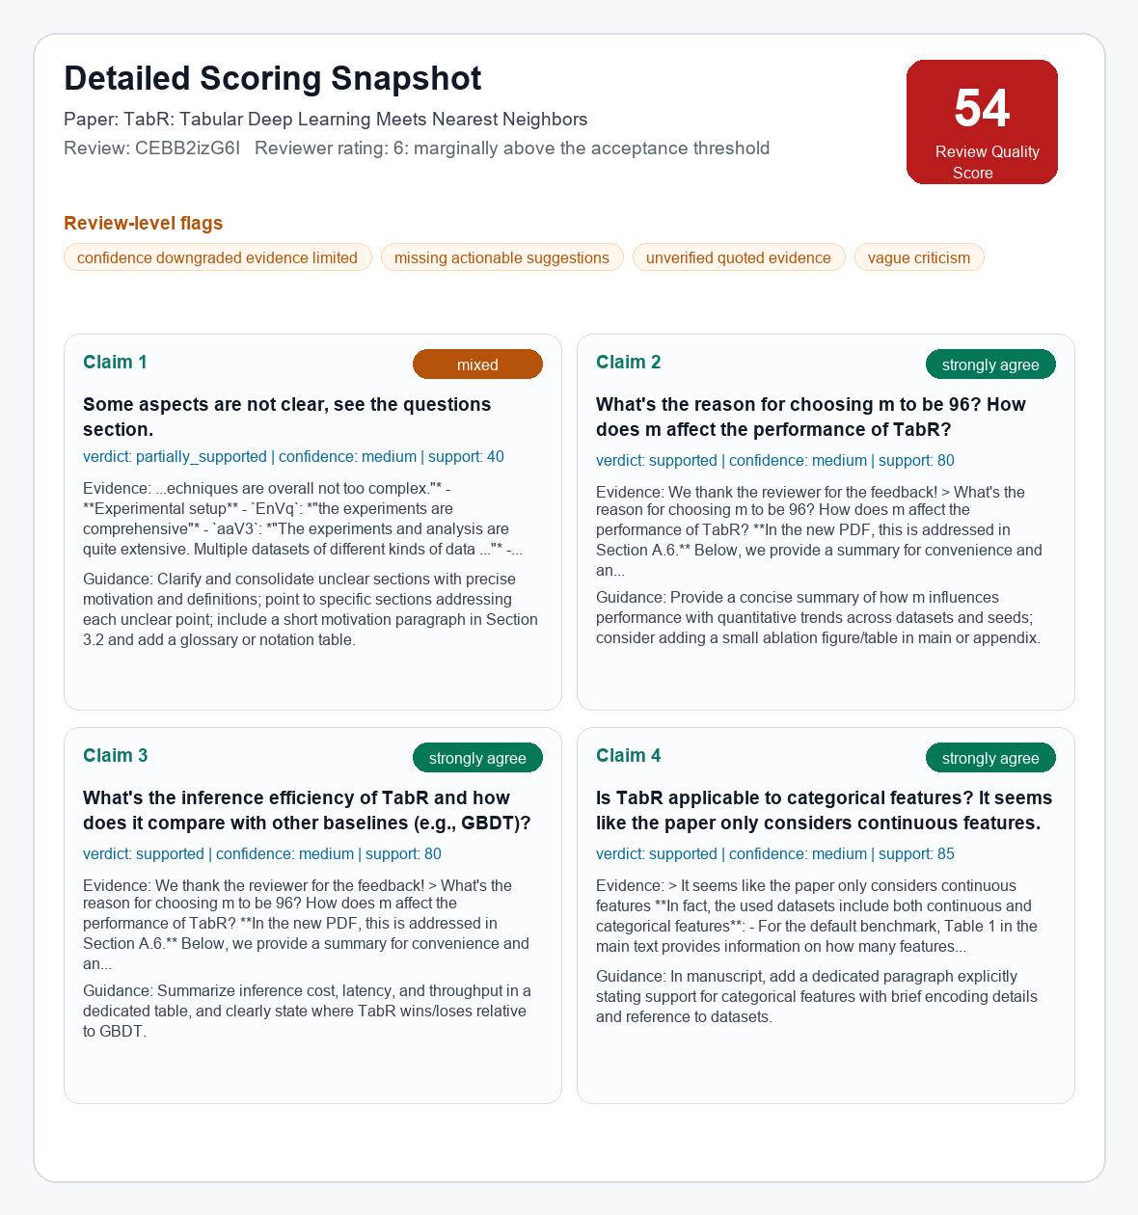
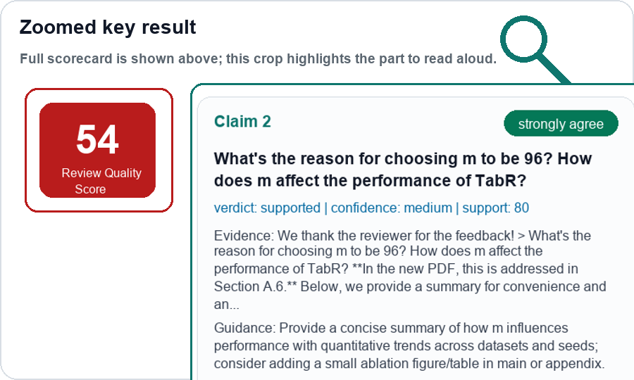
SecondOpinion: Review Audit MVP
Motivation evidence, technical architecture with an actual data trace, and current scoring output
1. Pilot review-quality signals
2. Technical architecture + data trace
3. Current scoring result
Public ICLR 2024 examples; links point to the paper forum.
Architecture nodes on the left; actual TabR data example on the right.
Detailed result for the same TabR review, with zoomed key area.
A. Reviewer conflict: same paper, different reviewers
Ex.1 Reviewer A: "weak on novelty" [cXs5md5wAq]
Ex.1 Reviewer B: "Novel problem setup and the first use of GNN" [cXs5md5wAq]
Ex.2 Reviewer A: "significant advance over prior work" [rhgIgTSSxW]
Ex.2 Reviewer B: "motivations behind the module designs are not entirely clear" [rhgIgTSSxW]
Component
Example data flowing through
full
Ingestion
OpenReview review CEBB2izG6I + paper PDF
→
Normalization
questions chunk; rating normalized to 6/10
→
link: cXs5md5wAq
link: rhgIgTSSxW
B. Vague / low-actionability wording
V1: "presentation ... chaotic" [eR4W9tnJoZ]
V2: "Please refer to Weaknesses" [eR4W9tnJoZ]
V3: "This work is too simple" [eR4W9tnJoZ]
V4: "no new algorithm, but a trick" [B0wJ5oCPdB]
Claim extraction
Claim: why choose m=96 and how it affects performance
→
Evidence retrieval
Author response says Section A.6 addresses it; extended results p.30
→
link: eR4W9tnJoZ
link: B0wJ5oCPdB
LLM judge
stance=strongly_agree; verdict=supported; confidence=medium
C. Tone / wording risk
T1: "I have no idea... / why bother writing down..." [xNdE7RiRyP]
T2: "fatal flaws ... faulty assumptions" [fI6TkT050a]
T3: "deeply flawed and presentation slightly misleading" [fI6TkT050a]
T4: "The authors appear to be confused" [cXs5md5wAq]
→
Reliability gate
downgrade/flag when quotes or evidence are limited
→
Report + annotation
HTML report + human/AI calibration tasks
link: xNdE7RiRyP
link: fI6TkT050a
→
These are signals, not final judgements: the system audits each reviewer point against evidence before assigning scores.
Why not multi-agent first? MVP priority = traceability, reproducibility, and calibration.
Demo report
| Repo
RQS = Review Quality Score. Current scores are preliminary MVP outputs for calibration, not final ground truth.

