Slide 1
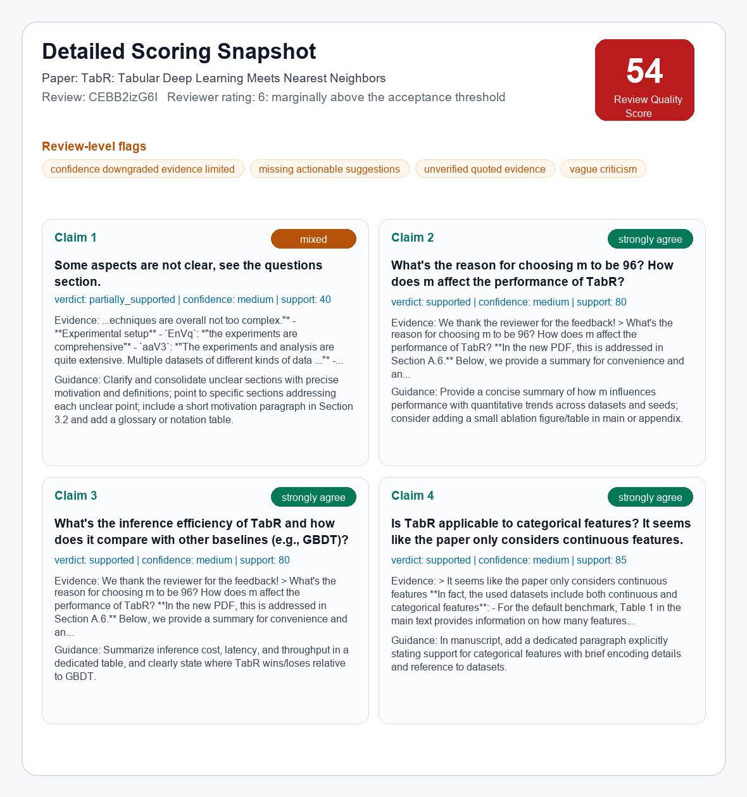
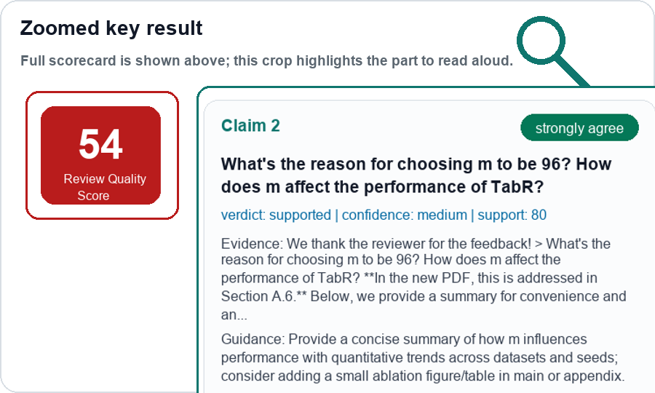
SecondOpinion: Review Audit MVP
Pilot evidence → evidence-grounded audit architecture → current scoring result
1. Pilot signals
2. Technical architecture
3. Current scoring result
Public ICLR 2024 examples
Each node includes one TabR data example
Detailed scorecard + zoomed key result
Reviewer conflict
Ex.1 A: "weak on novelty" (cXs5md5wAq)
Ex.1 B: "first use of GNN" (cXs5md5wAq)
Ex.2 A: "significant advance" (rhgIgTSSxW)
Ex.2 B: "module designs unclear" (rhgIgTSSxW)
Ingestion
review + rating + PDF
Normalize
questions chunk; rating=6
full
RQS
54
Claim 2
supported
medium confidence
→
↓
links: cXs5md5wAq, rhgIgTSSxW
Extract claims
Why choose m=96?
Retrieve evidence
response: Section A.6
Vague / low-actionability
V1: "presentation is chaotic" (eR4W9tnJoZ)
V2: "Please refer to Weaknesses" (eR4W9tnJoZ)
V3: "too simple" (eR4W9tnJoZ)
V4: "no new algorithm, but a trick" (B0wJ5oCPdB)
→
↓
Judge
strongly_agree; supported
Reliability gate
flag weak / unverifiable evidence
links: eR4W9tnJoZ, B0wJ5oCPdB
→
Tone risk
T1: "I have no idea / why bother" (xNdE7RiRyP)
T2: "fatal flaws" (fI6TkT050a)
T3: "deeply flawed" (fI6TkT050a)
T4: "authors appear to be confused" (cXs5md5wAq)
↓
Report + calibration
RQS 54; guidance: add m-ablation table; export human/AI labels
links: xNdE7RiRyP, fI6TkT050a
Goal: audit review quality, not attack reviewers or re-decide acceptance.
Simple pipeline first: traceable, reproducible, easy to calibrate.
Demo report
| Repo
RQS = Review Quality Score. Current scores are preliminary MVP outputs for calibration, not final ground truth.

