Slide 1
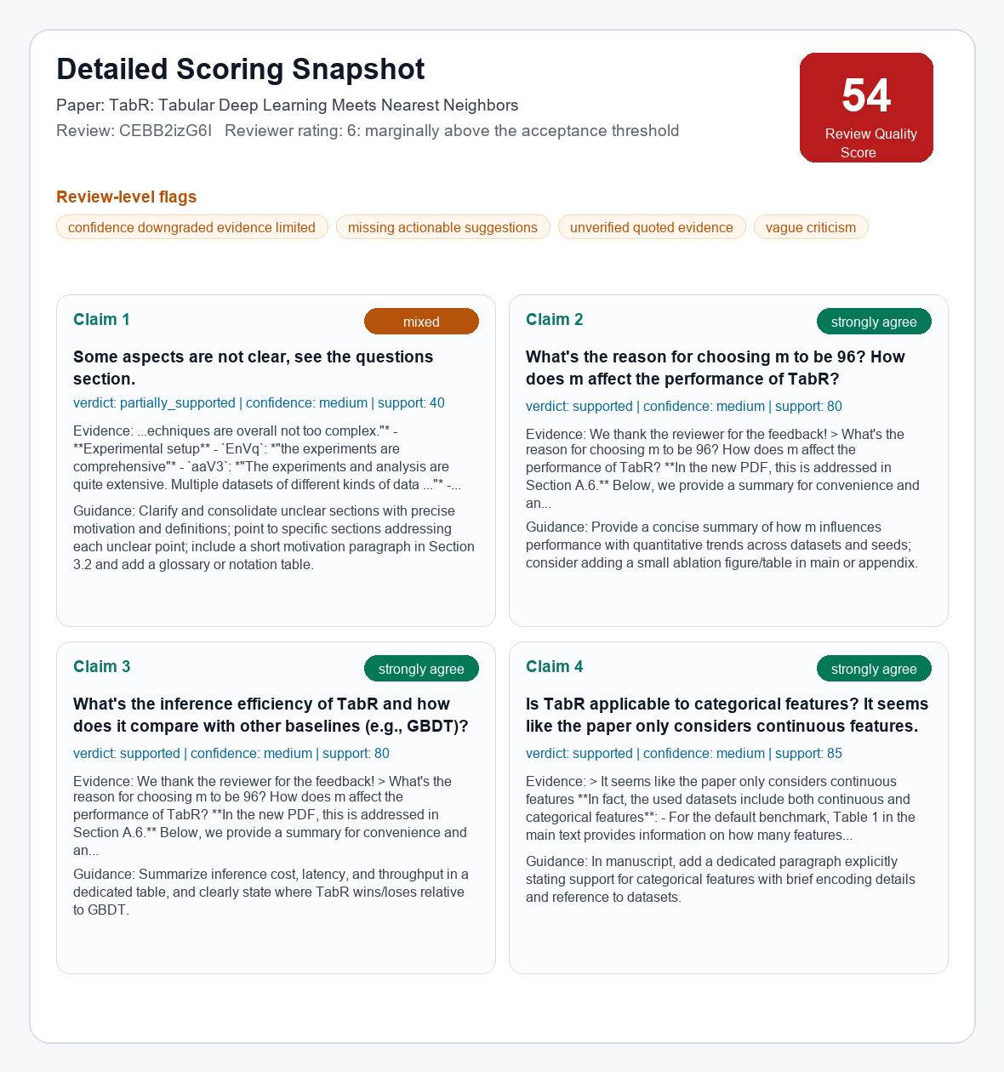
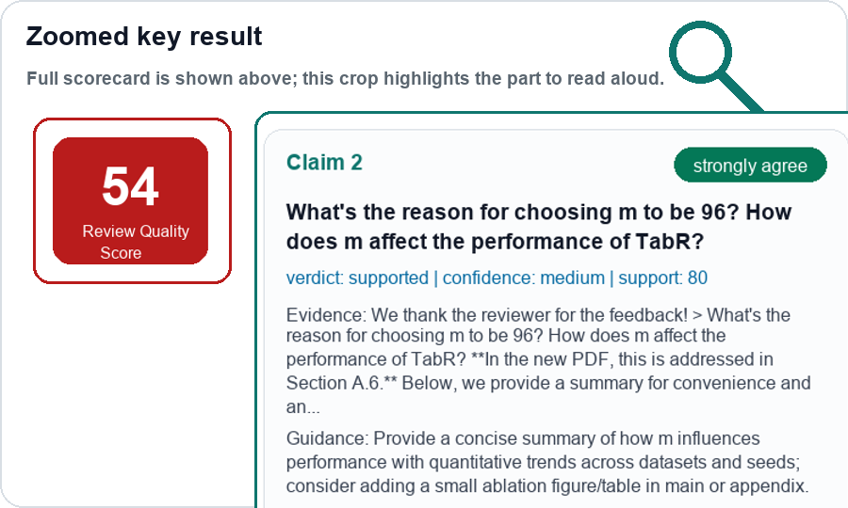
SecondOpinion: Review Audit MVP
Pilot evidence → evidence-grounded audit architecture → current scoring result
1. Pilot signals
2. Technical architecture
3. Current scoring result
Public ICLR 2024 examples
Reviewer conflict
Ex.1 A: "weak on novelty" (cXs5md5wAq)
Ex.1 B: "first use of GNN" (cXs5md5wAq)
Ex.2 A: "significant advance" (rhgIgTSSxW)
Ex.2 B: "module designs unclear" (rhgIgTSSxW)
Left: component. Right: one TabR data example.
Full scorecard + large zoom for presenting
Ingestion
review + rating + PDF
full
RQS
54
Claim 2
supported
medium confidence
→
↓
↓
Normalize
questions chunk; rating = 6
→
links: cXs5md5wAq, rhgIgTSSxW
↓
↓
Extract claims
Claim: why choose m=96?
Vague / low-actionability
V1: "presentation is chaotic" (eR4W9tnJoZ)
V2: "Please refer to Weaknesses" (eR4W9tnJoZ)
V3: "too simple" (eR4W9tnJoZ)
V4: "no new algorithm, but a trick" (B0wJ5oCPdB)
→
↓
↓
Retrieve evidence
Author response: Section A.6
→
↓
↓
links: eR4W9tnJoZ, B0wJ5oCPdB
Judge
strongly_agree; supported
→
Tone risk
T1: "I have no idea / why bother" (xNdE7RiRyP)
T2: "fatal flaws" (fI6TkT050a)
T3: "deeply flawed" (fI6TkT050a)
T4: "authors appear to be confused" (cXs5md5wAq)
↓
↓
Reliability
flag weak evidence / quotes
→
↓
↓
Report
RQS 54 + rebuttal guidance
→
links: xNdE7RiRyP, fI6TkT050a
Audit review quality, and then assist on rebuttal
Pipeline first: traceable, reproducible, easy to calibrate.
RQS = Review Quality Score. Preliminary MVP outputs for calibration, not final ground truth.

