Slide 1
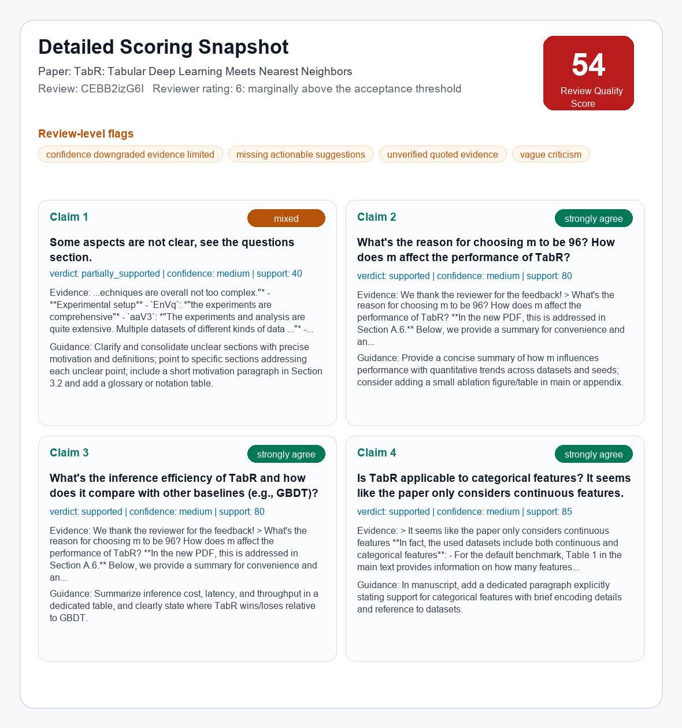
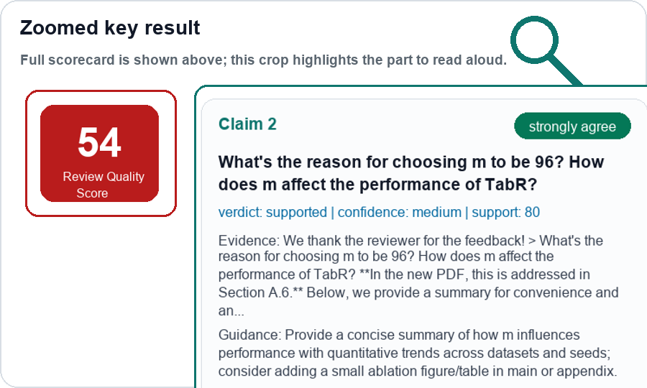
SecondOpinion: Review Audit MVP
Pilot evidence → evidence-grounded audit architecture → current scoring result
1. Pilot signals
2. Audit flow on one real review
3. Current scoring result
Public ICLR 2024 examples
Reviewer conflict
Ex.1 A: "weak on novelty" (cXs5md5wAq)
Ex.1 B: "first use of GNN" (cXs5md5wAq)
Ex.2 A: "significant advance" (rhgIgTSSxW)
Ex.2 B: "module designs unclear" (rhgIgTSSxW)
Raw review → claims → evidence → judgement → guidance
Full scorecard + large zoom for presenting
Reviewer wrote
Weakness: "Some aspects are not clear, see the questions section."
Questions: m=96 choice; efficiency vs GBDT; categorical features?
INPUT
full
RQS
54
Claim 2
supported
medium confidence
↓
links: cXs5md5wAq, rhgIgTSSxW
System extracts review points
C1 clarity issue | C2 m=96 sensitivity
C3 inference efficiency | C4 categorical support
LLM: gpt-5-nano
Vague / low-actionability
V1: "presentation is chaotic" (eR4W9tnJoZ)
V2: "Please refer to Weaknesses" (eR4W9tnJoZ)
V3: "too simple" (eR4W9tnJoZ)
V4: "no new algorithm, but a trick" (B0wJ5oCPdB)
↓
Evidence found
Search paper chunks + appendix + author response
Match: Section A.6 + extended results p.30
LOCAL
links: eR4W9tnJoZ, B0wJ5oCPdB
↓
Tone risk
T1: "I have no idea / why bother" (xNdE7RiRyP)
T2: "fatal flaws" (fI6TkT050a)
T3: "deeply flawed" (fI6TkT050a)
T4: "authors appear to be confused" (cXs5md5wAq)
SecondOpinion judges C2
strongly_agree / supported / medium confidence
Guidance: add an m-ablation summary/table
LLM: gpt-5-nano
↓
Reliability + report
Verify quotes, flag weak evidence, output RQS + HTML report
LOCAL
links: xNdE7RiRyP, fI6TkT050a
Audit review quality, and then assist on rebuttal
Two LLM calls; retrieval, reliability checks, and reporting stay local.
RQS = Review Quality Score. Preliminary MVP outputs for calibration, not final ground truth.

