Slide 1
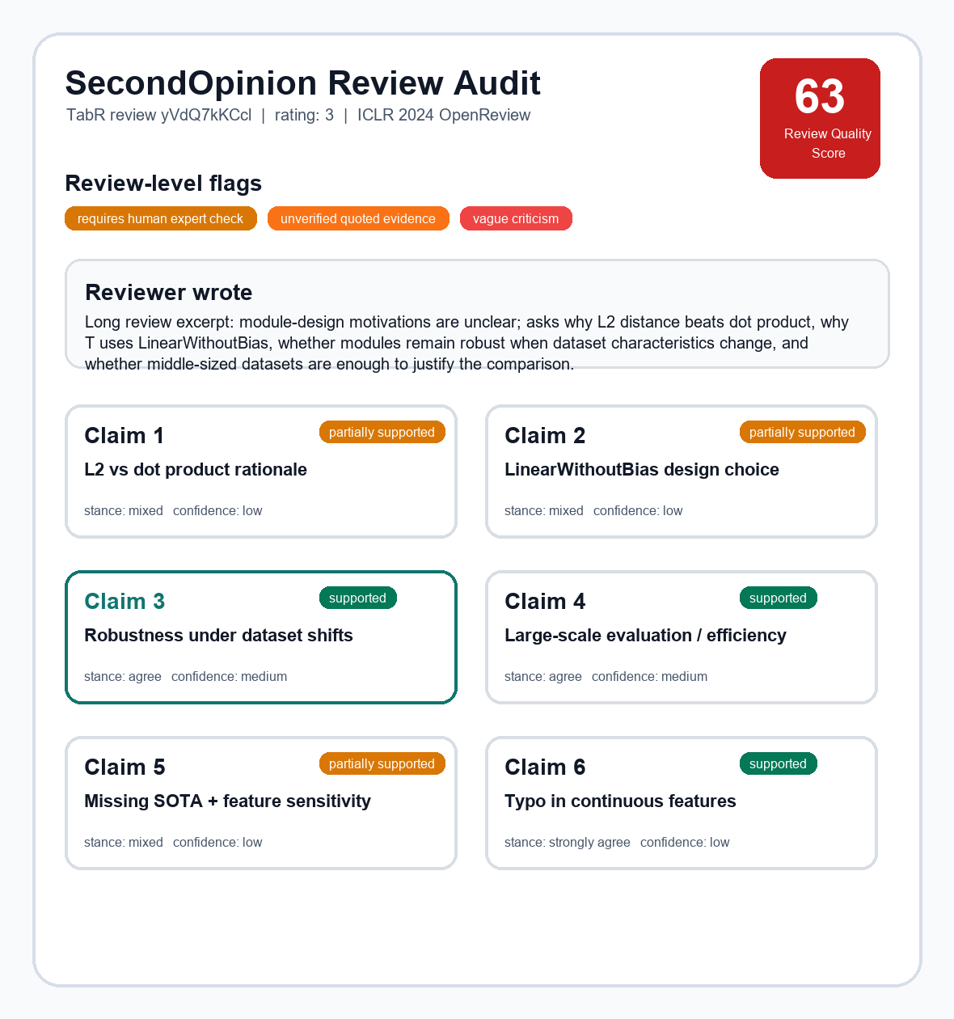
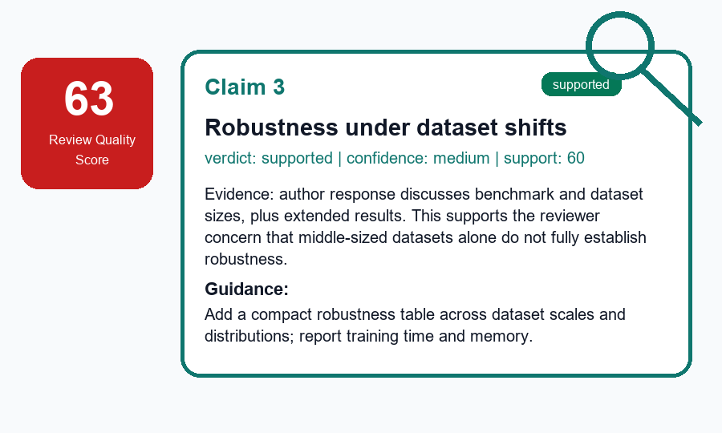
SecondOpinion: Review Audit MVP
Pilot evidence → evidence-grounded audit architecture → current scoring result
1. Pilot signals
2. Audit flow on a longer review
3. Current scoring result
Public ICLR 2024 examples
Reviewer conflict
Ex.1 A: "weak on novelty" (cXs5md5wAq)
Ex.1 B: "first use of GNN" (cXs5md5wAq)
Ex.2 A: "significant advance" (rhgIgTSSxW)
Ex.2 B: "module designs unclear" (rhgIgTSSxW)
Example: TabR review yVdQ7kKCcl (rating 3)
Same TabR review: full scorecard + zoomed claim
Reviewer wrote
module designs are not entirely clear.
why L2 beats dot product and why T uses LinearWithoutBias.
Is L2 sensitive to uninformative features?
INPUT
full
RQS
63
Claim 3
supported
medium confidence
links: cXs5md5wAq, rhgIgTSSxW
Extracts review claims
C1 L2 vs dot product | C2 LinearWithoutBias
C3 robustness shifts | C4 large-scale efficiency
C5 missing SOTA + feature sensitivity | C6 typo
↓
LLM: gpt-5-nano
Vague / low-actionability
V1: "presentation is chaotic" (eR4W9tnJoZ)
V2: "Please refer to Weaknesses" (eR4W9tnJoZ)
V3: "too simple" (eR4W9tnJoZ)
V4: "no new algorithm, but a trick" (B0wJ5oCPdB)
↓
Evidence found
Search paper PDF chunks + appendix + author response
Matches: benchmark/data-size response; L2 robustness response; extended tables
LOCAL
links: eR4W9tnJoZ, B0wJ5oCPdB
↓
Tone risk
T1: "I have no idea / why bother" (xNdE7RiRyP)
T2: "fatal flaws" (fI6TkT050a)
T3: "deeply flawed" (fI6TkT050a)
T4: "authors appear to be confused" (cXs5md5wAq)
SecondOpinion judges claims
C3: agree / supported / medium confidence
C1-C2: mixed / partially supported / low
Guidance: add theory + ablation + large-scale robustness table
LLM: gpt-5-nano
↓
links: xNdE7RiRyP, fI6TkT050a
LOCAL
Reliability + report
Flag expert-check + weak quote evidence; output RQS 63 + HTML report
Audit review quality, and then assist on rebuttal
https://yongwen12.github.io/SecondOpinion/?v=7eaf5b6
RQS = Review Quality Score. Preliminary MVP outputs for calibration, not final ground truth.

