Slide 1


2-year survival probability
Everolimus
6/10 = 60%
2 years follow-up
Placebo
6/10 = 60%
Good
prognosis
Poor
prognosis
Death

Slide 2
2-year survival probability
Everolimus
KM estimate = 80%
2 years follow-up
Placebo
6/10 = 60%
Good
prognosis
Poor
prognosis
Death

Slide 3
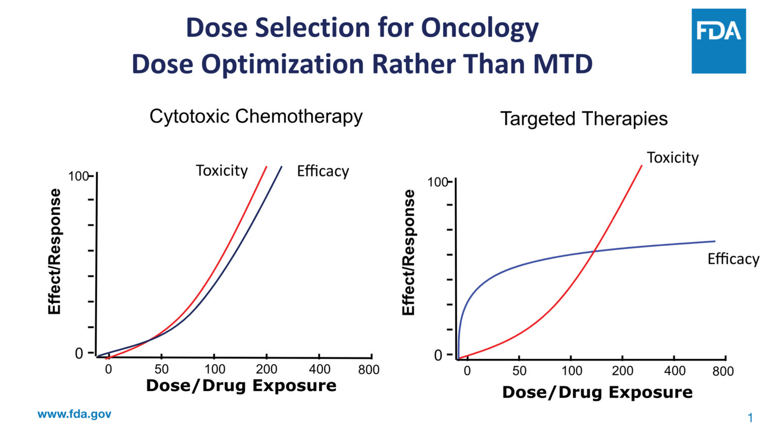
30%
30%
MTD

Slide 4
30%
30%
MTD
OBD

