Slide 1
Welcome all!
Today’s lecture will be about: clustering!
All the material could be found in the github reporsity:
https://github.com/yingjun2/IS590DT/tree/master/Lab_1101_clustering
You could also check the video online:
https://us.bbcollab.com/guest/86C9B478F2ED4B4722ACA722FE9CFC7F
The lecture starts at 4:40pm.

Slide 2
Data Mining Lab: Clustering
Date: 11/01
Instructor: Yingjun Guan

Slide 3
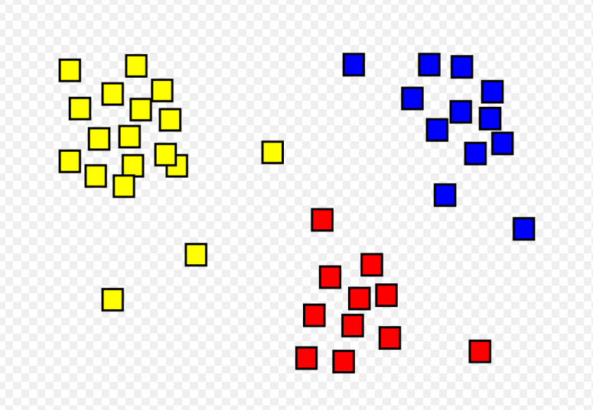
What’s clustering?
Clustering: group objects into subsets or clusters, such that objects within each cluster are more similar to one another than objects assigned to different clusters.

Slide 4
Difference between clustering and classification.
Labeled vs unlabeled
Learn vs apply

Slide 5
What’s clustering?
Goal: group objects into subsets or clusters, such that objects within each cluster are more similar to one another than objects assigned to different clusters.
How to measure similarity? --> Distance!

Slide 6

Dissimilarity Measures
Euclidean Distances d(x,z)
Who’s Eucilid?
What’s Eucilidean distance?
How to write them down in math?
<encourage participation on blackboard>
C = $\sqrt[2]{a^{2}+b^{2}}$

Slide 7
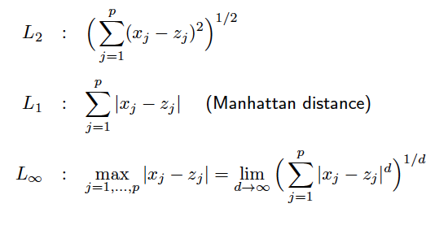
How to express Euclidean distance in math
L1 norm; L2 norm; L_{inf} norm

Slide 8
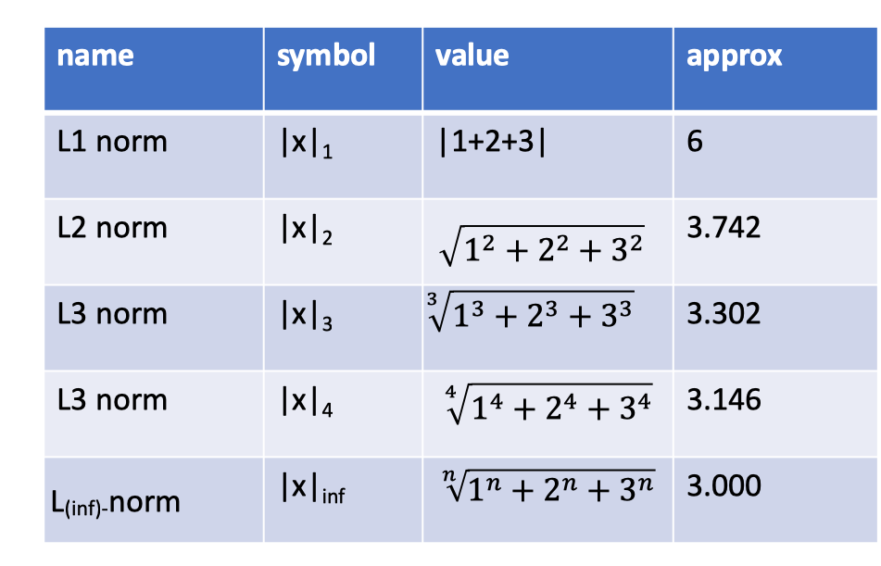
Let’s take an example.
Distance to a point v(1,2,3).

Slide 9
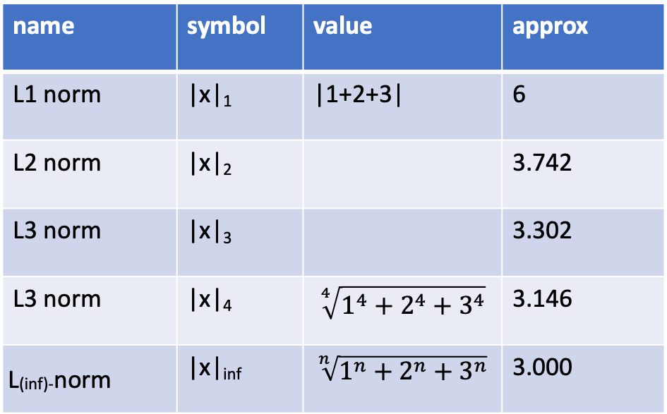


Let’s take an example.
Distance to a point v(1,2,3).
name | symbol | value | approx
L1 norm | |x|₁ | |1+2+3| | 6
L2 norm | |x|₂ |  | 3.742
L3 norm | |x|₃ |  | 3.302
L3 norm | |x|₄ | $$\sqrt[4]{1^{4}+2^{4}+3^{4}}$$ | 3.146
L_{(inf)-}norm | |x|_{inf} | $$\sqrt[n]{1^{n}+2^{n}+3^{n}}$$ | 3.000
$$\sqrt{1^{2}+2^{2}+3^{2}}$$
$$\sqrt[3]{1^{3}+2^{3}+3^{3}}$$

Slide 10
L1 and L2 are very important in evaluating loss.
Remember the loss function we mention before? We always want the loss to be small <the distance of true value and estimate is small.>

Slide 11

Jaccard distance
Jaccard distance between sets are calculated as below:
Eg: {A;C;D;E} and {A;D;E} is 1 – 3/4.
Other applications?
Jaccard distance could also measure distance between sentences based on the words and even movies/restaurants based on their ratings.

Slide 12
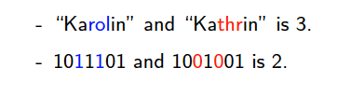
Hamming distance
Hamming distance between two strings (of the same length): number of positions at which the corresponding symbols are different.
Other applications?
Although the length are the same, you could think about distance between texts, DNA, and Protein sequences!

Slide 13

Edit distance
Edit distance: number of inserts and deletes to change one string into
Another.
Other applications include protein detection, <cancer diagnostic>; text mining <named entity recognition>; etc.

Slide 14
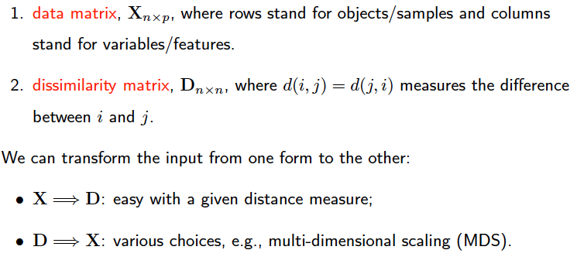
Two Types of Inputs for Clustering
people | height | weight | salary
a | x | x | x
b | x | x | x
c | x | x | x
Distance | a | b | c
a | d | d | d
b | d | d | d
c | d | d | d

Slide 15
Two Types of Inputs for Clustering
people | height | weight | salary
a | x | x | x
b | x | x | x
c | x | x | x
Example;
Why we need these two;
Problems in transforming;
R application;
Distance | a | b | c
a | d | d | d
b | d | d | d
c | d | d | d

Slide 16
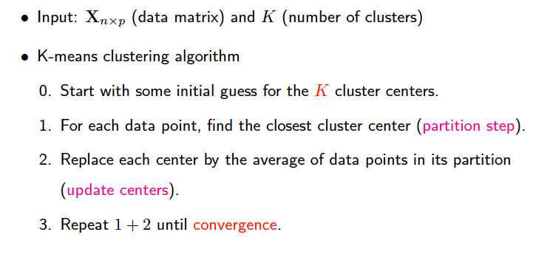
K-means Clustering

Slide 17
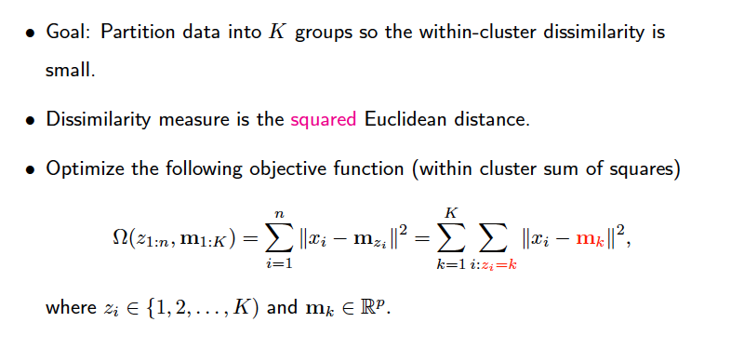
Tips on KMeans

Slide 18

Computation cost and how to reduce it
Reduction: feature selection methodologies.
Eg: PCA, SVD, random projection, etc.

Slide 19
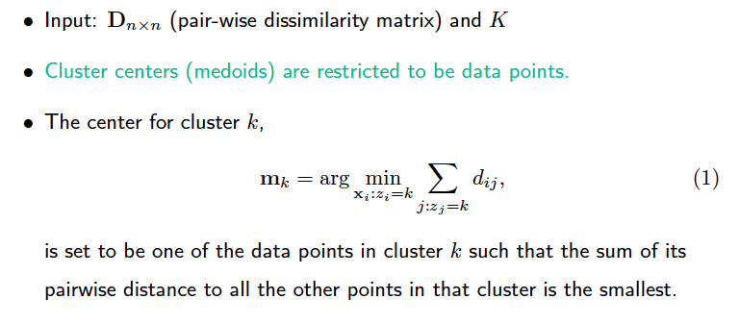
K-medoids Clustering
Why do we need K-Medoids?
Categorical data
Complexity

Slide 20
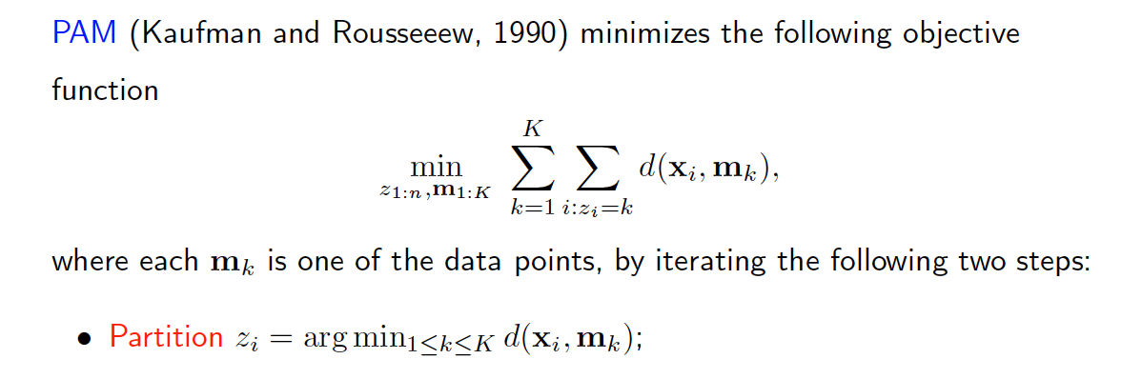
Partition Around Medoids (PAM)
Model and R application.

Slide 21
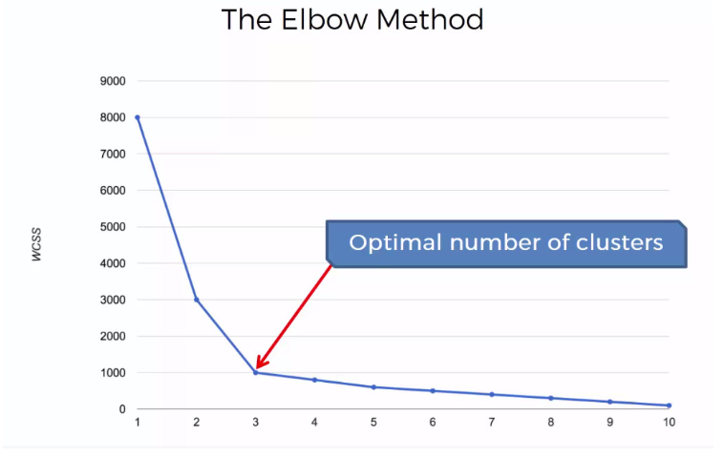
How to select K?
Elbow point.

Slide 22
That’s all, thank you!
Today’s lecture will be about: clustering!
All the material could be found in the github reporsity:
https://github.com/yingjun2/IS590DT/tree/master/Lab_1101_clustering
You could also check the video online:
https://us.bbcollab.com/guest/86C9B478F2ED4B4722ACA722FE9CFC7F
If you have any comments or suggestions, please feel free to tell me in person on by email (yingjun2@Illinois.edu)!
See you in another two weeks~

