Slide 1
IS590DT: Data Mining Applications WEEK 13: Text Processing, Feature Ranking and Sentiment Analysis
Spring 2019
Yingjun Guan
yingjun2@illinois.edu
http://ischool.illinois.edu/people/yingjun-guan

Slide 2
Contents today
Introduction of text data
Text processing
Feature ranking
TF-IDF
Sentiment Analysis
Summary

Slide 3
What’s the first word that come to your mind when talking about “Text Mining”?
Any differences compared with “data mining”?

Slide 4
Introduction of text data
Today, we are talking about words vs docs.
What’s the relationship …
Among docs;
Give me some definitions of distance.
Why/what do we care about the docs?
Compared with words, what’s doc’s characteristics.
How hard is it to get the right doc?

Slide 5
Introduction of text data
Today, we are talking about words vs docs.
What’s the relationship …
Among words;
Give me some definitions of distance.
Why/what do we care about the words?
Compared with documents, what’s word’s characteristics.
How hard is it to get the right word?

Slide 6
Introduction of text data
Today, we are talking about words vs docs.
What’s the relationship …
Between docs and words.
Can I represent the doc with words?
How to simplify?
Can I represent the word with doc?
How to simplify?

Slide 7
Why is this important?
In the world of machine reading.
In the world of information retrieval.
In the world of linguistic network analysis.

Slide 8
Our goals……
word
document
 | word1 | word2 | word3 | …
doc1
doc2
doc3
doc4
…
Point of embedding;
Point of IOT;
Point of dimensionality.
Your comment?
This helps?
Or not?

Slide 9
Text processing
Today, let’s talk about how to better use word to represent the document. <IR>
Can it?
How to improve?
The goal for better IR:
Less words (lower dimensionality)
Better performance (precision & recall)

Slide 10
How to reduce the word dimensionality?
Text processing
Case;
when upper case? When lower?
Other tricks. [sentence beginning; proper noun; etc.]
Is it a good idea to turn all into upper/lower?
Any other way to combine upper and lower?
Any other thoughts?

Slide 11
How to reduce the word dimensionality?
Text processing
Punctuation;
In what cases do you need to consider the punctuation?
In most cases, we ignore punctuations. What consequences might occur?

Slide 12
How to reduce the word dimensionality?
Text processing
Stemming;
Why stem?
Eg: car, cars, car‘s, cars’ → car
eg: am, is, are → be
Notes:
ing

Slide 13
How to reduce the word dimensionality?
Text processing
Stemming;
Stemming vs lemmatization?
Stemming usually refers to a crude heuristic process that chops off the ends of words in the hope of achieving this goal correctly most of the time, and often includes the removal of derivational affixes.
Lemma (lemmatization) usually refers to doing things properly with the use of a vocabulary and morphological analysis of words, normally aiming to remove inflectional endings only and to return the base or dictionary form of a word.
Notes:
ing

Slide 14
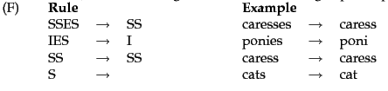
How to reduce the word dimensionality?
Text processing
Stemming;
different stemming algorithms.
Notes:
ing

Slide 15
How to reduce the word dimensionality?
Text processing (Stemming)

Slide 16
Pop-quiz
Are the following statements true or false?
Stemming increases the size of the vocabulary.
In a Boolean retrieval system, stemming never lowers precision.
In a Boolean retrieval system, stemming never lowers recall.
<if example needed, go to page 18>

Slide 17
How to reduce the word dimensionality?
Text processing
Stop words
Common stop words.
Should? Shouldn’t?
Using different stopwords for different projects.

Slide 18
How to evaluate the retrieval?
The performance {precision & recall}
Corpus: D1{SVM}, D2{SVM}, D3{SVMs}, D4{UL}; D5{Bush}; D6{Trump}; D7{Xi}.
If you are interested in research docs, rather than political docs, try comparing using w1{SVM} and w2{SVM_stemmed} for the performance {precision & recall}.

Slide 19
How to reduce the word dimensionality?
Text processing
word cloud

Slide 20
Application: word cloud
What is word cloud?
an image composed of words used in a particular text or subject, in which the size of each word indicates its frequency or importance.

Slide 21
Let’s make some word cloud!
Run your python!

Slide 22
What’s word cloud again?
An image composed of words used in a particular text or subject, in which the size of each word indicates its frequency or importance.
How to measure the importance?

Slide 23
Feature ranking
Features (words) may weigh differently in representing the document.
Let’s see some examples first.
Sweet {fruit docs}
Apple {fruit docs}
Apple {technique companies}
Apple Inc {technique companies}

Slide 24
Feature ranking
Rule of thumb standards for features.
Popularity
Enough occurrence
Distinctiveness
Able to help make prediction
Informativeness
Avoid meaningless feature {stopwords}
Completeness
Support Vector vs Vector Machine vs Support Vector Machine

Slide 25
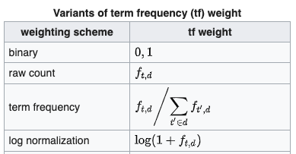
Tf-idf
tf–idf or TFIDF, short for term frequency–inverse document frequency, is a numerical statistic that is intended to reflect how important a word is to a document in a collection or corpus
TF:term frequency, tf(t,d).

Slide 26
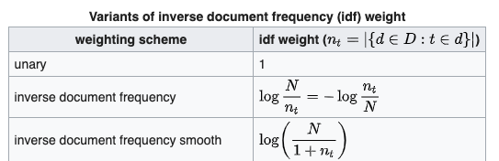
The inverse document frequency is a measure of how much information the word provides, i.e., if it's common or rare across all documents

Slide 27
Example
Corpus:
D1: “This is a sample, a good sample”
D2: “This is another sample, too.”
x | Tf(x,d1) | Tf(x,d2) | df | Tfidf(x,d1) | Tfidf(x,d2)
this
is
a
good
sample
another
too

Slide 28
Sentiment Analysis
Definition:
Computational study of opinions, sentiments, subjectivity, evaluations, attitudes, appraisal, affects, views, emotions, etc., expressed in text.
Reference:
Bing Liu. Sentiment Analysis and Opinion Mining Morgan & Claypool Publishers, May 2012.

Slide 29
Different names.
Many names and tasks
❑ Sentiment analysis
❑ Opinion mining
❑ Sentiment mining
❑ Subjectivity analysis
❑ Affect analysis
❑ Emotion detection
❑ Opinion spam detection
❑ Etc.

Slide 30
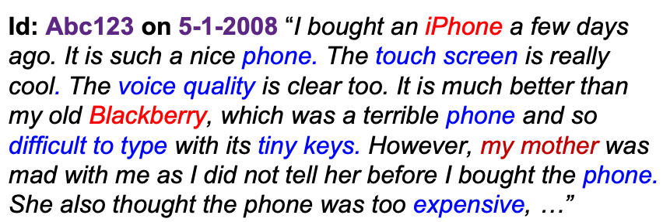
Different levels
One can look at this review/blog at the
❑ document level, i.e., is this review + or -?
❑ sentence level, i.e., is each sentence + or -?
❑ entity and feature/aspect level

Slide 31
Polarity or not?
Positive?
Negative?
In between?
Intensity?

Slide 32
Word level
Lexicon.
Sentiment analysis tools rely on lists of words and phrases with positive and negative connotations. Many dictionaries of positive and negative opinion words were already developed. In this paper, we will look at most known words databases.
Ref: https://medium.com/@datamonsters/sentiment-analysis-tools-overview-part-1-positive-and-negative-words-databases-ae35431a470c

Slide 33
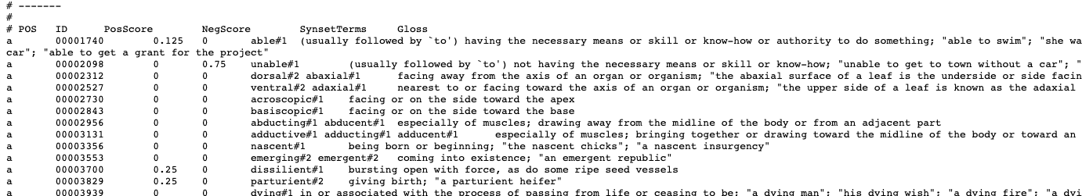
Examples of lexicon
https://raw.githubusercontent.com/aesuli/SentiWordNet/master/data/SentiWordNet_3.0.0.txt

Slide 34
Attention!
polysemy
Synonym
Context
Language culture

Slide 35
Sentence level
Using words and corpus to help.
Bag of words; normalized sum score.
Pay attention of bag of words

Slide 36
Document level
Hard to judge
Complex (too many components)
Complicated (hard)
Overall rating could help somehow.
Examples from IMDB

Slide 37
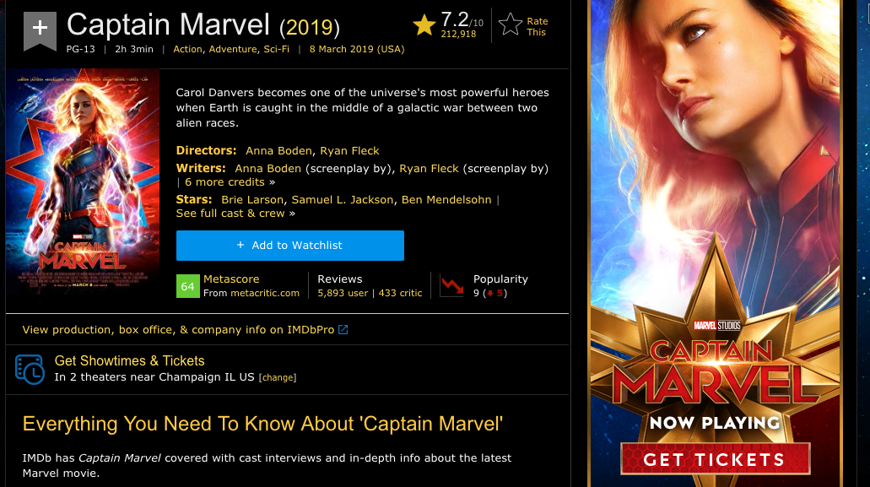
https://www.imdb.com/title/tt4154664/?ref_=nv_sr_1?ref_=nv_sr_1

Slide 38
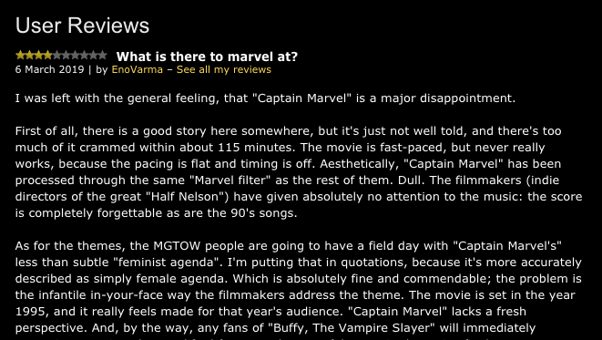
User Reviews?

Slide 39
datasets
Try analyze these 20 movie reviews in your assignment 8.
Label.
Processing.
Output.
Discussion.

Slide 40
Last but not least…
Feedback
Assignment 7
Assignment 8
Finals

Slide 41
Assignment 8
Word cloud (using tf-idf to determine font size)
Write how you do the text processing
Hint: you could use either binary or trinary classes.

Slide 42
For the rest of semesters.
Students’ feedback
Project
Presentation (30min + Q&A)
Report (5-10 pages, academic structure)
Final

Slide 43
Have a good rest of your week.

