Slide 1
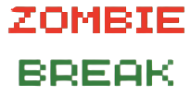
SMEG
Sen Chuan, Michael, Edgar, Geoffrey

Slide 2
Product
2D Infinite map survival game.
Survive hordes of zombie to win.
Pick-up items that increases your chances of survival.
Enhance your stats to make yourself stronger.

Slide 3
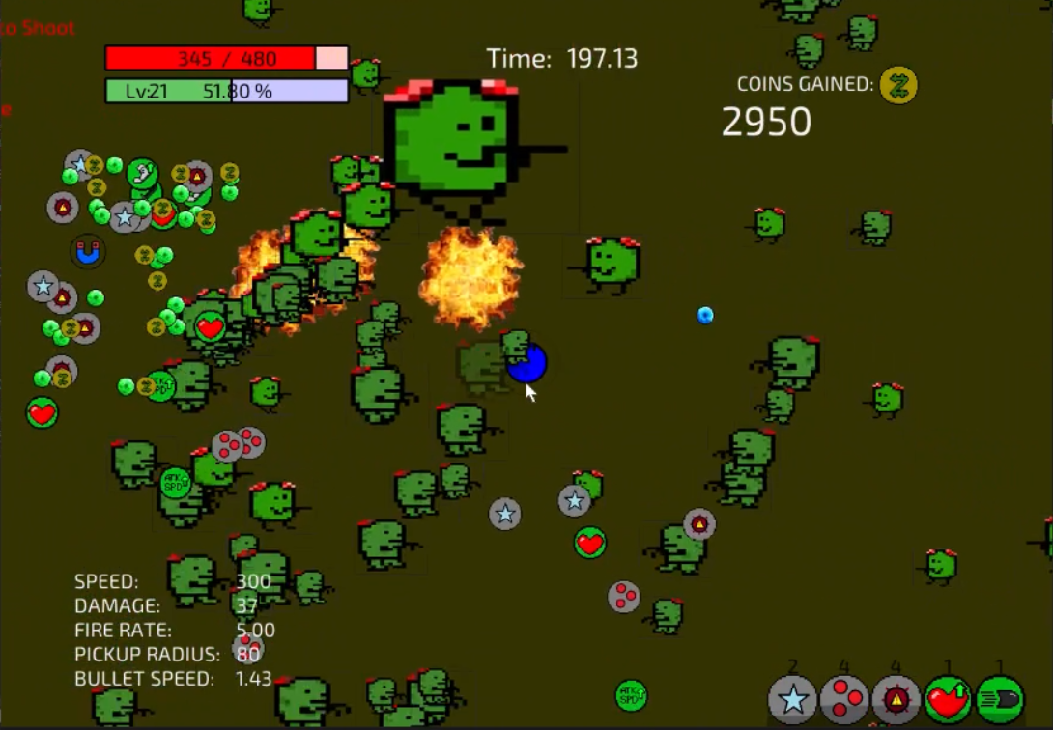
Unique Selling Point
Player always has decreasing HP
Killing mobs will increase HP
Adds pressure to player
Forces player to always attack instead of only running to survive

Slide 4
Reflections
What went right
Game is fast-paced and stress-inducing as intended
Induced playtesters’ competitive spirit as they tried the game repeatedly
What went wrong
Instructions unclear, player unsure of what to do
There is no end condition
Game is hectic and players don’t know what was happening initially
Upgrade screen too sudden and causes player to die
Notes:
What went right
What went wrong
What changes were made based on feedback
How testing helped
What did you learn
What do you want to improve on next time
etc

Slide 5
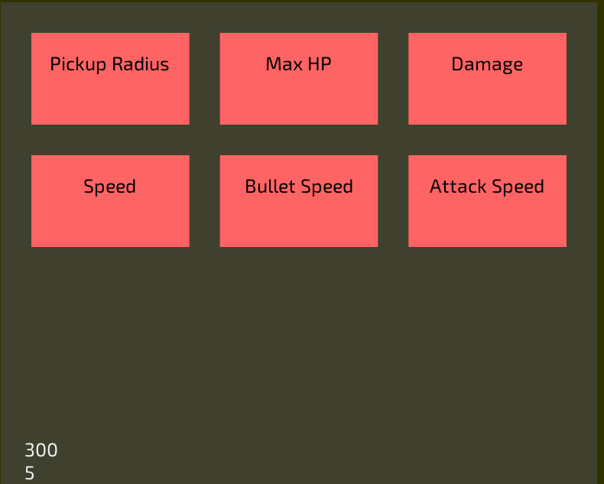
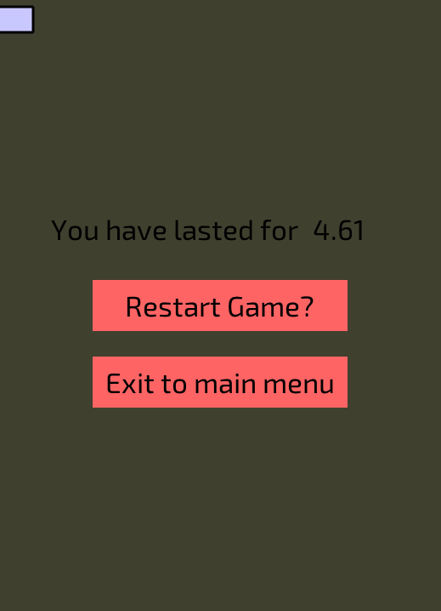
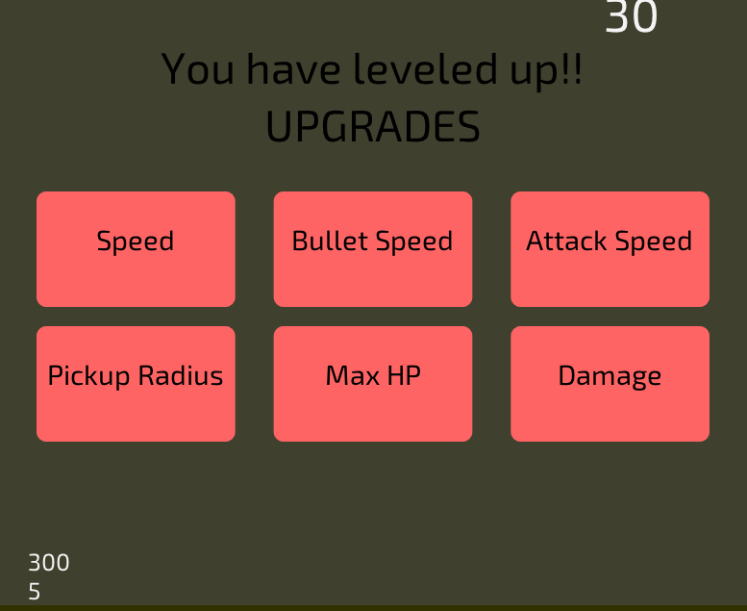
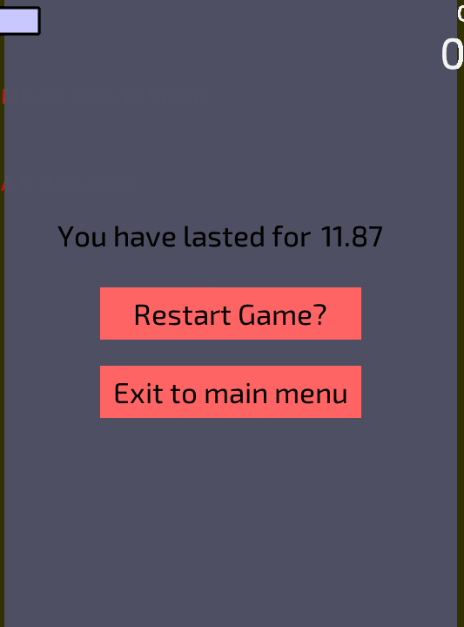
Reflections
What changes were made
Upgrade screen fixed to be less sudden
Introduced an end condition
Added music and sound effects for immersive gameplay
Added instructions page to inform players of what will happen during the game
Notes:
What went right
What went wrong
What changes were made based on feedback
How testing helped
What did you learn
What do you want to improve on next time
etc

Slide 6
Reflections
How did the testing help
Re-evaluated our game from a player’s perspective
Understood what was expected of our game based on the playtest surveys
Notes:
What went right
What went wrong
What changes were made based on feedback
How testing helped
What did you learn
What do you want to improve on next time
etc

Slide 7
Reflections
What we learnt
Creating structures and managing functions between files
Cooperation and the necessity of good programming practice
Future improvements
Sort out the specifics and scope of the game before trying anything
Create functions that help declutter files, and for better coding experience

