Slide 1






EMPLOYEE PERFORMANCE EVALUATION SYSTEM
By : Yongzon Christian

Slide 2



INTRODUCTION
The Employee Performance Evaluation System is a tool that helps organizations track and review how well employees are doing their jobs. It makes it easier to record work progress, give feedback, and find ways to improve. This system ensures fairness and clarity for both employees and managers. By using this system, companies can support employee growth and make better decisions about promotions and training.

Slide 3


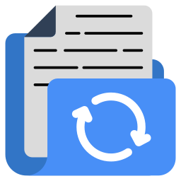


MAIN FEATURES
CREATE
VIEW
UPDATE
DELETE
The system allows users to create and save new employee performance records.
Users can access and review all employee performance data, including evaluations and feedback.
Existing performance records can be modified or updated as needed.
Users can remove outdated or incorrect performance records from the system.

Slide 4
BENEFACTORS

Slide 5

MANAGERS/
SUPERVISORS
Easily track, evaluate, and provide feedback to employees, ensuring fair and data-driven decisions.

Slide 6

EMPLOYEES
Gain clarity on performance expectations, receive constructive feedback, and identify growth opportunities.

Slide 7

HR DEPARTMENT
Streamlines performance reviews, supports talent management, and simplifies reporting for promotions or training.

Slide 8
ENTITY RELATIONSHIP DIAGRAM (ERD)

Slide 9
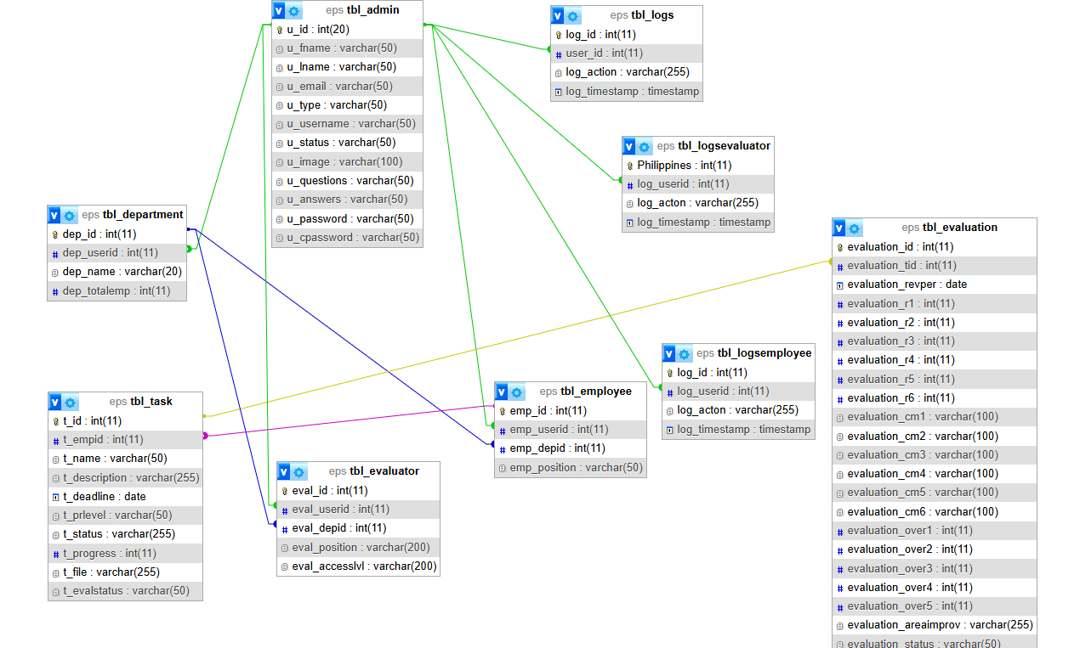

Slide 10
FLOWCHART

Slide 11
THANK
You

