Slide 1
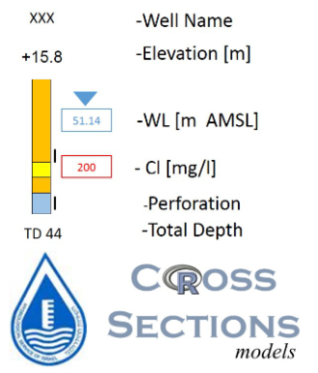
Stratigraphy :
Bina Formation, top
Moza Formation, top
Kesalon Formation, top
Qatana Formation, top
Hydrogeological Unit:
Kurkar. - Alluvium
Saqiya Gr. - Aquiclude
Avedat Gr. - Aquiclude
Mt. Scopus Gr. - Aquiclude
Judea Gr. - Upper Sub Aquifer
Judea Gr. - Aquiclude
Judea Gr. - Lower Sub Aquifer
Kurnub Gr. - Aquifer
Arad Gr. - Aquifer
Estimated Information
Not Classified
H0A01

