Slide 1
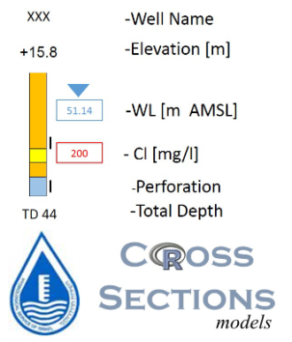
Stratigraphy :
Sakhnin Formation, top
Dir Hanna Formation, top
Kamon Formation, top
Zalmon Formation, top
Hydrogeological Unit:
Hula Gr. - Alluvium
Kefar Gela’di Gr. - Aquiclude
Avedat Gr. - Aquiclude
Mt. Scopus Gr. - Aquiclude
Judea Gr. - Upper Sub Aquifer
Judea Gr. - Aquiclude
Judea Gr. - Lower Sub Aquifer
Kurnub Gr. - Aquifer
Arad Gr. - Aquifer
Estimated Information
Not Classified
H0A01

