Slide 1
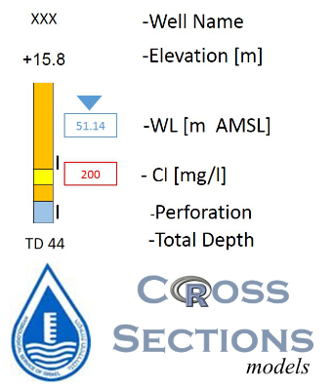
Stratigraphy :
Nezer Formation, top
Ein Yorqeam Formation, top
Hevyon Formation, top
Hatira Formation, top
Hydrogeological Unit:
Death Sea Gr. - Alluvium
Mt. Scopus Gr. - Aquiclude
Judea Gr. - Upper Sub Aquifer
Judea Gr. - Aquiclude
Judea Gr. - Lower Sub Aquifer
Kurnub Gr. - Aquifer
Arad Gr. - Aquifer
Estimated Information
Not Classified
H0A01

