Slide 1
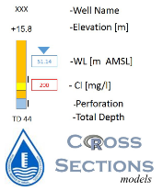
Stratigraphy :
Nezer Formation, top
Ein Yorqeam Formation, top
Hevyon Formation, top
Hatira Formation, top
Lithological Unit:
 | Clay
 | Clay-Silt
 | Clay-Sand
 | Clay-Sandston
 | Clay-Pebble/Conglomerate
 | Silt-Clay
 | Silt-Sand
 | Silt-Sandston
 | Silt-Pebble/Conglomerate
 | Silt-Marl
 | Silt-Chalk
 | Sand-Clay
 | Sand-Silt
 | Sand-Sandston
 | Sand-Pebble/Conglomerate
 | Sand-Marl
 | Sand-Chalk
 | Pebble/Conglomerate-Clay
 | Pebble/Conglomerate-Silt
 | Pebble/Conglomerate-Sand
 | Pebble/Conglomerate-Sandston
 | Pebble/Conglomerate-Marl

