Slide 1
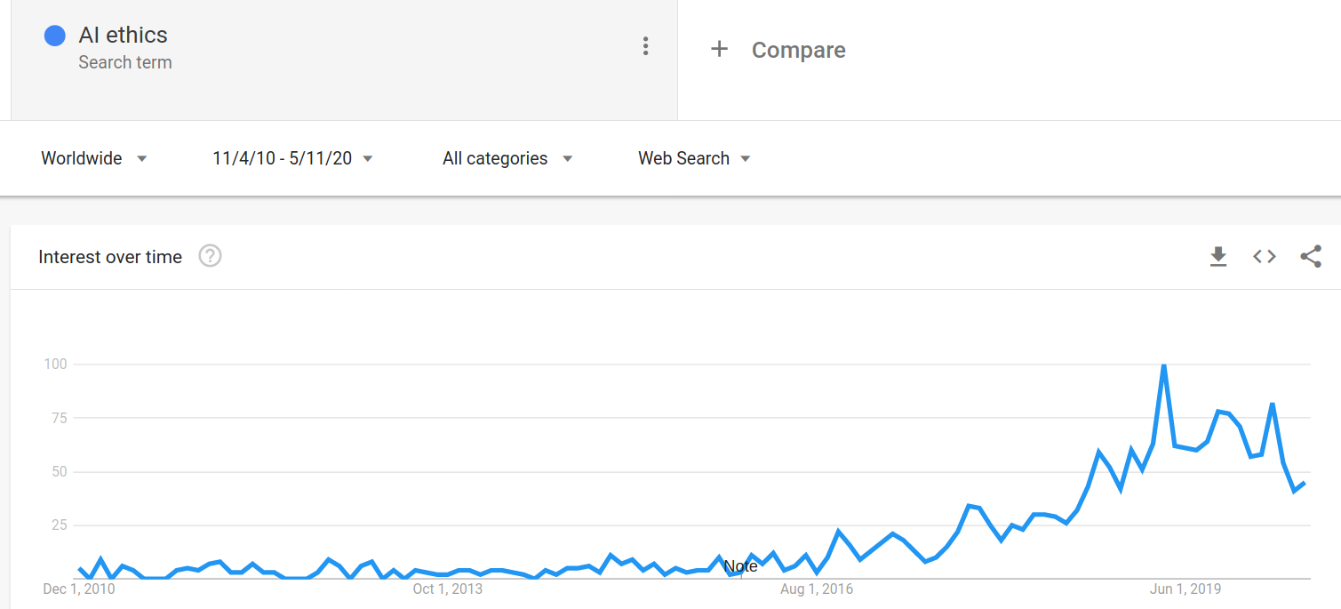
Myopic nonsense vs Sci-fi nonsense

Slide 2
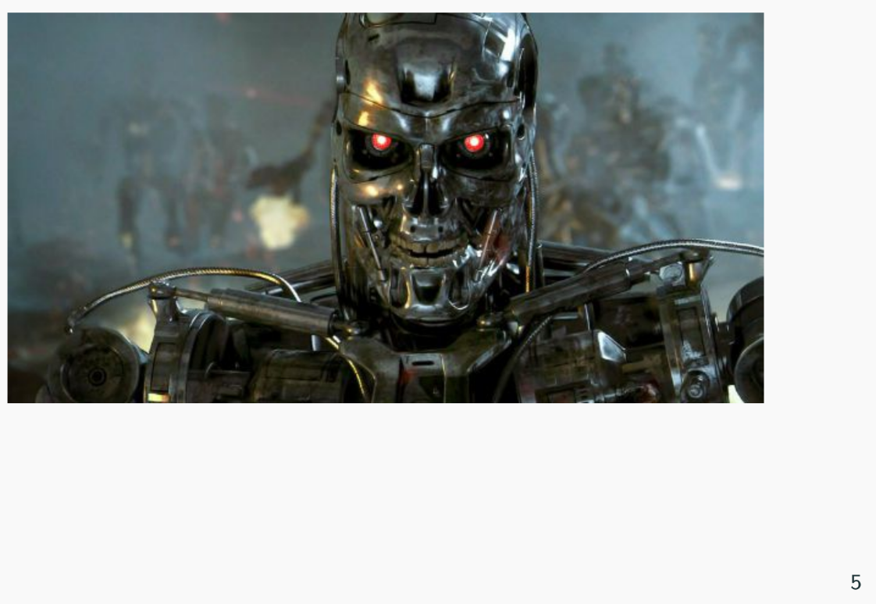
Contempt

Slide 3
A general trend
...the study of the beginning of the universe is now respectable. Professional physicists who investigate the first three minutes or the first microsecond no longer need to feel shy when they talk about their work. But the end of the universe is another matter... the striking thing about these papers is that they are written in an apologetic or jocular style, as if the authors were begging us not to take them seriously. The study of the remote future still seems to be as disreputable today as the study of the remote past was thirty years ago
- Freeman Dyson (1979)

Slide 4
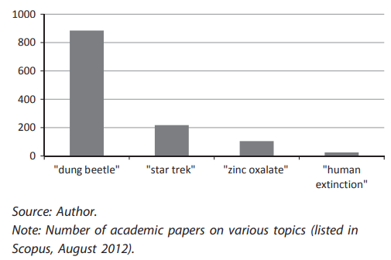
The allocation of academic resources

Slide 5
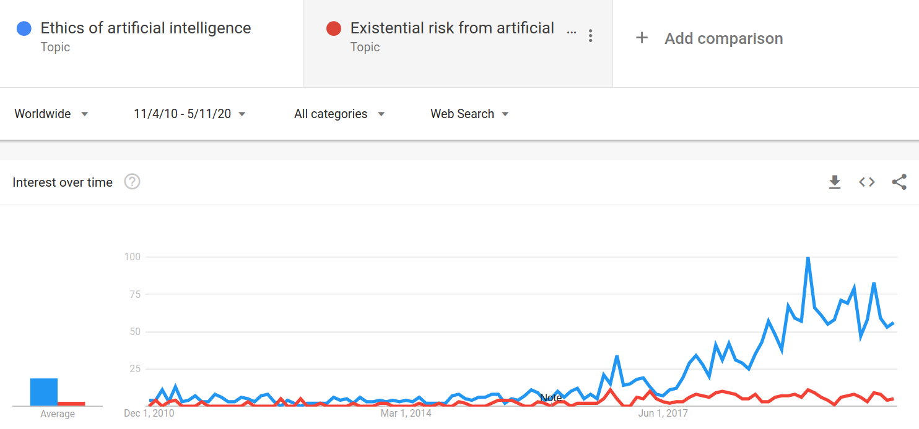

Slide 6
Why care about scope?
Choice of timeframe has huge practical consequences
On a short-term view, technology has many risks and only incremental benefits.
While, in the long run, it is our only hope of not dying out.

Slide 7
Actual arguments against longtermism
We’re really bad at forecasting
People with weird ideas in one area are often wrong about lots of things. (“a mind so open your brain falls out”)
Distraction from current ("real") problems

Slide 8
Judgment under radical uncertainty
it could happen soon;
it could be dangerous;
aligning it could be very hard;
the product of these probabilities is not low enough to ignore.
If you were standing in a minefield

Slide 9
My piece isn’t about longtermism > short-termism.
A plea against contempt and factions

