Slide 1
QUTVIEW
Sovereign food-import corridor risk intelligence for the UAE
Watching the risk that price monitors can't see.
Yonatan Getinet Alemayehu
Founder · Hub71 Access Programme, Cohort 20

Slide 2
THE PROBLEM
The UAE measures food security by price. Price isn't the risk.
The UAE imports 85–90% of its food, and its national strategy aims to rank #1 in the world for food security by 2051. Yet resilience is tracked almost entirely by price and reserves — not by corridor risk: how dangerously concentrated each import corridor is, and which supplier a commodity can't survive losing.
Dairy — the #1 food import
“Local” food isn't self-sufficient
Single-source traps sit unflagged
~$1B/yr, and no corridor-risk visibility at all. It happens to be safe — but nobody could prove it.
After the 2006 fodder-cultivation ban, 90%+ of animal feed is imported. Local poultry, dairy & meat run on it.
Lentils are 82% dependent on one origin (Canada) — on top of being 100% imported.
The institutions responsible for sovereign food security — Silal chief among them — manage price and quantity in separate silos, with no upstream view of which corridors are fragile, why one moved, or who else could supply it if one failed.
QUTVIEW
Hub71 Access · Cohort 20
2

Slide 3
THE SOLUTION
QUTVIEW scores the structure of every food corridor — and warns early.
It turns public, authoritative trade data — UN Comtrade, World Bank, FAOSTAT — into a live per-corridor risk system across 13 strategic commodities. For each corridor, automatically:
1
2
3
4
5
6
Senses
Forecasts
Alerts
Explains
Recommends
Names alternatives
concentration + volatility risk
6-month price, honest error
when a threshold trips
what moved, arithmetically
a reviewable action
real diversification origins
Plus an AI-written intelligence brief per corridor — every number machine-verified against the database before it displays — and a logged human Approve / Revise sign-off. It recommends; a person decides.
QUTVIEW
Hub71 Access · Cohort 20
3

Slide 4
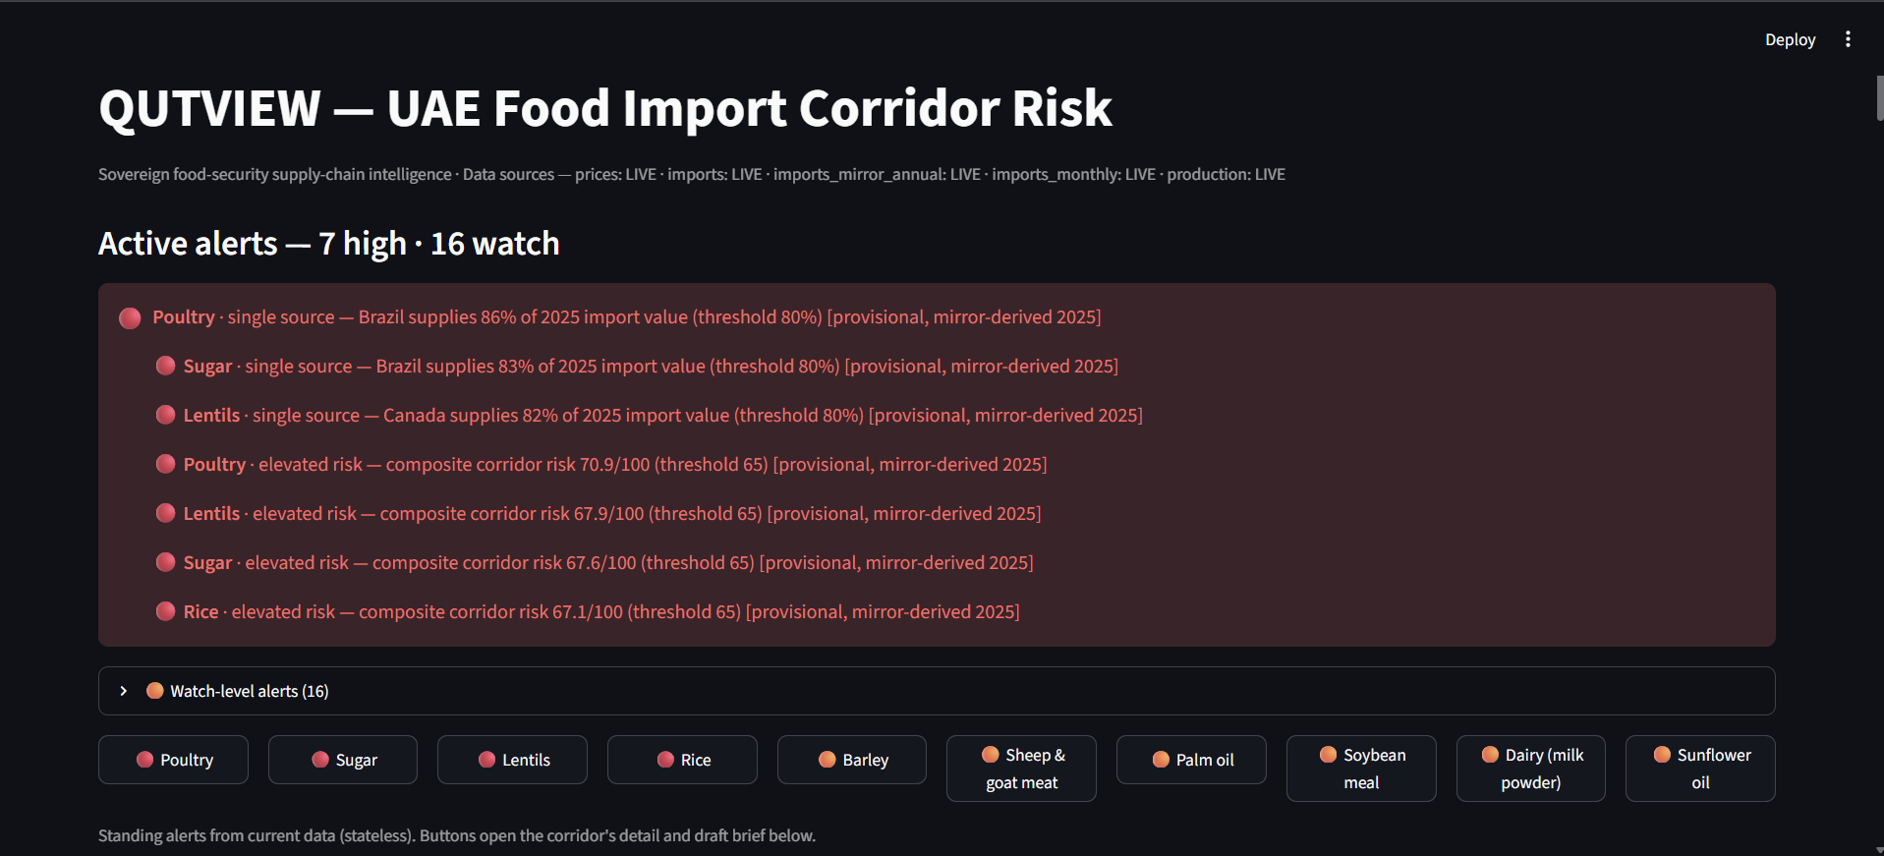
THE PRODUCT
One system, three surfaces — with a human in the loop.
1
Live risk dashboard
Risk cards, origin breakdowns, forecasts, the feed-dependency lens, and active alerts.
Live dashboard
2
Power BI report
The same data at executive altitude, with plain-language guidance on every page.
3
Grounded AI brief
An analyst-quality written brief per corridor; no number reaches the page unverified.
4
Logged sign-off
Live dashboard, snapshot August 2026 — every provisional figure labelled
Approve / Request-revision, recorded and tied to the data version — decision support, made real.
QUTVIEW
Hub71 Access · Cohort 20
4

Slide 5
WHAT IT ALREADY REVEALS
Insights nobody else surfaces — every figure from real data.
Big ≠ fragile
The feed-dependency lens
It caught its own false story
Dairy is the largest food import (~$1B/yr) yet low-risk — well diversified (New Zealand ~40% across ~60 origins). QUTVIEW tells big from fragile, so its red flags are trusted.
The UAE's “local” poultry, dairy and meat secretly run on three imported feed corridors (maize, soybean meal, barley). No other dashboard shows this cross-silo exposure.
An apparent “Brazil surge” in poultry was reporting lag — Brazil's value was flat; unreported suppliers shrank the base. The tool corrected a narrative we believed.
QUTVIEW
Hub71 Access · Cohort 20
5

Slide 6
BUSINESS MODEL
Institutional SaaS for sovereign buyers.
Model
Anchor
Annual subscription licenses to sovereign food-security institutions — high-value, low-volume, recurring.
Silal, Abu Dhabi's food-security operator, as first target; pipeline to ADAFSA and the Ministry of Food Security.
Scale
Second line
Every GCC state shares the same 80–90% import dependency — the same engine serves six sovereign markets, plus adjacent MENA beyond.
Once proven, license the corridor-risk data / API to commercial food importers and traders.
Stage: pre-revenue. Product built and live. Immediate goal — convert the Silal thesis into a paid anchor pilot.
QUTVIEW
Hub71 Access · Cohort 20
6

Slide 7
MARKET
Six sovereign markets, one structural exposure.
Every GCC state imports 80–90% of its food and holds a national food-security mandate with a dedicated budget. QUTVIEW sells into a defined set of sovereign buyers — not a mass market — each a high-value recurring institutional contract, expandable to commercial importers as a second tier.
6
80–90%
2051
sovereign GCC markets
food import dependency
UAE strategy: rank #1 for food security
Tailwind: food security became a permanent national-security priority across the Gulf after the 2020–2022 supply shocks.
QUTVIEW
Hub71 Access · Cohort 20
7

Slide 8
COMPETITION
Adjacent players — but nobody owns corridor risk.
Generic BI tools
Commodity-price data
Our wedge
Power BI, Tableau — visualise data, no risk model.
Mintec, S&P, Gro — sell price, not corridor structure.
Scores corridor structure
concentration, dependency, single-source — not price.
The feed-dependency cross-silo lens
reveals “local” food's hidden import reliance.
Honest by design
mirror reconstruction, coverage gate, grounding check, reporting-lag guard — credibility enforced in code.
Consultancies
Spreadsheets
Expensive one-off reports, not a live tool.
How most governments track it today.
Silal is a complement, not a competitor — it monitors prices; QUTVIEW is the corridor-risk layer above it.
QUTVIEW
Hub71 Access · Cohort 20
8

Slide 9
TRACTION
A live product, built solo.
13
3
100%
commodities, 7 essential categories
surfaces: dashboard, Power BI, AI brief
public, authoritative data sources
Built end-to-end by the founder — the entire data pipeline, risk model, forecasting, BI report and grounded AI layer. The system already senses, forecasts, alerts, explains, recommends, drafts, and captures a logged human decision.
Funds raised: bootstrapped — no external capital raised to date. Seeking the Hub71 pre-seed SAFE. Stage: pre-revenue, pre-pilot.
QUTVIEW
Hub71 Access · Cohort 20
9

Slide 10
TEAM
Founder-market fit.
YA
Yonatan Getinet Alemayehu
Founder · Management Information Systems, Minnesota State University, Mankato
Built the entire QUTVIEW platform single-handedly. Track record of shipping real data systems: a live Power BI reporting solution for Ethiopian coffee-trade data; a salary-and-performance system in a competitive project judged by Federated Insurance's CFO; and enterprise systems (ERP, management platforms) in development.
MIS foundation
Ethiopian heritage
Bridges the technical build and the institutional, government-facing business the product serves.
Personally connected to the Horn of Africa region (Ethiopia, Kenya) a real supply origin in QUTVIEW's data and hands-on with Ethiopian commodity trade data.
QUTVIEW
Hub71 Access · Cohort 20
10

Slide 11
BUILDING QUTVIEW IN ABU DHABI
Committed to relocate — and to build here.
1
2
3
Relocate
Land the anchor
Build the team
One founder committed to relocating long-term and building the team out of Abu Dhabi.
Use Hub71's ecosystem to reach Silal & ADAFSA for a first paid pilot.
Hire a small technical + commercial founding team in country.
The ask: Hub71 Access — the incentive package and, above all, the ecosystem access to reach the sovereign buyers QUTVIEW is built for. Purpose-built for the National Food Security Strategy 2051.
Yonatan Getinet Alemayehu · yonatangetinet@gmail.com
Try the live tool: qutview.streamlit.app · Overview: yoni062004.github.io/qutview

