Slide 1
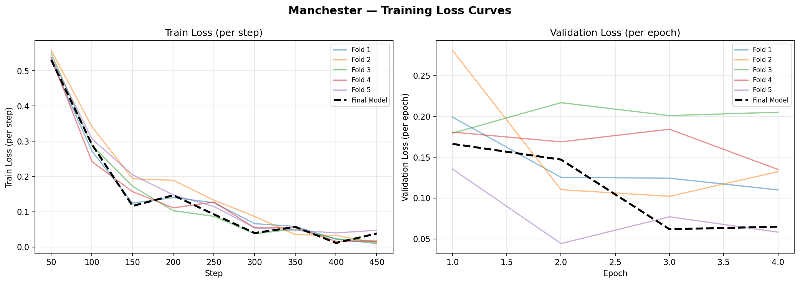
Training & Validation Loss — RoBERTa (5-Fold CV)
Manchester — convergence behaviour and why the noisy val-loss is not a problem
◀ Train Loss — smooth descent to ~0
Validation Loss — noisy across folds ▶
📉 Train Loss converges
📊 Why val-loss is noisy
✅ Not harmful overfitting
Drops smoothly from ~0.55 to near 0 — the model learns efficiently. The final model (dashed) also reaches a low validation loss (~0.065).
Only ~340 validation tweets per fold, so a few hard examples swing the curve. Small data → noisy curves. This is expected, not a defect.
We select the model by F1, not loss (early stopping on F1). The slight rise is over-confidence raising cross-entropy without lowering accuracy.
Proof it is not overfitting: Test F1 (0.986) ≈ CV F1 (0.961). We even tried label smoothing + fewer epochs — it did not improve results, confirming the original config.

