Slide 1
Manchester Arena
Full Figure Gallery — Initial Presentation
EDA → Preprocessing → RoBERTa Fine-Tuning → Llama 3.1 Zero-Shot → Comparison
reliable vs misinformation • Gold Standard 2,427 • Test 365

Slide 2
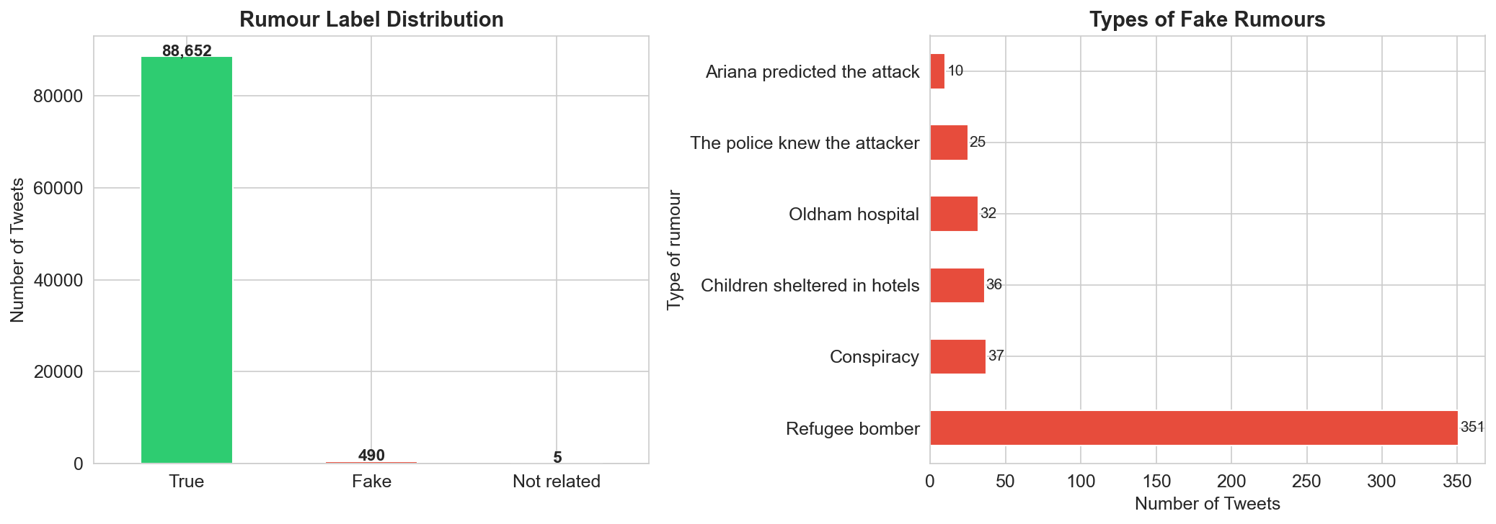
Label Distribution
EDA
Class balance in the raw Manchester data
reliable vastly outnumbers misinformation — motivates the Gold Standard

Slide 3
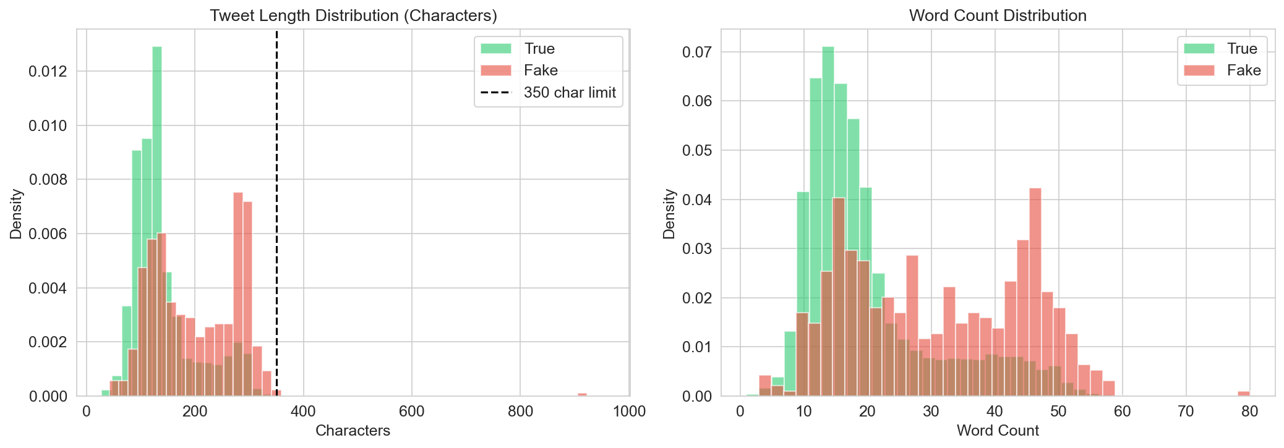
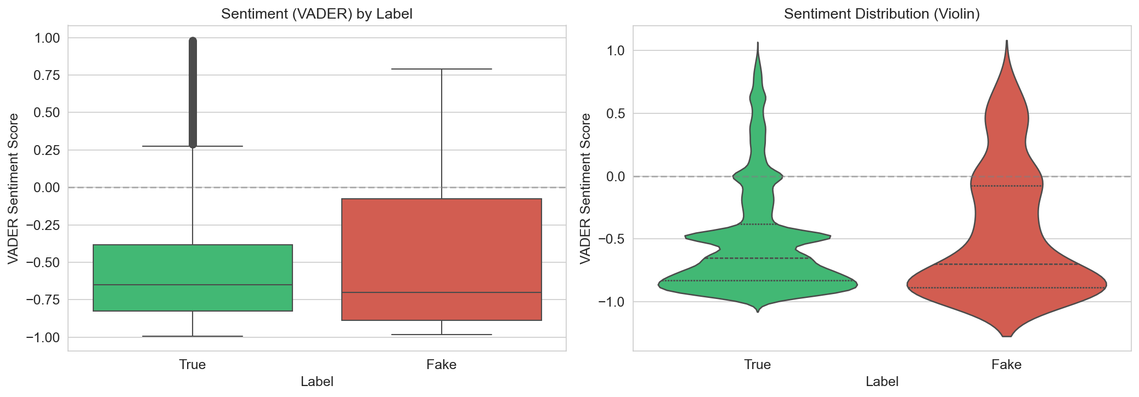
Tweet Length & Sentiment
EDA
Distribution analysis across classes
Tweet Length Distribution
Sentiment Analysis (VADER)

Slide 4
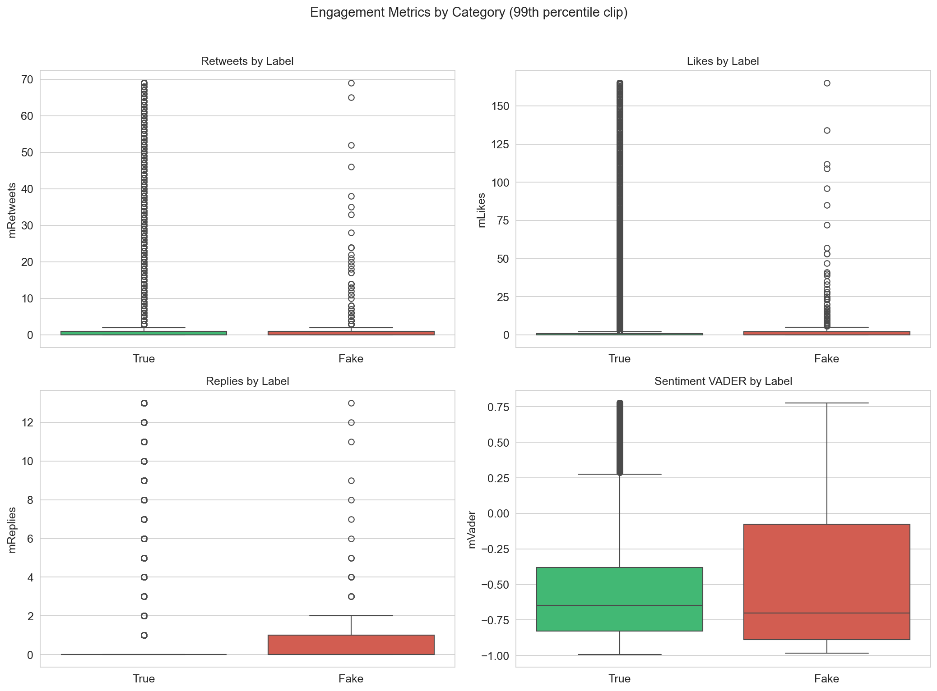
Engagement Analysis
EDA
Likes, retweets & replies by class

Slide 5
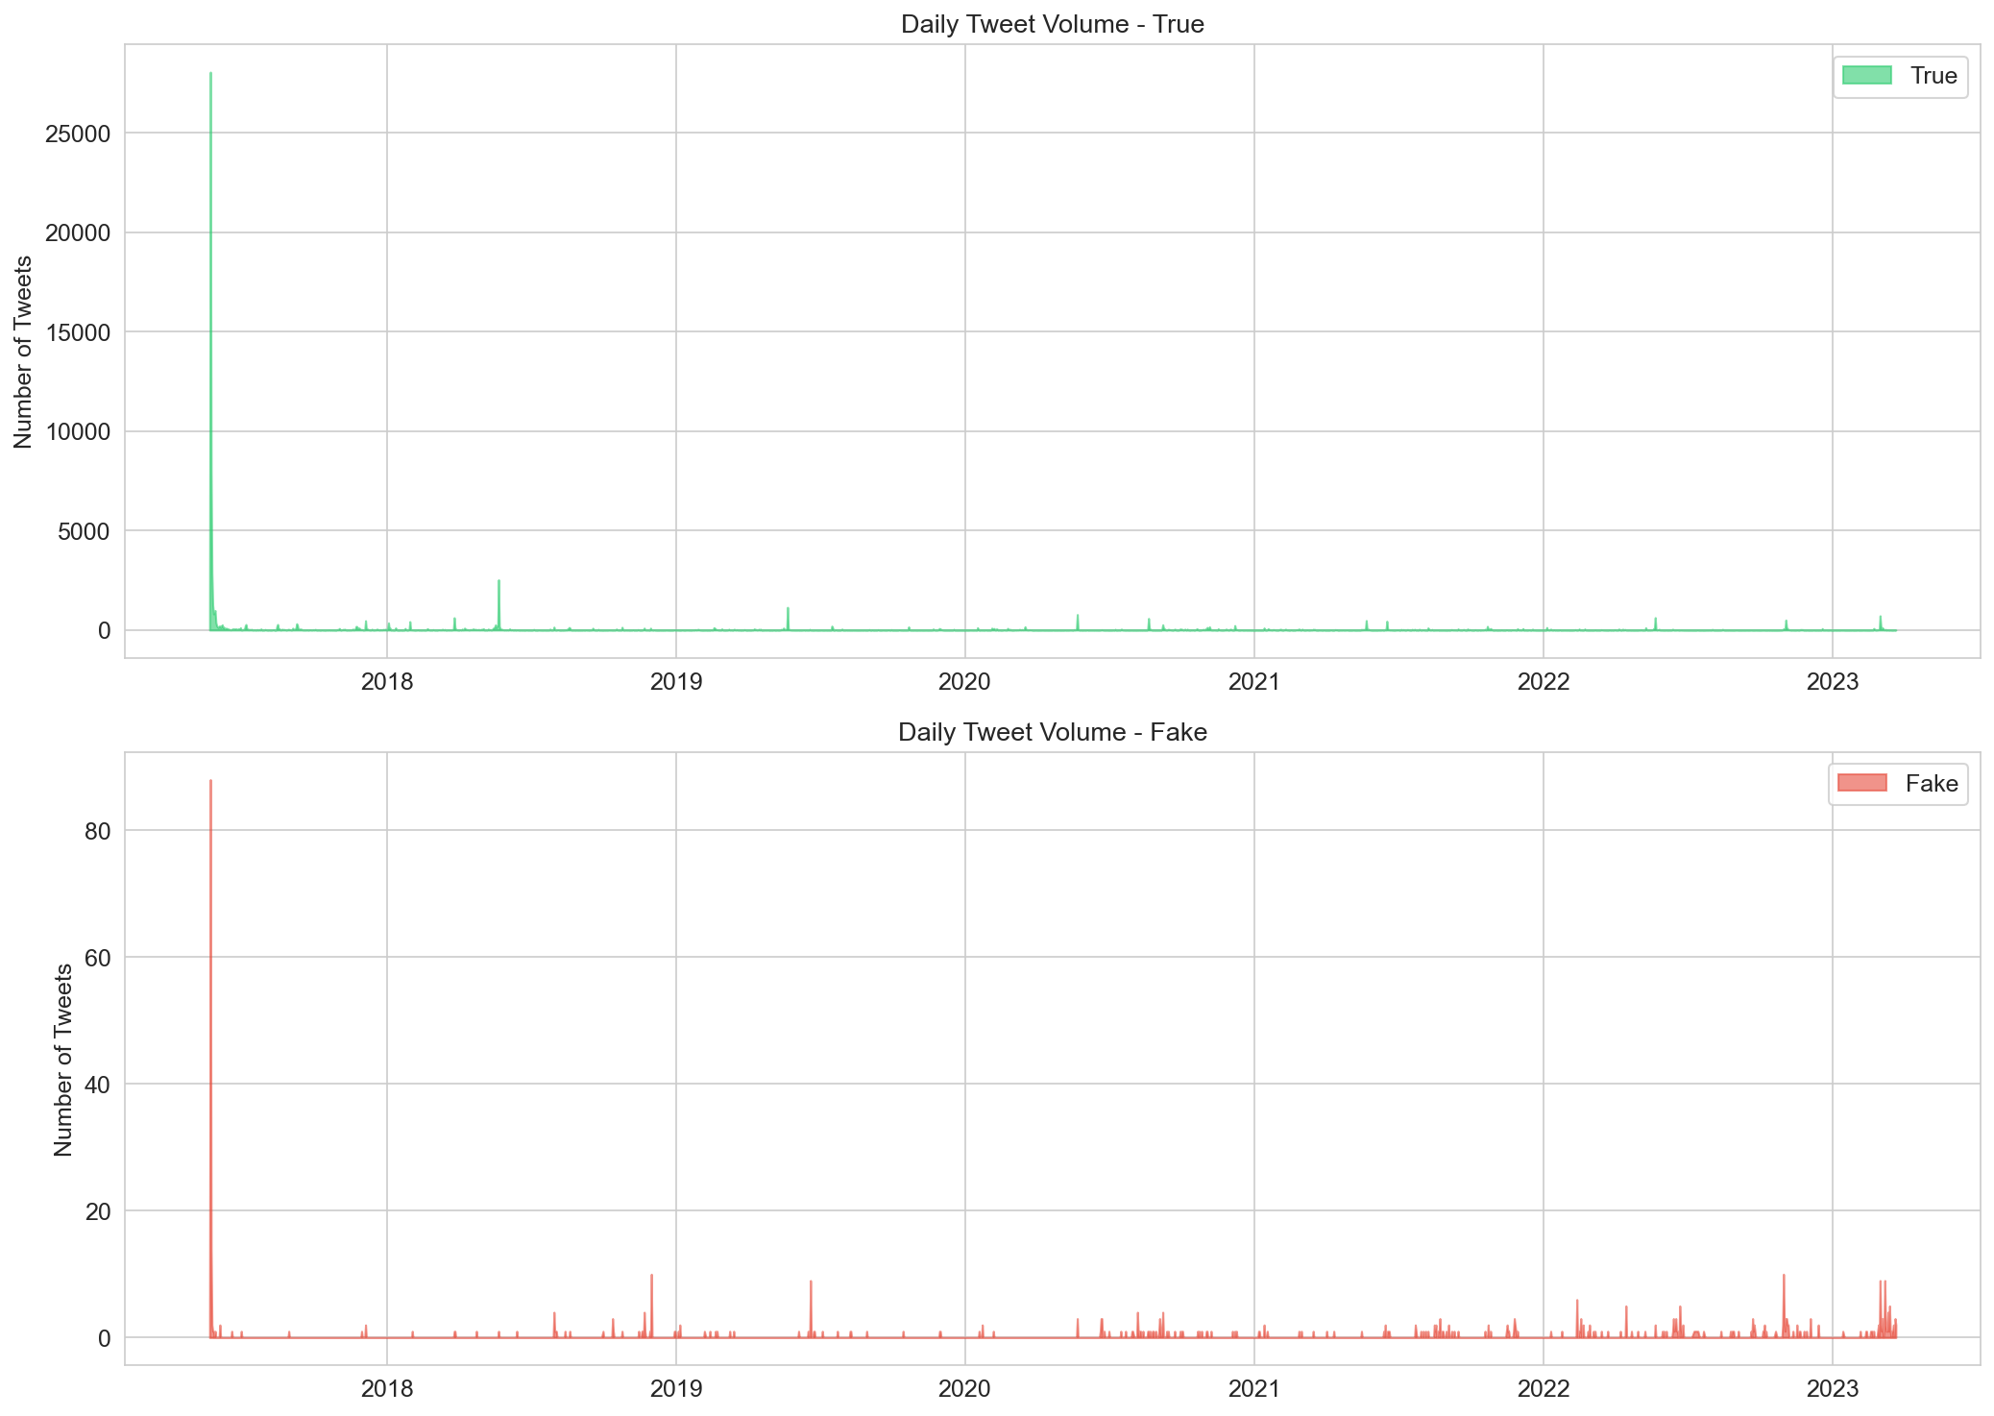
Temporal Analysis
EDA
Tweet volume over time

Slide 6
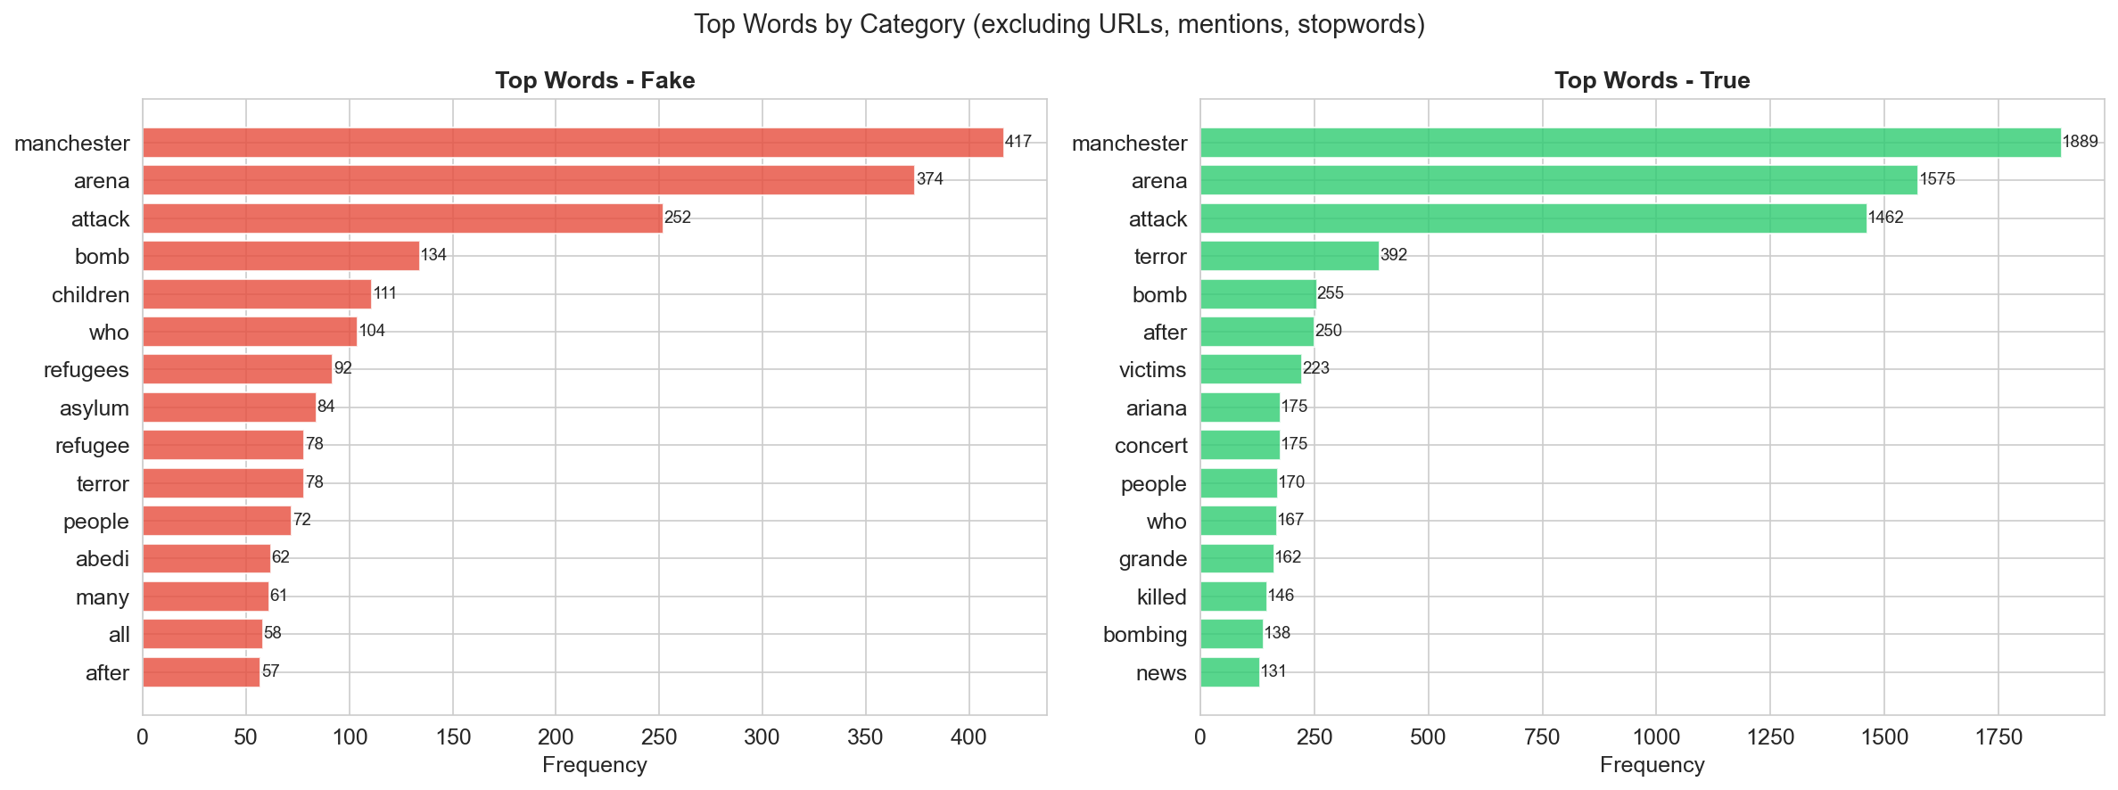
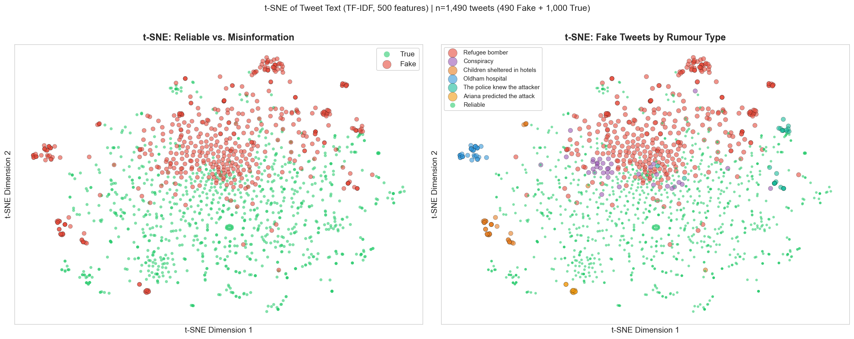
Top Words & Embedding Space
EDA
Lexical and semantic structure
Most Frequent Words
t-SNE of Tweet Embeddings

Slide 7
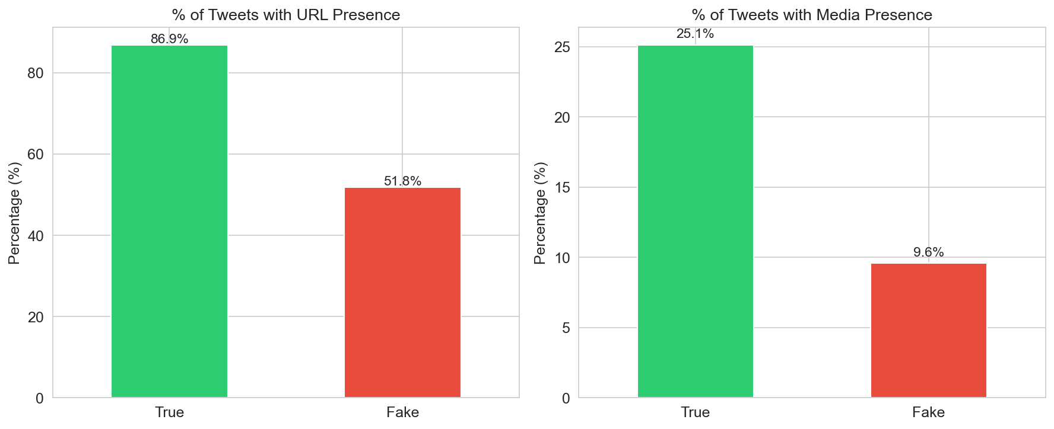
URL & Media Usage
EDA
How reliable vs misinformation tweets share links/media

Slide 8
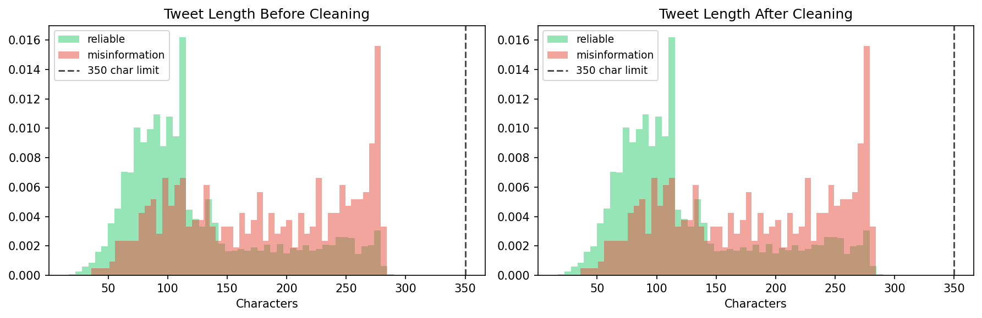
Text Cleaning
PREPROCESS
Before vs after preprocessing
URLs, @mentions, emojis removed; # kept as text

Slide 9
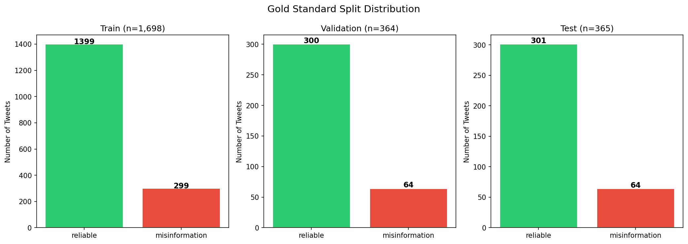
Gold Standard Splits
PREPROCESS
Stratified 70 / 15 / 30 split of the curated sample
Train 1,698 • Val 364 • Test 365 — same label ratio in each

Slide 10
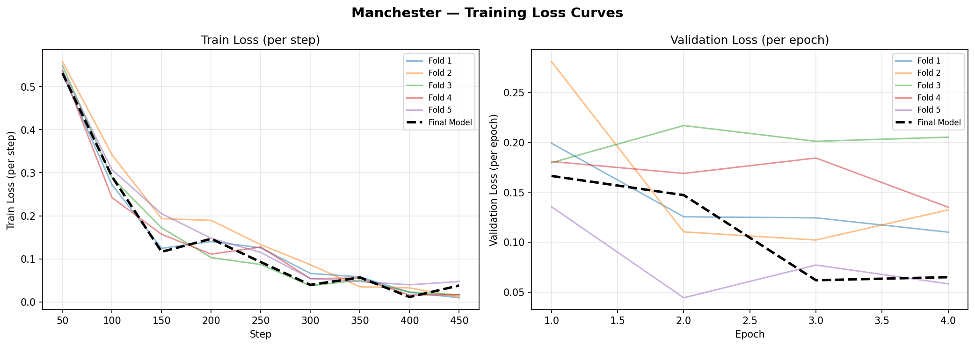
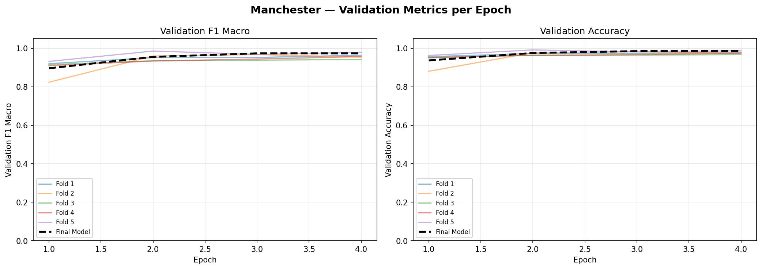
RoBERTa Training Curves
RoBERTa
Loss & F1 across epochs (5-Fold CV)
Training / Validation Loss
Validation F1 Macro

Slide 11
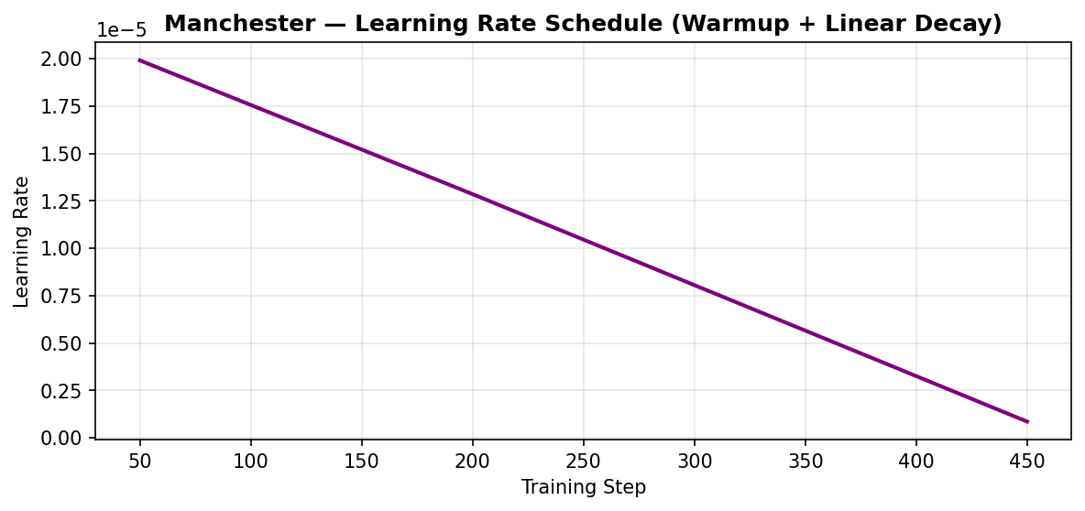
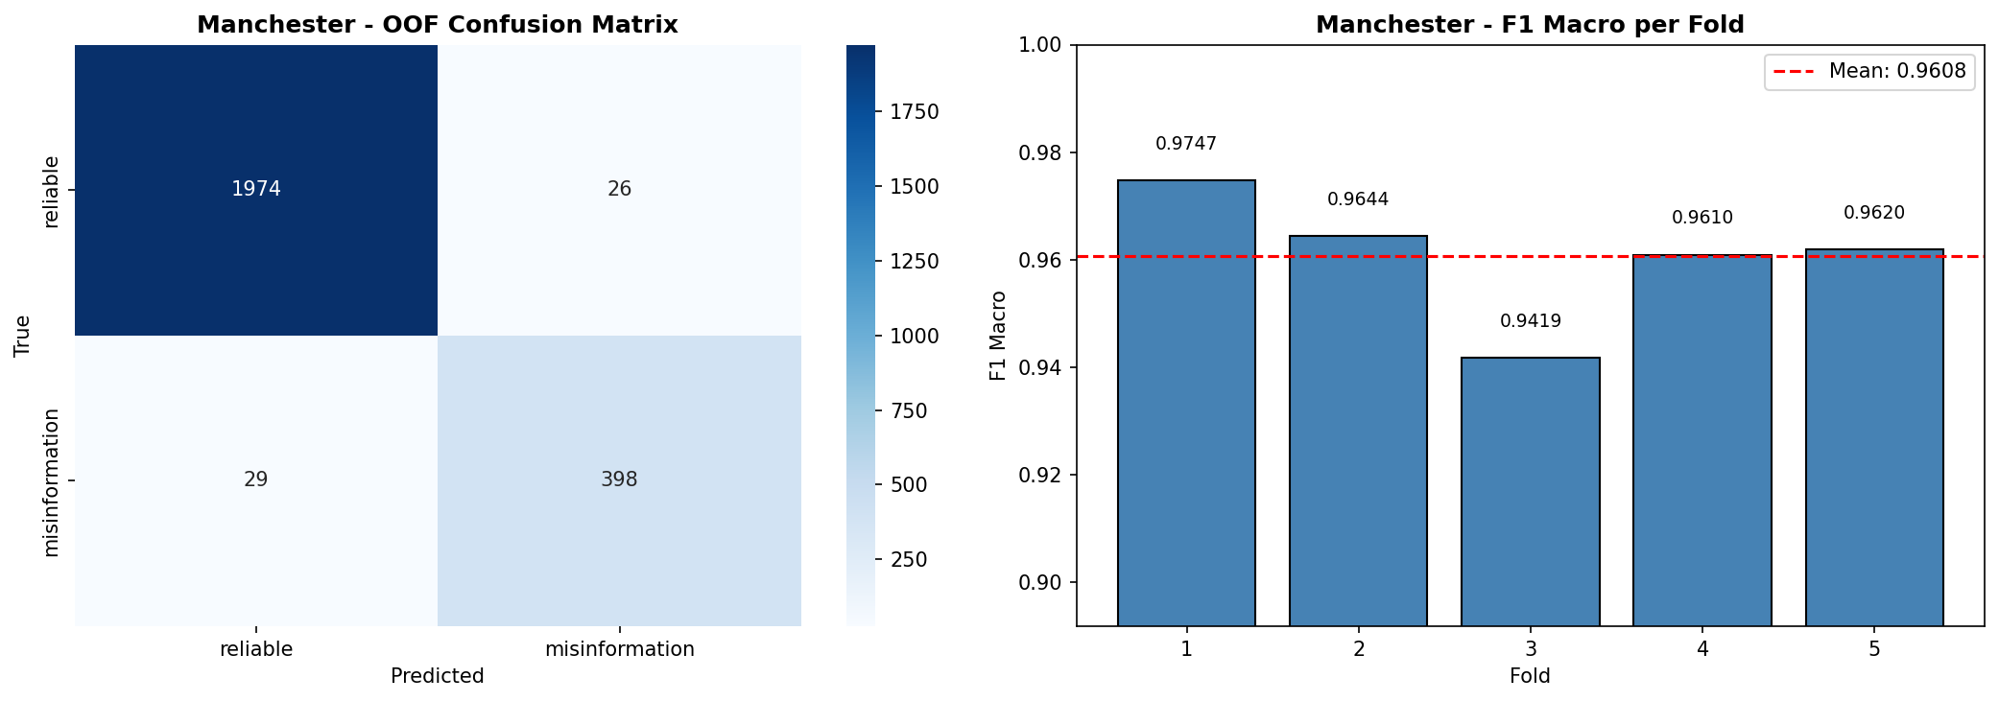
Learning Rate & CV Results
RoBERTa
Schedule and per-fold performance
LR Schedule (warmup + linear decay)
5-Fold CV — OOF CM & F1 per fold

Slide 12
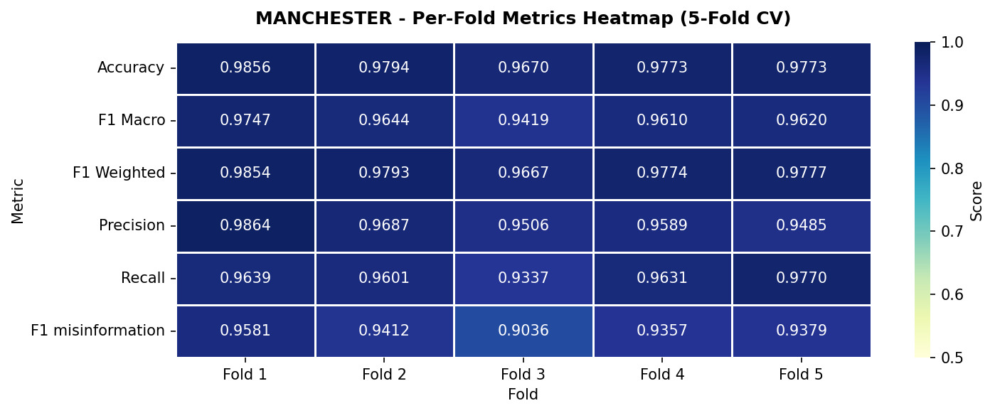
Per-Fold Metrics Heatmap
RoBERTa
Stability of metrics across the 5 folds
Low variance across folds → no dependence on a lucky split

Slide 13
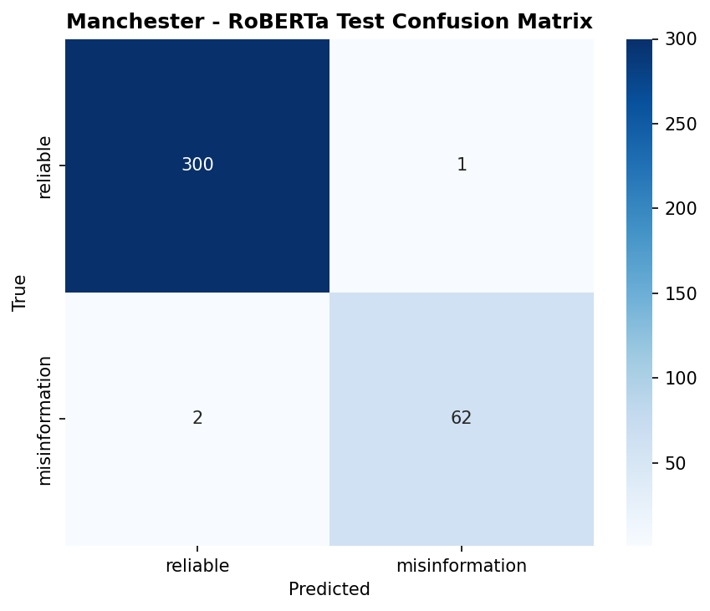
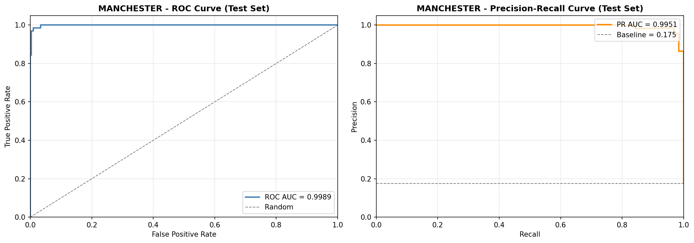
RoBERTa — Test Evaluation
RoBERTa
Final held-out test set (n=365)
Confusion Matrix
ROC & Precision-Recall Curves

Slide 14
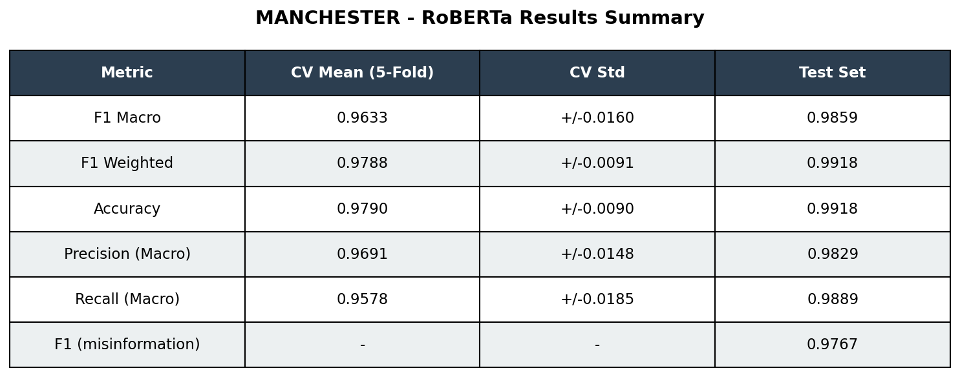
RoBERTa — Results Summary
RoBERTa
CV vs Test metrics table
Test F1 Macro 0.986 • Accuracy 0.992 • ROC-AUC near-perfect

Slide 15
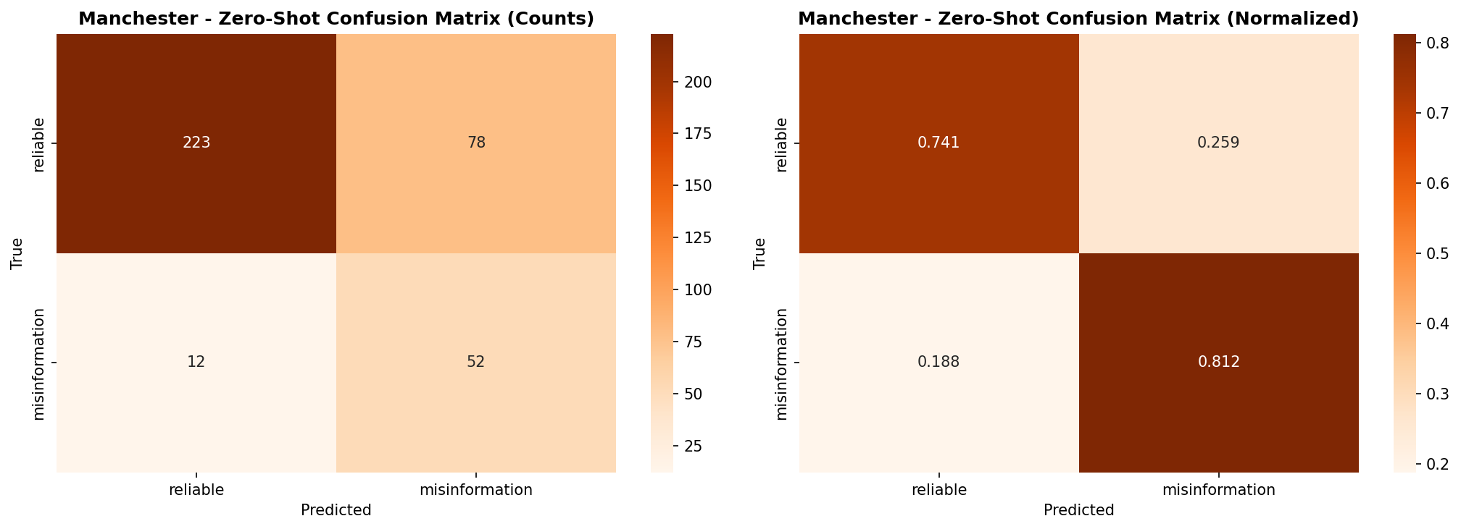
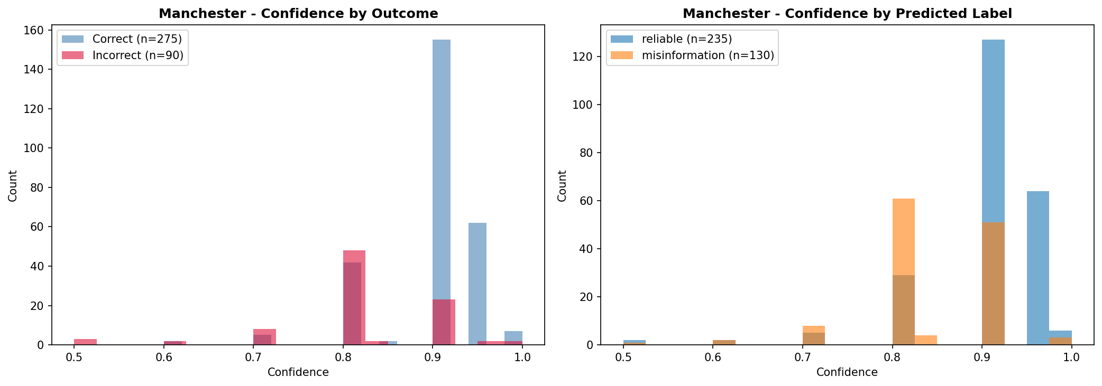
Zero-Shot — Llama 3.1 8B
ZERO-SHOT
Confusion matrix & confidence distribution
Confusion Matrix (counts & normalized)
Model Confidence by Outcome

Slide 16
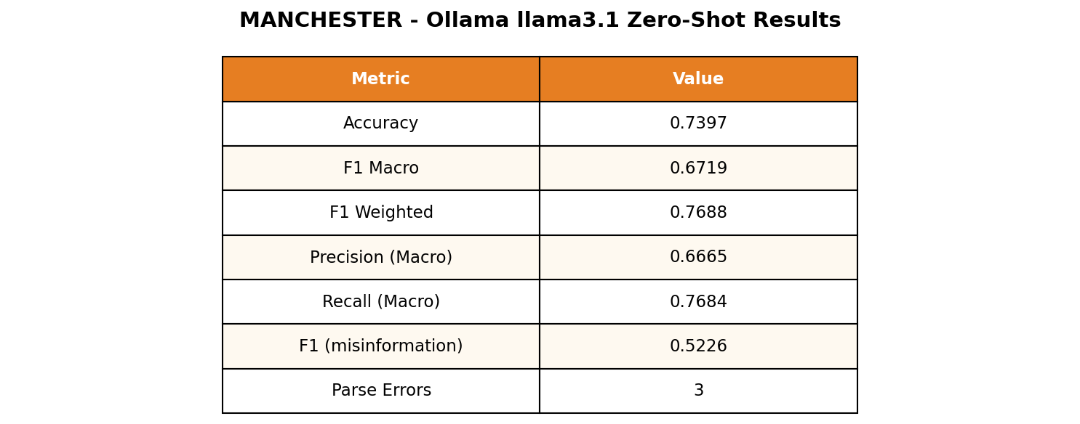
Zero-Shot — Results Summary
ZERO-SHOT
Llama 3.1 8B metrics table
Test F1 Macro 0.684 • Accuracy 0.753 • no training examples

Slide 17
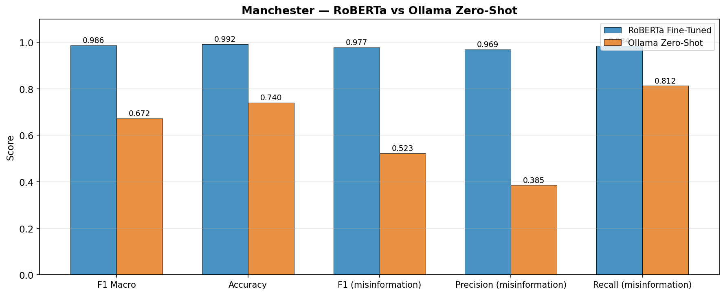
Head-to-Head — Metrics
COMPARE
RoBERTa vs Llama 3.1 Zero-Shot
RoBERTa leads on every metric

Slide 18
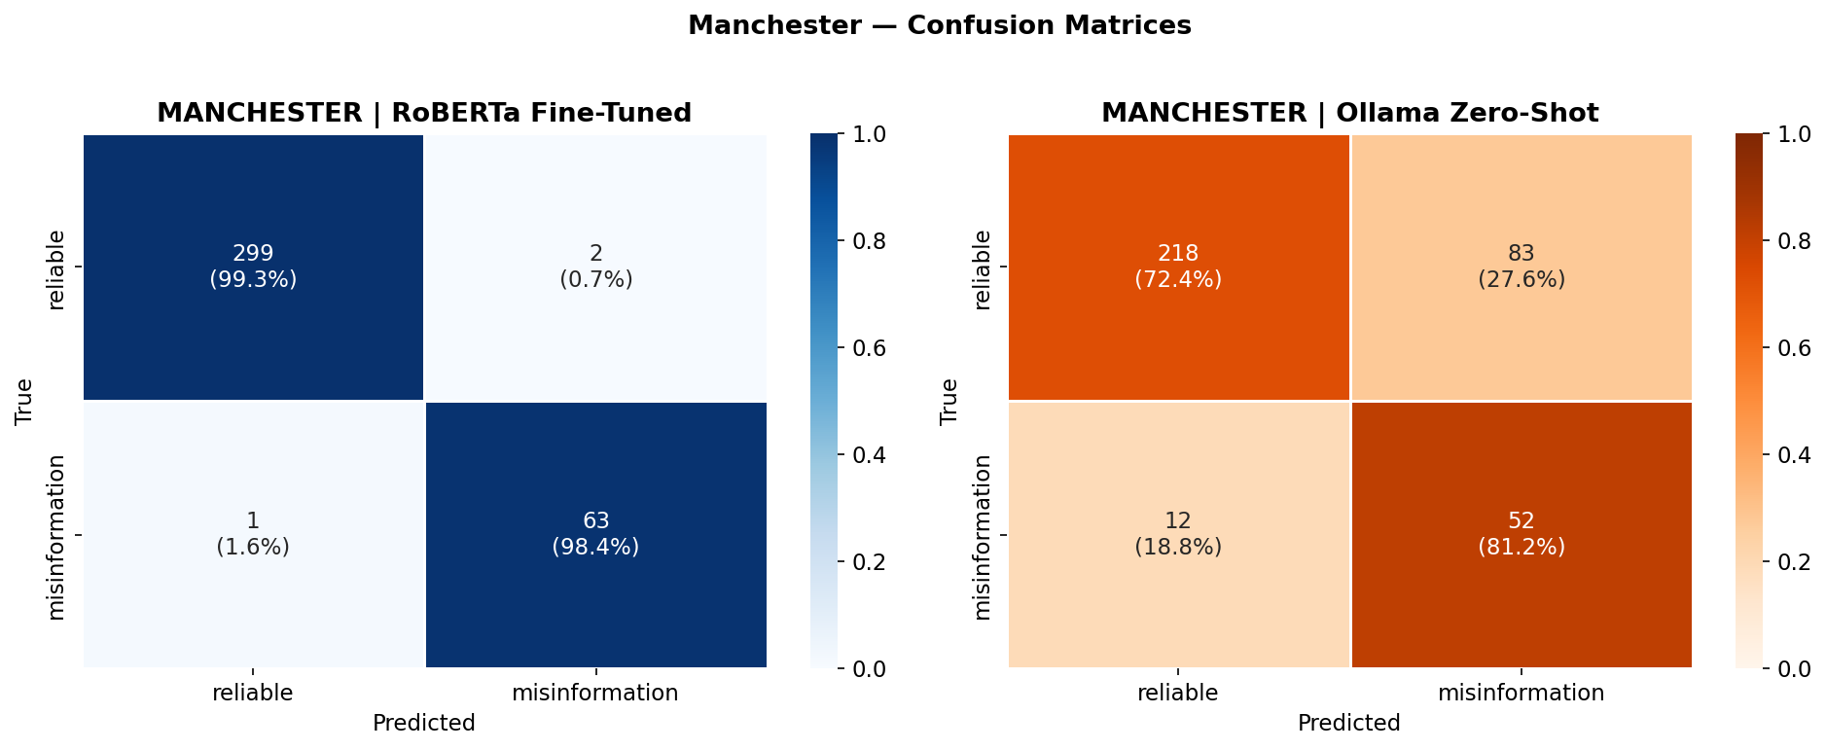
Head-to-Head — Confusion Matrices
COMPARE
Side-by-side error patterns

Slide 19
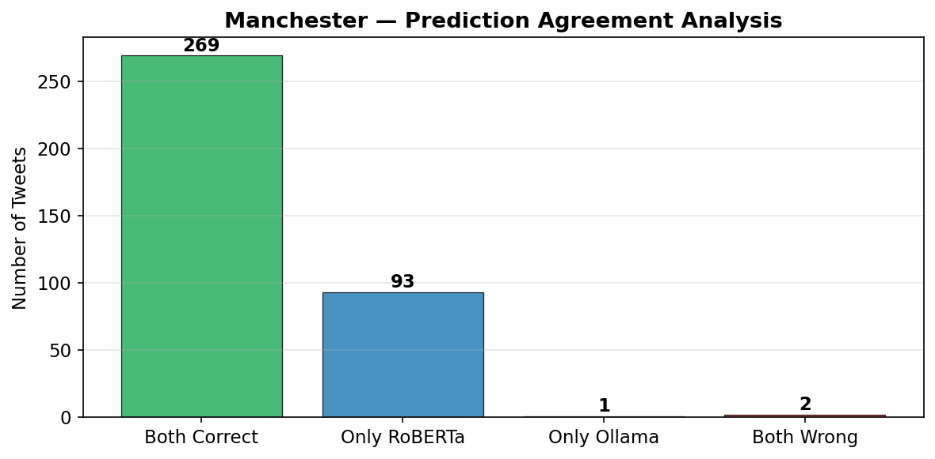
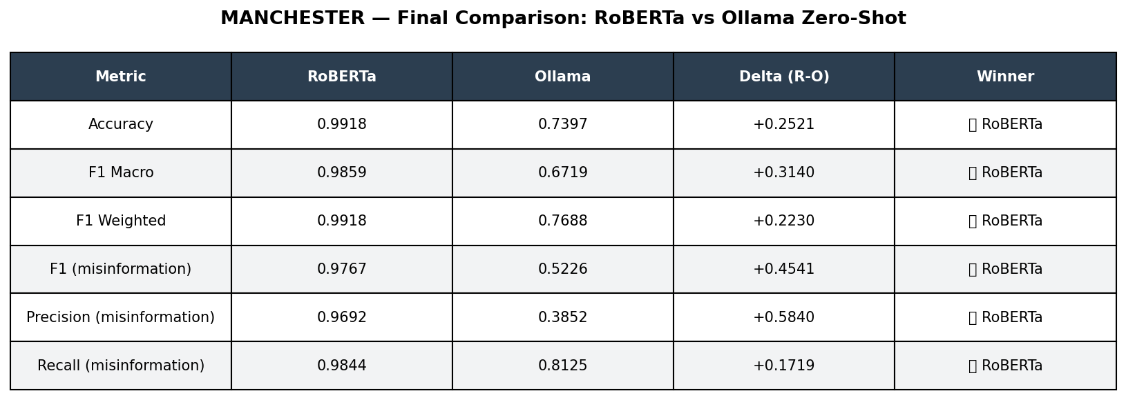
Agreement & Final Summary
COMPARE
Where the models agree, and the verdict
Model Agreement
Final Summary

