Slide 1
Detecting Misinformation on Twitter
Fine-Tuned RoBERTa vs Zero-Shot LLM
A 3-Class Study: reliable · misinformation · unrelated
Manchester Arena 2017
Monkeypox 2022
PHEME 2015
Final Project · Yoni · 2026

Slide 2
The Problem & Why Three Classes
From a binary task to a realistic three-way decision
Can a large language model with NO training examples detect misinformation as well as a RoBERTa model fine-tuned on thousands of labeled tweets — now across three classes?
reliable
misinformation
unrelated
NEW
Factually accurate, verified, or plausible information about the event.
False, unverified, or misleading claims — rumours, conspiracy theories, fabrications.
The tweet matched the search keywords but is not actually about the event — noise.

Slide 3
Three Datasets
Real-world misinformation across three domains
Manchester Arena
Monkeypox
PHEME
Total tweets
89,147
Total tweets
~6,287
Total tweets
62,445
Gold standard
3,427
Gold standard
4,043
Gold standard
4,500
Classes
reliable / misinfo / unrelated
Classes
reliable / misinfo / unrelated
Classes
not_rumour / rumour / unrelated
Domain
Terror attack (2017)
Domain
Health crisis (2022)
Domain
Breaking news (2015)
Balanced gold standard: up to 1,500 tweets per class, stratified 70 / 15 / 15 into train / validation / test. Test sets are near-balanced across the three classes.

Slide 4
Building the 'unrelated' Class
A relevance filter, tailored to each dataset
🔎 Manchester
🏷️ Monkeypox
🗂️ PHEME
Keyword relevance filter
Native ternary label
Topic-based filter
A "reliable" tweet that mentions NONE of the event keywords (arena, bomb, Ariana, Abedi, …) is re-labelled unrelated — plus the 3 native "Not related" tweets.
The dataset already ships a 3-way annotation (ternary_class). Class 9 — generic / off-topic tweets — is mapped directly to unrelated.
Tweets whose topic is 'unknown' (not tied to any tracked event, Charlie Hebdo / Ferguson) become unrelated, regardless of rumour status.
≈ 2,539 unrelated
≈ 2,647 unrelated
≈ 9,589 unrelated

Slide 5
Two Approaches
Supervised fine-tuning vs zero-shot prompting
RoBERTa · Fine-Tuned
Llama 3.1 8B · Zero-Shot
Model
roberta-base (125M params)
Runtime
Ollama — fully local, no API / internet
Training
5-fold stratified cross-validation
Training
None — zero labeled examples
Imbalance
Weighted cross-entropy loss
Prompt
Chain-of-Thought, 3 class definitions
Hyper-params
LR 2e-5 · batch 16 · ≤4 epochs
Output
Structured JSON: label + reasoning
Regularization
Early stopping (patience 2)
Decoding
temperature 0 (deterministic)
Hardware
Local GPU (RTX 4070 SUPER), fp16
Robustness
Retry + keyword-fallback parser

Slide 6
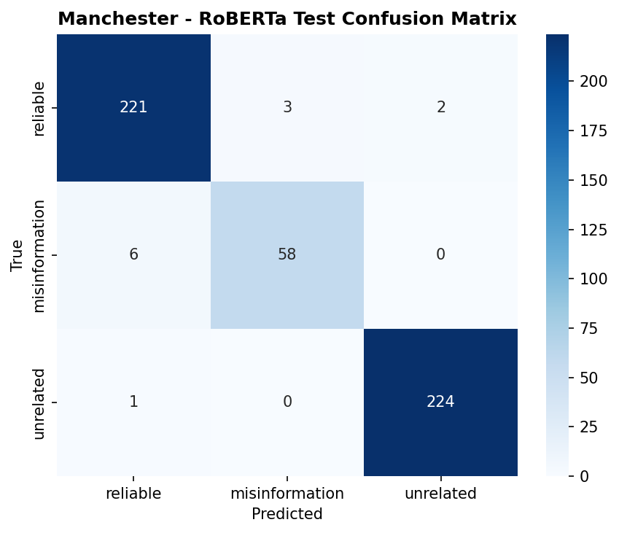
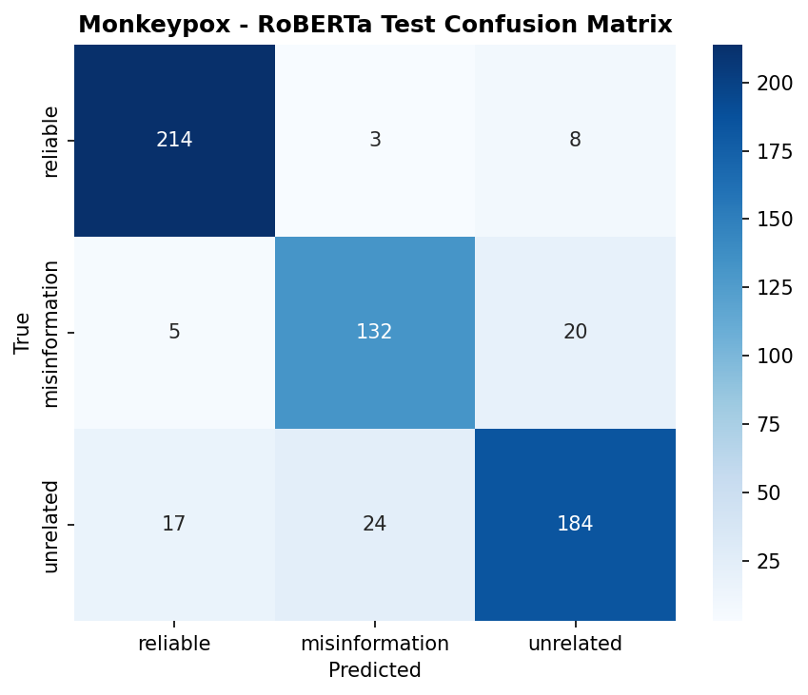
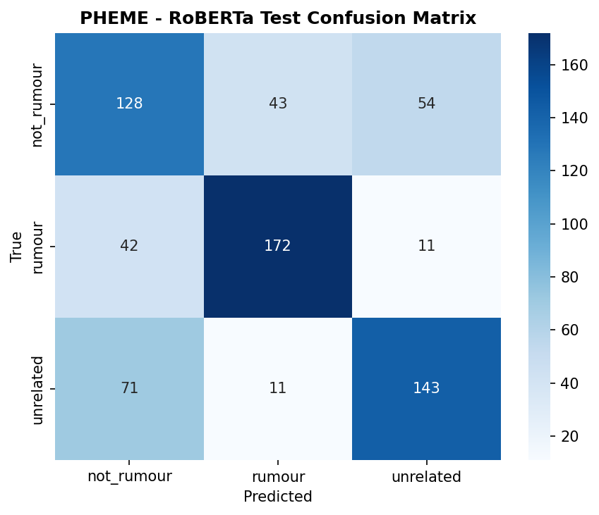
RoBERTa — Test Confusion Matrices
Strong diagonal: the fine-tuned model rarely confuses classes
Manchester (F1 0.965)
Monkeypox (F1 0.869)
PHEME (F1 0.658)
Manchester & Monkeypox are cleanly separated; PHEME stays hardest — rumour vs not_rumour needs event context a single tweet lacks.

Slide 7
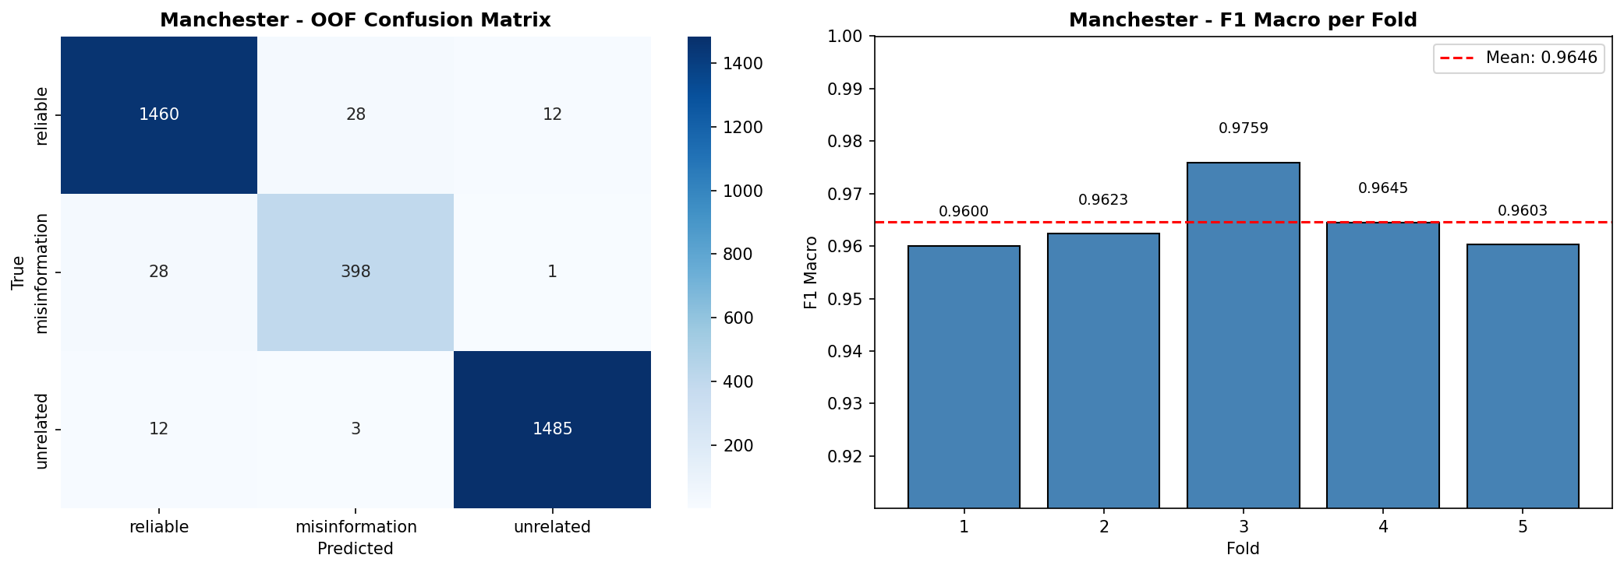
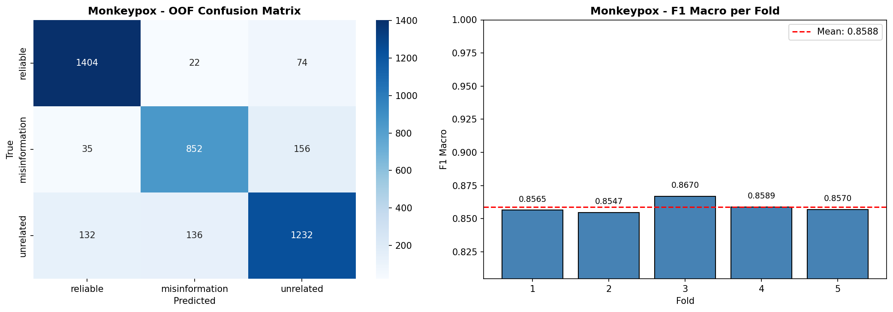
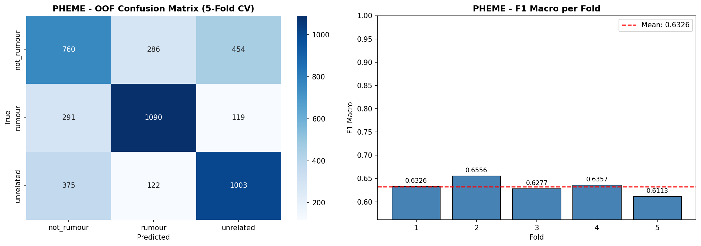
RoBERTa — 5-Fold Cross-Validation
OOF confusion matrix + per-fold F1 (low variance = stable model)
Manchester
Monkeypox
PHEME

Slide 8
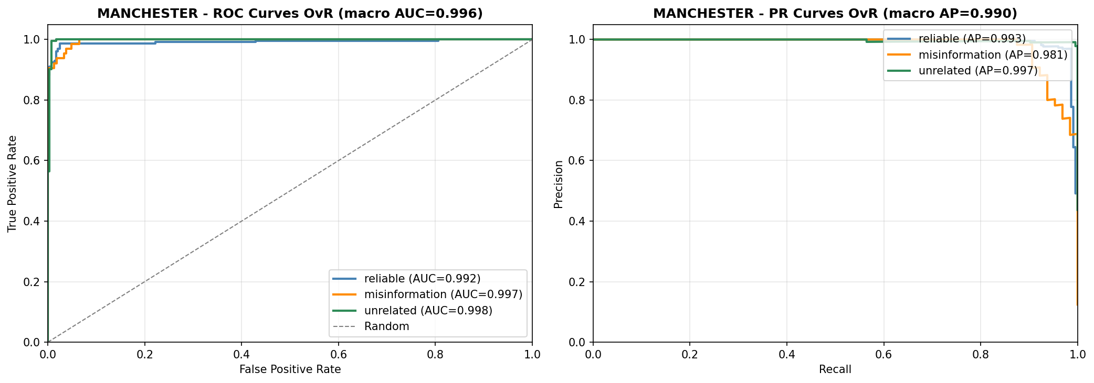
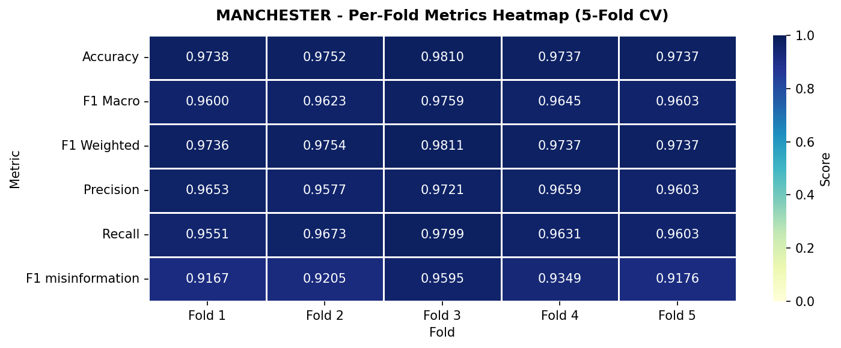
RoBERTa — ROC / PR & Per-Fold Metrics (Manchester)
One-vs-rest curves for the 3-class problem
One-vs-Rest ROC & Precision–Recall (macro ROC-AUC 0.996, PR-AUC 0.990)
Per-Fold Metrics Heatmap (5-fold CV)

Slide 9
RoBERTa — Test Results (all datasets)
Supervised upper bound for the 3-class task
Dataset
CV F1 (mean ± std)
Test F1 Macro
Accuracy
Precision
Recall
F1 Weighted
Manchester
0.965 ± 0.007
0.965
0.977
0.970
0.960
0.977
Monkeypox
0.859 ± 0.005
0.869
0.873
0.868
0.870
0.872
PHEME
0.633 ± 0.016
0.658
0.656
0.660
0.656
0.658
Why it works
• CV mean ≈ Test score for every dataset → no overfitting (e.g. Manchester 0.965 CV vs 0.965 Test).
• Weighted cross-entropy handles the smaller misinformation class (Manchester has only 64 test cases).
• PHEME is intrinsically hard: rumour detection on isolated tweets caps accuracy near 0.66.

Slide 10
Zero-Shot — Llama 3.1 8B via Ollama
No training examples — only a well-engineered prompt
How it works
Prompt (Chain-of-Thought, 3-class)
1
Ollama runs Llama 3.1 8B locally (no key, no internet)
You are an expert fact-checker... Classify this tweet about <topic>. CLASSES: "reliable": accurate info... "misinformation": false claims... "unrelated": not about the event... TWEET: """<text>""" Think step-by-step: 1. Is it on-topic, or unrelated? 2. What claim is made? 3. Verifiable, or conspiracy signals? Output JSON: {"reasoning":"...",
"label":"unrelated",
"confidence":0.83}
2
Build a Chain-of-Thought prompt with the 3 class definitions
3
Model first checks: is the tweet on-topic at all?
4
Reasons step-by-step, then emits structured JSON
5
Parse JSON → label; keyword-fallback if malformed
6
Checkpoint every 50 tweets (resume-safe)

Slide 11
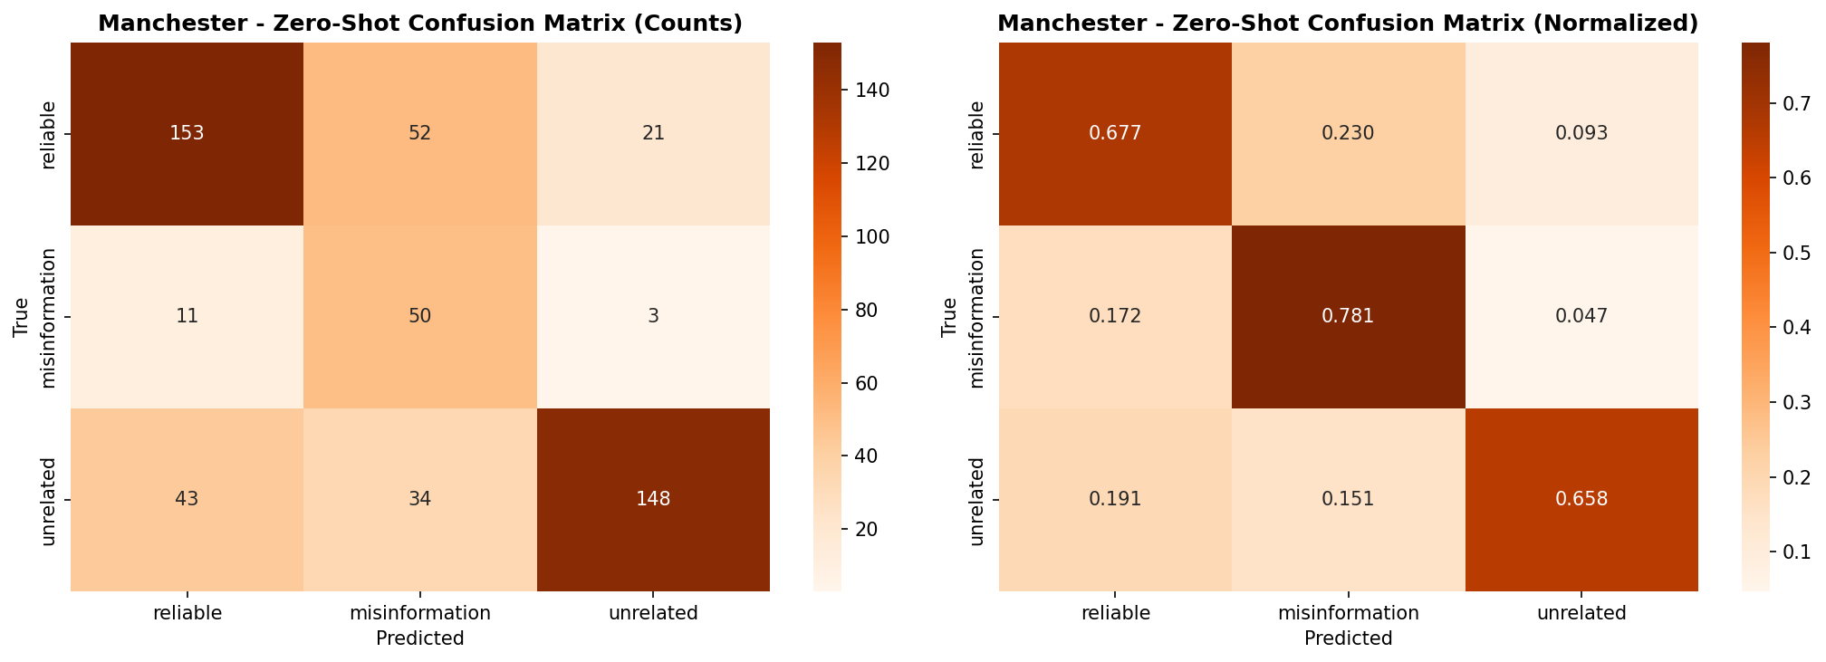
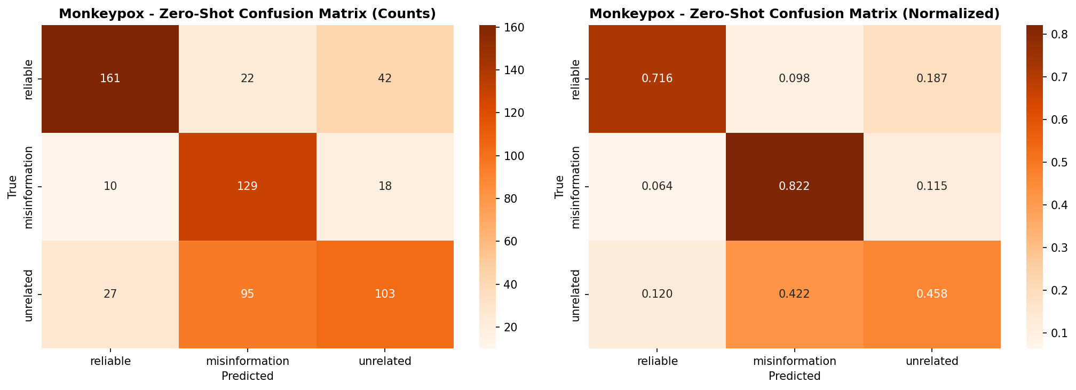
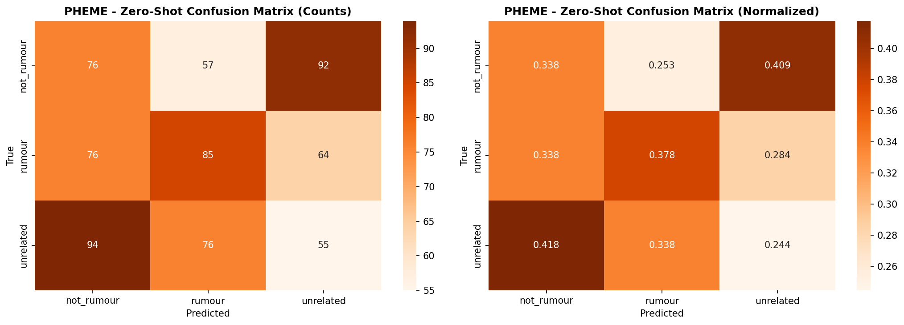
Zero-Shot — Confusion Matrices
The LLM uses all three labels, but confuses them far more
Manchester (F1 0.651)
Monkeypox (F1 0.644)
PHEME (F1 0.320)

Slide 12
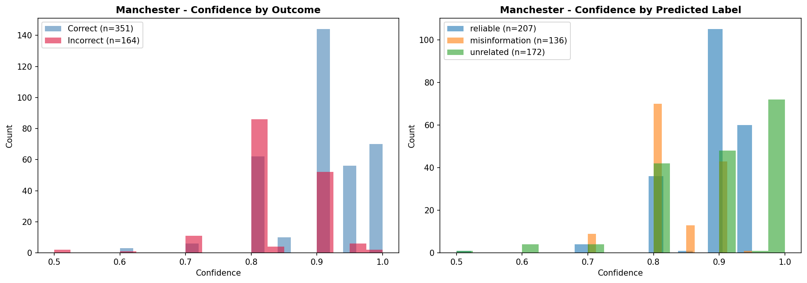
Zero-Shot — Confidence & Parse Quality
Self-reported confidence vs correctness (Manchester)
Output reliability
JSON parsed
513 / 515
Null predictions
1
Keyword fallback
~1
Mean confidence
high & overconfident
The model is confident even when wrong — confidence is not a reliable error signal.

Slide 13
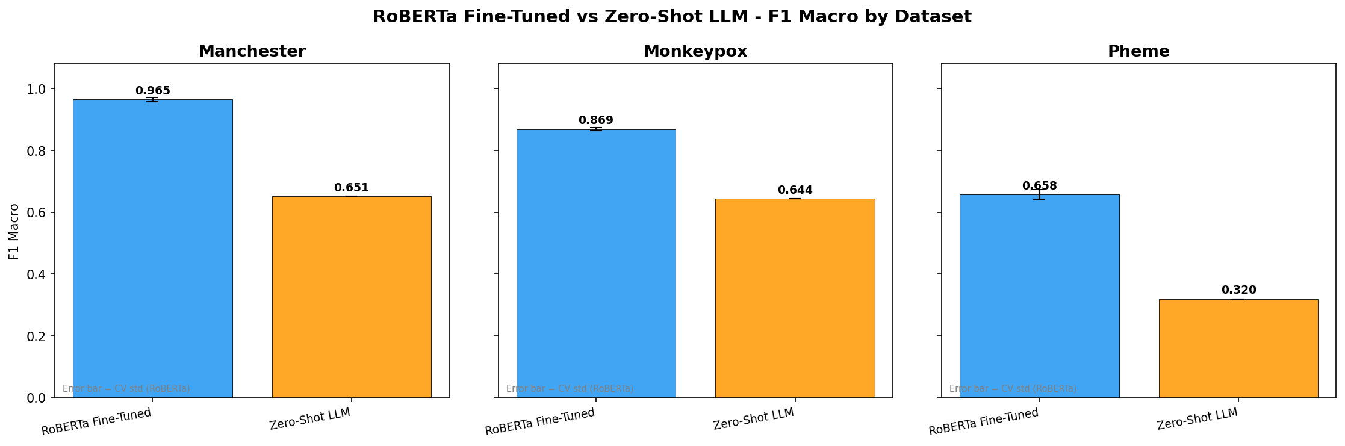
Head-to-Head — F1 Macro by Dataset
RoBERTa fine-tuned vs Llama 3.1 zero-shot
RoBERTa wins every dataset: Δ F1 = +0.314 (Manchester), +0.225 (Monkeypox), +0.338 (PHEME). Error bars = CV std.

Slide 14
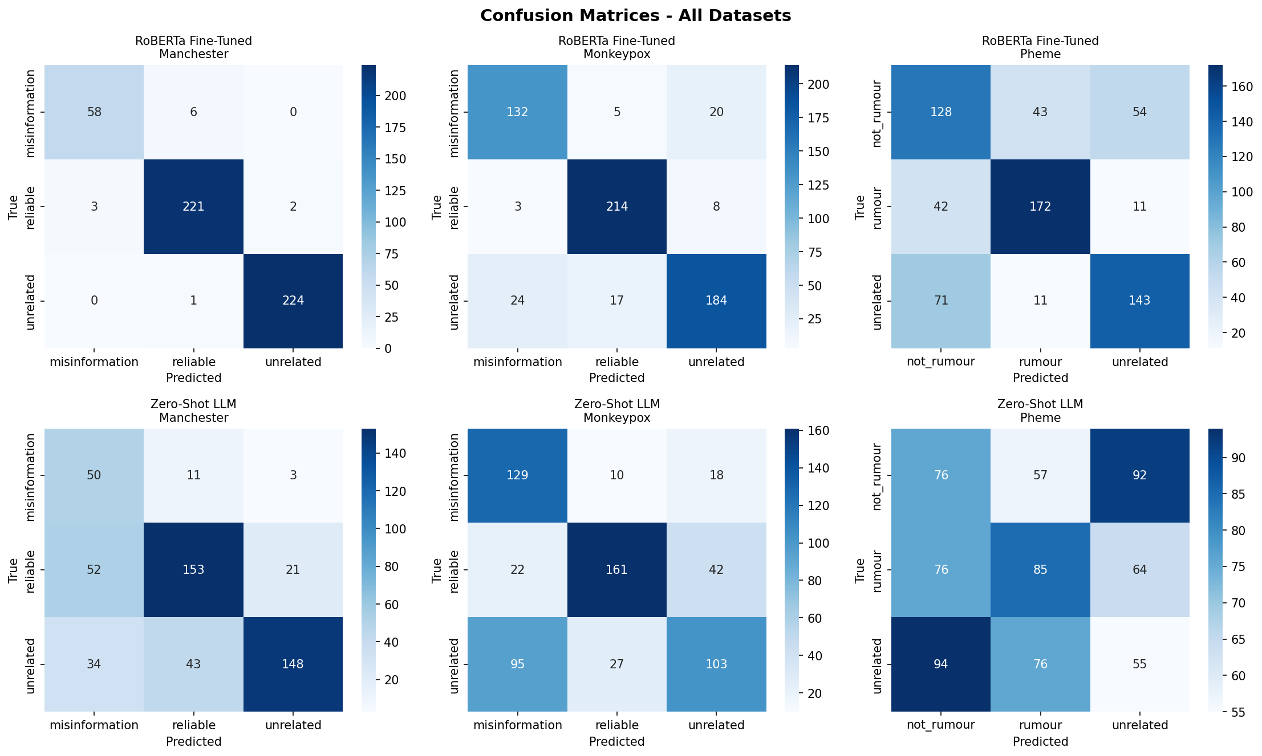
Confusion Matrices — Side by Side
Top: RoBERTa · Bottom: Zero-Shot (all three datasets)

Slide 15
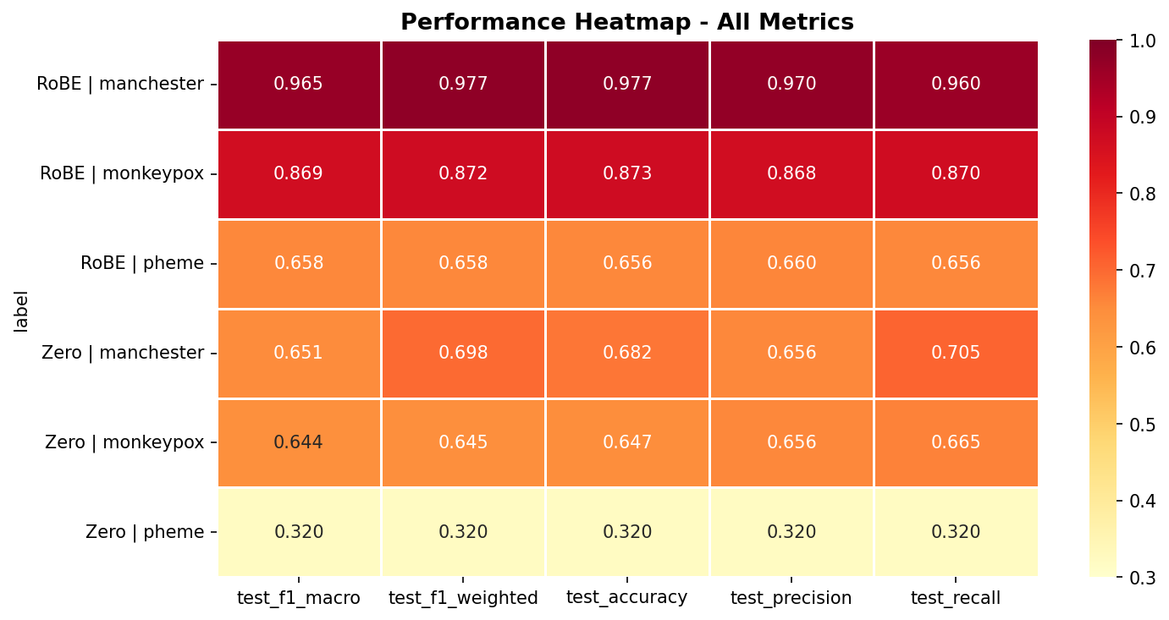
Performance Heatmap — All Metrics
Every metric, both models, all datasets
Reading it
Darker = higher score.
The RoBERTa rows stay dark across every metric; the zero-shot rows fade — most sharply on PHEME.
The gap is consistent: it is not driven by a single metric.

Slide 16
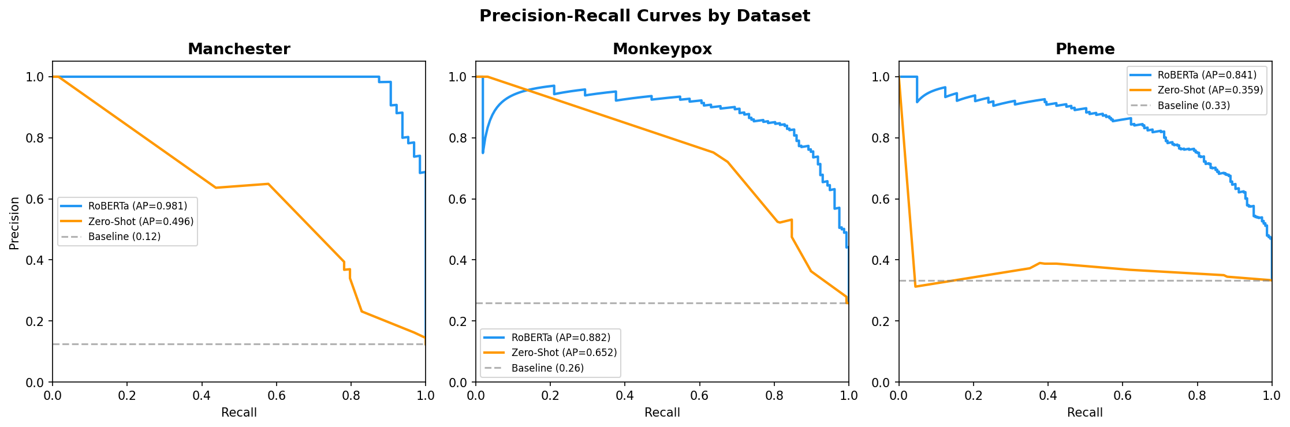
Precision–Recall Curves
Positive class per dataset (misinformation / rumour)
RoBERTa keeps high precision deep into the recall range; the zero-shot curve collapses toward the baseline, confirming the F1 gap.

Slide 17
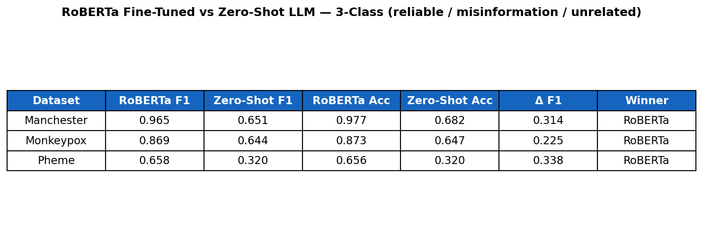
Summary Table & Statistical Significance
Final 3-class results — RoBERTa vs zero-shot
McNemar's test (RoBERTa vs Zero-Shot)
Manchester
Monkeypox
PHEME
p < 0.0001 · significant
p < 0.0001 · significant
p < 0.0001 · significant
b=160, c=8 (RoBERTa-only-correct vs ZS-only-correct)
b=164, c=27 (RoBERTa-only-correct vs ZS-only-correct)
b=296, c=69 (RoBERTa-only-correct vs ZS-only-correct)

Slide 18
Conclusions
1
Fine-tuning wins — decisively.
RoBERTa beats zero-shot on all 3 datasets (Δ F1 +0.22 to +0.34), significant at p < 0.0001.
2
Zero-shot is still respectable.
With zero training, Llama 3.1 8B reaches F1 ≈ 0.65 on Manchester & Monkeypox — usable as a cold-start baseline.
3
The third class is learnable.
Both models use all three labels; RoBERTa separates "unrelated" almost perfectly, the LLM only partially.
4
PHEME remains the hard case.
Rumour detection on isolated tweets caps both models — context beyond a single tweet is needed.
reliable · misinformation · unrelated — 3-class misinformation classification

