Slide 1
Zero-Shot vs Fine-Tuned LLMs
for Misinformation Detection
Comparing RoBERTa Fine-Tuned with Llama 3.1 8B Zero-Shot
across Three Misinformation Datasets
🏟️ Manchester Arena
🦠 Monkeypox
📰 PHEME
Yoni | Final Project 2025–2026

Slide 2
Research Question
What drives this study?
Can a large language model, with zero training examples, detect misinformation
as accurately as a fine-tuned RoBERTa model trained on thousands of labeled tweets?
🗃️ 3 Datasets
🧠 2 Approaches
📊 5 Metrics
Manchester Arena bombing,
Monkeypox health claims,
PHEME breaking news
Fine-Tuning (supervised)
vs
Zero-Shot (no training)
F1 Macro, F1 Weighted,
Accuracy, Precision,
Recall

Slide 3
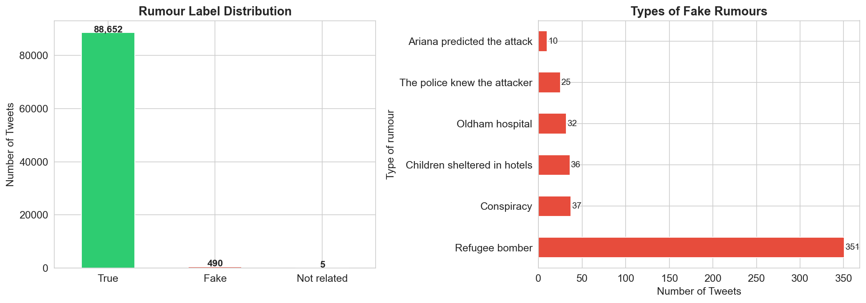
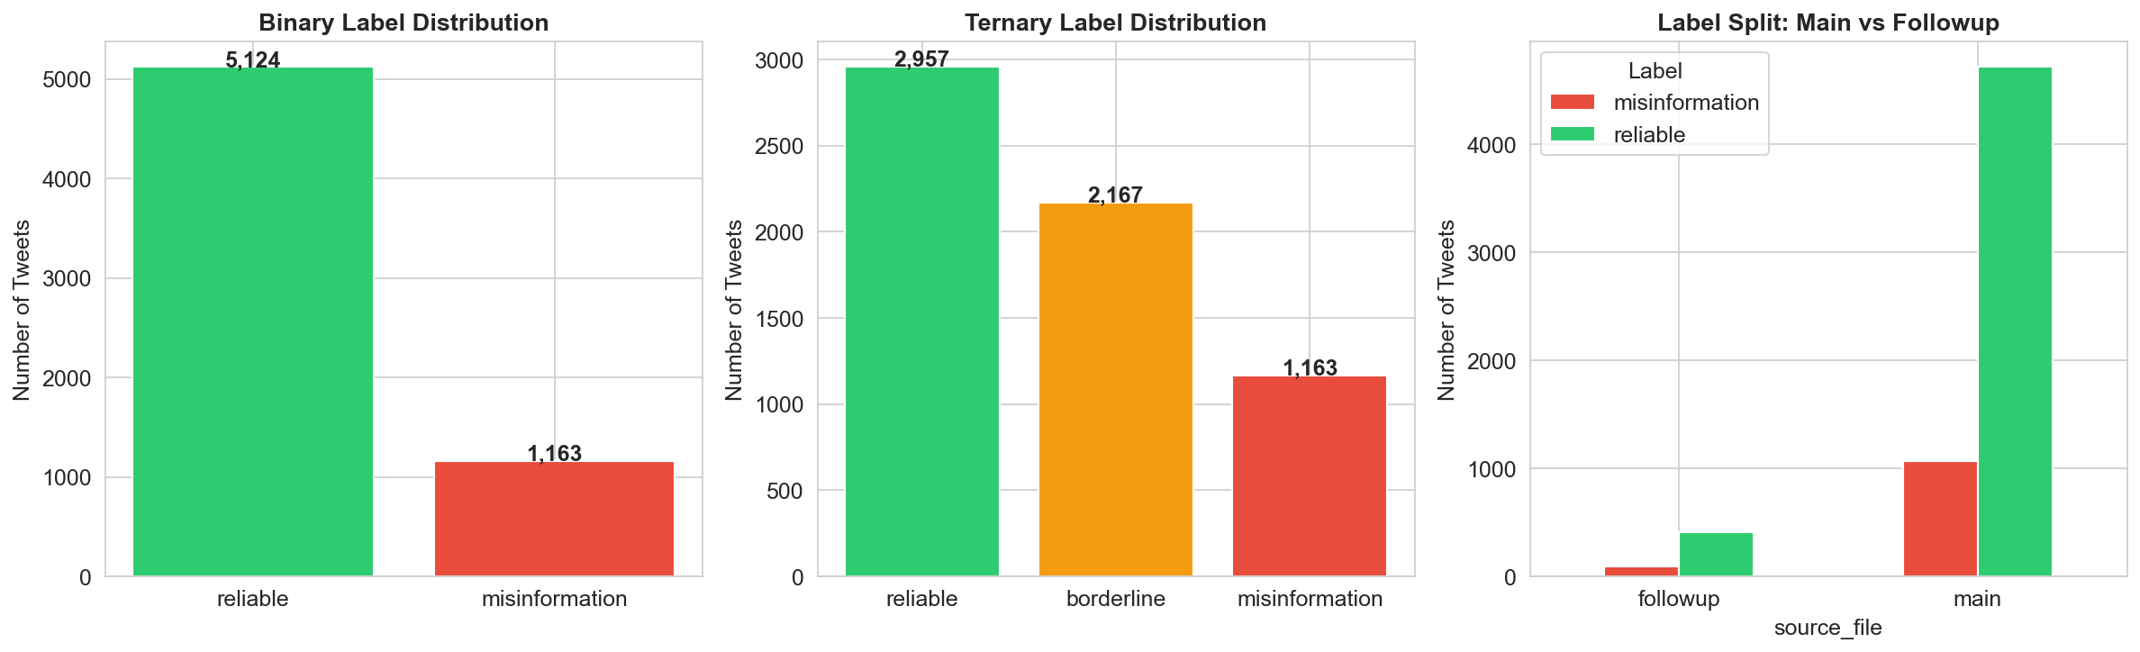
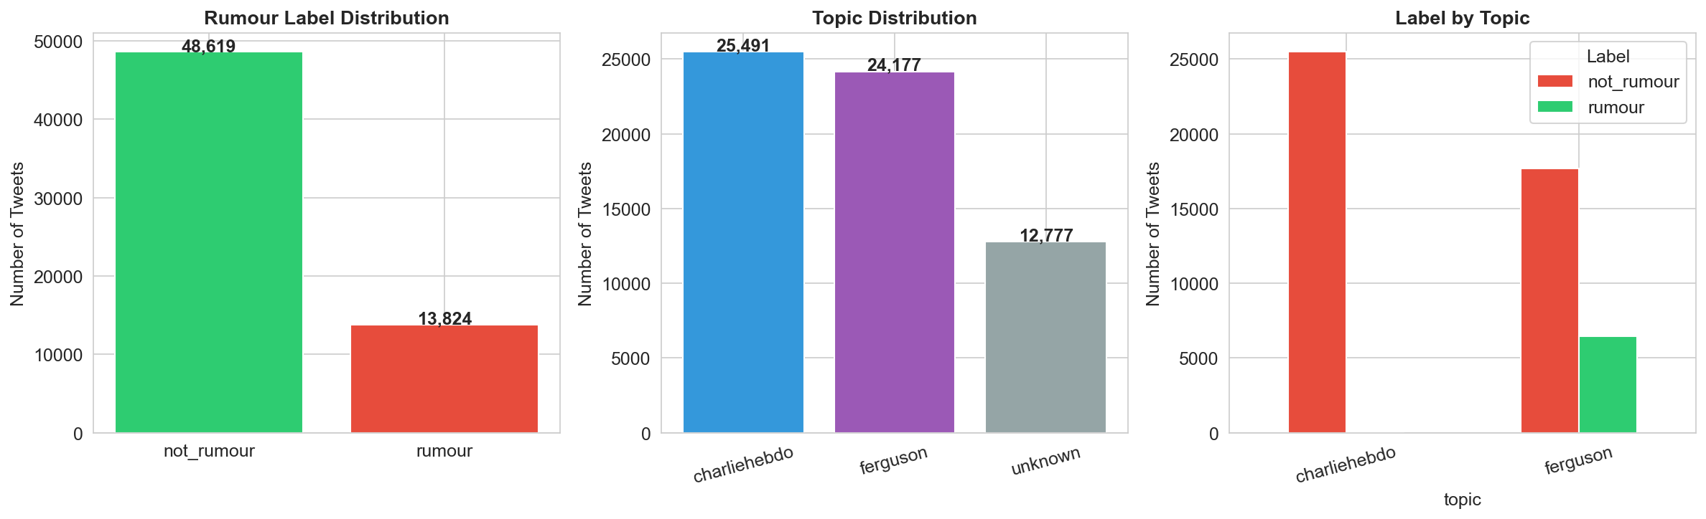
Datasets
Three domains — real-world misinformation challenges
Manchester Arena
Monkeypox
PHEME
Total tweets: 89,147
Total tweets: ~6,287
Total tweets: 62,445
Gold Standard: 2,427
Gold Standard: 3,043
Gold Standard: 12,887
Labels: reliable / misinformation
Labels: reliable / misinformation
Labels: not_rumour / rumour
Source: Twitter (event-specific)
Source: Twitter (health crisis)
Source: Twitter (breaking news)

Slide 4
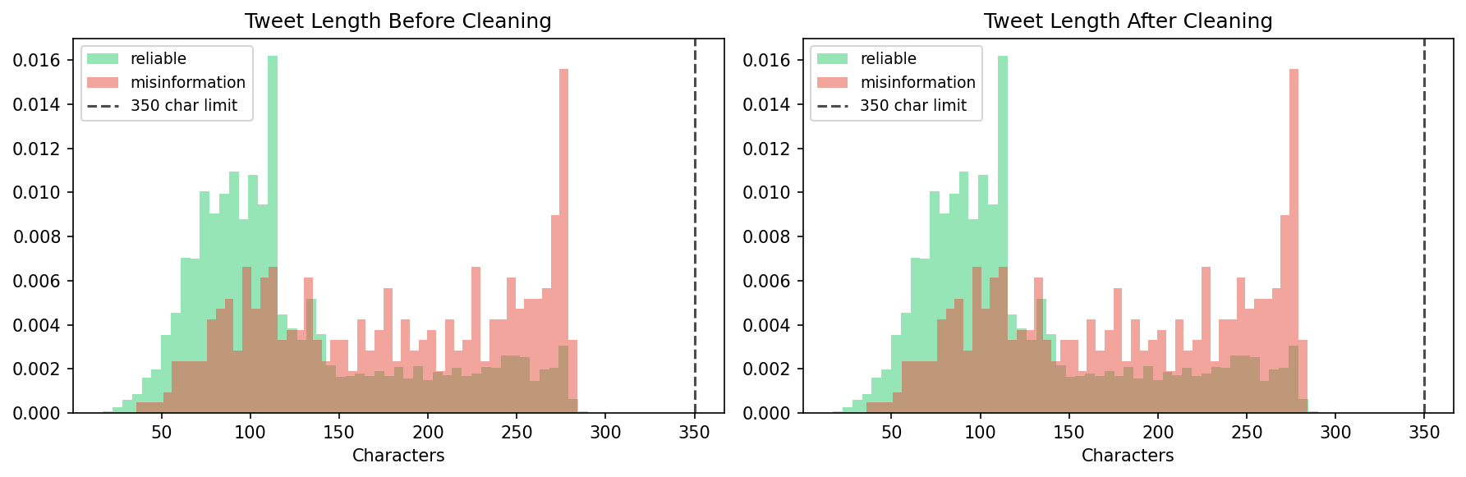
Data Preprocessing
Building a clean, curated Gold Standard for fair evaluation
1
Remove URLs, @mentions,
#tags (keep text), RT, emojis
Before → After Cleaning
2
Filter tweets < 5 words
(noise removal)
3
Deduplicate
(remove exact copies)
4
Sample Gold Standard
~2,500 stratified tweets
Example Tweet (Manchester):
Before: "@user RT: Manchester Arena BOMB — refugees did this! 💥 #Islamists http://t.co/xyz"
After:
"Manchester Arena BOMB — refugees did this Islamists"
5
Stratified Split
70% Train / 15% Val / 15% Test

Slide 5
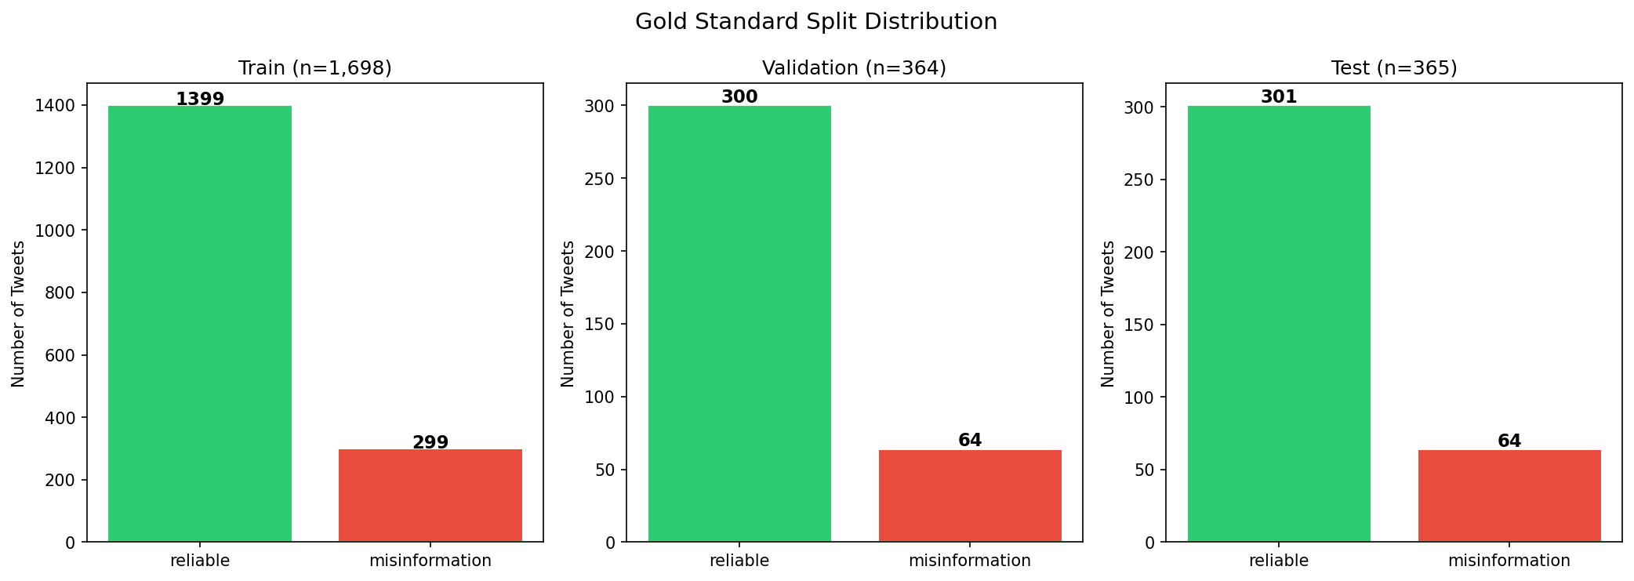
Gold Standard & Class Imbalance
Why we cannot use the raw data directly
⚠️ The Problem
Manchester Gold Standard Splits
Manchester raw: 89,147 tweets
→ Only 490 misinformation (0.55%)
A naive model predicting "reliable" always
would achieve 99.4% accuracy!
✅ Our Solution
• Take ALL minority class examples
• Random sample from majority class
• Result: a curated Gold Standard per dataset
• Stratified 70/15/15 split
• Class weights in training loss
Dataset
Gold Total
Train
Val
Test
Manchester
2,427
1,698
364
365
Monkeypox
3,043
2,130
456
457
PHEME
12,887
9,020
1,933
1,934

Slide 6
RoBERTa Fine-Tuning
Supervised approach — learning from labeled examples
Raw Tweet
Training Configuration
▼
Parameter
Value
Reason
RoBERTa
Tokenizer (BPE)
Learning Rate
2e-5
Prevent catastrophic forgetting
▼
Token Embeddings
[CLS] t1 t2 ... [SEP]
Batch Size
16
GPU memory balance
▼
Epochs (max)
4
With early stopping (patience=2)
RoBERTa-base
12 Transformer Layers
(125M params)
Warmup Ratio
10%
Smooth LR increase at start
▼
[CLS] Representation
(768-dim)
Loss Function
Weighted Cross-Entropy
Handles class imbalance
▼
Precision
fp16 (mixed)
Faster GPU training
Classification Head
768 → 2 (Linear)
Seed
42
Reproducibility
▼
📋 5-Fold Stratified Cross-Validation
reliable / misinformation
Gold Standard split into 5 equal parts → train on 4, validate on 1 → rotate → report mean ± std F1

Slide 7
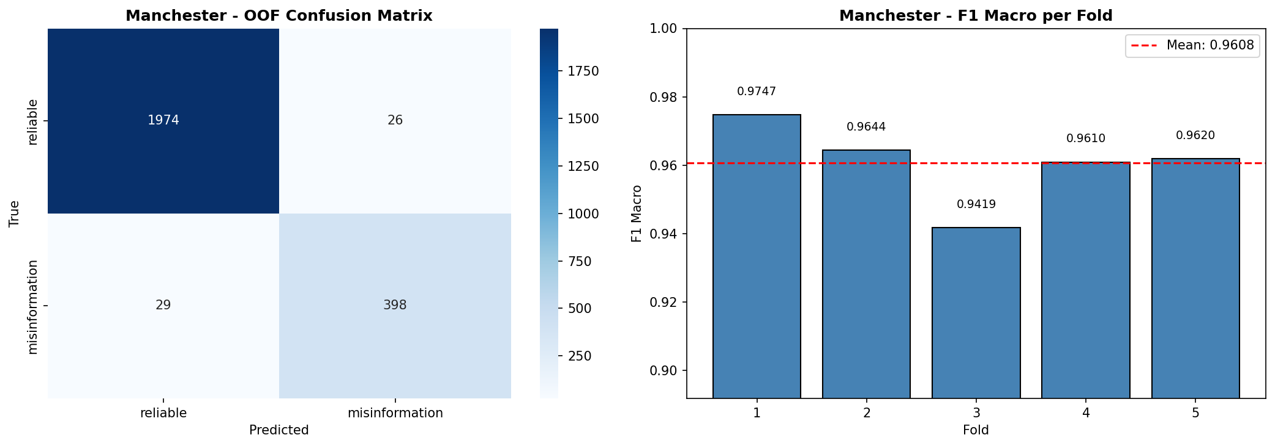
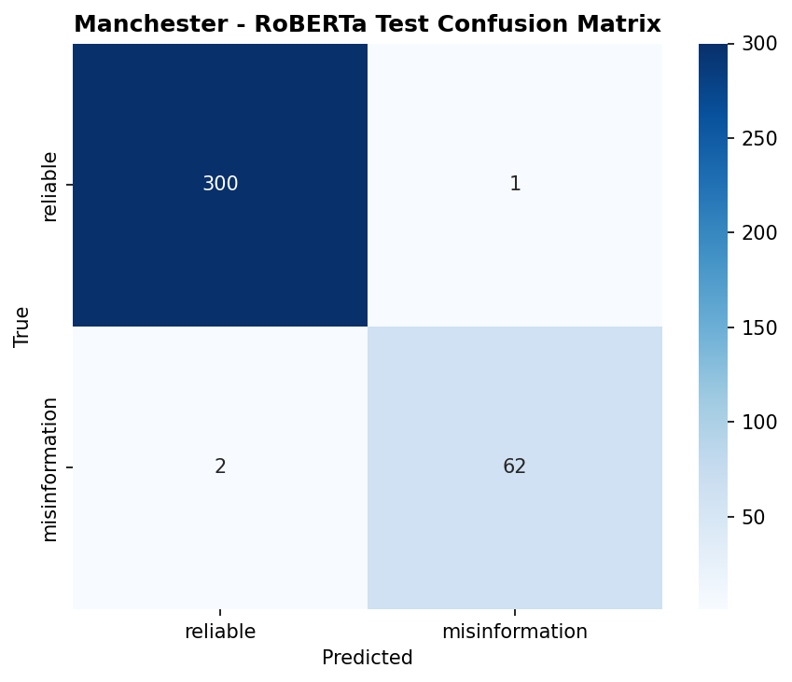
RoBERTa Results
5-Fold CV + Final Test Set Evaluation
Manchester — 5-Fold CV
Manchester — Test Set Confusion Matrix
Test Set Results — All Datasets (RoBERTa Fine-Tuned)
Dataset
CV F1 Macro (mean ± std)
Test F1 Macro
Test Accuracy
Test Precision
Test Recall
Manchester
0.961 ± 0.012
0.986
0.992
0.989
0.983
Monkeypox
0.893 ± 0.014
0.913
0.921
0.913
0.913
PHEME
0.599 ± 0.007
0.598
0.822
0.627
0.586

Slide 8
Zero-Shot Classification — Ollama + Llama 3.1 8B
No training examples required
🔁 How Zero-Shot Works
Prompt Structure (Chain-of-Thought)
You are an expert fact-checker... Topic: the 2017 Manchester Arena bombing CLASSES: "reliable": factually accurate... "misinformation": false claims... TWEET: """[tweet text]""" INSTRUCTIONS: Think step-by-step: 1. What claim does the tweet make? 2. Verifiable facts or emotional? 3. Conspiracy signals? Output JSON: {"reasoning": "...",
"label": "reliable",
"confidence": 0.87}
🏠
Ollama runs Llama 3.1 8B locally
(no API key, no internet required)
📝
Build a Chain-of-Thought prompt
with dataset-specific class definitions
🤖
Model reasons step-by-step,
then outputs structured JSON
🔍
Parse JSON → extract label
Fallback: keyword scan in raw text
💾
Checkpoint every 50 tweets
(resume if interrupted)
temperature=0 (deterministic output)

Slide 9
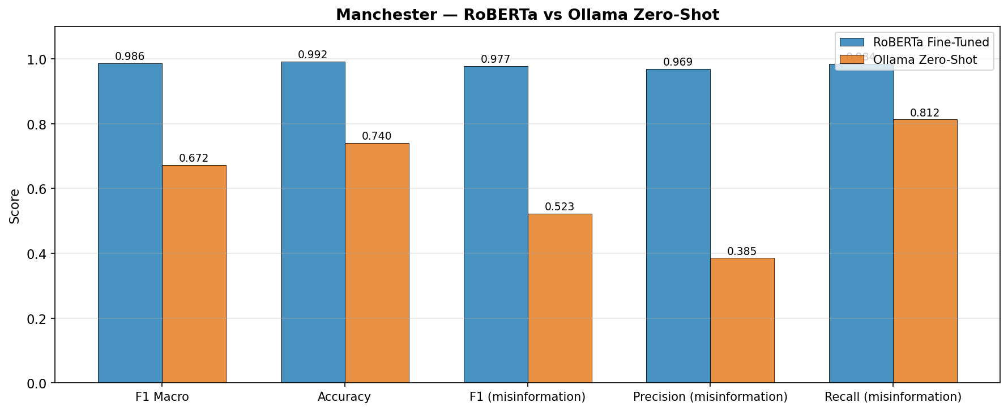
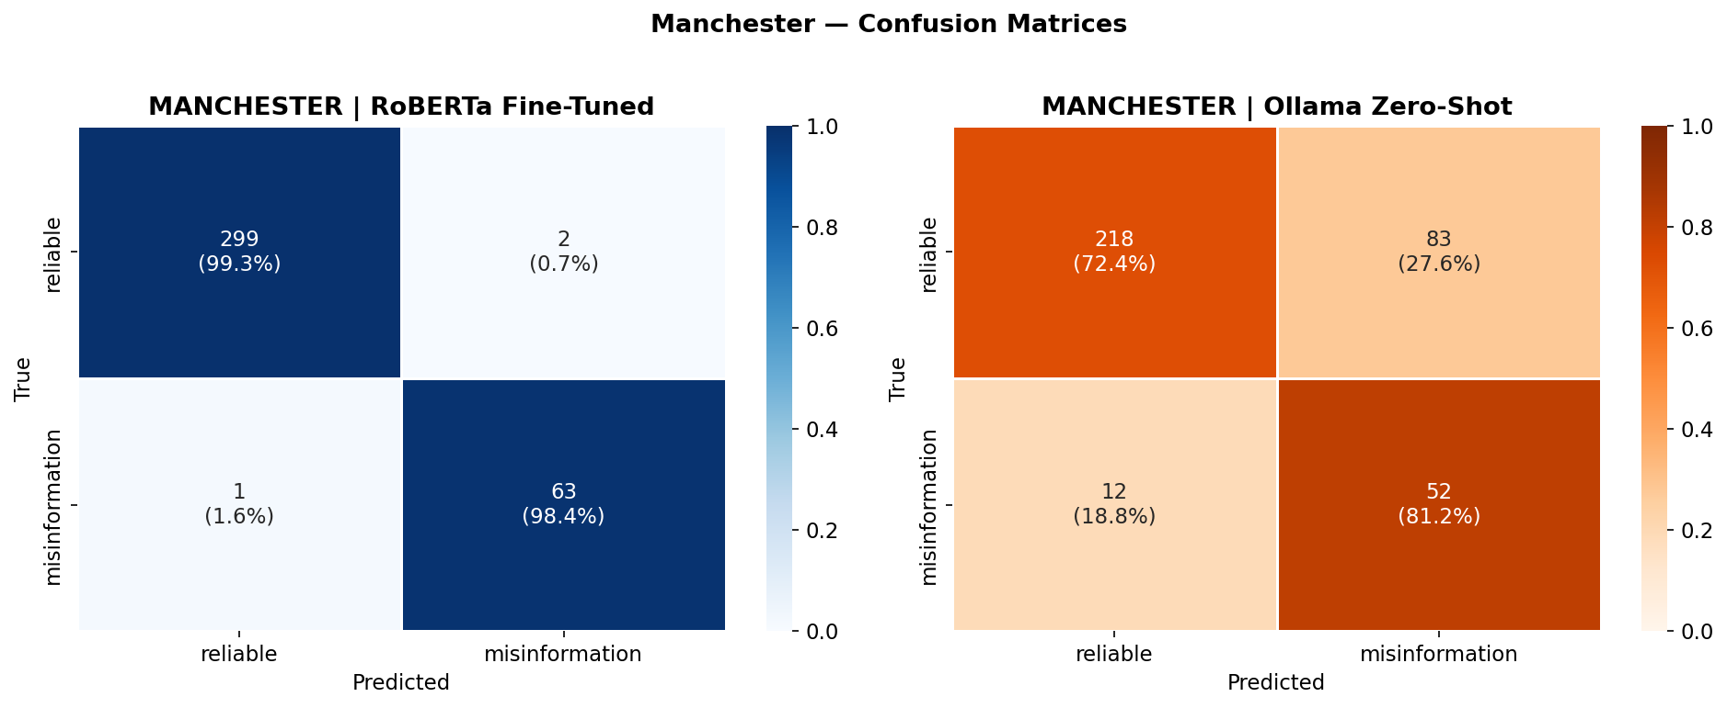
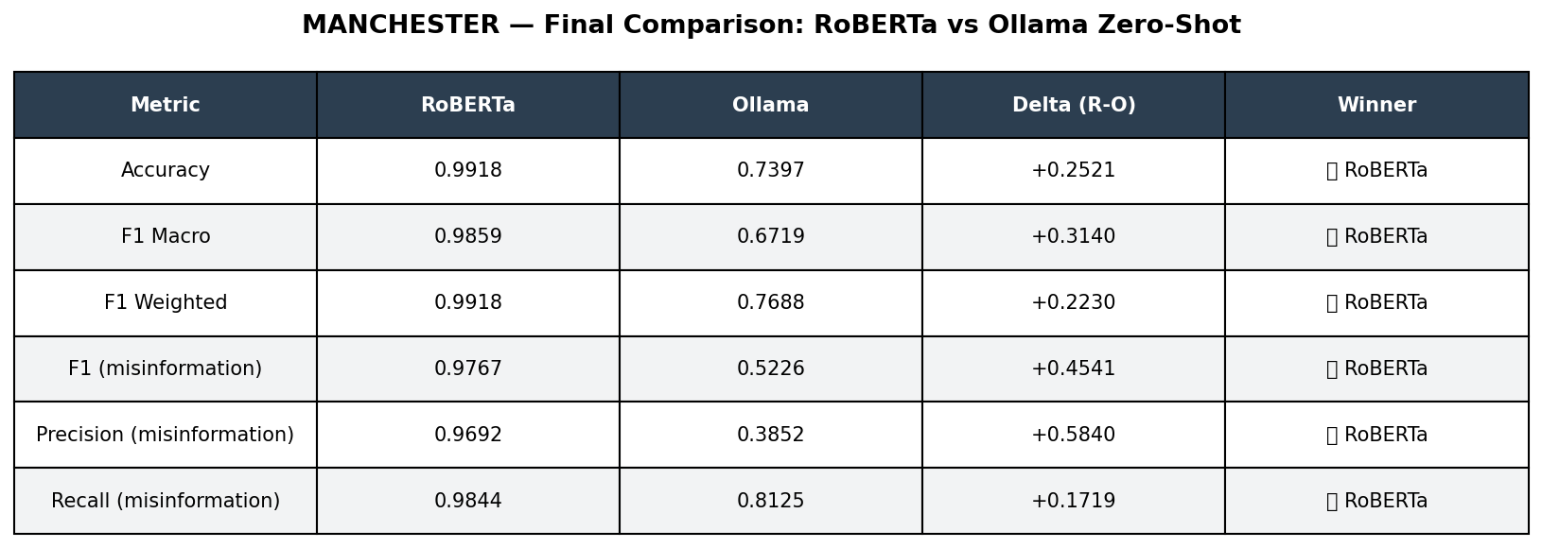
Results Comparison — RoBERTa vs Llama 3.1 Zero-Shot
Head-to-head on all three datasets
Manchester
Confusion Matrices (Manchester)
Manchester — Final Summary
💡 Key Finding
• RoBERTa wins all 3 datasets (F1 Macro: 0.986 / 0.913 / 0.598 vs Zero-Shot: 0.684 / 0.613 / 0.398) • Llama 3.1 8B Zero-Shot is competitive on Manchester & Monkeypox — with zero training examples • McNemar's Test confirms the differences are highly significant (p ≈ 3.4e-24 / 5e-29 / <1e-80)

Slide 10
Full Results — Side by Side
All metrics, both models, all datasets (test set)
Dataset
Model
F1 Macro
Accuracy
Precision
Recall
F1 (positive class)
Manchester
RoBERTa Fine-Tuned
0.986
0.992
0.989
0.983
—
Manchester
Llama 3.1 Zero-Shot
0.684
0.753
0.674
0.777
0.536
Monkeypox
RoBERTa Fine-Tuned
0.913
0.921
0.913
0.913
—
Monkeypox
Llama 3.1 Zero-Shot
0.613
0.613
0.685
0.682
0.616
PHEME
RoBERTa Fine-Tuned
0.598
0.822
0.627
0.586
—
PHEME
Llama 3.1 Zero-Shot
0.398
0.434
0.503
0.506
0.546
RoBERTa Fine-Tuned (125M, supervised)
Llama 3.1 8B Zero-Shot (Ollama, no training)
PHEME is hardest for both models — rumour detection requires event context that a single tweet rarely contains.

Slide 11
Validity — No Overfitting, No Data Leakage
Why our results can be trusted
🔒
Held-Out Test Set
🔁
5-Fold Cross-Validation
The test set (15%) was never touched during training, hyperparameter choice, or prompt design. Evaluated exactly once.
CV mean ≈ Test score (e.g. Manchester 0.961 CV vs 0.986 Test). A large gap would signal overfitting — we see none.
🛑
Early Stopping
⚖️
Class Weights, Not Oversampling
Training halts when validation F1 stops improving (patience=2). Prevents memorizing the training data.
No duplicated samples that could leak between folds. Imbalance handled in the loss function only.
🎲
Fixed Seed (42) + Stratified Splits
🧊
Zero-Shot Cannot Overfit
Same label ratio in every split, fully reproducible runs. Per-fold class weights computed from the training fold only.
The LLM saw no training data at all — its score is a true generalization measure, and temperature=0 makes it deterministic.

Slide 12
Summary & Next Steps
Phase 1 — Completed
🚀 Phase 2 — Planned
✅ 3 datasets preprocessed & Gold Standards created
🌐
GPT-OSS 120B (via Groq API)
✅ RoBERTa-base fine-tuned on each dataset (5-Fold CV)
OpenAI open-source, 120B params
✅ Zero-Shot with Llama 3.1 8B via Ollama (local)
🦙
Llama 3.3 70B (via Groq API)
✅ Full evaluation: F1 Macro, Confusion Matrices, McNemar test
Meta, 70B dense model
✅ Comparison figures & Master Results CSV generated
🧩
Qwen3 32B (via Groq API)
Alibaba, 32B with thinking mode
Goal: determine whether bigger models = better zero-shot performance (scaling law)
"The best model is the one that generalizes — with or without training."

