Slide 1

The Problem

Slide 2

Breath
Seriously, just breath.

Slide 3
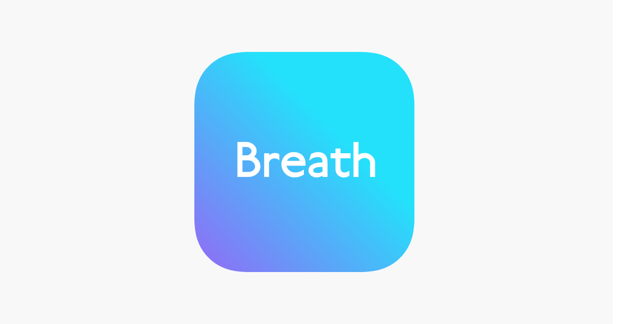

Powered by

Slide 4


Slide 5





How it works

Slide 6
Live Demo

Slide 7


