Slide 1






ShoreRestore
Imagining a cleaner ocean

Slide 2

Mission Statement
Beaches across the globe are one of the most heavily pollution impacted ecosystems
Our goal was to visualize the potential impact of littering clean beaches, and the potential success of cleaning dirty ones

Slide 3
Work Methodology
Modelling Tools
CycleGAN, UNIT, MUNIT -
We chose CycleGAN due to familiarity
Data Sources
Various open-source dirty/clean beaches datasets and scraped google images
Data Refinement
Filtered images by relevance and by image orientation and content

Slide 4
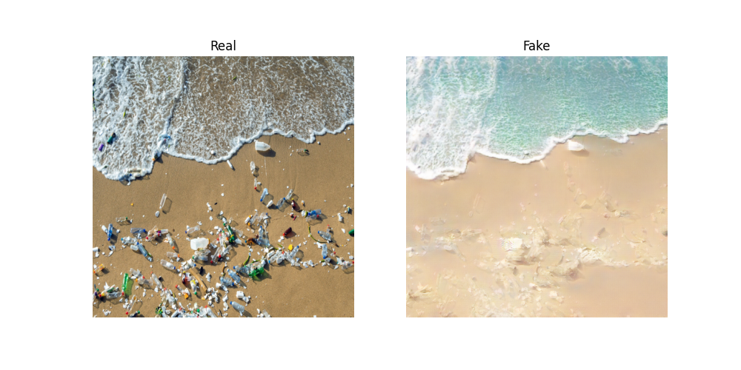
Model 2 – Extended Dirty Dataset

Slide 5
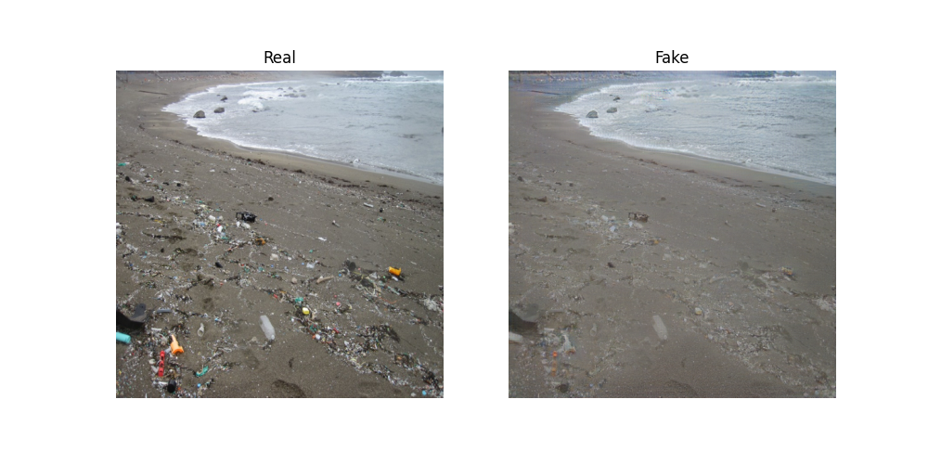
Model 2 – Extended Dirty Dataset

Slide 6
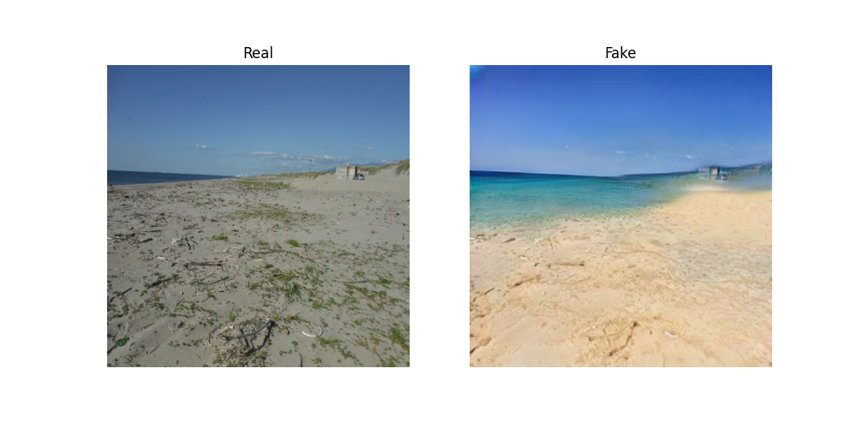
Model 3 – Extended Clean Dataset

Slide 7
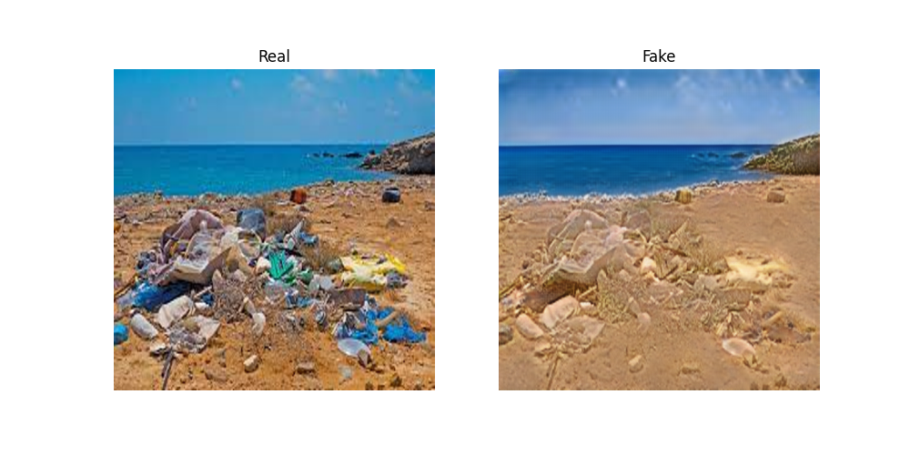
Model 3 – Extended Clean Dataset

Slide 8
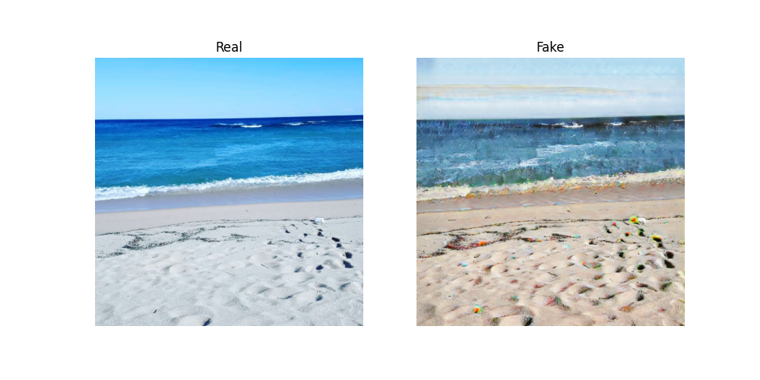
Model 3 – Extended Clean Dataset

Slide 9
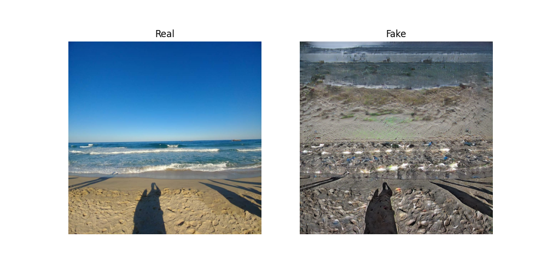
Model 3 – Extended Clean Dataset

Slide 10
What’s Next?
Attempt to improve clean2dirty transformation (harder task)
Further refine existing dataset
Experiment with alternative architectures
Develop an applicative solution to demonstrate our results (demo)

Slide 11
Demo
ShoreRestore

