Slide 1

1/20
DATA SCIENCE FINAL PROJECT
Data-Driven Bank Marketing
Term Deposit Prediction
Client Ranking for Campaign Prioritization
Presented by:
Rika Fadhilah Naufal
Yonkie Yudha Ardika
Notes:
Speaker Script (Bahasa Indonesia):
Pembuka: perkenalkan judul project dan use case. Tekankan bahwa tujuan project adalah membantu campaign manager memprioritaskan client untuk campaign term deposit berdasarkan data historis dan prediction score. Sebutkan nama presenter sesuai pembagian presentasi.

Slide 2
PRESENTATION FLOW
2/20
Agenda
01
Profile Group Intro
Project scope and stakeholder context
02
Problem Formulation
Business problem and ML target
03
Data Understanding
Stakeholder
Need
Define
Analyze
Model
Decide
Dataset, target, leakage, preprocessing
04
Findings and Solution
EDA, model, threshold, interpretation
05
Conclusion and Recommendation
Actionable decisions and next steps
Notes:
Speaker Script (Bahasa Indonesia):
Slide ini menjelaskan alur presentasi. Kita mulai dari konteks stakeholder dan masalah bisnis, lalu masuk ke data, insight EDA, pendekatan machine learning, dan terakhir rekomendasi yang bisa digunakan untuk keputusan campaign.

Slide 3
EXECUTIVE SUMMARY
3/23
Executive Summary
Background
Bank offers term deposits through direct marketing calls. Project focus: improve client prioritization for subscription campaigns.
41,188
11.27%
historical observations
positive class
Problem
Only 11.27% of observations converted, so campaign effort needs better prioritization.
AP 0.4810
0.60
Stakeholder
Marketing / Campaign Manager uses ranking output; CRM, Product, and Contact Center support execution.
test-set ranking
selective scenario
Goal
Predict subscription score before contact; target = y = yes, meaning client subscribes to term deposit.
Approach
Analytics + Machine Learning Classification using Gradient Boosting.
Main decision
Metric
Average Precision because positive class is imbalanced and subscriber ranking matters.
Use prediction score to prioritize clients before contact attempt.
Notes:
Slide ini merangkum keseluruhan project. Background-nya adalah direct marketing untuk produk term deposit. Problem utamanya adalah conversion rate historical hanya 11,27%, sehingga campaign perlu prioritas yang lebih terarah. Stakeholder utama adalah Marketing atau Campaign Manager. Target yang diprediksi adalah y = yes, yaitu client melakukan subscription. Pendekatannya menggabungkan Data Analytics dan Machine Learning Classification. Metric utama adalah Average Precision karena class subscriber sangat minoritas dan kita membutuhkan ranking client.

Slide 4
PROJECT CONTEXT
4/23
Profile Group Intro
Use case: term deposit subscription prediction for direct marketing campaign.
Primary stakeholder: Marketing / Campaign Manager.
Supporting stakeholders: CRM Team, Product Manager, Contact Center.
Team role: convert historical campaign data into client ranking support.
CRM
Team
Product
Manager
Marketing /
Campaign
Manager
Contact
Center
Analytics &
ML Team
Notes:
Project ini berada pada konteks direct marketing banking. Stakeholder yang paling membutuhkan output adalah Marketing atau Campaign Manager karena mereka perlu menentukan client mana yang diprioritaskan. CRM menyediakan konteks profile dan interaction history, Product Manager melihat product performance, Contact Center menjalankan call campaign, dan analytics team membantu mengubah data historis menjadi ranking support.

Slide 5
STAKEHOLDER PROBLEM FRAMING
5/23
Problem Formulation
Stakeholder need
Marketing teams need to prioritize clients before contact because only 11.27% converted.
ML problem
Predict each eligible client’s subscription score during campaign execution before contact attempt.
Stakeholder
need
Business
pain
Prioritization
gap
Data + ML
Operating
threshold
Output
Prediction score for client ranking and campaign prioritization.
Why machine learning is used
Many features interact: profile, campaign context, previous response, and economic context. The model converts these patterns into a ranking score.
Notes:
Masalah bisnisnya bukan sekadar memprediksi ya atau tidak, tetapi membantu campaign team menentukan prioritas sebelum contact attempt dilakukan. Karena hanya 11,27% historical observations menghasilkan subscription, jika semua client diperlakukan sama maka effort campaign menjadi kurang terarah. Machine learning digunakan karena banyak feature yang saling berinteraksi, sehingga model dapat menghasilkan score untuk ranking.

Slide 6
DATASET & COLUMN MEANING
6/23
Data Understanding
Source: Bank Marketing Campaign Dataset from historical direct-marketing calls.
Unit of analysis: one client observation in campaign context.
41,188 observations, 21 columns: 20 candidate features + 1 target.
Target y: yes = subscription, no = no subscription.
No external data joined for modeling; external contact-cost benchmark only supports business scenario impact.
Client profile
Financial profile
age, job, marital, education
default, housing, loan
Campaign context
contact, month, day_of_week, duration, campaign
Previous campaign
Economic indicators
pdays, previous, poutcome
emp.var.rate, cons.price.idx, cons.conf.idx, euribor3m, nr.employed
Target
y = term deposit outcome
Notes:
Bagian data understanding dimulai dari sumber dan unit analisis. Satu baris data merepresentasikan satu observasi client dalam konteks campaign, bukan unique customer karena tidak ada client ID. Total terdapat 41.188 observasi dan 21 kolom. Feature dibagi menjadi profile, financial, campaign context, previous campaign, dan economic indicators. Tidak ada external data yang digabung untuk modeling; external benchmark hanya digunakan untuk business scenario cost.

Slide 7
DATA UNDERSTANDING
7/23
Attribute Reference
Feature group
Attributes
Business meaning
Client & Financial
age, job, marital, education; default, housing, loan
Client background and loan/default context.
Campaign Context
contact, month, day_of_week, campaign
Channel, timing, and number of current campaign contacts.
Leakage Diagnostic
duration
Call duration; excluded because it is known only after contact finishes.
Previous Campaign
pdays, previous, poutcome
Prior contact recency, prior count, and previous campaign result.
Economic Indicators
emp.var.rate, cons.price.idx, cons.conf.idx, euribor3m, nr.employed
Macro-economic context during campaign period.
Target
y
Term deposit subscription outcome: yes or no.
Notes:
Attribute reference ini membantu menjelaskan arti setiap kelompok kolom. Feature duration memang ada di dataset, tetapi hanya digunakan sebagai leakage diagnostic dan tidak masuk pre-contact model. Feature pdays, previous, dan poutcome penting karena membawa informasi dari previous campaign. Economic indicators penting karena hasil EDA dan model interpretation menunjukkan sinyal yang cukup kuat.

Slide 8
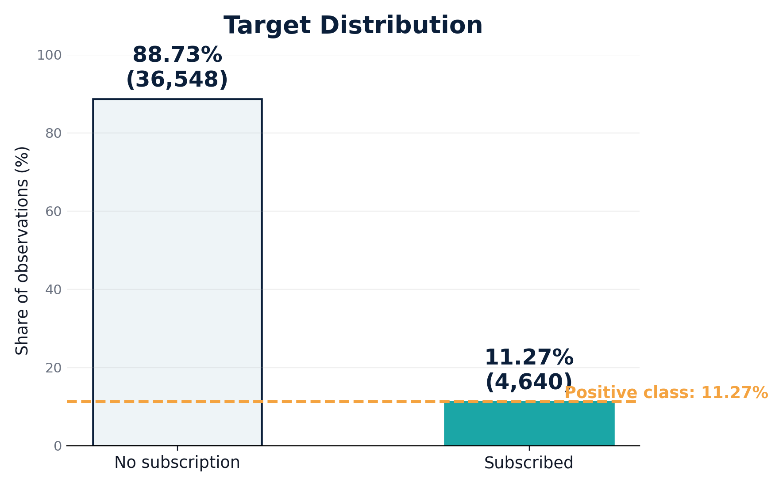
DATASET TARGET IMBALANCE
8/23
Target Is Strongly Imbalanced
Positive class: 4,640 observations or 11.27% subscribed.
Majority class: 36,548 observations or 88.73% did not subscribe.
Accuracy alone can look high while failing to detect subscribers.
Metric rationale
Use Average Precision to focus on Precision–Recall behavior for subscribers.
Notes:
Target y sangat imbalanced. Hanya 4.640 observasi atau 11,27% yang subscribe, sedangkan 88,73% tidak subscribe. Karena itu, accuracy saja tidak cukup. Model bisa terlihat akurat hanya dengan menebak mayoritas no, tetapi gagal menemukan subscriber. Maka metric utama yang digunakan adalah Average Precision.

Slide 9
SELECTED FEATURE DISTRIBUTION
9/23
Special Values Shape the Feature Engineering
Only the most relevant distributions are shown here because they directly affect preprocessing and feature engineering.
Distribution insight
`pdays = 999` and `poutcome = nonexistent` are structural signals, not ordinary missing values.
pdays = 999
96.3%
Feature engineering decision
poutcome = nonexistent
86.3%
`pdays` is transformed into previous-contact information instead of treated as a normal continuous variable.
default = unknown
20.9%
unknown in ≥1 profile/loan feature
26.0%
Cleaning decision
`unknown` is retained because it can carry semantic information in historical campaign data.
Notes:
Slide ini menambahkan distribusi feature yang paling relevan. Nilai pdays = 999 muncul sangat dominan, yaitu 96,32%, dan artinya client belum pernah dihubungi pada previous campaign. Poutcome = nonexistent juga dominan karena banyak client tidak punya previous campaign outcome. Karena nilai-nilai ini memiliki makna bisnis, kita tidak menganggapnya sebagai missing value biasa.

Slide 10
REASONING TO REDUCE BIAS & LEAKAGE
10/23
Data Cleaning & Feature Engineering
Raw
data
Feature
availability
Feature
engineering
Preprocess
Model-ready
matrix
Exclude
Engineer
Retain
Encode & Scale
`duration` is post-contact leakage; not available before contact finishes.
`pdays = 999` means no previous contact; transformed into previous-contact information.
`unknown` and `nonexistent` have semantic / structural meaning; not ordinary NaN.
OHE/Binary encoding; Robust/Standard scaler based on distribution and cardinality.
Notes:
Data cleaning dan feature engineering dirangkum dalam flow. Pertama, feature availability dicek berdasarkan scoring time. Duration dihapus karena baru diketahui setelah call selesai. Pdays tidak langsung digunakan sebagai angka biasa karena 999 punya makna tidak pernah dihubungi sebelumnya. Unknown dan nonexistent dipertahankan karena memiliki makna semantik atau struktural. Encoding dan scaling dipilih berdasarkan cardinality, distribusi, dan business meaning.

Slide 11
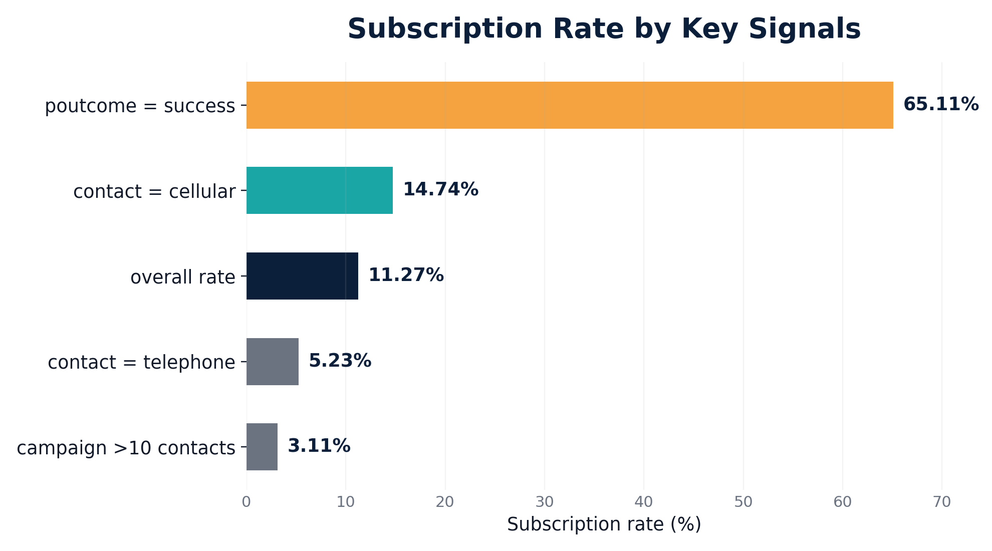
EDA: FEATURE VS TARGET
11/23
Previous Success Is the Strongest Signal
Previous campaign success has 65.11% subscription rate.
Cellular contact shows higher rate than telephone contact.
Repeated contacts do not show higher historical subscription rate.
Patterns are descriptive associations, not causal rules.
Business cue
Use previous response and contact history as supporting context, not standalone targeting rules.
Notes:
Dari EDA, signal paling kuat secara descriptive adalah previous campaign success. Subscription rate untuk poutcome success mencapai 65,11%, jauh di atas overall rate 11,27%. Cellular contact juga memiliki subscription rate lebih tinggi dibanding telephone. Namun semua ini bersifat asosiasi, bukan bukti sebab-akibat. Karena itu, temuan ini dipakai sebagai supporting context.

Slide 12
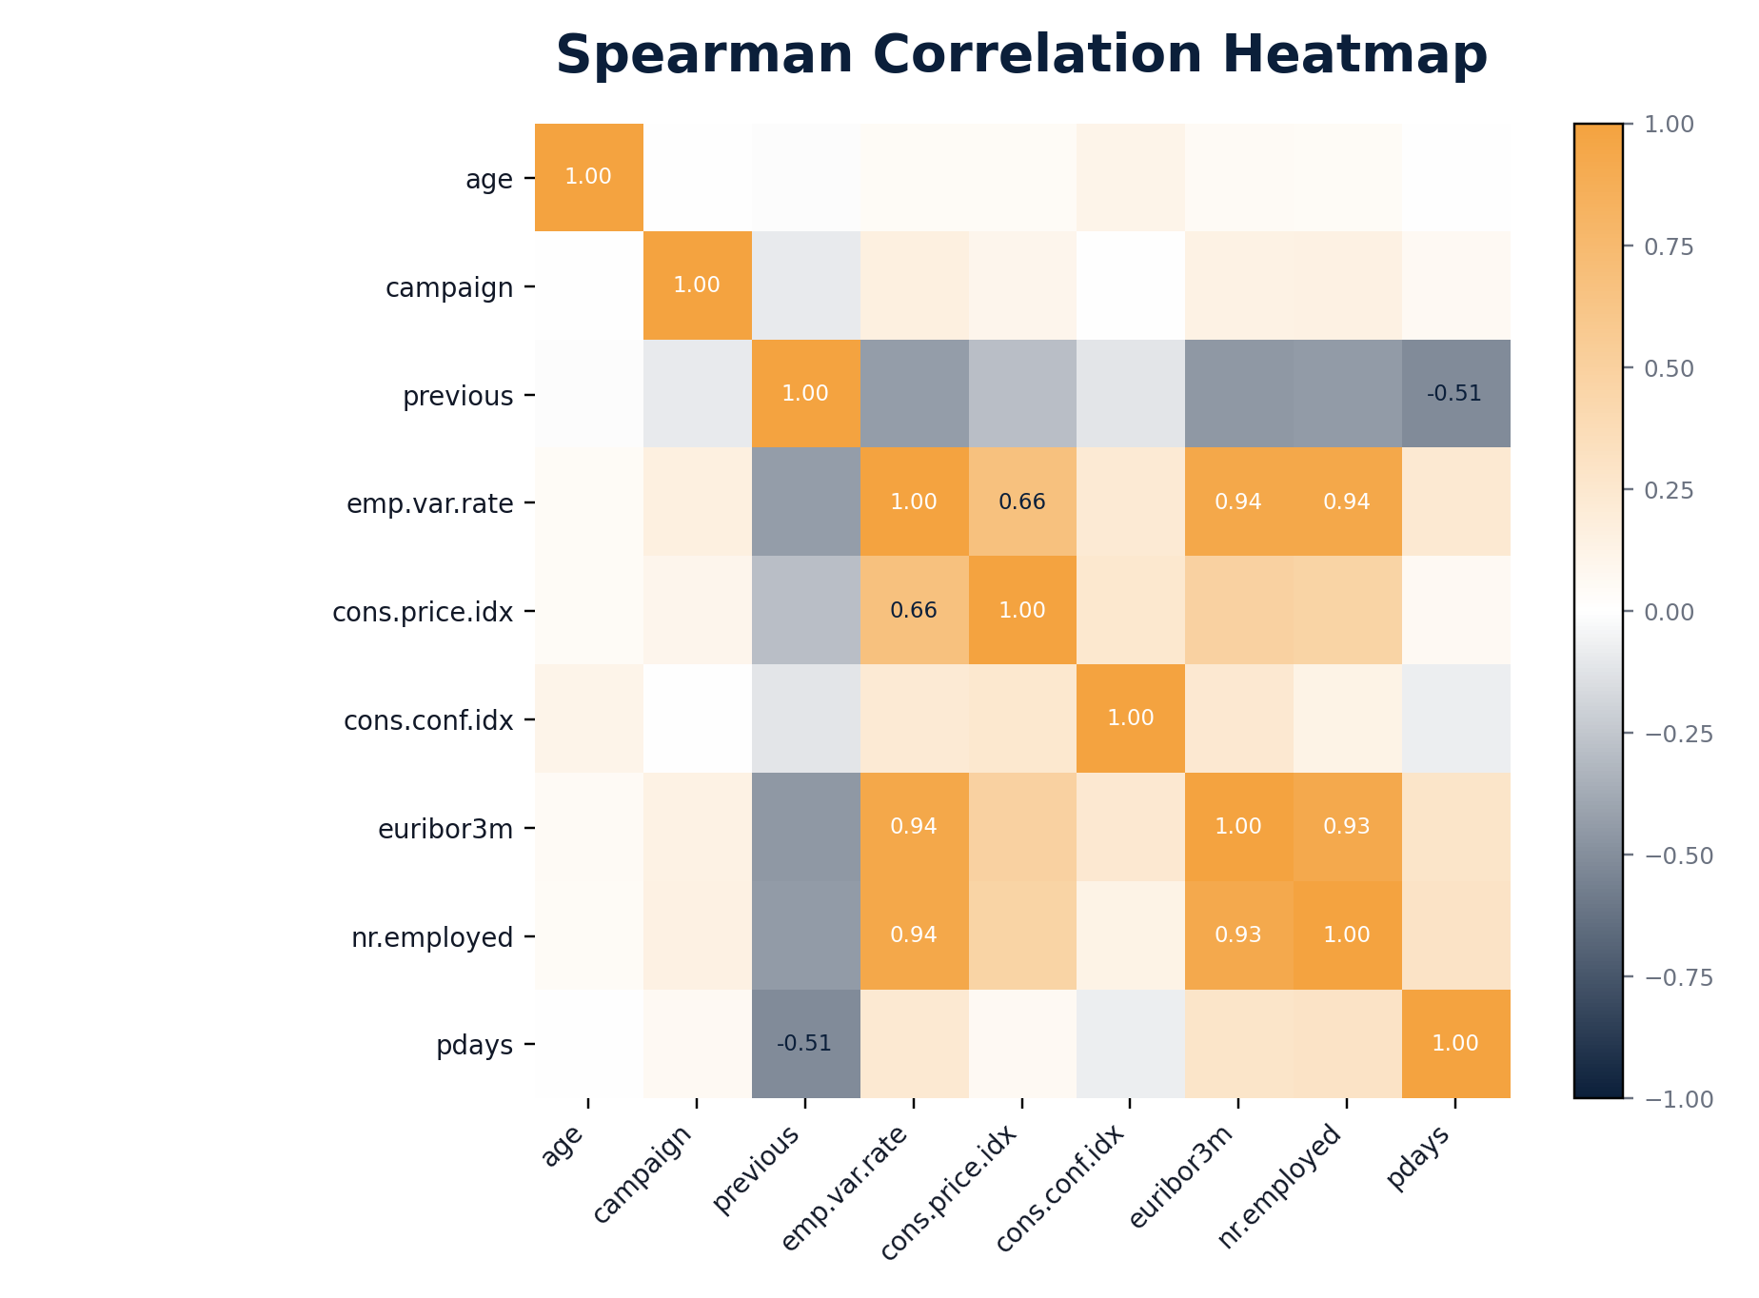
EDA: MULTIVARIATE RELATIONSHIP
12/23
Economic Signals Move Together
`emp.var.rate`, `euribor3m`, and `nr.employed` are strongly correlated.
They carry overlapping information about macro conditions.
Correlation explains feature movement, not causal impact.
Implication
Monitor economic distributions when comparing campaign performance across periods.
Notes:
Multivariate analysis menggunakan Spearman correlation karena beberapa numerical features skewed dan memiliki extreme values. Economic indicators seperti emp.var.rate, euribor3m, dan nr.employed sangat berkorelasi. Artinya, feature ini membawa informasi yang overlapping tentang kondisi ekonomi. Karena itu interpretasi model harus hati-hati dan monitoring distribution perlu dilakukan ketika campaign berbeda periode.

Slide 13
ANALYTICAL APPROACH
13/23
Analytics + Classification Model
Analytics identifies client, campaign, and economic patterns.
Machine learning generates prediction score for prioritization.
Average Precision is used for model selection due to imbalanced target.
Threshold is treated as an operating scenario, not a universal optimum.
Training flow
Raw training
data
Random
Oversampling
Feature
engineering
Preprocess
Gradient
Boosting
Scoring flow
Eligible
clients
Feature
engineering
Preprocess
Gradient
Boosting
Prediction
score
Leakage control
Random Oversampling is applied only inside training folds; validation/test data remains unchanged.
Notes:
Pendekatan analytical terdiri dari dua bagian. Analytics digunakan untuk memahami pola dalam data, sedangkan model classification digunakan untuk menghasilkan prediction score. Di training flow, Random Oversampling hanya diterapkan pada training fold agar minority class lebih terlihat oleh model. Di scoring flow, oversampling tidak digunakan; eligible clients masuk ke feature engineering, preprocessing, Gradient Boosting, lalu menghasilkan prediction score.

Slide 14
MODEL SELECTION FROM CROSS-VALIDATION
14/23
Gradient Boosting + ROS Has the Best CV AP
Models were compared using the same training data, preprocessing pipeline, and 5-fold Stratified Cross Validation. AP is the primary model-selection metric.
Naive baseline
0.1127
Selected model
Base Gradient Boosting + Random Oversampling
LogReg
0.4421
GB no treatment
0.4607
Tuning result
Tuned configuration did not improve AP.
GB + ROS
0.4634
Decision
Tuned GB + ROS
0.4625
Use base configuration because AP is slightly higher and simpler.
Notes:
Slide ini menunjukkan pemilihan model berbasis cross-validation. Semua model dibandingkan dengan protocol yang sama. Naive baseline hanya menghasilkan AP sekitar 0,1127. Gradient Boosting tanpa treatment sudah baik, tetapi Gradient Boosting dengan Random Oversampling menghasilkan 5-fold CV AP tertinggi, yaitu 0,4634. Tuning sudah dicoba, tetapi AP menjadi 0,4625, sehingga base configuration dipertahankan.

Slide 15
SELECTED MODEL PERFORMANCE
15/23
Selected Model Generalizes to Test Data
0.4634
0.4810
0.8140
5-fold CV AP
Untouched test AP
Untouched test ROC-AUC
Metric rationale
AP focuses on Precision–Recall behavior for subscribers under class imbalance.
Selected model: Base Gradient Boosting + Random Oversampling.
Test-set AP is consistent with cross-validation, supporting client ranking on unseen data.
Average Precision remains the main metric because the positive class is only 11.27%.
Notes:
Final model dievaluasi pada untouched test set. Hasilnya AP 0,4810 dan ROC-AUC 0,8140. Test AP ini masih sejalan dengan 5-fold CV AP 0,4634, sehingga model cukup konsisten untuk ranking pada unseen data. Average Precision tetap menjadi metric utama karena fokus pada subscriber sebagai positive class yang minoritas.

Slide 16
MODEL MECHANICS
16/23
How the Final Model Works
Gradient Boosting builds decision trees sequentially.
Each tree learns remaining prediction errors from previous trees.
Random Oversampling increases minority-class exposure during training folds only.
Final model outputs a score for ranking, not an automatic business decision.
Tree 1
initial pattern
Tree 2
correct errors
Tree 3...
refine
Combined
prediction
Final configuration
n_estimators = 100
learning_rate = 0.10
max_depth = 3
random_state = 42
Tuning decision
Tuned configuration was evaluated, but base configuration retained because AP was slightly higher and simpler.
Notes:
Gradient Boosting bekerja dengan membangun pohon keputusan secara bertahap. Setiap tree berikutnya belajar dari error tree sebelumnya. Random Oversampling membantu menambah exposure positive class hanya selama training folds. Final model menghasilkan score, bukan keputusan otomatis. Decision business tetap membutuhkan threshold, capacity, dan rule dari stakeholder.

Slide 17
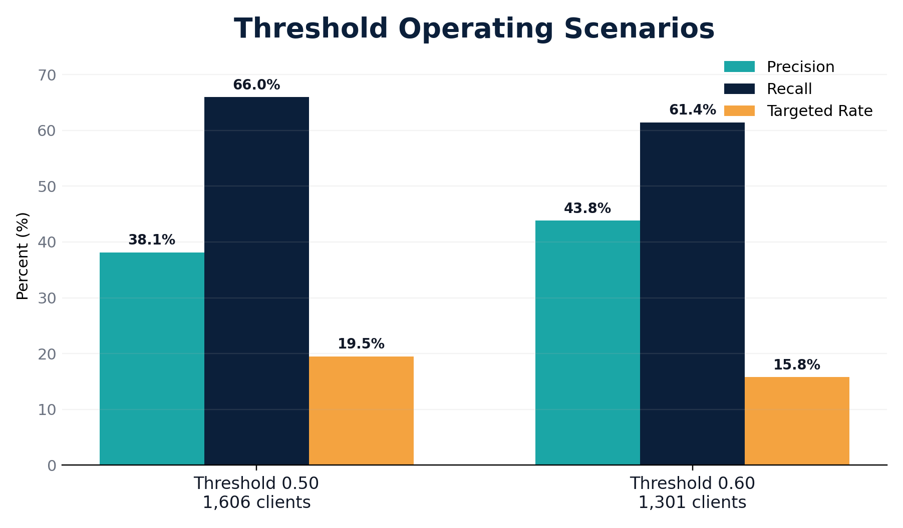
OPERATING THRESHOLD TRADE-OFF
17/23
0.50 Covers More; 0.60 Is More Selective
0.50
0.60
Recall 65.95%
1,606 clients
Precision 43.81%
1,301 clients
Threshold 0.50 captures more actual subscribers.
Threshold 0.60 reduces target pool and improves precision.
Final cut-off depends on campaign capacity and business priority.
Notes:
Threshold bukan universal optimum. Pada threshold 0,50, recall lebih tinggi dan lebih banyak actual subscriber tertangkap, tetapi target pool lebih besar. Pada threshold 0,60, target pool lebih kecil dan precision lebih tinggi. Jadi pemilihan threshold harus disesuaikan dengan kapasitas campaign dan prioritas bisnis.

Slide 18
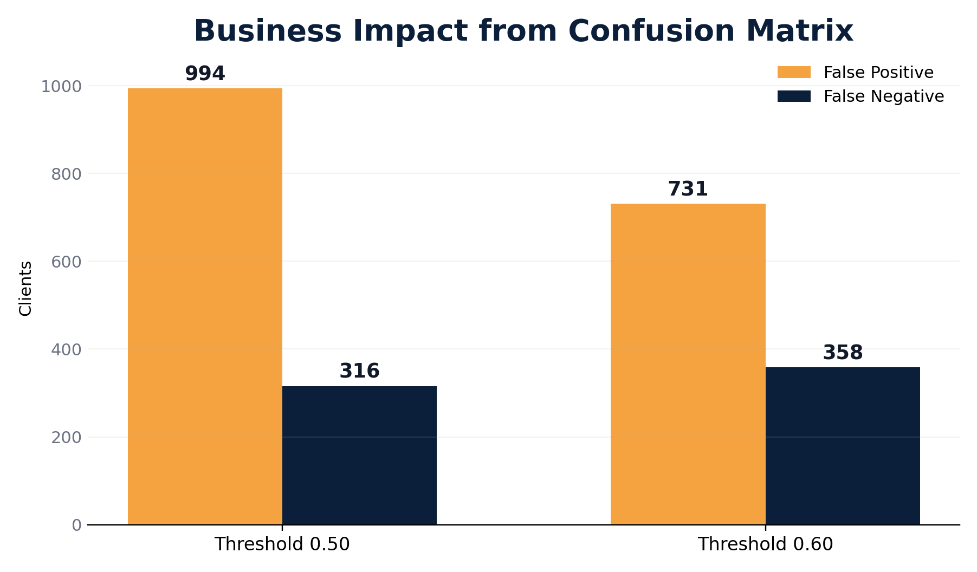
BUSINESS IMPACT FROM CONFUSION MATRIX
18/23
0.60 Reduces 263 False Positives
Moving from 0.50 to 0.60 reduces FP from 994 to 731.
Illustrative FP contact-cost reduction: USD 1,315 at USD 5/contact.
Sensitivity scenario: USD 2,393.30 reduction at USD 9.10/contact.
Trade-off: FN increases from 316 to 358, or 42 additional missed subscribers.
Business impact caveat
Actual pre-ML campaign cost baseline is unavailable. Impact is evaluated through illustrative operating scenarios.
Notes:
Business impact dihitung dari confusion matrix dan contact-cost scenario. Jika threshold dinaikkan dari 0,50 ke 0,60, false positive turun dari 994 menjadi 731. Dengan asumsi USD 5 per contact, potential unnecessary contact cost turun sekitar USD 1.315. Dengan sensitivity cost USD 9,10, reduction sekitar USD 2.393,30. Namun trade-off-nya adalah false negative naik 42 actual subscribers. Karena baseline cost sebelum ML tidak tersedia, ini tetap disebut illustrative scenario.

Slide 19
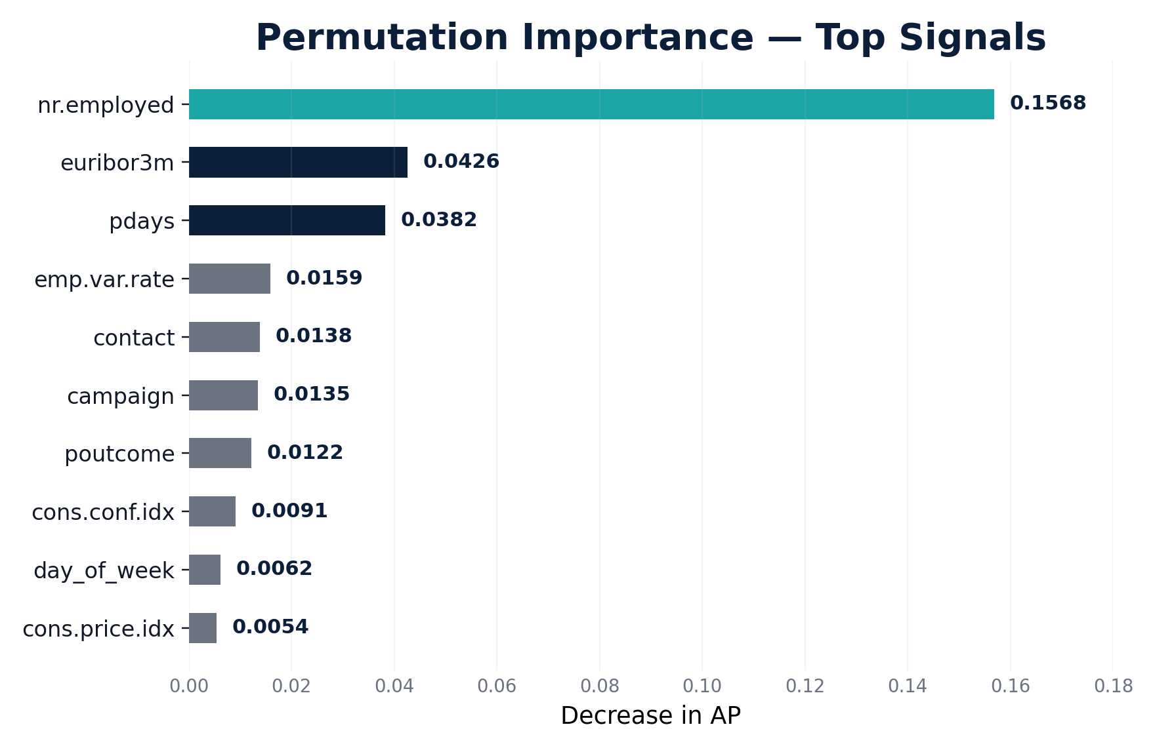
MODEL INTERPRETATION
19/23
Economic Indicators Are Major Predictive Signals
Permutation Importance and SHAP use different definitions of importance.
Both methods consistently highlight economic indicators as major predictive signals.
`pdays` is interpreted through feature engineering as previous-contact history.
Interpretation is predictive and associational, not causal.
Major signals
nr.employed, euribor3m, pdays, emp.var.rate, contact, campaign, poutcome.
Notes:
Untuk model interpretation, permutation importance menunjukkan feature mana yang paling menurunkan AP ketika diacak. SHAP digunakan sebagai explanation tambahan pada transformed features. Keduanya konsisten menunjukkan bahwa economic indicators menjadi major predictive signals. Namun ini tetap predictive dan associational, bukan causal. Pdays harus dibaca sebagai previous-contact history karena sudah melalui feature engineering.

Slide 20
MODEL LIMITATION & DATA GAPS
20/23
Use Within Similar Campaign Context
Temporal generalization
No revenue / CLV
Dataset reflects one historical campaign context; performance may shift across periods.
Dataset does not contain revenue per subscription, deposit value, or customer profitability.
No unique client ID
Conditional features
Rows represent campaign observations, not necessarily unique customers.
`contact`, `month`, `day_of_week`, and `campaign` depend on scoring-time availability.
Alternative models evaluated
Potential additional data
Logistic Regression, Random Forest, Extra Trees, Gradient Boosting, class weighting, and Random Oversampling were compared.
Campaign capacity, actual contact cost, revenue per subscription, deposit amount, and customer profitability / CLV.
Notes:
Limitasi utama model adalah temporal generalization karena data berasal dari satu konteks campaign historis. Dataset juga tidak memiliki revenue per subscription, deposit value, profitability, atau CLV, sehingga tidak bisa menghitung ROI. Tidak ada unique client ID, sehingga row merepresentasikan observation. Beberapa feature juga conditional tergantung scoring time. Alternatif model sudah dievaluasi, tetapi tidak mengalahkan Gradient Boosting plus ROS pada CV AP.

Slide 21
CONCLUSION
21/23
What We Learned
Diagnostic insights
Predictive solution
Decision implication
Previous success is a strong historical signal.
Repeated contacts need review, not automatic escalation.
Economic conditions affect interpretation across periods.
Base Gradient Boosting + ROS selected.
Test AP 0.4810; ROC-AUC 0.8140.
Prediction score supports client ranking.
0.50 prioritizes coverage.
0.60 improves selectivity.
Final threshold depends on capacity and business priorities.
Overall conclusion
Combine historical response, campaign context, economic conditions, and prediction score for more focused campaign prioritization.
Notes:
Kesimpulannya, secara diagnostic previous campaign success adalah signal historis yang kuat, repeated contacts perlu direview, dan economic conditions perlu dimonitor. Secara predictive, model Gradient Boosting plus Random Oversampling dipilih dengan test AP 0,4810 dan ROC-AUC 0,8140. Secara keputusan bisnis, threshold 0,50 cocok untuk coverage, sedangkan 0,60 lebih selective.

Slide 22
ACTIONABLE RECOMMENDATIONS
22/23
Turn Scores into Campaign Decisions
1
Rank eligible clients
Score clients before contact and prioritize highest prediction score within campaign capacity.
Coverage-oriented
Threshold 0.50 • 1,606 clients
Use when campaign capacity is larger.
2
Use historical response as context
Use `poutcome` and contact history for segmentation support, not standalone rule.
3
Review repeated contacts
Flag high-contact-count clients and review score before additional attempts.
Efficiency-oriented
Threshold 0.60 • 1,301 clients
Use when campaign capacity is tighter.
4
Monitor economic context
Track economic feature distribution and model performance across campaign periods.
Final threshold
Reflect actual campaign capacity, eligibility rules, observed performance, and business priorities.
Notes:
Recommendation dibuat langsung dari hasil analisis. Pertama, gunakan prediction score untuk ranking eligible clients sebelum contact. Kedua, gunakan previous response dan contact history sebagai konteks segmentation. Ketiga, review client dengan repeated contacts sebelum additional attempts. Keempat, monitor economic context dan model performance antar periode. Threshold final harus disesuaikan dengan kapasitas campaign dan observed performance.

Slide 23
23/23
CLOSING
Thank You
Questions & Discussion
Data-Driven Bank Marketing
Term Deposit Prediction
Notes:
Terima kasih. Sampai di sini, kesimpulan utama kami adalah prediction score dapat membantu campaign team membuat prioritas client yang lebih terarah. Kami siap menerima pertanyaan dan diskusi.

