Slide 1




Beat Google!
Group 17
企管三詹又霓、會計四蘇奕丞
統計四何季蓉、會計四許祐齊

Slide 2
01
Motivation
02
Code Design
目 錄Contents
03
Web Result

Slide 3
Motivation

Slide 4
Analysis
01
Issues
Lots of Novels adapt to dramas
such as 神鵰俠侶
02
We can only find the film version on the first page of Google
Result
03
Make search engine for novel lovers
With only the result of novels
Solution
Notes:
Our search engine is designed for novel lovers. Nowadays there are more and more novel. After the adaptation we ca

Slide 5
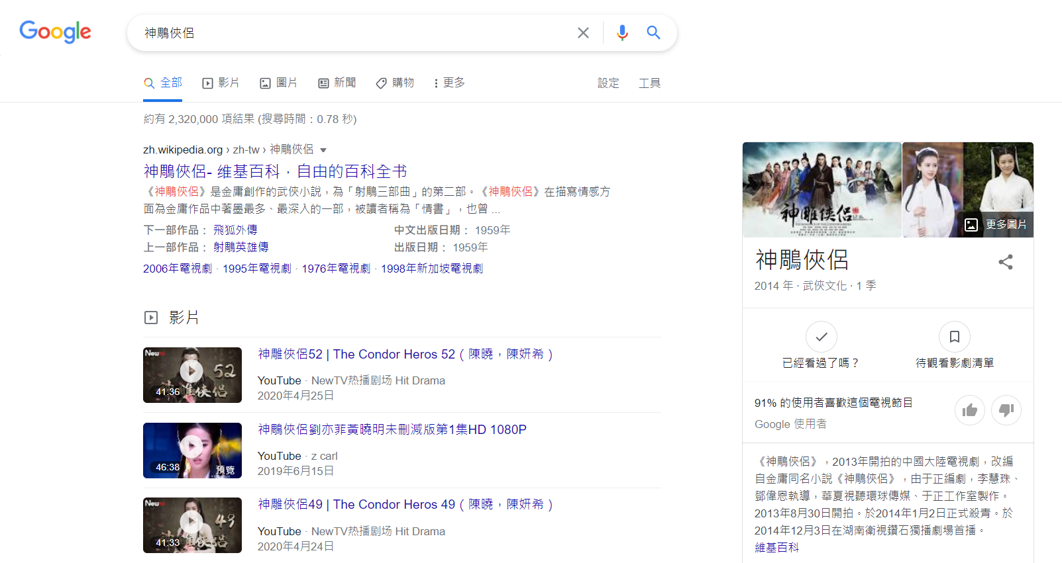
Page of google
search result

Slide 6
Code Design

Slide 7
Keyword
Word Counter
01
Class to save keyword, appear numbers and its weight
01
Count keyword with a URL
02
02
First fetch the content from the URL
With its name, count, weight
03
03
Then count it with the keyword we set
Ex : [小說, 10, 20]

Slide 8
Score Ranking
("小說", 0, 10)
("書評", 0, 1)
("電子書", 0, 8)
("演員", 0, -2)
("書名", 0, 5)
("主演", 0, -3)
("文字", 0, 3)
("視頻", 0, -5)
("作者", 0, 2)
("電影", 0, -6)

Slide 9
WebPage
WebPage Query
Count all the keywords we set within a single webpage(URL)
01
01
Get the connection of the subpage with URL
02
Fetch the content of subpage
Get the total score of this webpage
02
03
We will get the URLs in each subpage
04
We save this in a hashmap

Slide 10
Web Node
Webnode Comparator
01
A linked structure for tree
Compare each nodes’score
01
01
02
Element : WebPage
03
Parent Node
04
Children Node

Slide 11
URL Encode
Google Query
Change the code of URL to UTF-8
Get the connection of the google search page with keyword
01
01
02
Fetch the content of searching result
03
We will get the search result with a lot of URLs and their title
04
We save this in a hashmap

Slide 12
Web Tree
Test Project
01
Set the root for the webtree
01
Get the request of searching keyword
Count the score of the webpage and its subpage
Connect the HTML page we design
02
02
Make the ranking of our result
Show our ranking result in the HTML page
03
03

Slide 13
Search
Google item
The searching page we design with CSS and Html
The presenting page that shows the precise result with ranking
01
01
Which can type in the keyword we will like to search
02
02
Through CSS and Html

Slide 14
Web Result

Slide 15
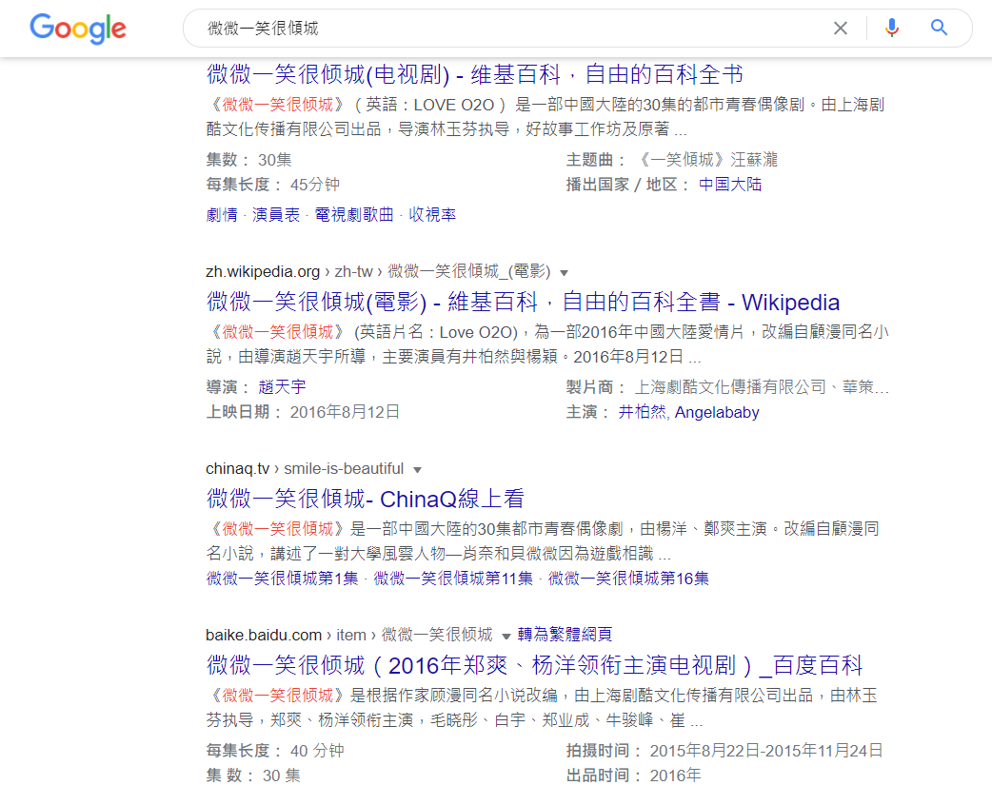
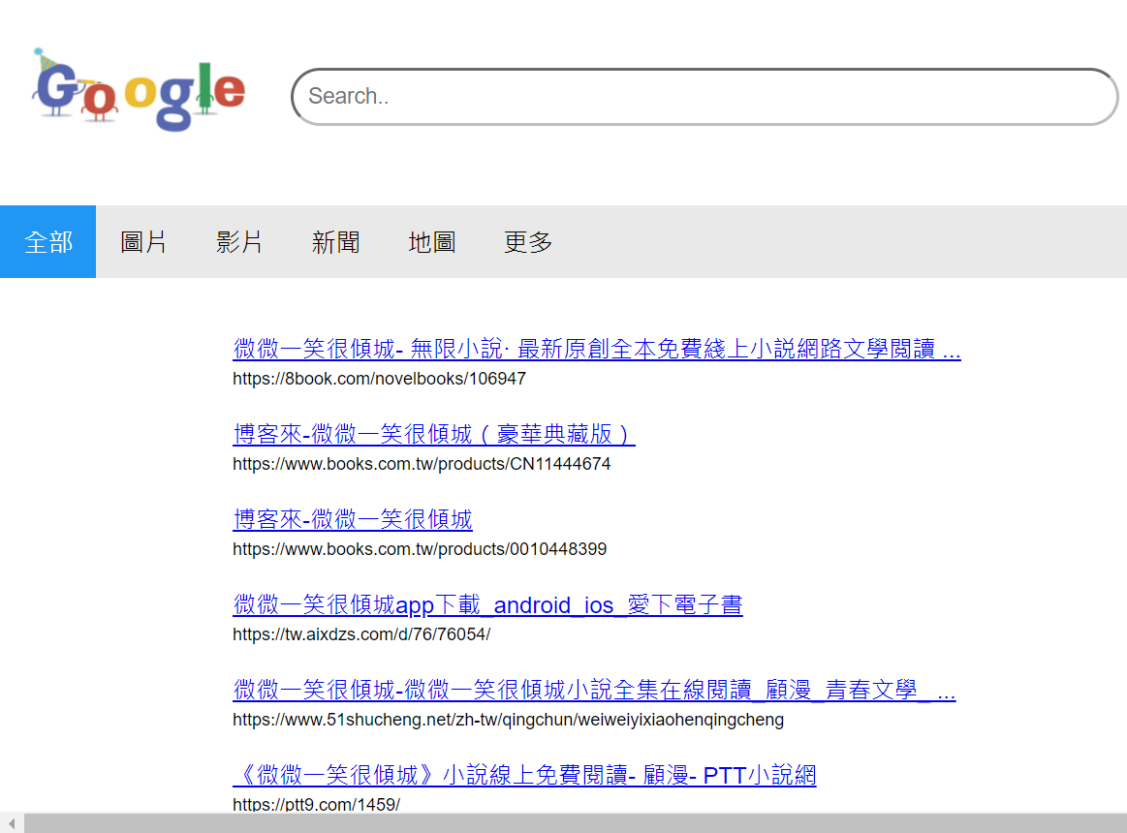
Our Result

Slide 16
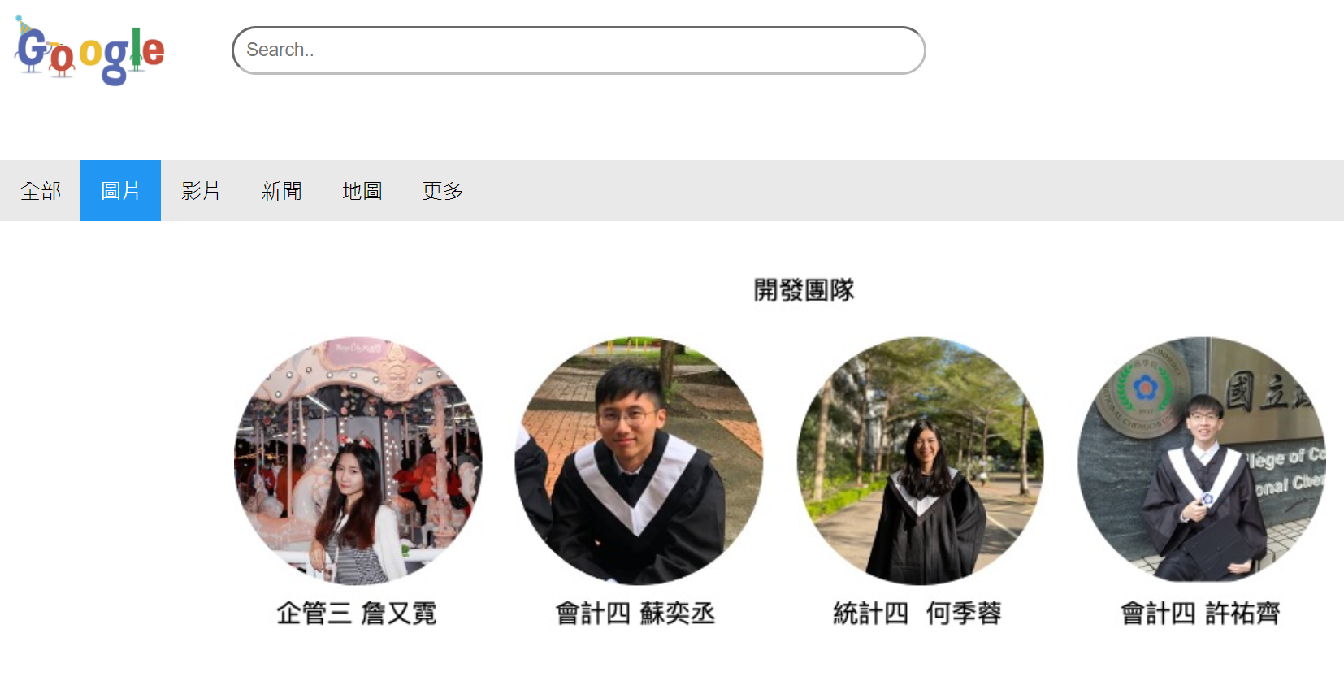
Additional Function

Slide 17
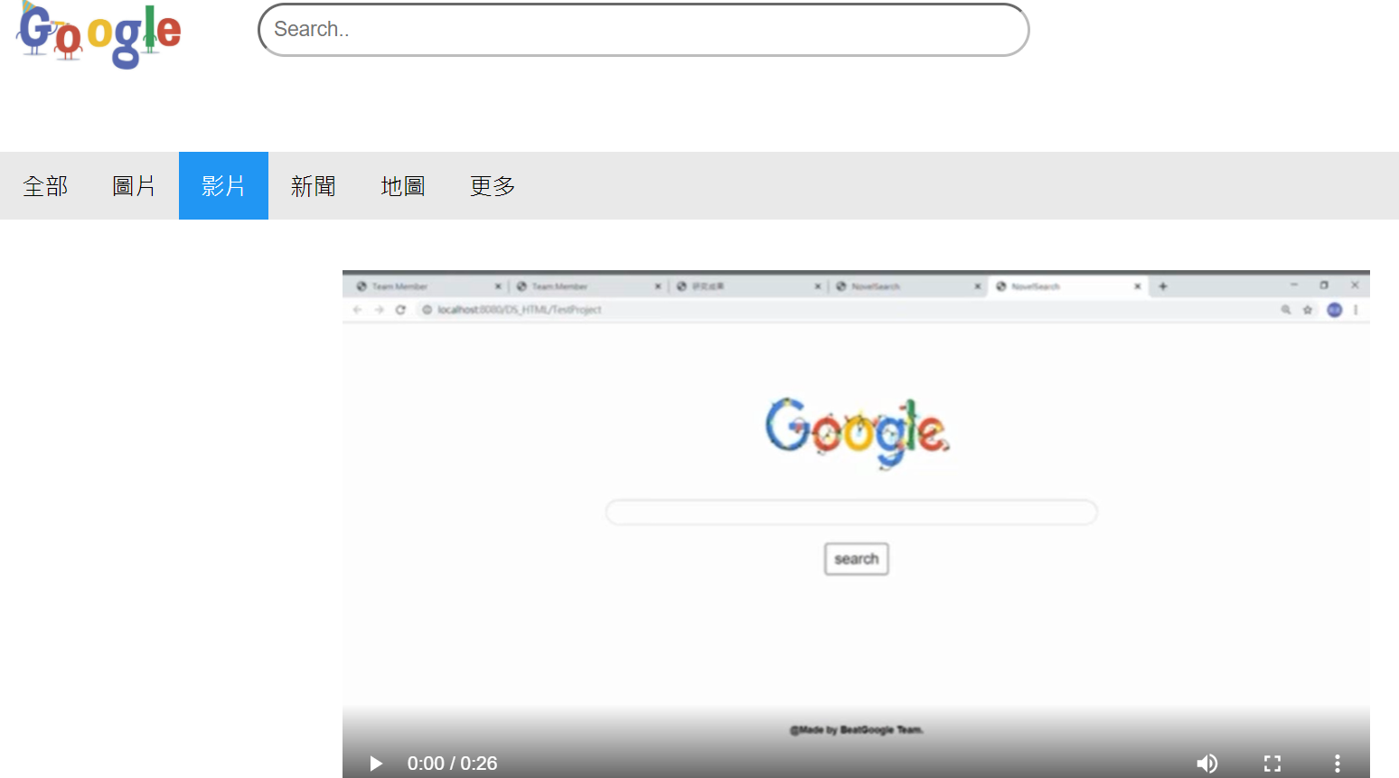
Additional Function

Slide 18
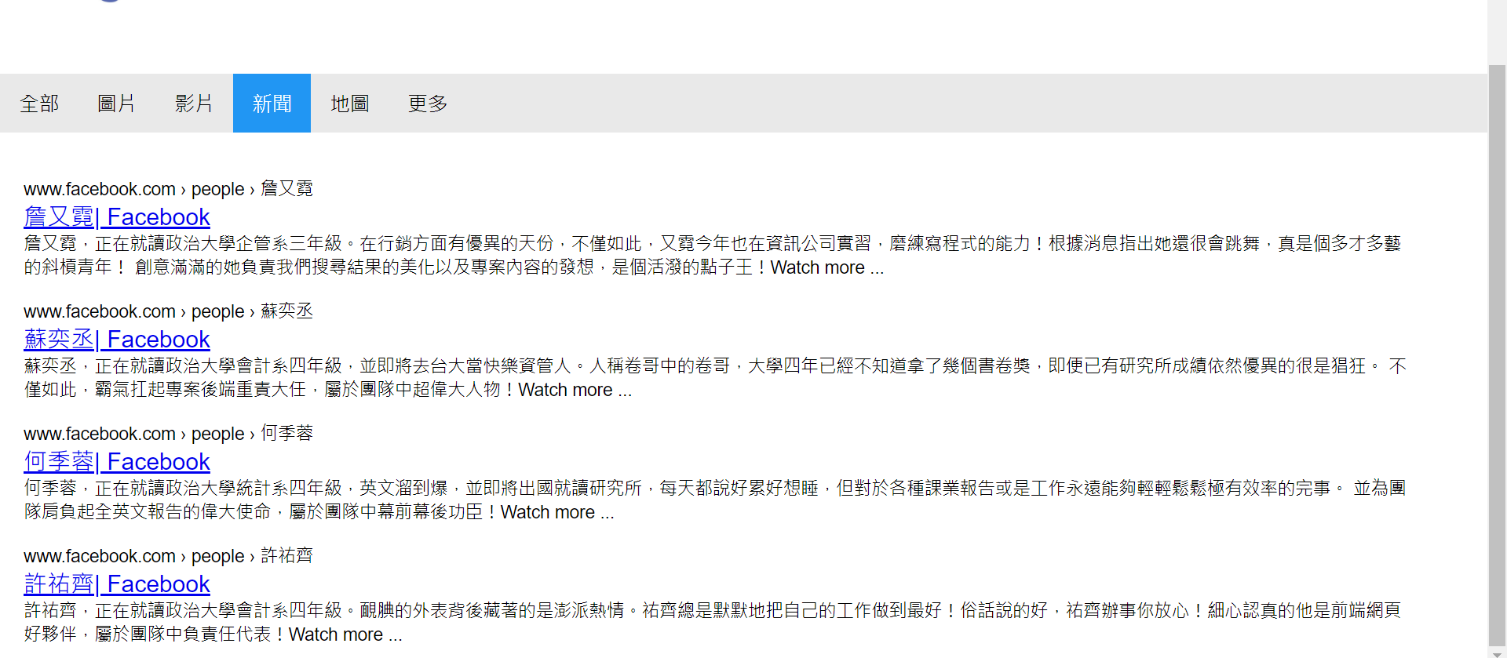
Additional Function

Slide 19
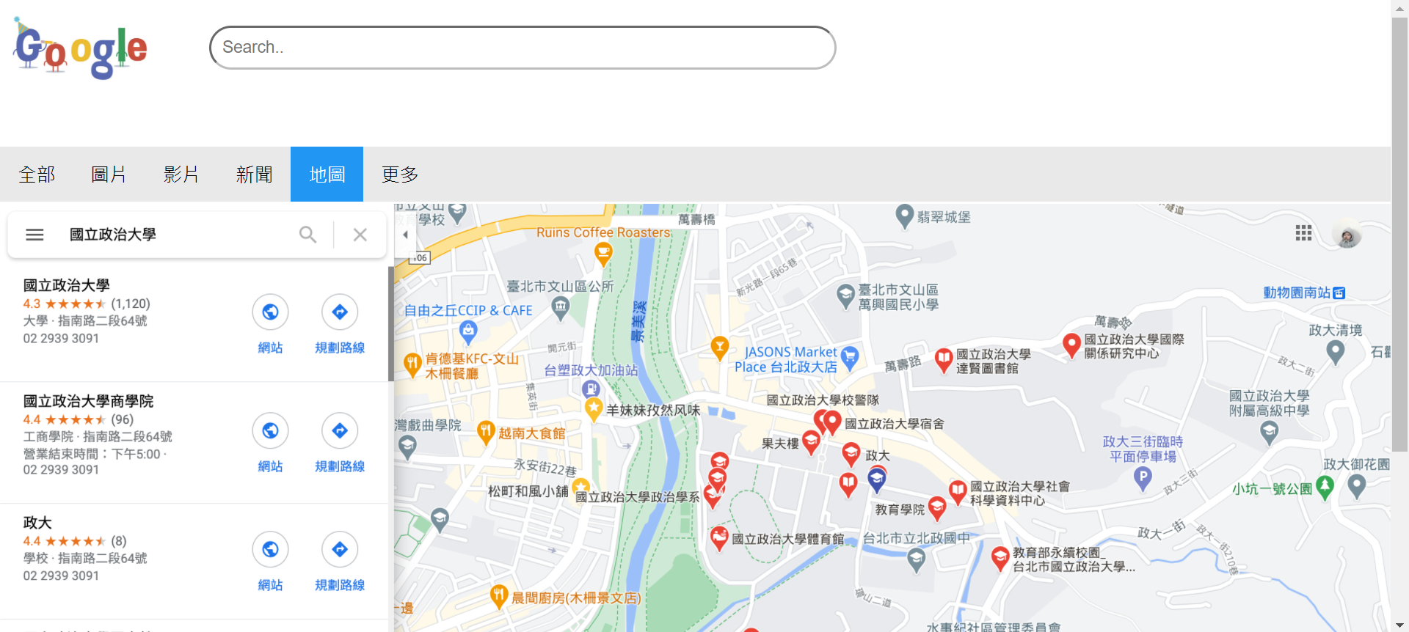
Additional Function

Slide 20
ＴHANKS!
Group 17
企管三詹又霓、會計四蘇奕丞統計四何季蓉、會計四許祐齊

