Slide 1

Transfer Learning - with meta graph

Slide 2
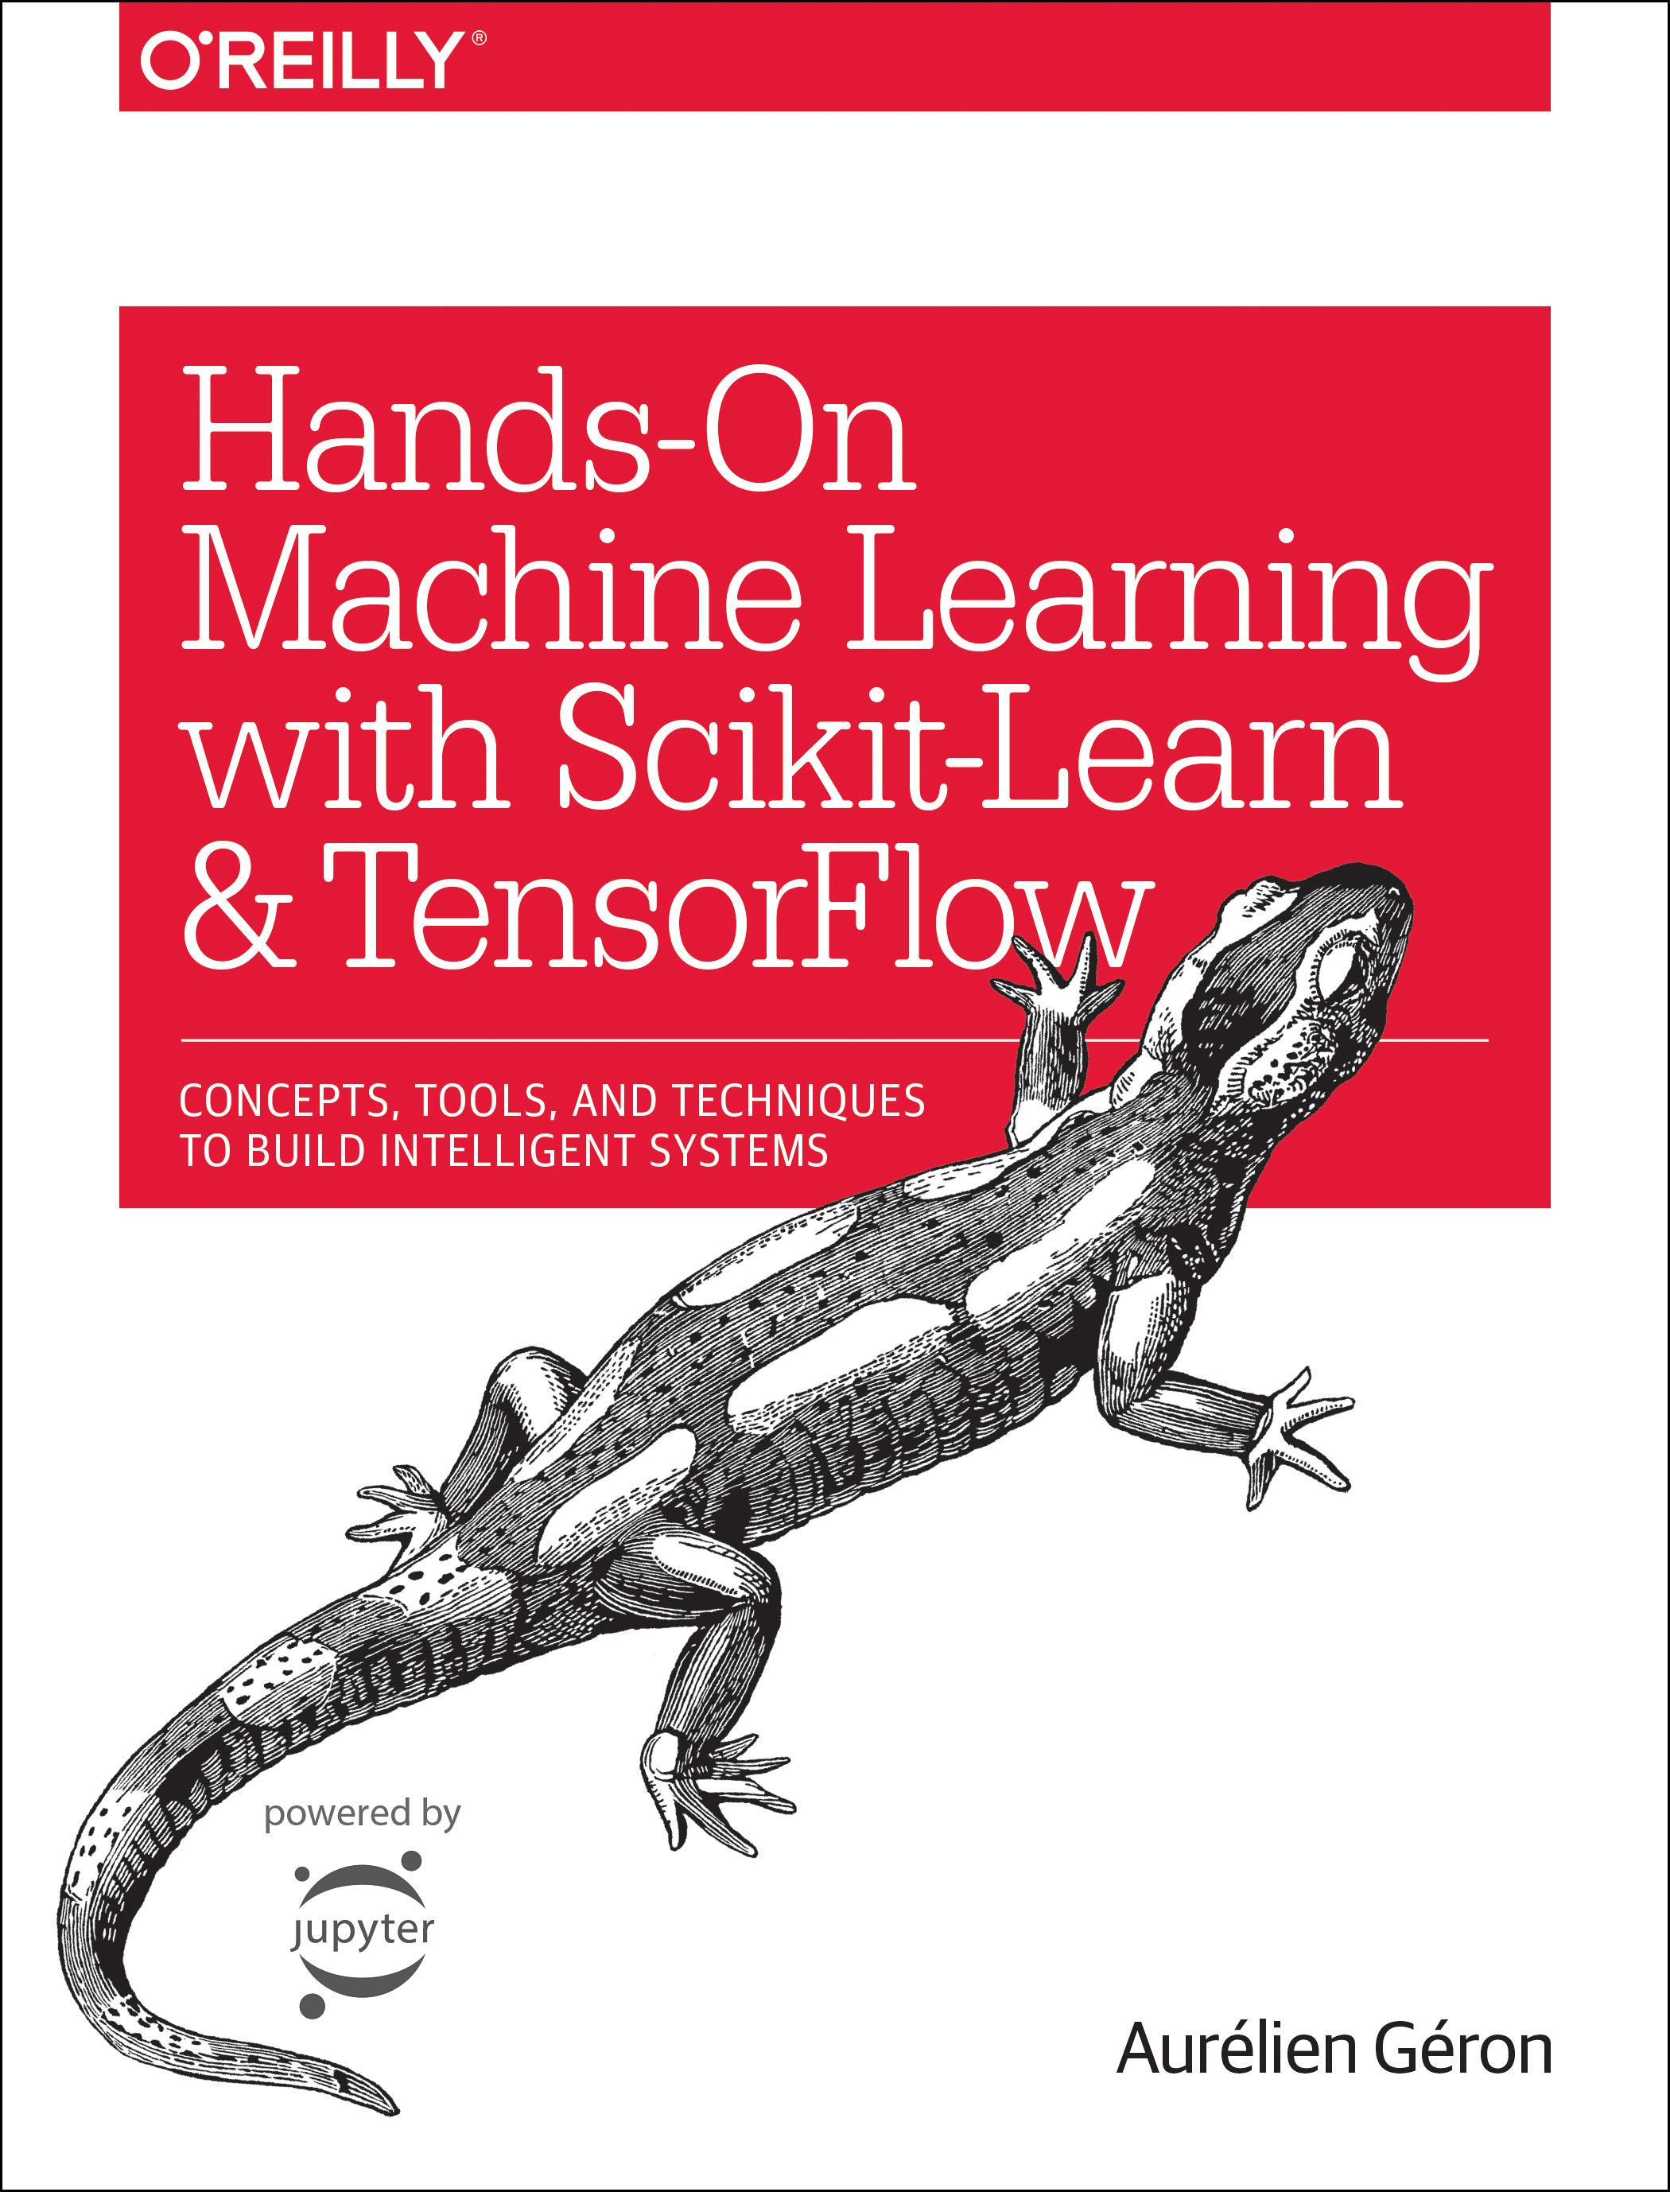
Reference
Chapter 11 (O'Reilly) of Hands-On ML
Youtube
Code

Slide 3
Data

Slide 4
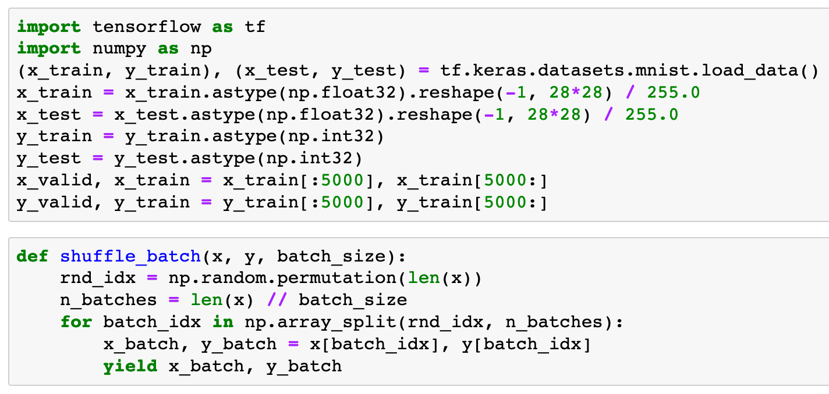


Slide 6
Default Graph is Empty

Slide 7
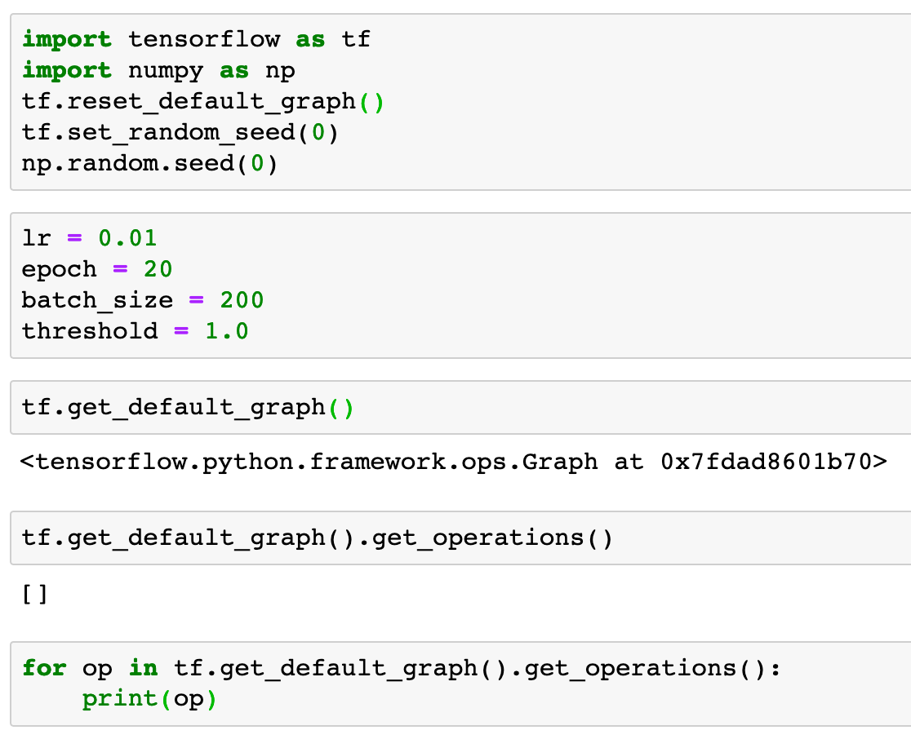

Slide 12
After importing Meta Graph Default Graph is not Empty

Slide 13
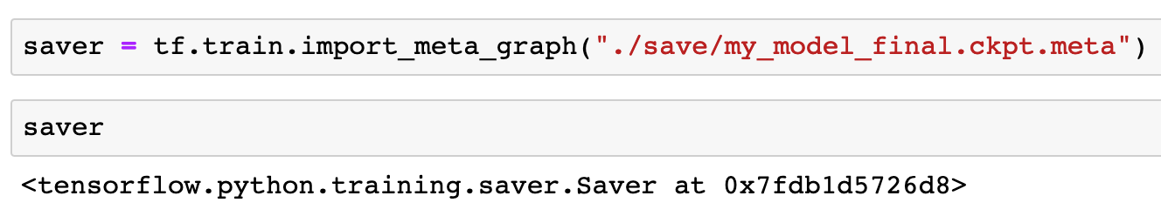

Slide 15
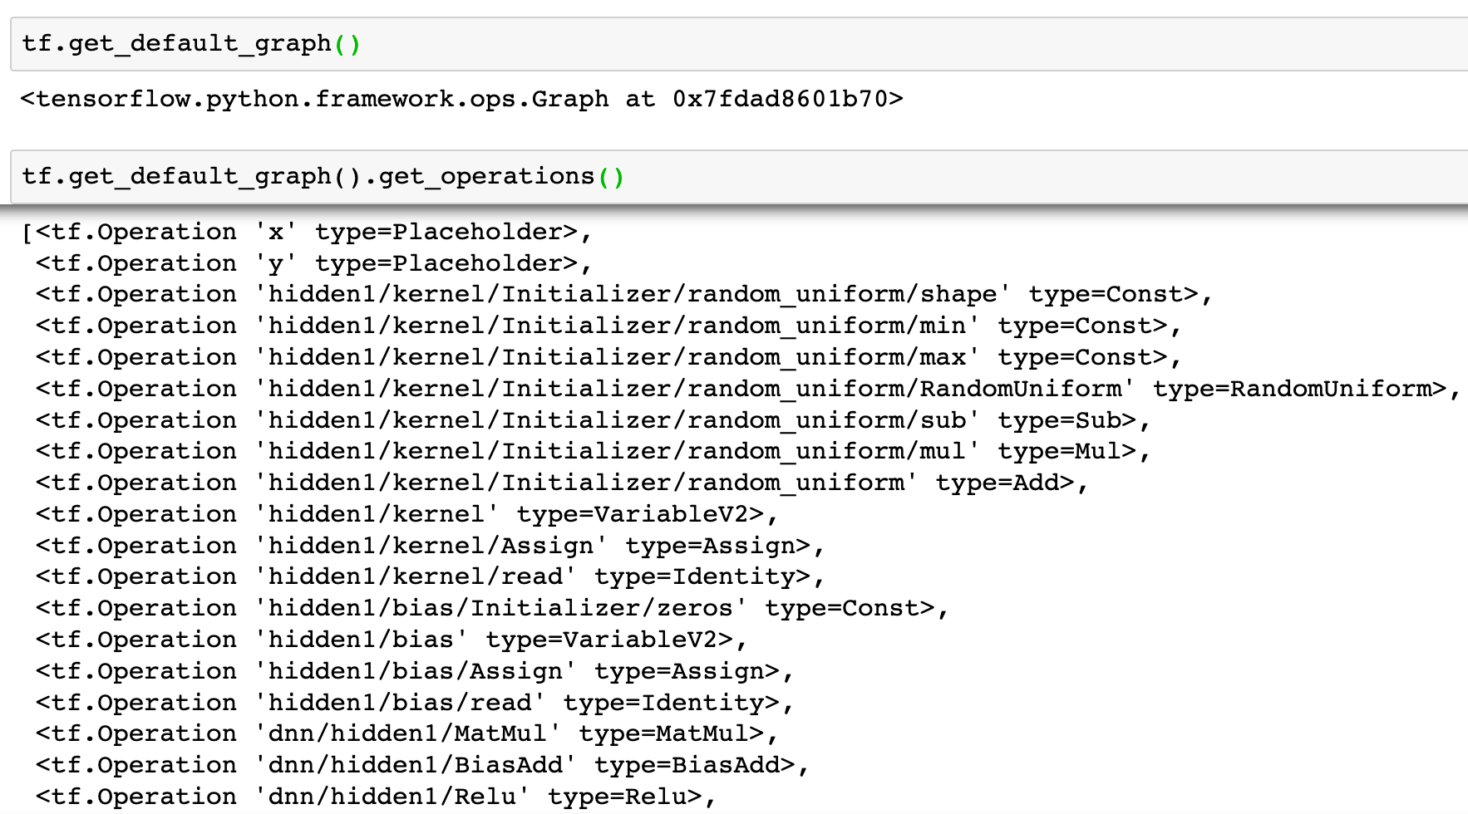

Slide 17
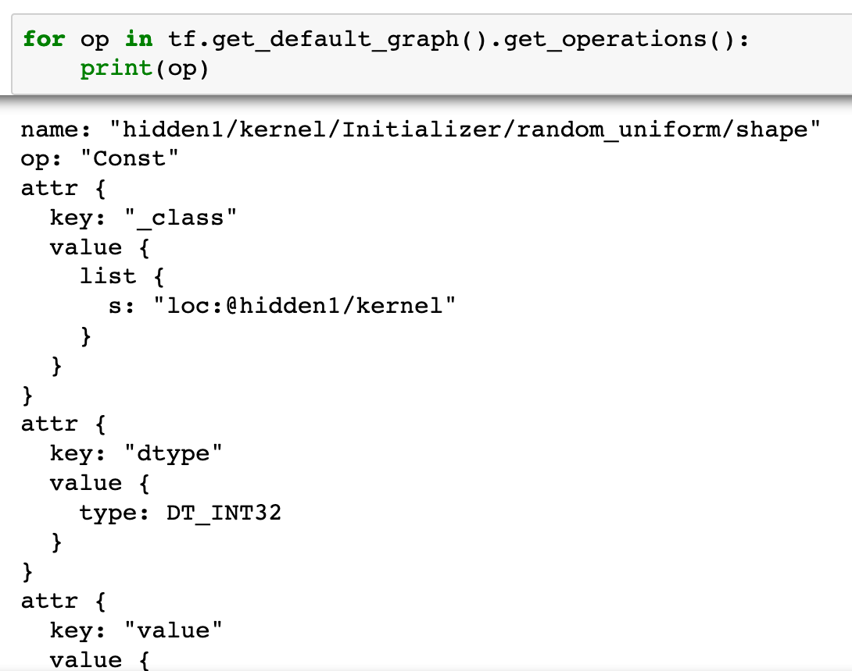

Slide 18
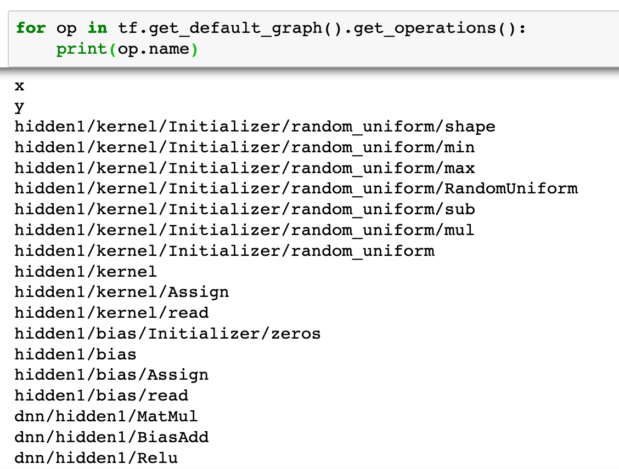

Slide 19
After hidden3 we add two more layers

Slide 20
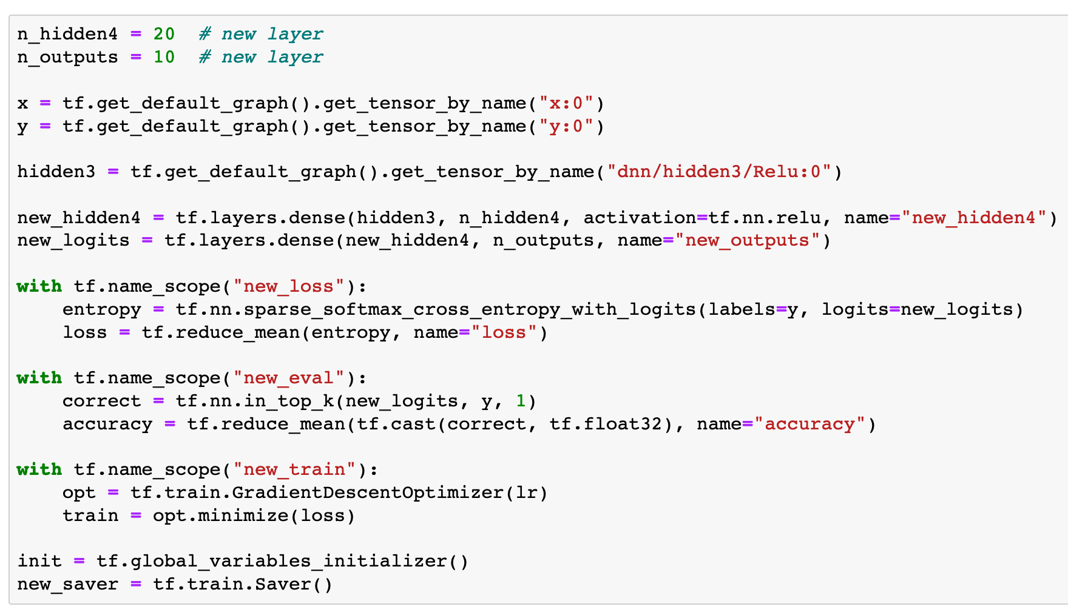

Slide 21
Train all layers

Slide 22
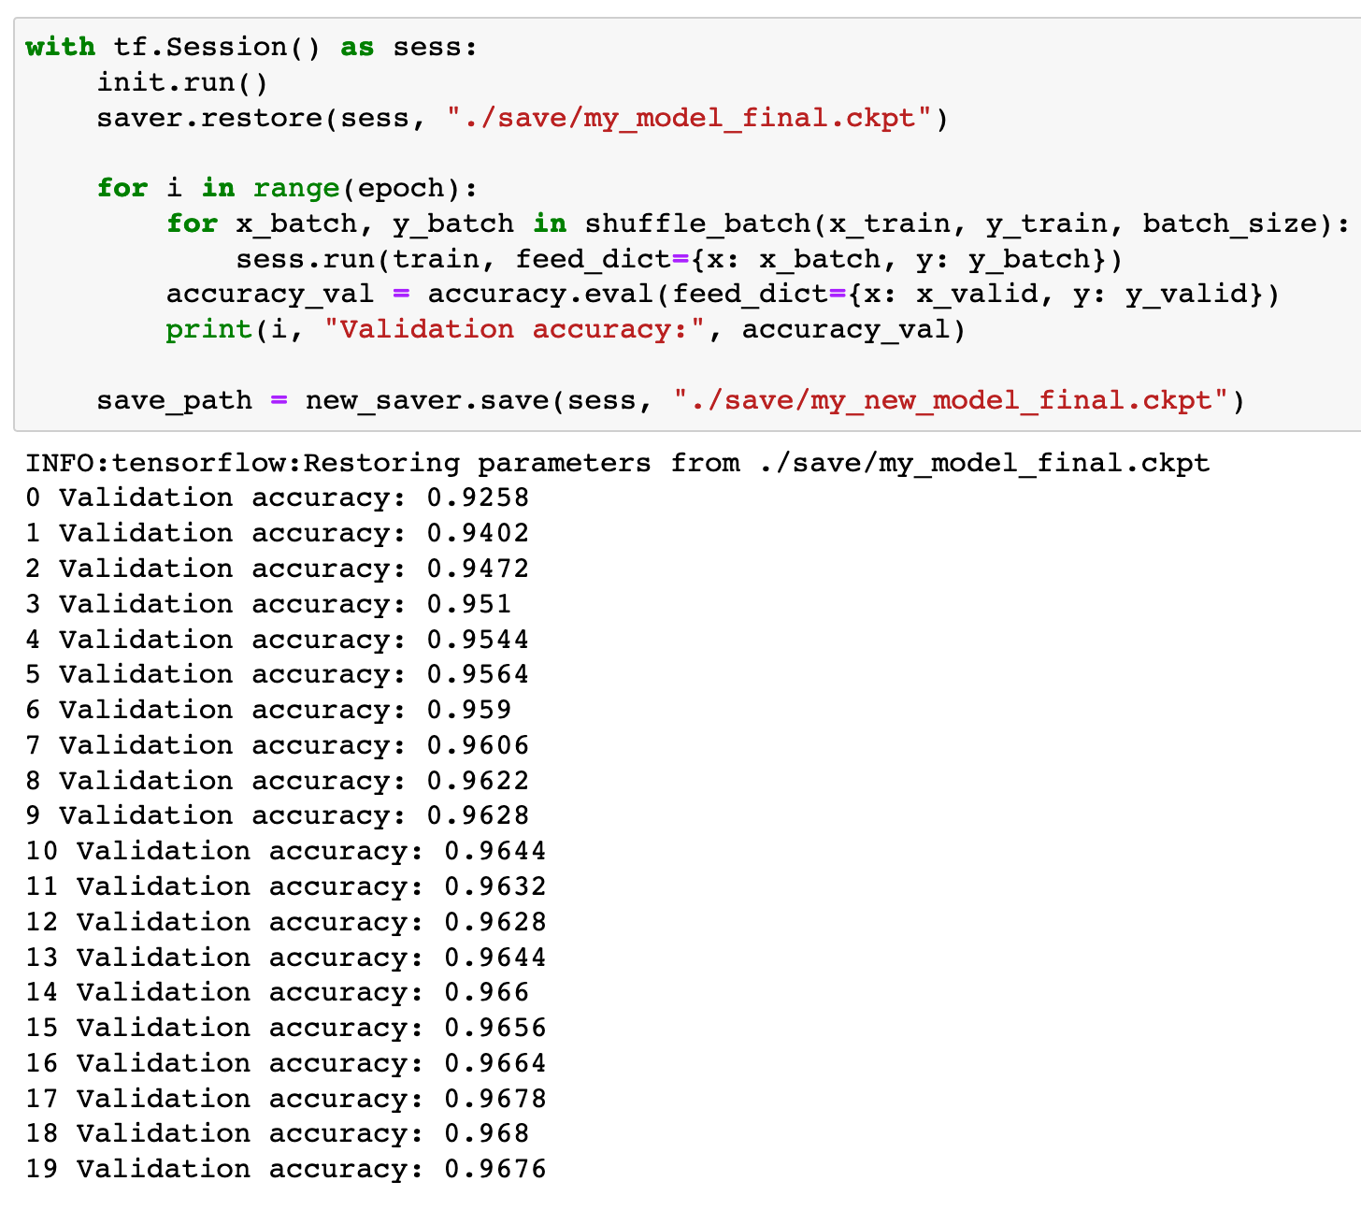

Slide 23
So, this is not transfer learning after all

Slide 24
Now
Let’s Play with Code

