Slide 1

Transfer Learning - without meta graph

Slide 2
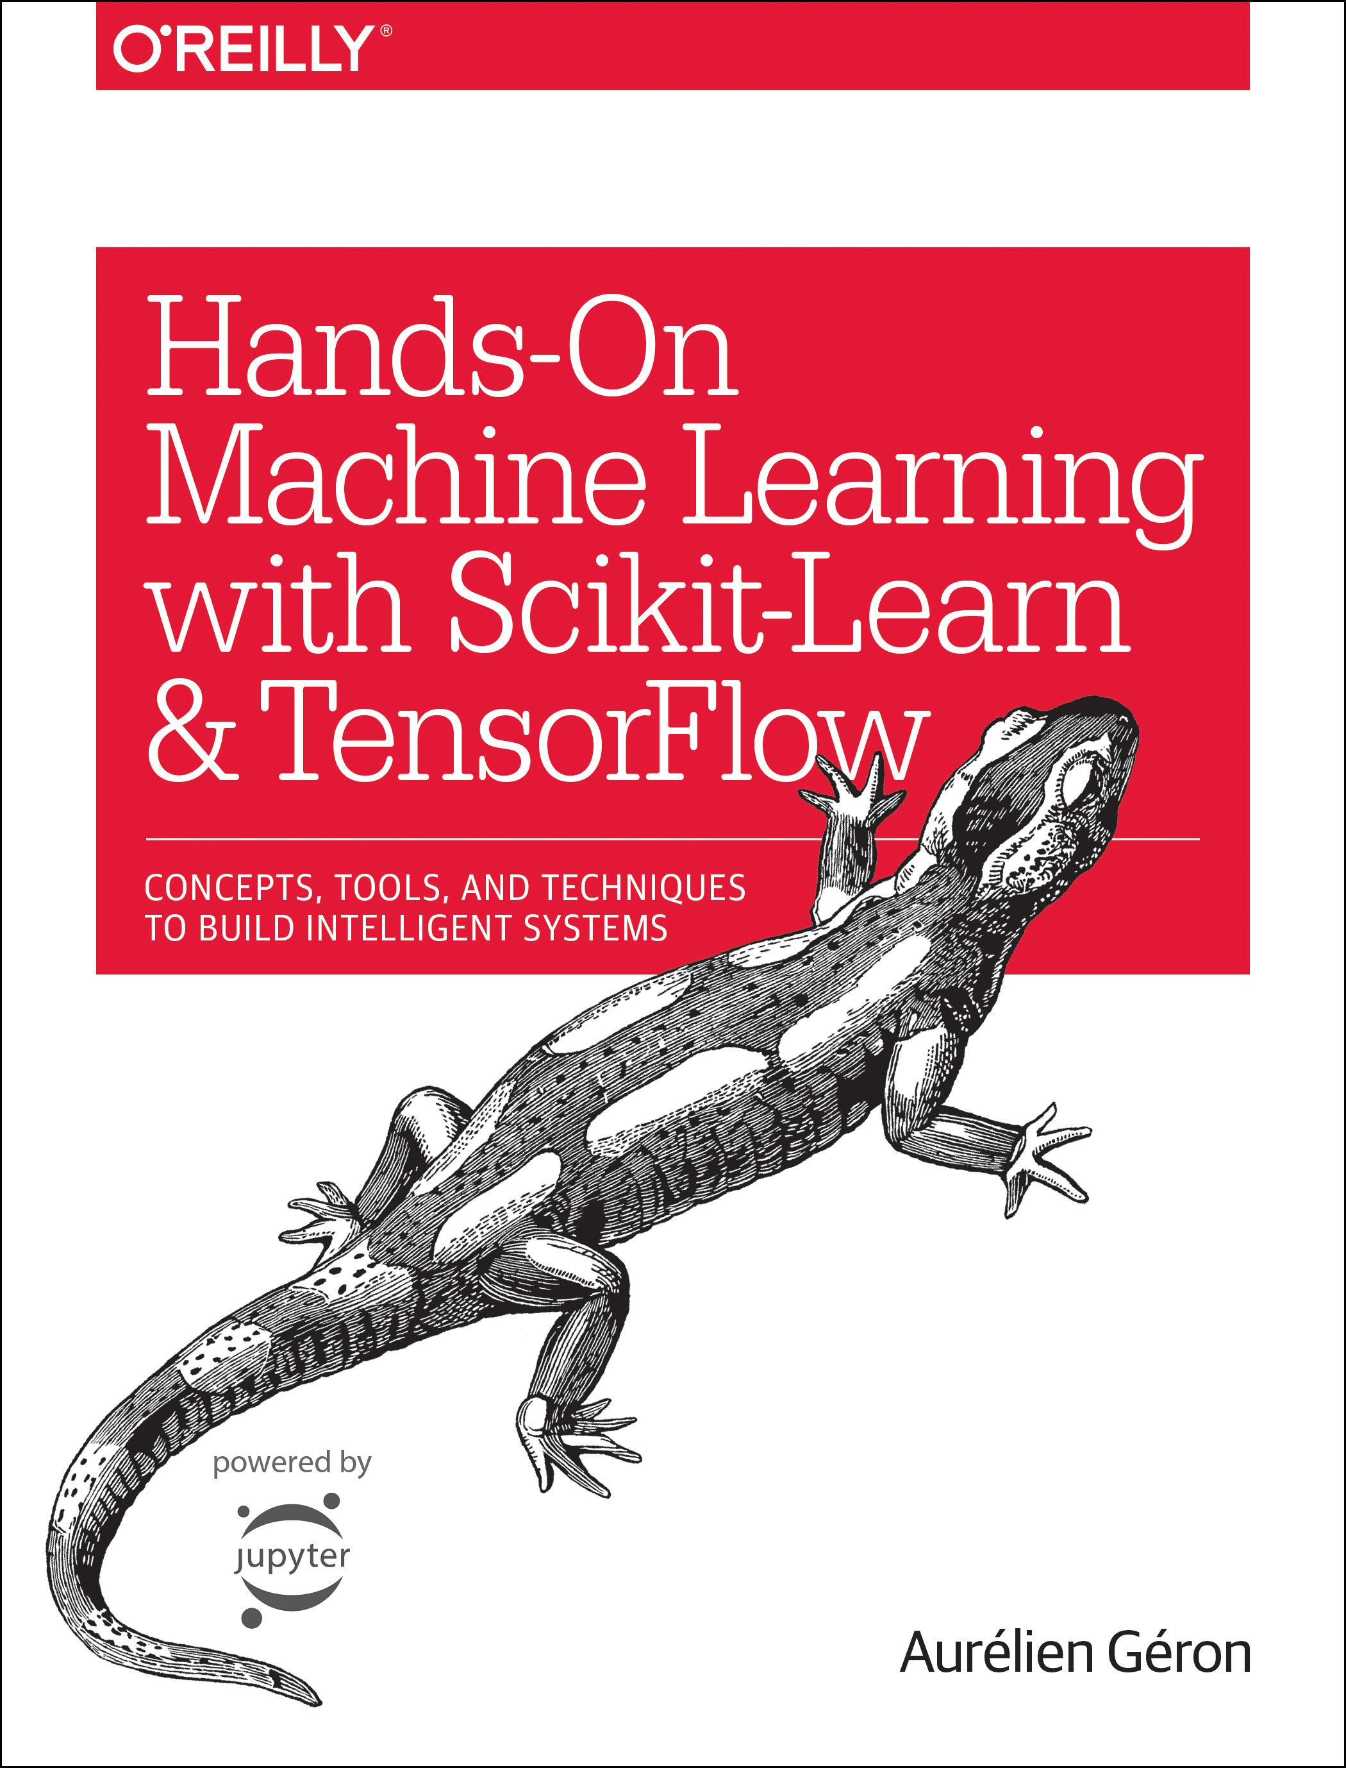
Reference
Chapter 11 (O'Reilly) of Hands-On ML
Youtube
Code

Slide 3
Data

Slide 4
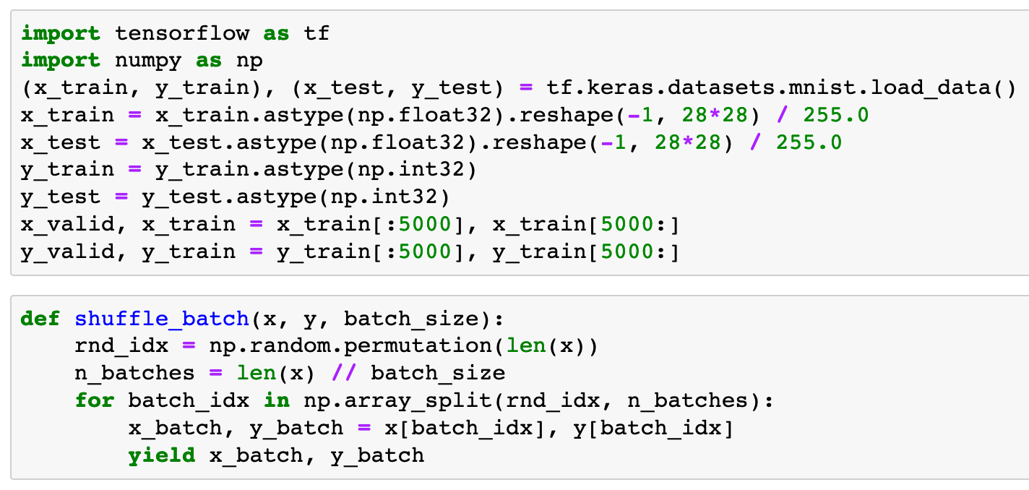


Slide 6
Graph Explicitly Given

Slide 7
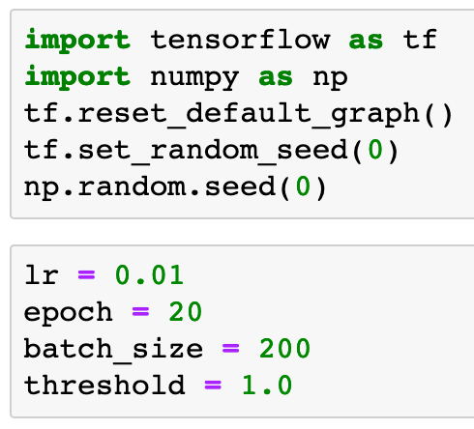

Slide 9
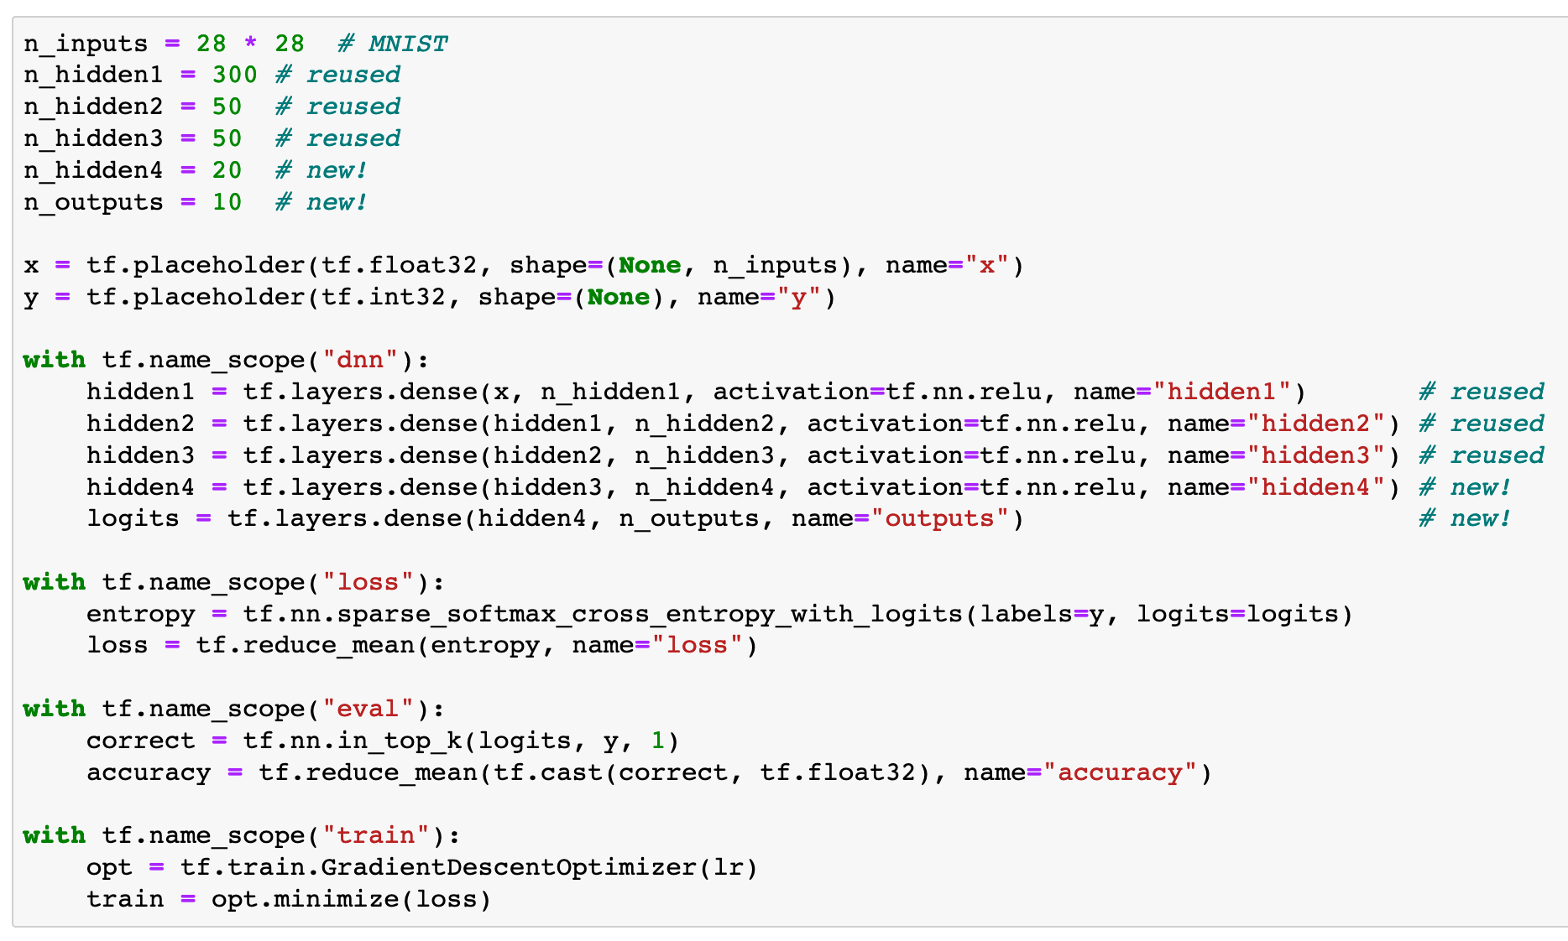

Slide 10
Make Saver Handle to Restore First Three Layers

Slide 11
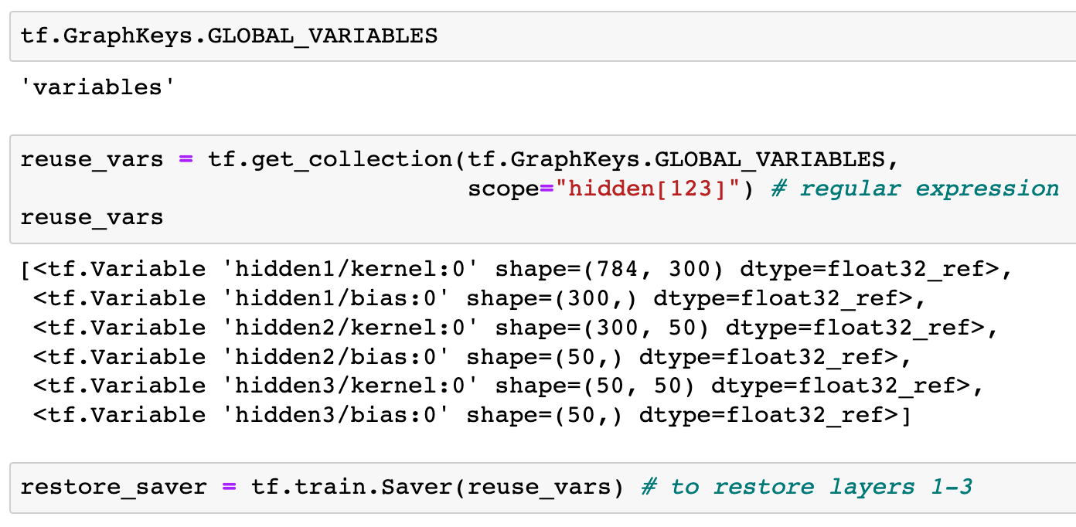

Slide 14
Make Init Handle to Initialize Variables

Slide 15


Slide 16
Make Saver Handle to Save Model

Slide 17


Slide 18
Train all layers

Slide 19
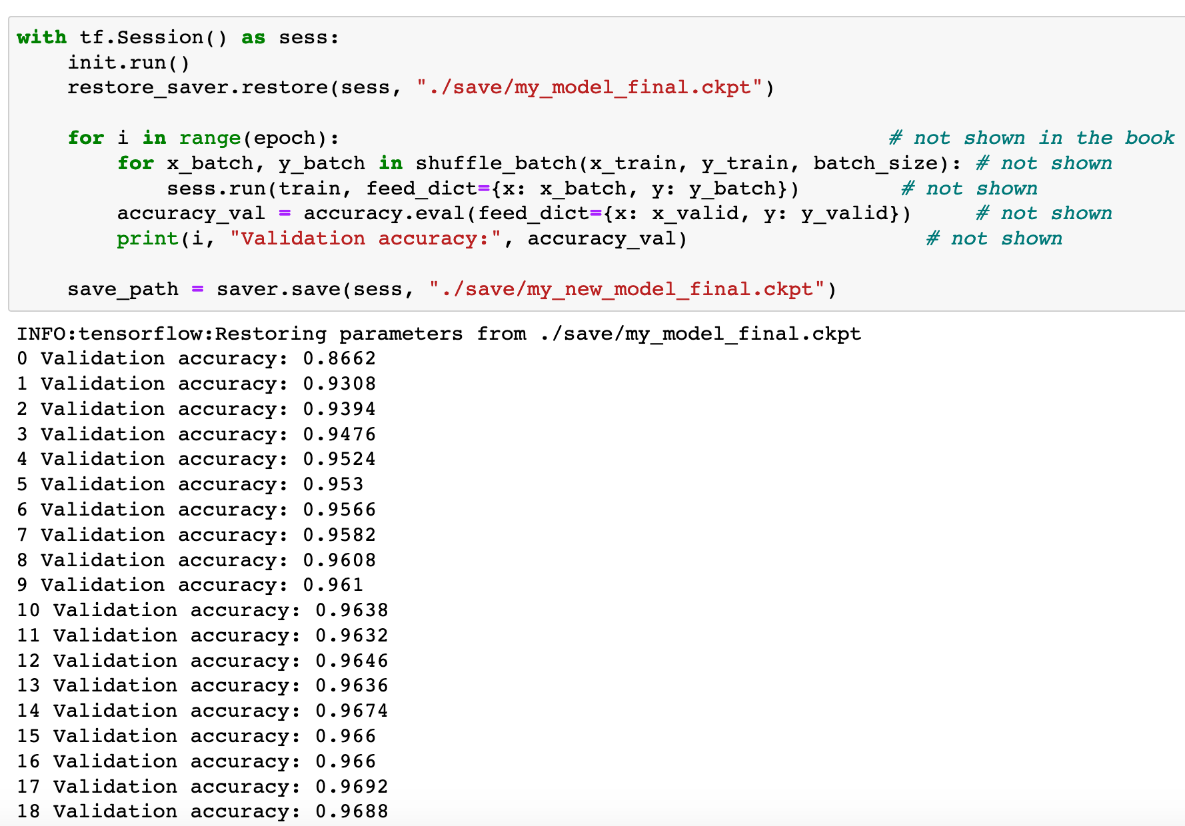

Slide 20
So, this is not transfer learning after all

Slide 21
Now
Let’s Play with Code

