Slide 1

max_norm Regularization - tf.clip_by_norm

Slide 2

Reference
Chapter 11 (O'Reilly) of Hands-On ML
Youtube
Code

Slide 3
Data

Slide 4
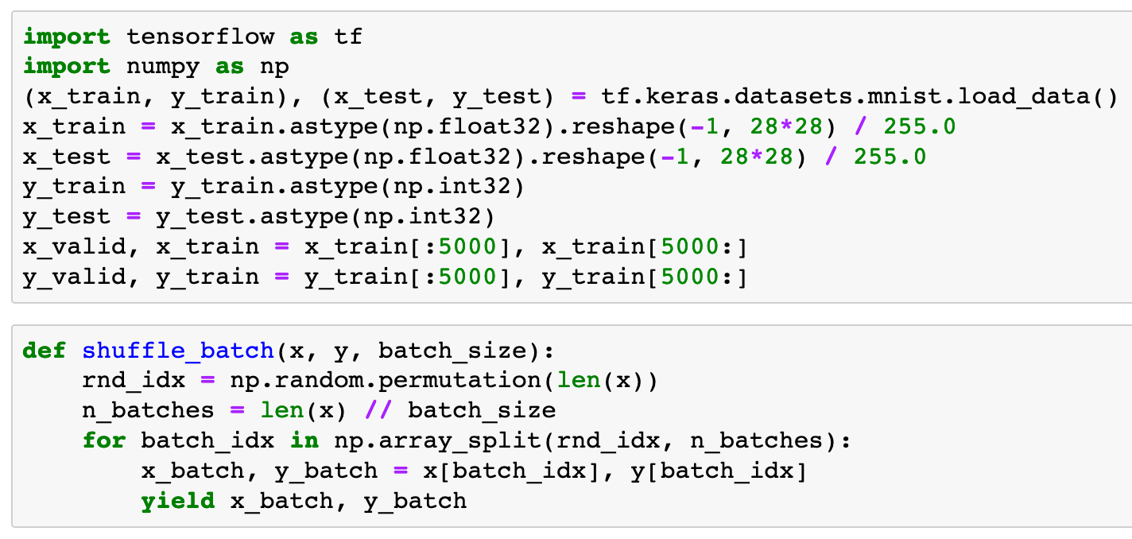


Slide 6
Warm Up

Slide 7
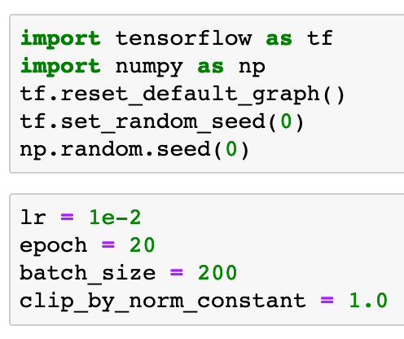

Slide 9
Part of Graph

Slide 10
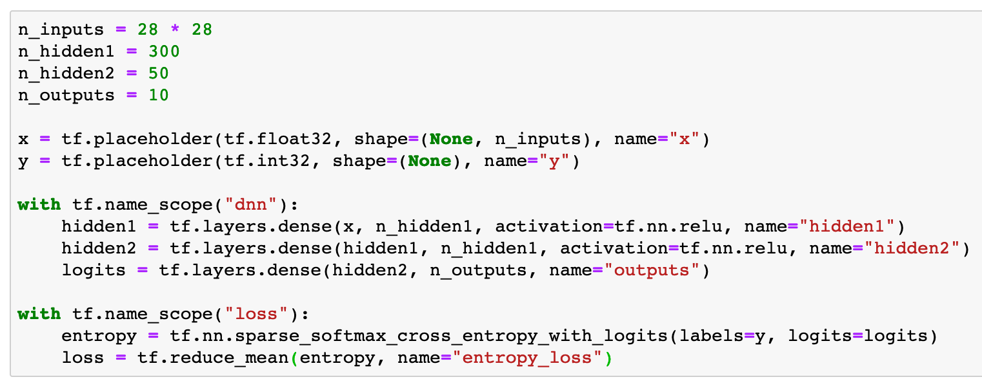

Slide 11
tf.clip_by_norm

Slide 12
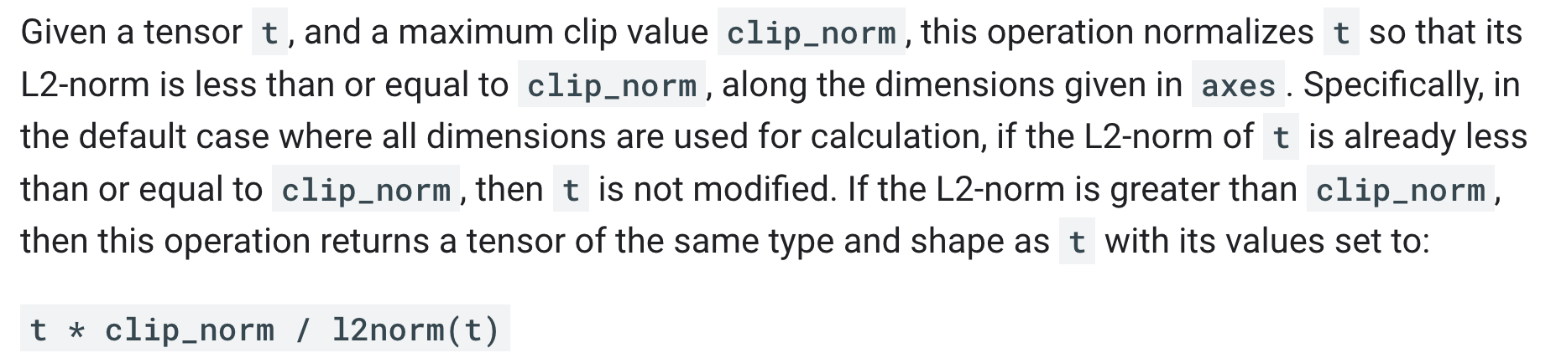
tensorflow

Slide 13
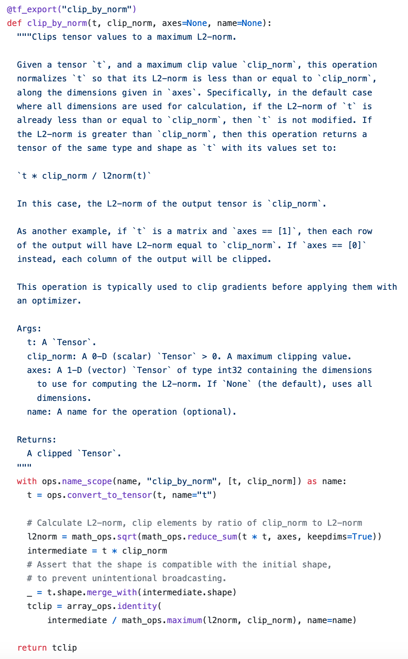
source code

Slide 14
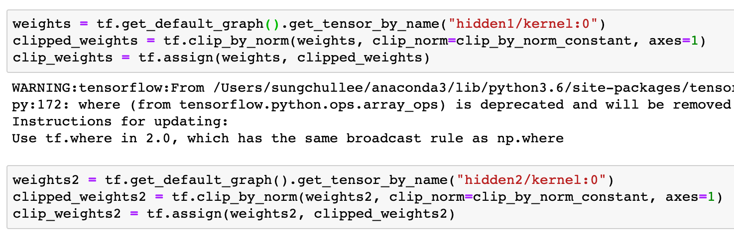

Slide 16
Continue to build Graph

Slide 17
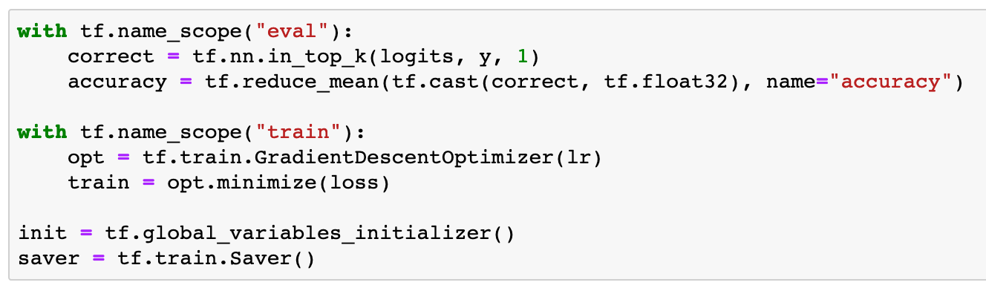

Slide 18
Session

Slide 19
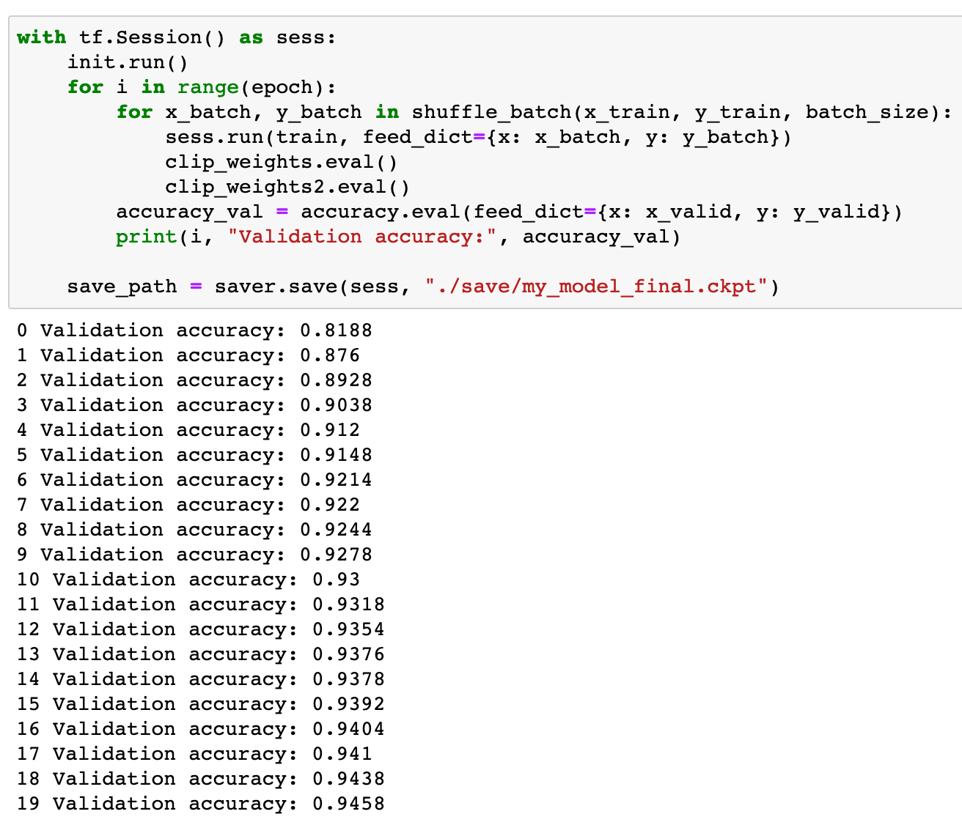

Slide 20
Now
Let’s Play with Code

