Slide 1

Making Handles of Tensors and Operations - get_tensor_by_name vs get_operation_by_name

Slide 2
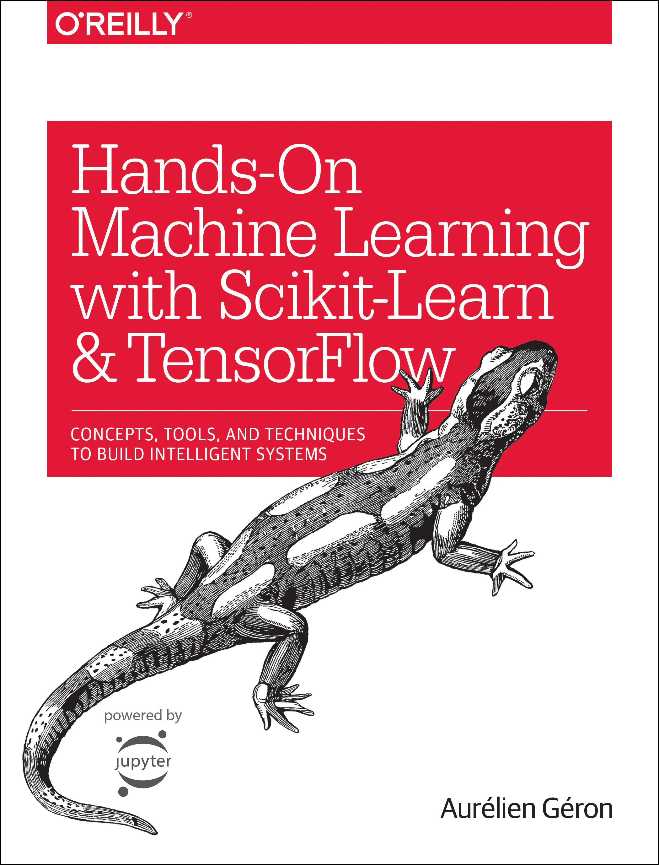
Reference
Chapter 11 (O'Reilly) of Hands-On ML
Youtube
Code

Slide 3
Warm Up

Slide 4
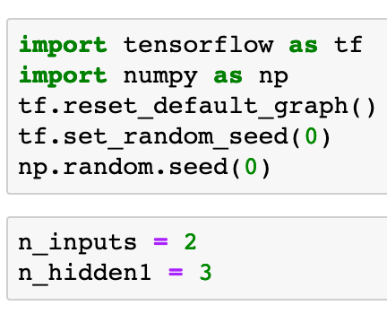


Slide 6
Load the weights from the other framework

Slide 8
Graph

Slide 9
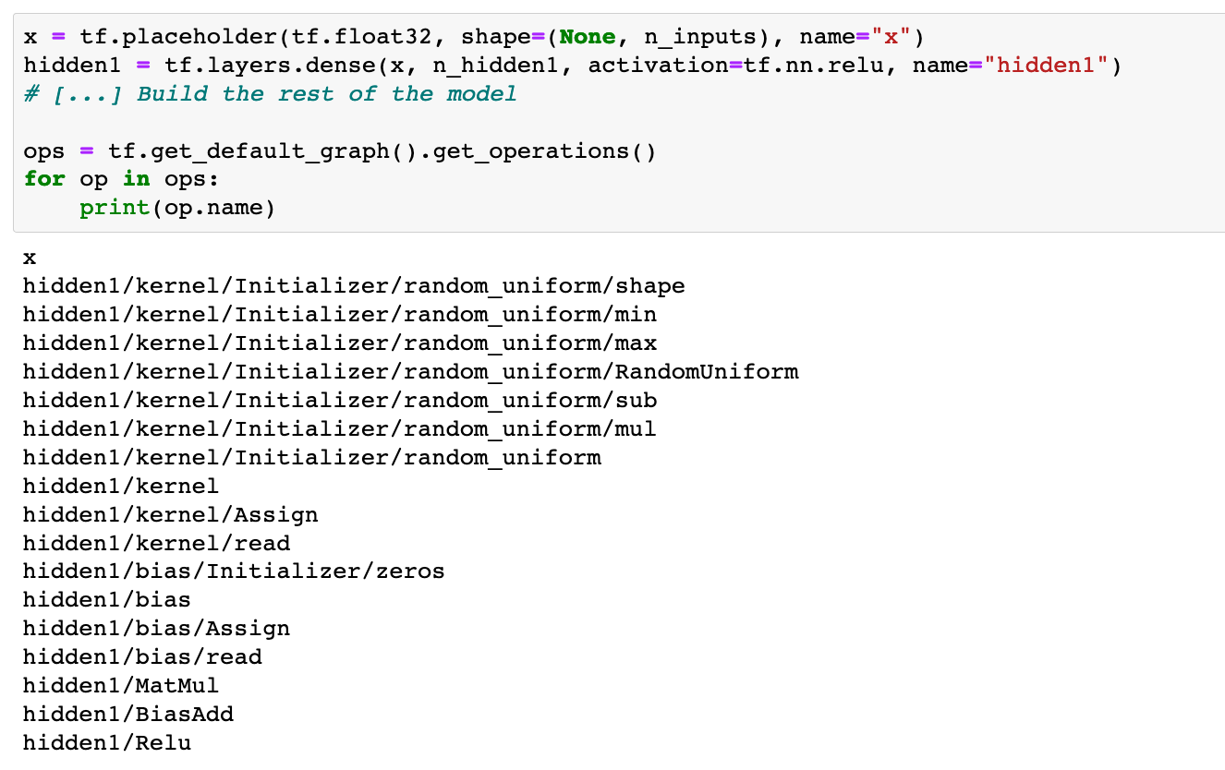

Slide 12
output: get_tensor_by_name vs input: get_operation_by_name

Slide 13
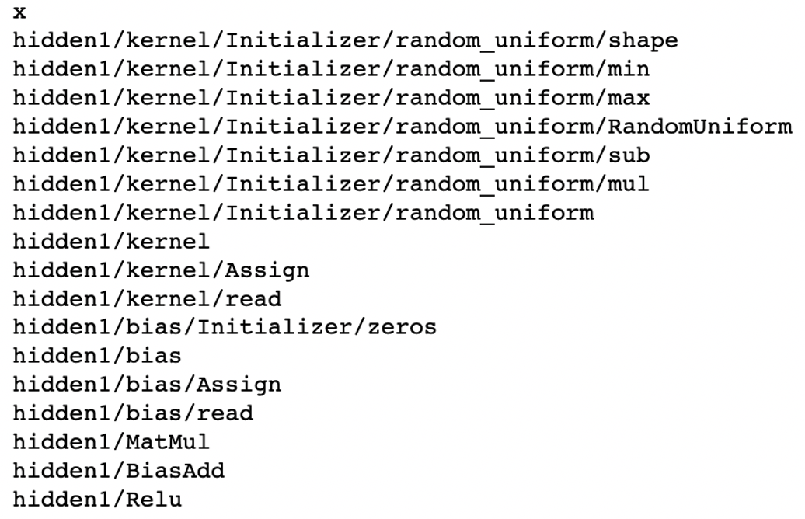
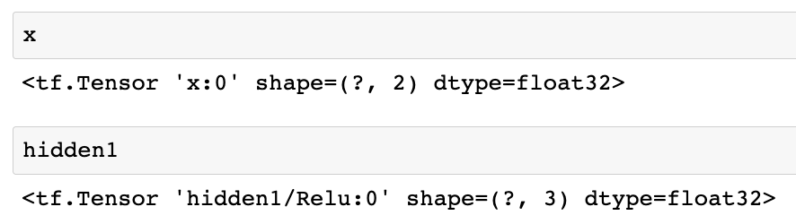

Slide 16
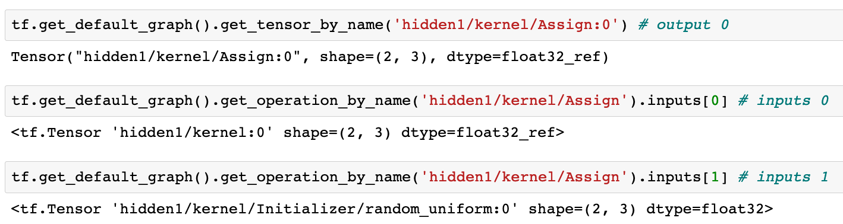

Slide 20
How to Use Different Initializer

Slide 21
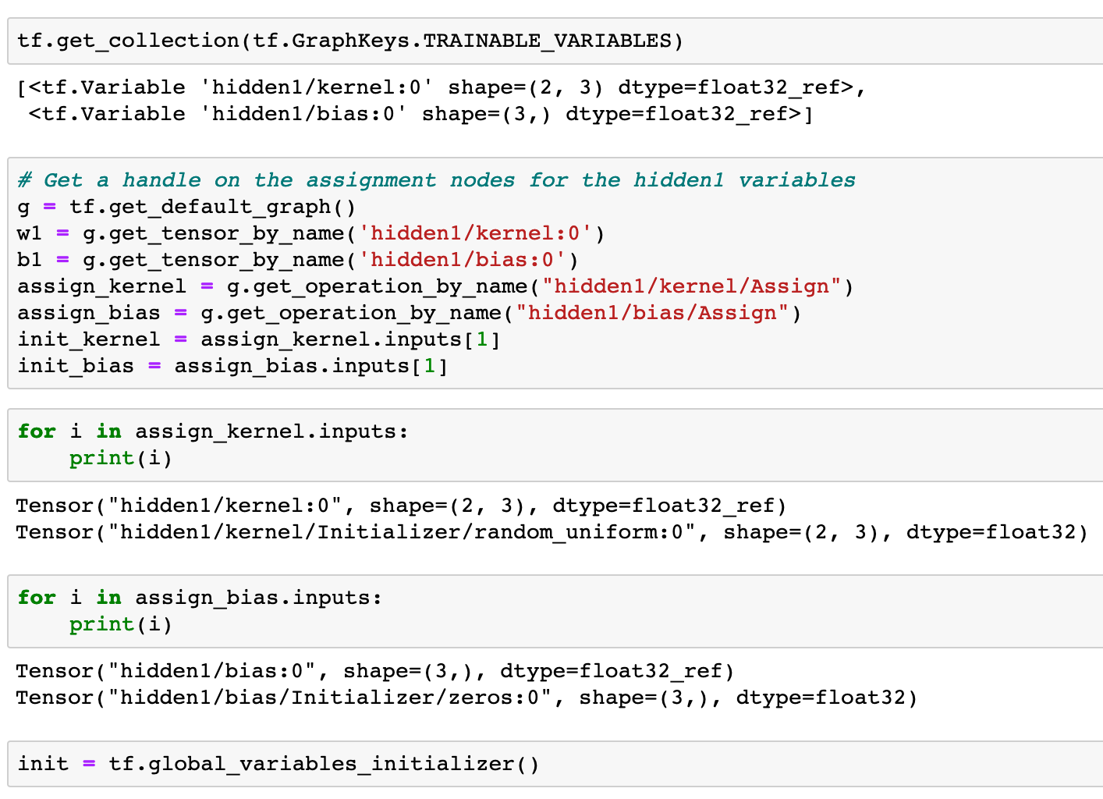

Slide 26
Session

Slide 27
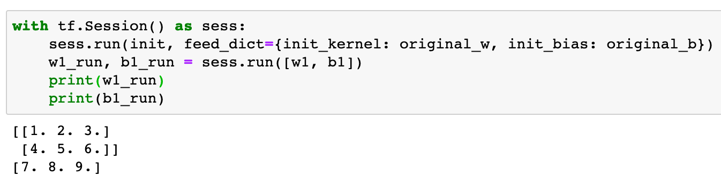
One can feed valus to tensor like placeholder

Slide 28
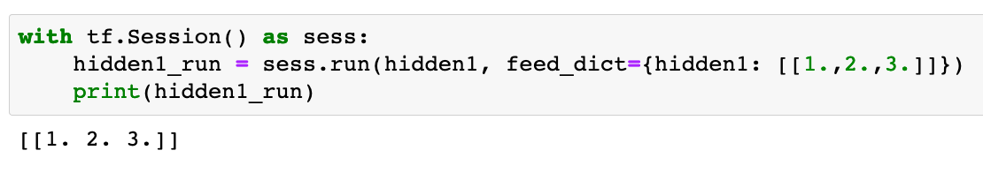
One can feed valus to tensor like placeholder

Slide 29
Now
Let’s Play with Code

