Slide 1

max_norm Regularization - kernel_regularizer

Slide 2

Reference
Chapter 11 (O'Reilly) of Hands-On ML
Youtube
Code

Slide 3
Data

Slide 4
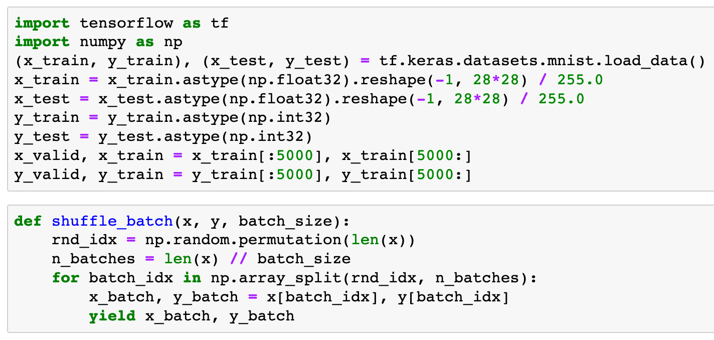


Slide 6
Warm Up

Slide 7
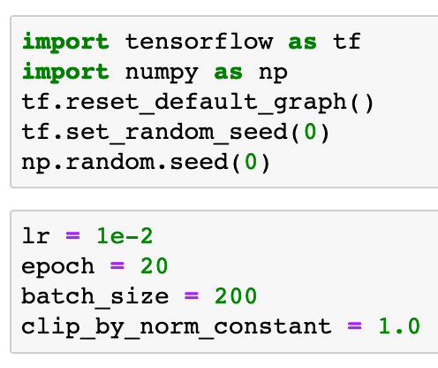

Slide 9
Part of Graph

Slide 10
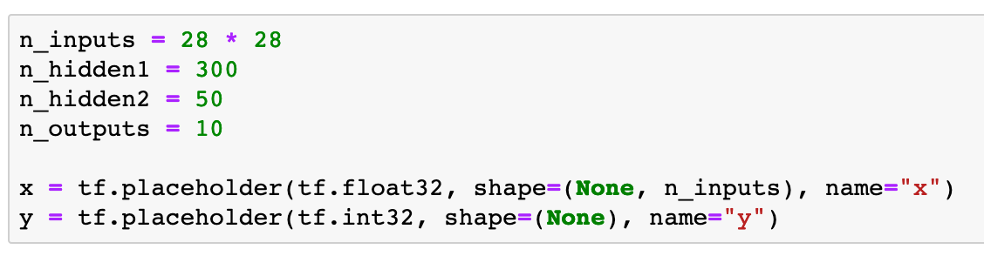

Slide 11
kernel_regularizer

Slide 12
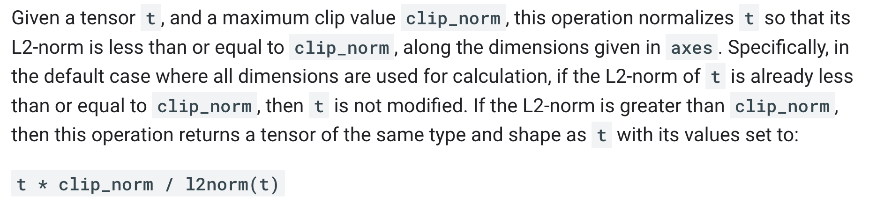
tensorflow

Slide 13
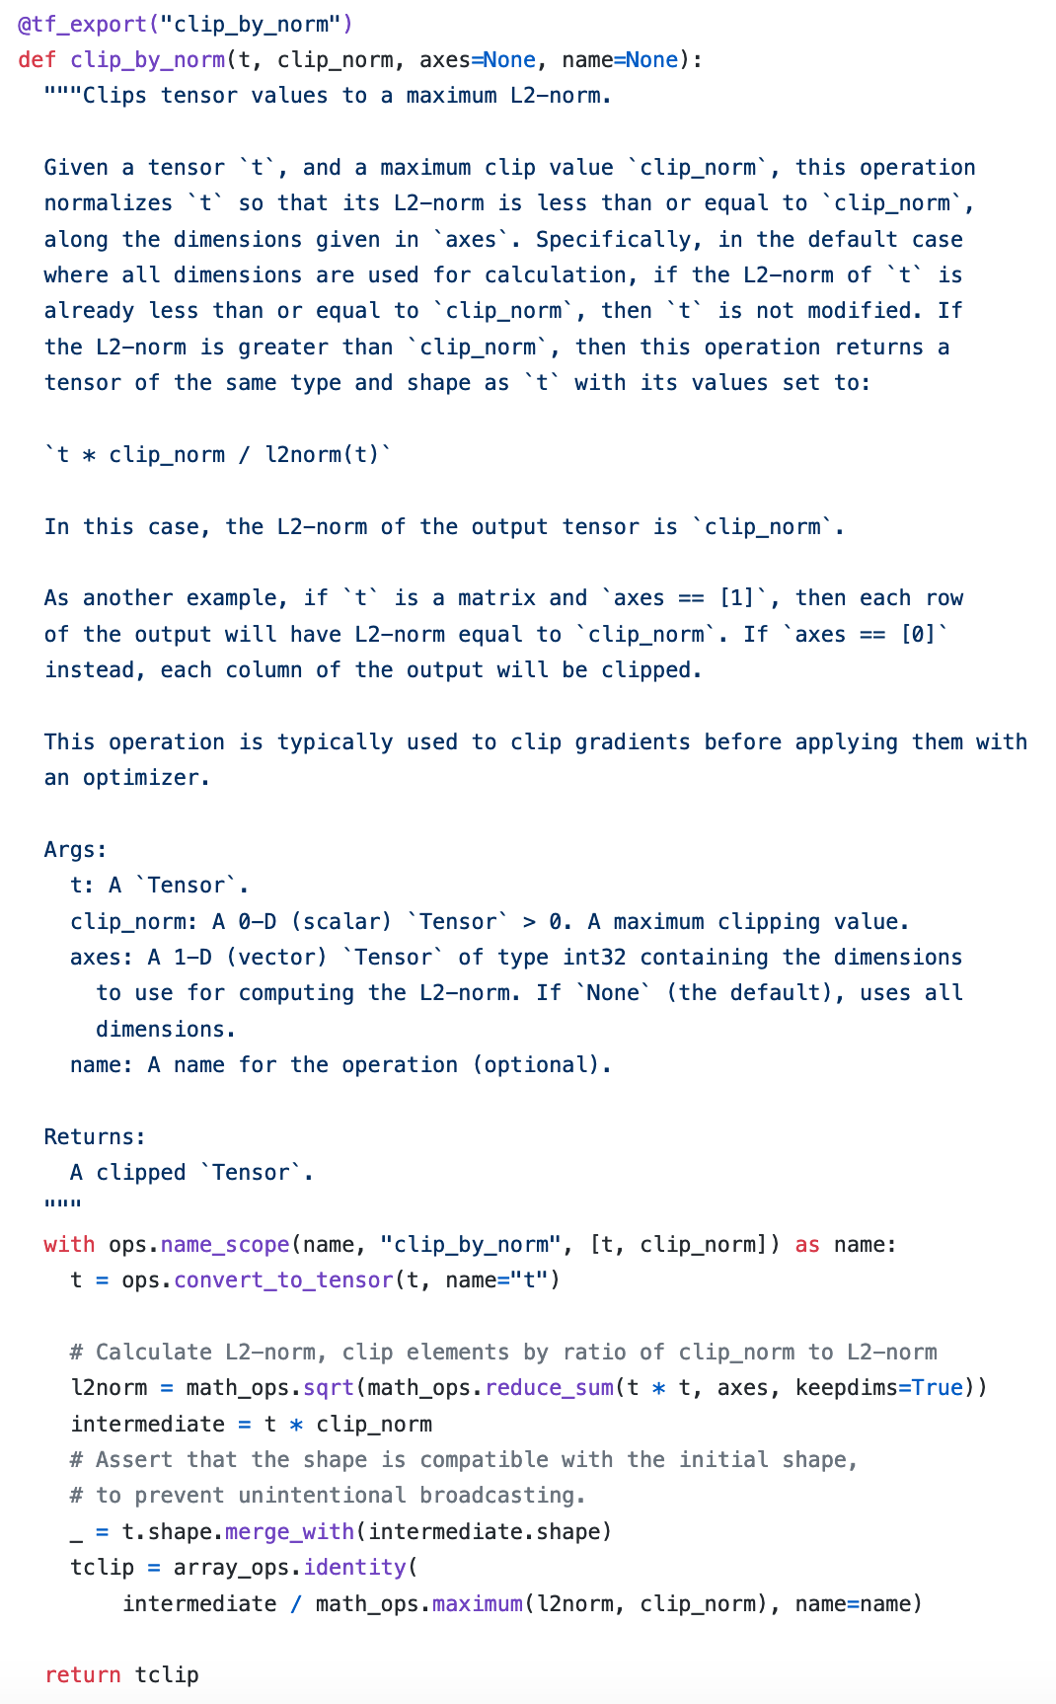
source code

Slide 14
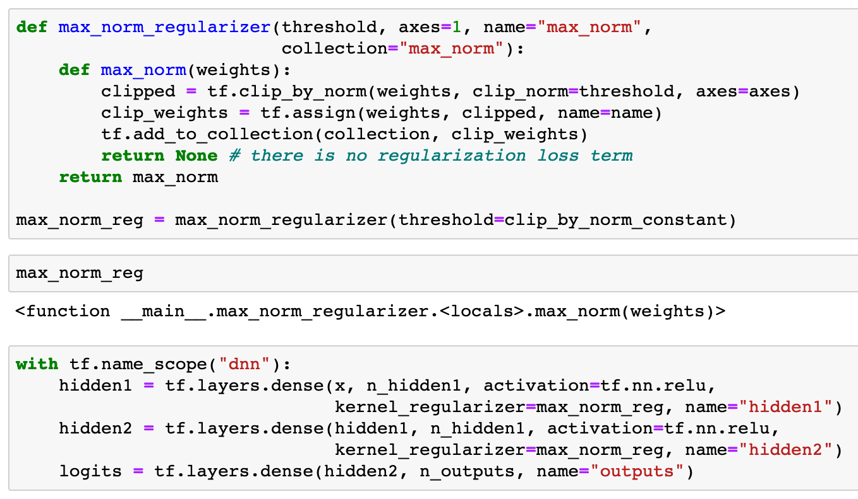

Slide 16
function of weights

Slide 18
Continue to build Graph

Slide 19
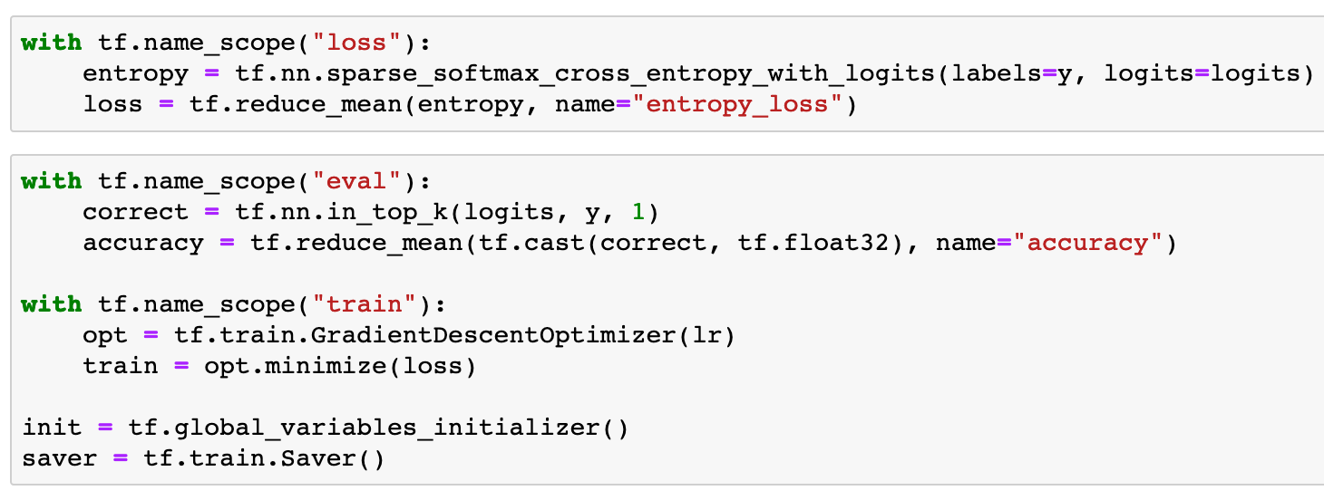

Slide 20
Session

Slide 21
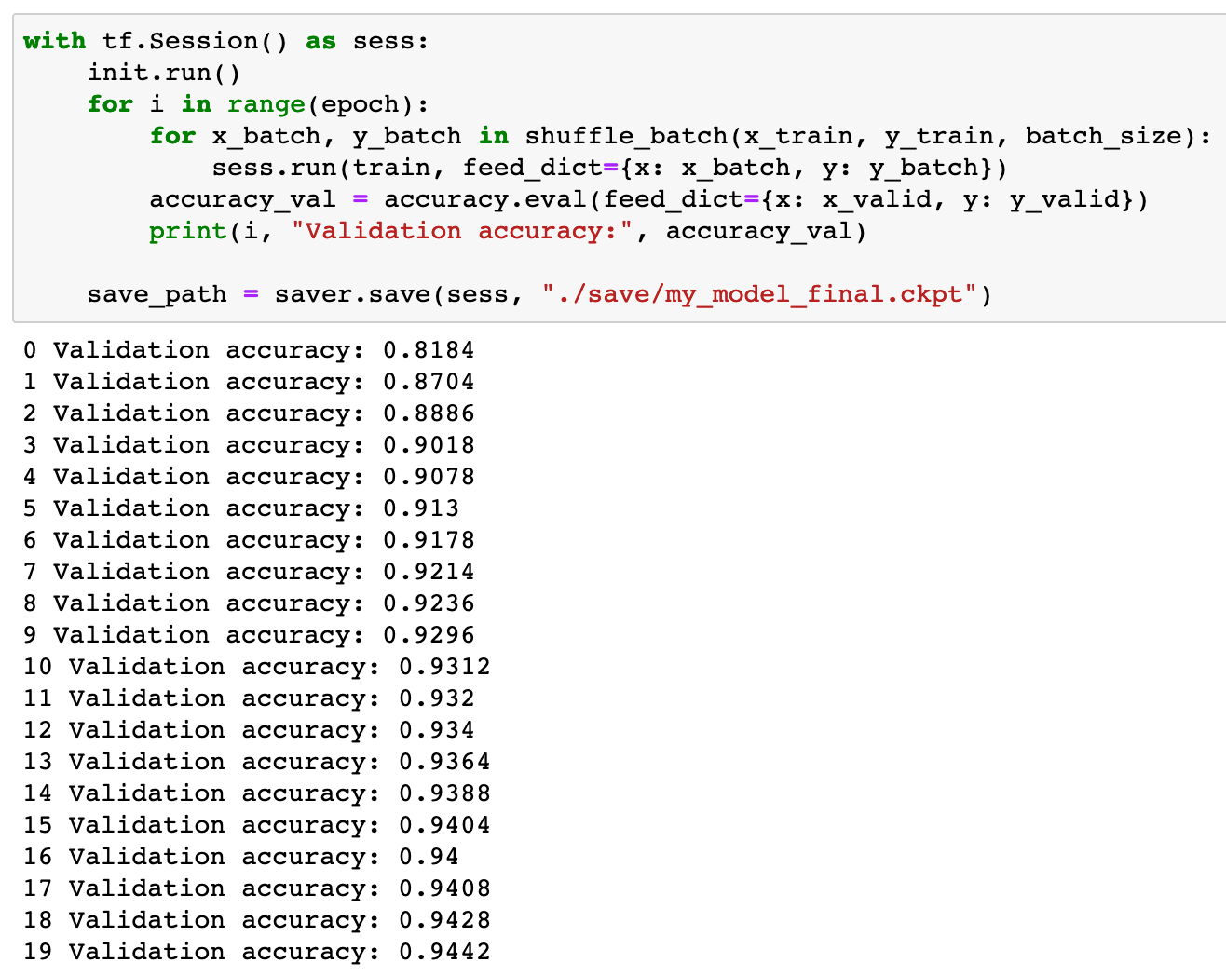

Slide 22
Now
Let’s Play with Code

