Slide 1

Transfer Learning - Freezing Lower Layer using tf.stop_gradient

Slide 2
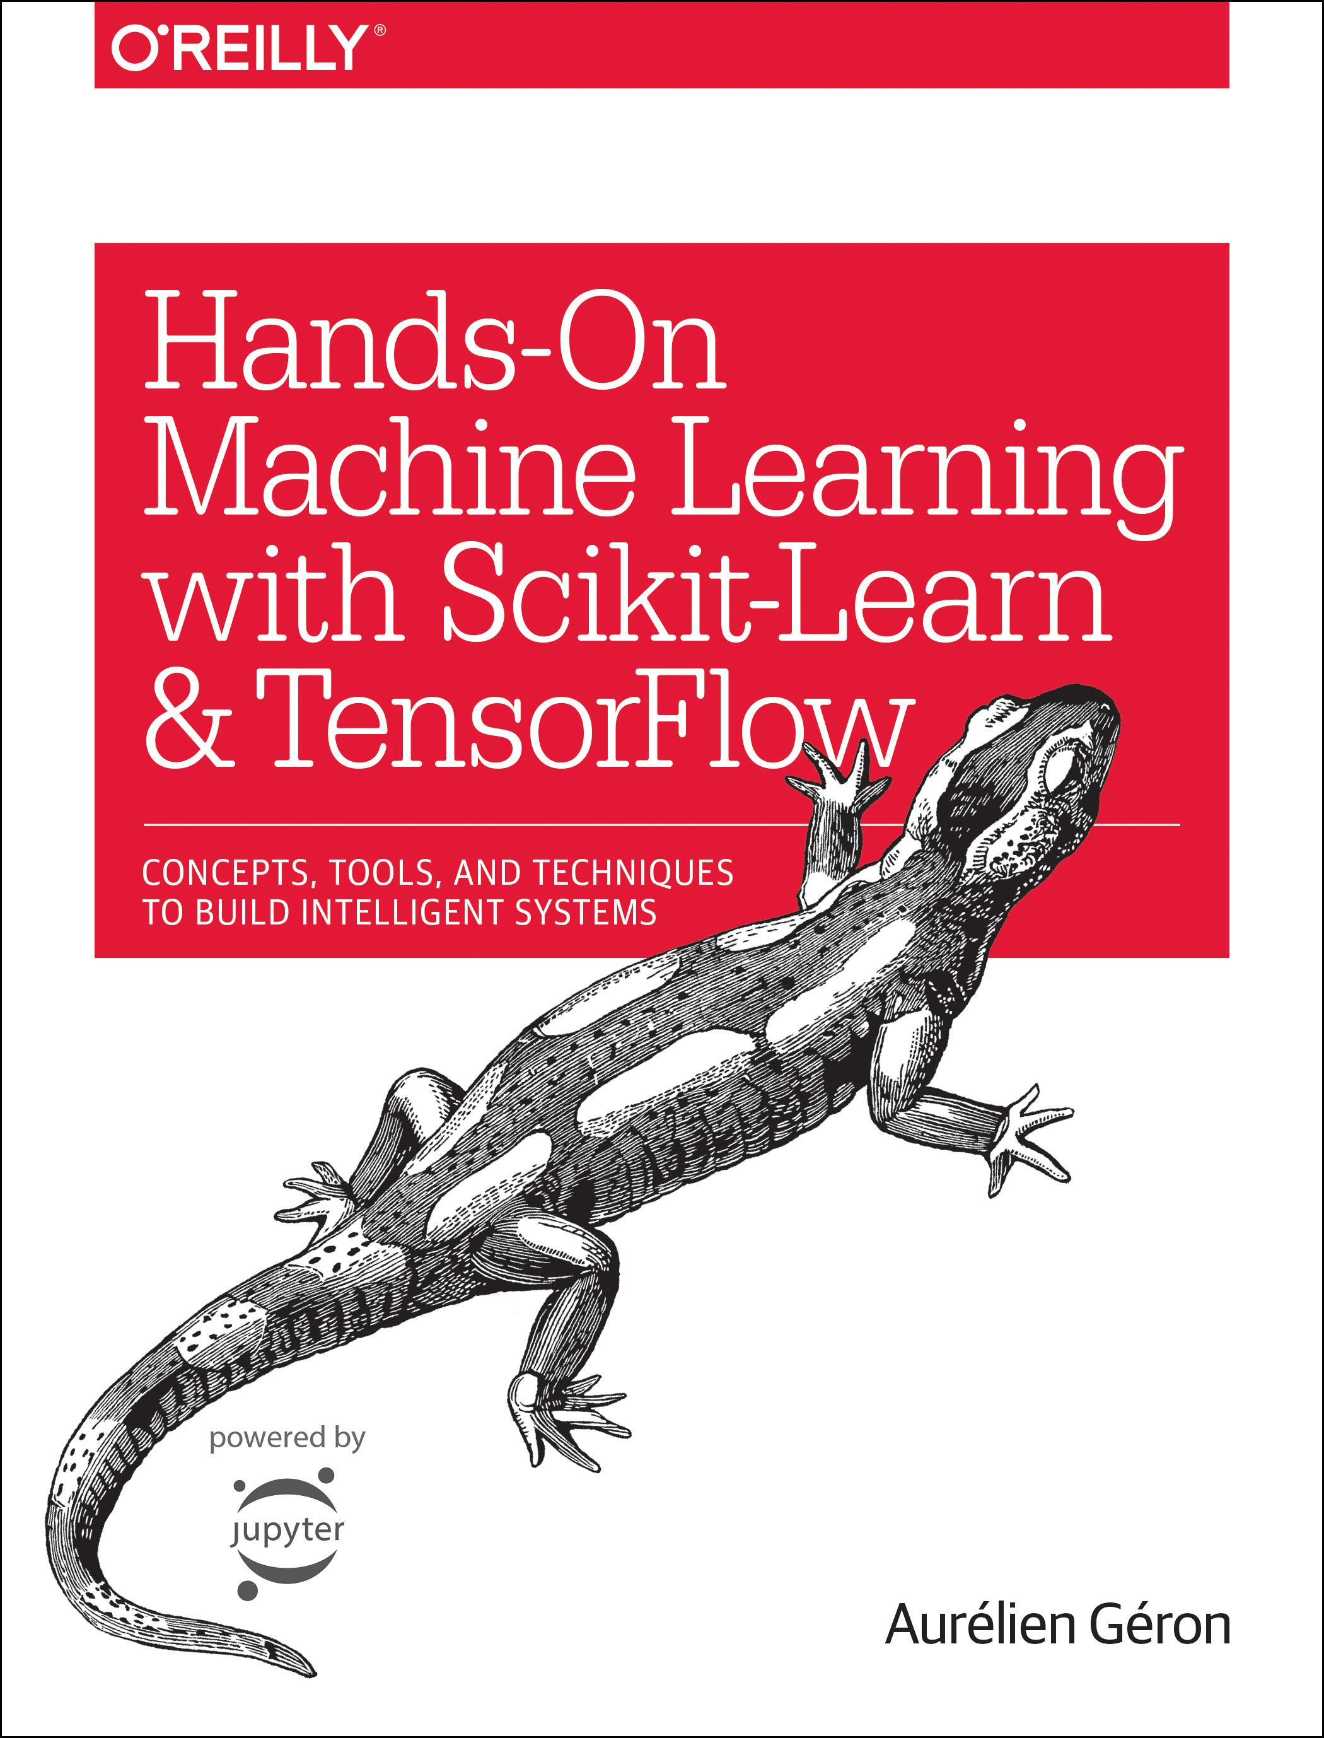
Reference
Chapter 11 (O'Reilly) of Hands-On ML
Youtube
Code

Slide 3
Data

Slide 4
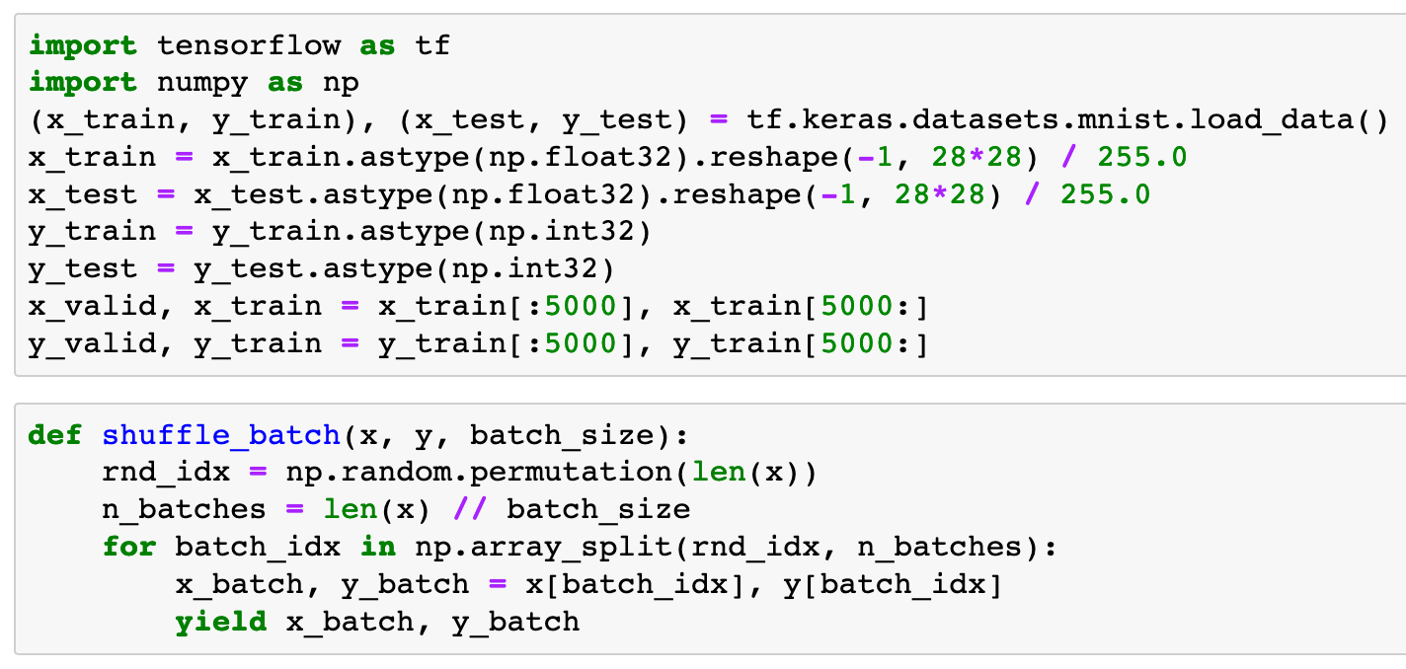


Slide 6
Graph Explicitly Given

Slide 7
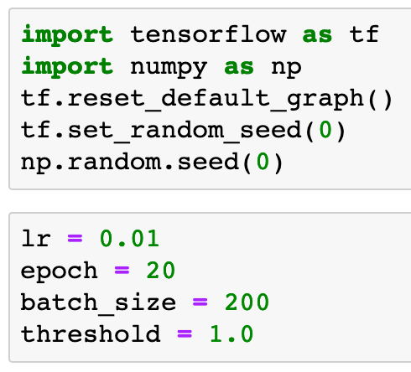

Slide 9
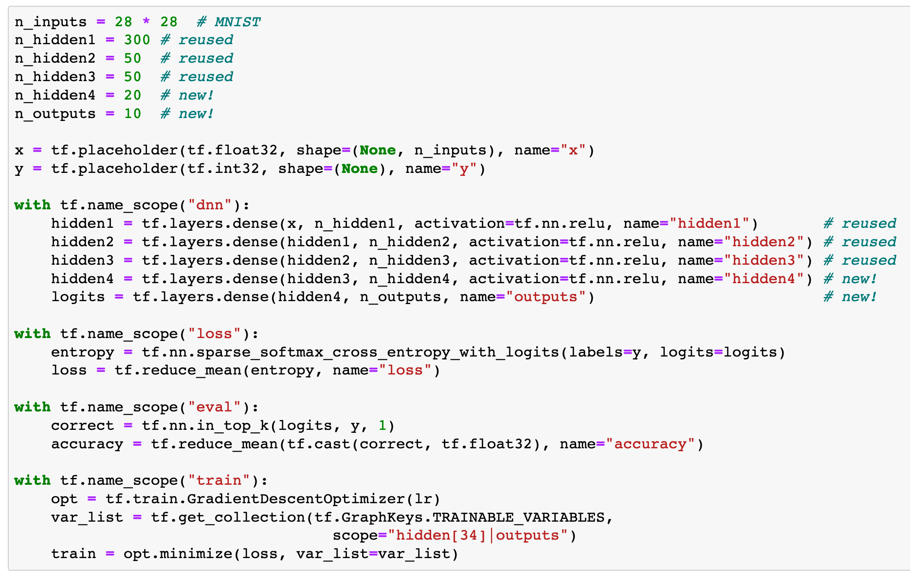
Previously

Slide 10
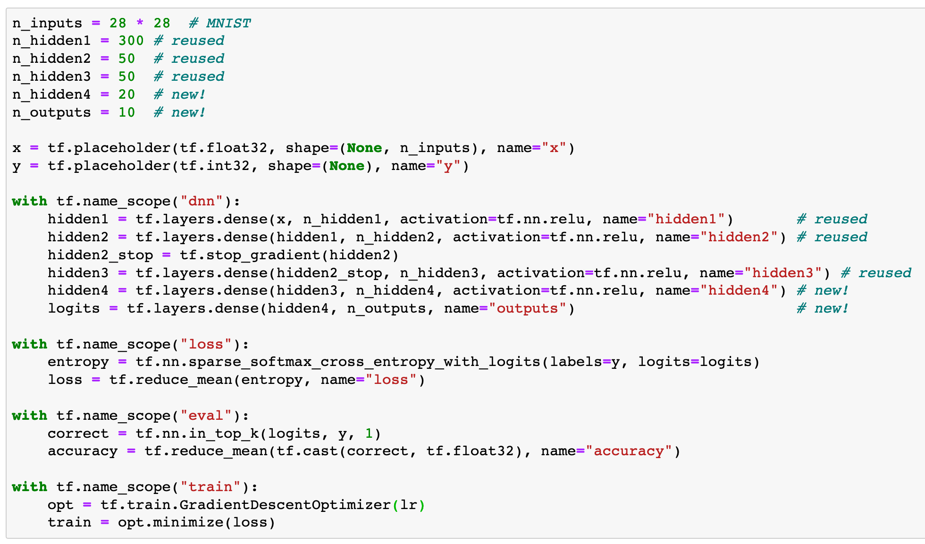
Now

Slide 11
Now
Stop
Gradient
Computation

Slide 12
Make Saver Handle to Restore First Three Layers

Slide 13
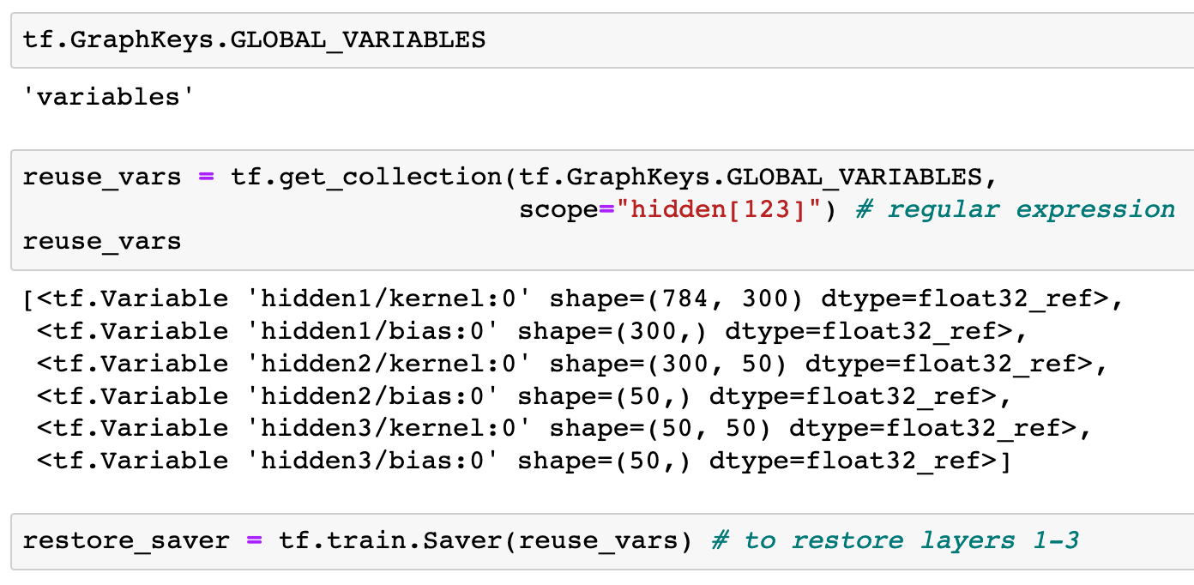

Slide 16
Make Init Handle to Initialize Variables

Slide 17


Slide 18
Make Saver Handle to Save Model

Slide 19


Slide 20
Train Last Layers

Slide 21
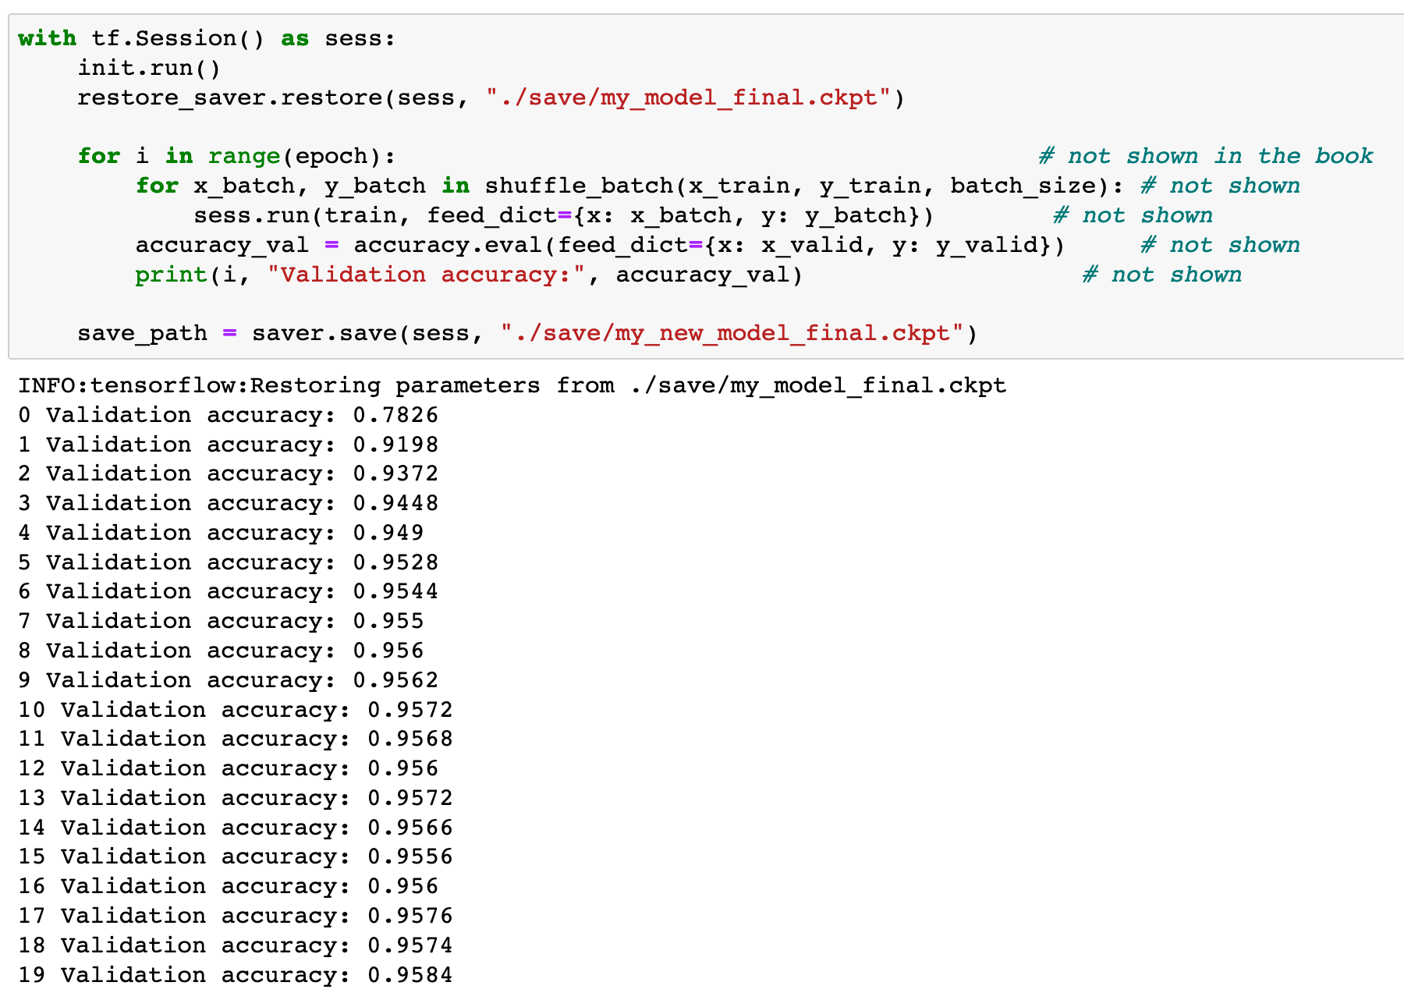

Slide 22
So, this is indeed transfer learning after all

Slide 23
Now
Let’s Play with Code

