Slide 1

tf.layers.dense - Use Different Initializer - get_tensor_by_name and get_operation_by_name

Slide 2

Reference
Chapter 11 (O'Reilly) of Hands-On ML
Youtube
Code

Slide 3
Warm Up

Slide 4
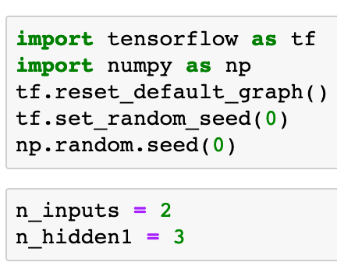


Slide 6
Load the weights from the other framework

Slide 8
Graph

Slide 9
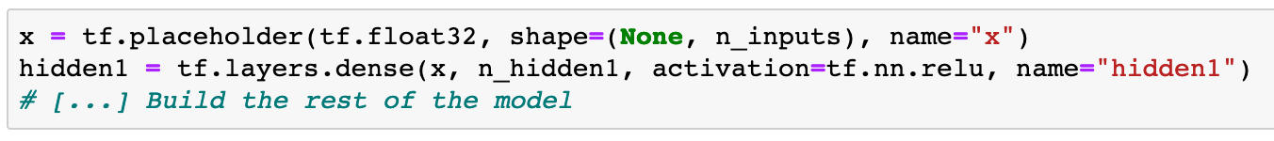

Slide 10
How to Use Different Initializer

Slide 11
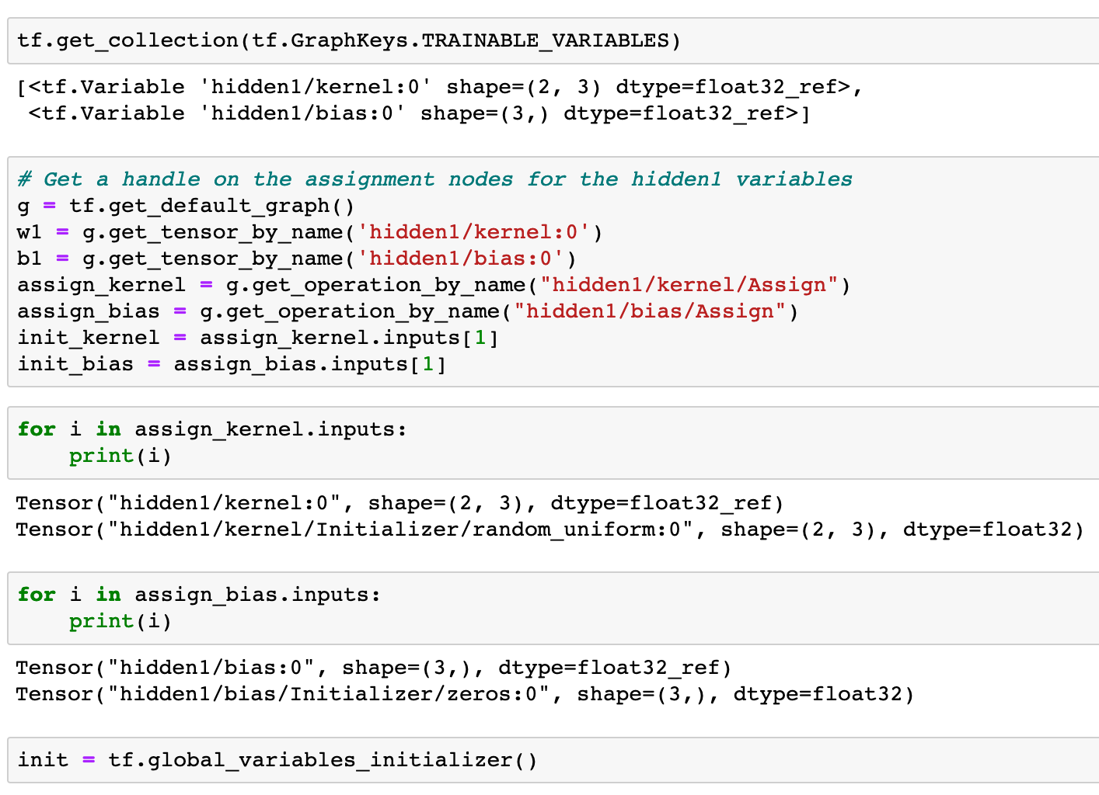

Slide 16
Session

Slide 17
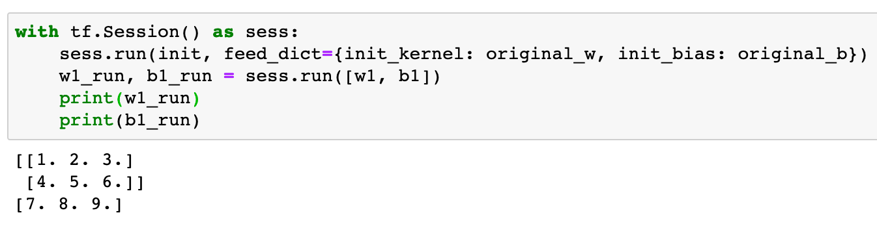

Slide 18
Now
Let’s Play with Code

