Slide 1

Transfer Learning - Freezing Lower Layer

Slide 2
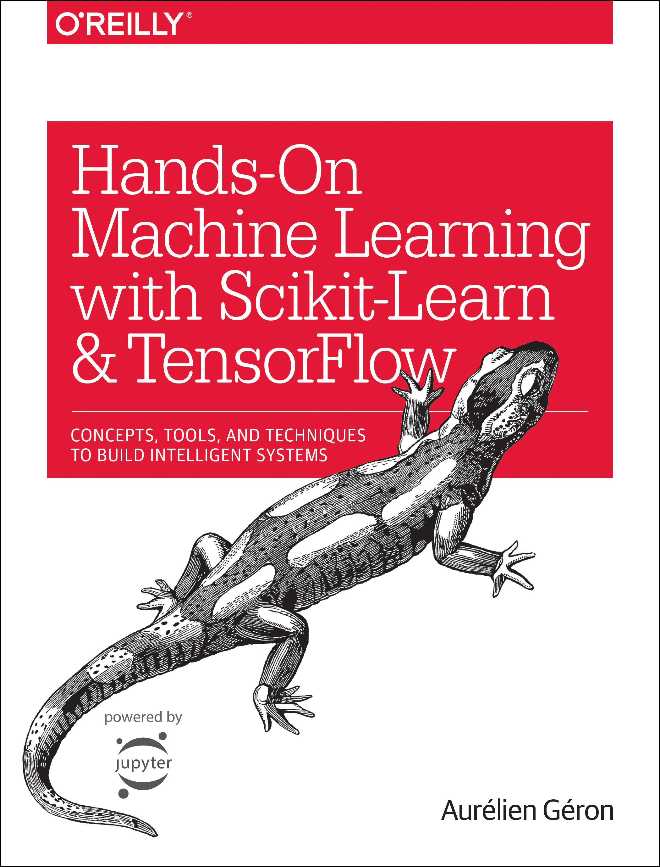
Reference
Chapter 11 (O'Reilly) of Hands-On ML
Youtube
Code

Slide 3
Data

Slide 4
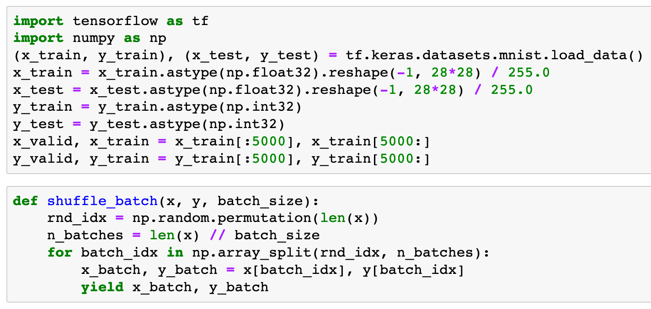


Slide 6
Graph Explicitly Given

Slide 7
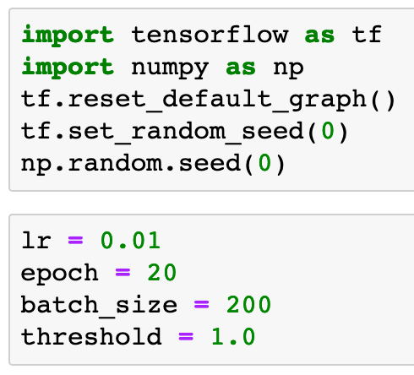

Slide 9
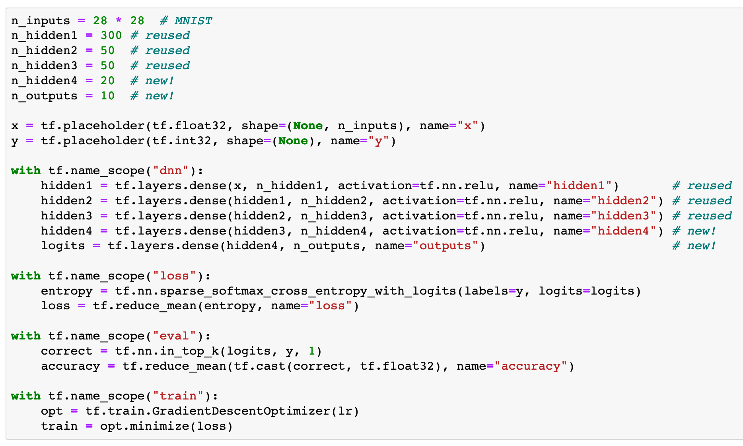
Previously

Slide 10
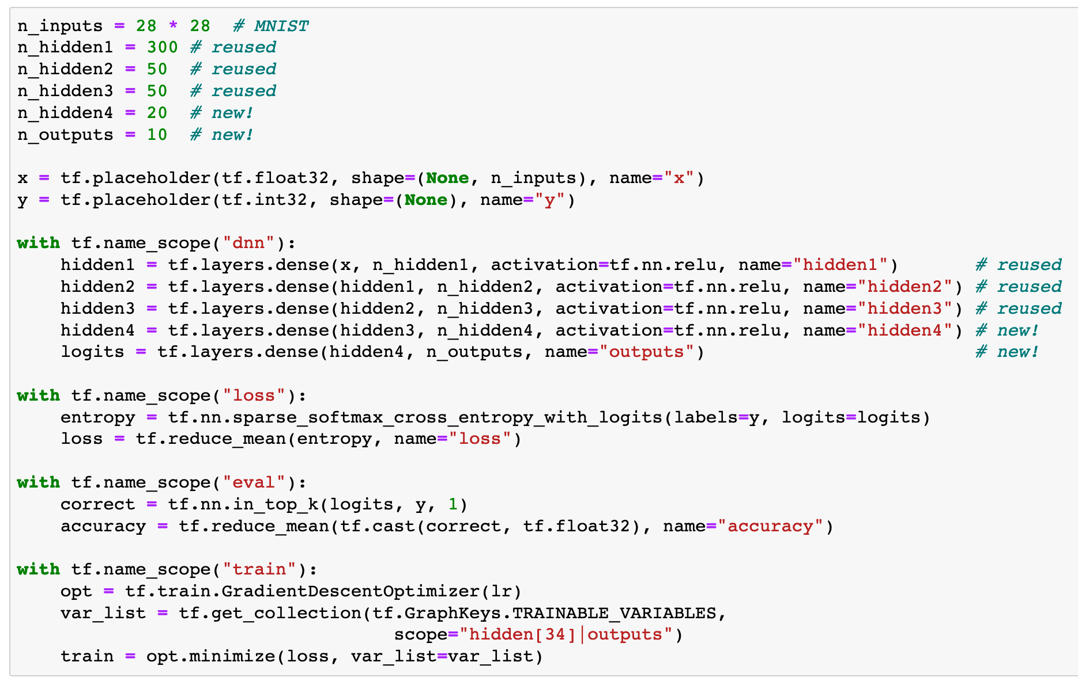
Now

Slide 11
Now
Restrict
Variables

Slide 12
Now
Optimize using Restried Variables
Restrict
Variables

Slide 13
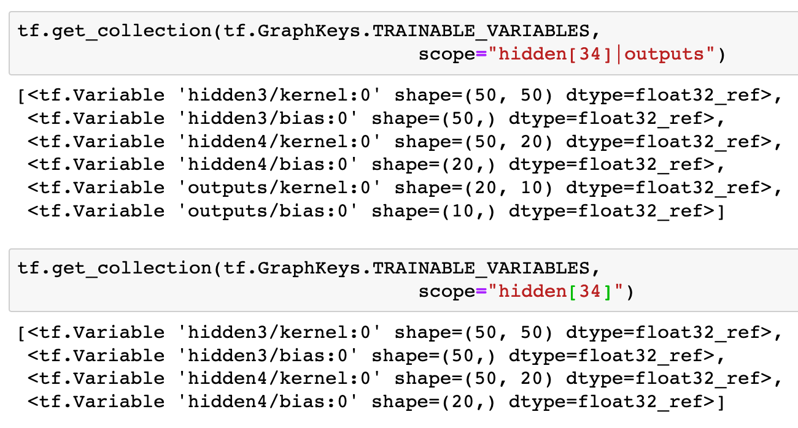

Slide 15
Make Saver Handle to Restore First Three Layers

Slide 16
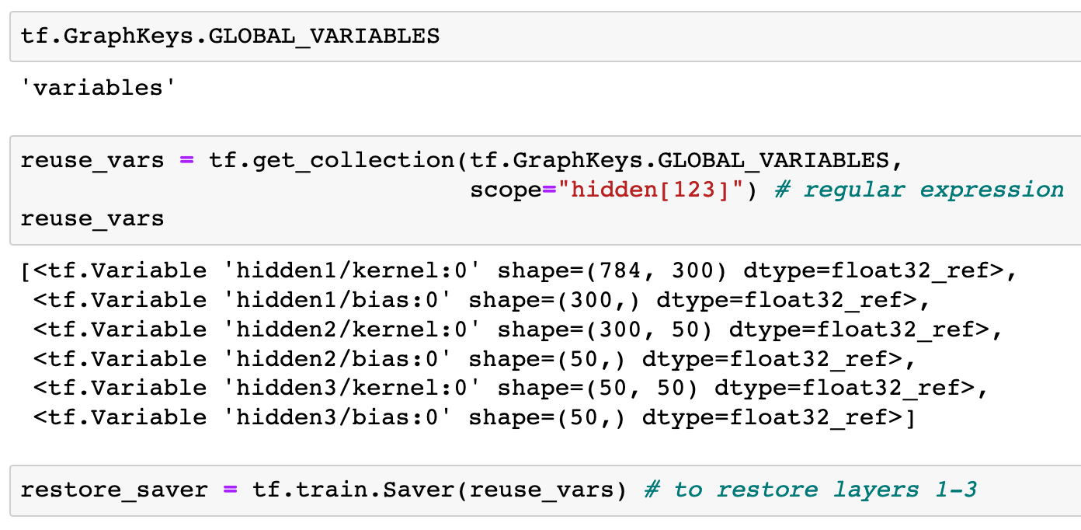

Slide 19
Make Init Handle to Initialize Variables

Slide 20


Slide 21
Make Saver Handle to Save Model

Slide 22


Slide 23
Train Last Layers

Slide 24
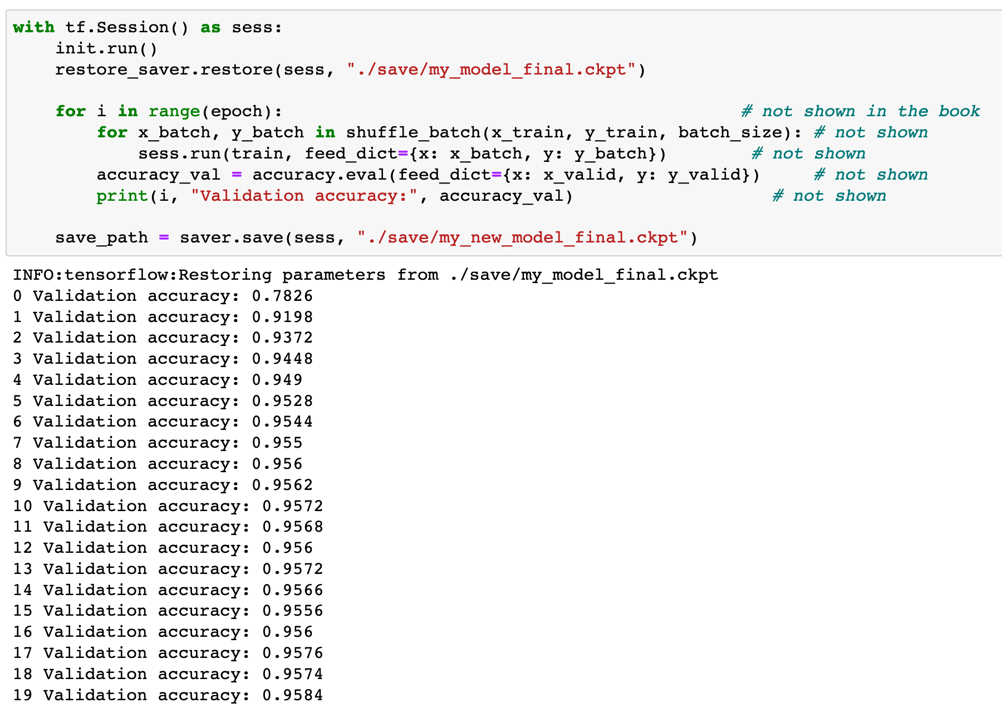

Slide 25
So, this is indeed transfer learning after all

Slide 26
Now
Let’s Play with Code

