Slide 1

L2 Regularization - kernel_regularizer

Slide 2

Reference
Chapter 11 (O'Reilly) of Hands-On ML
Youtube
Code

Slide 3
Data

Slide 4
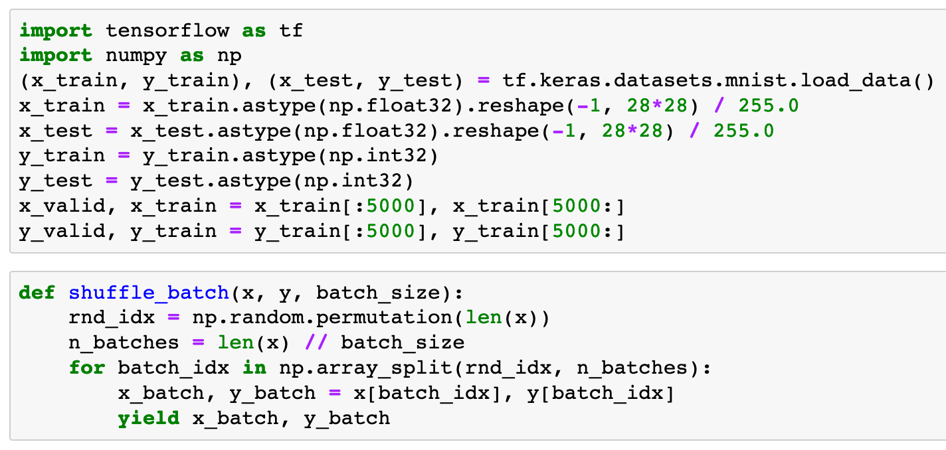


Slide 6
Warm Up

Slide 7
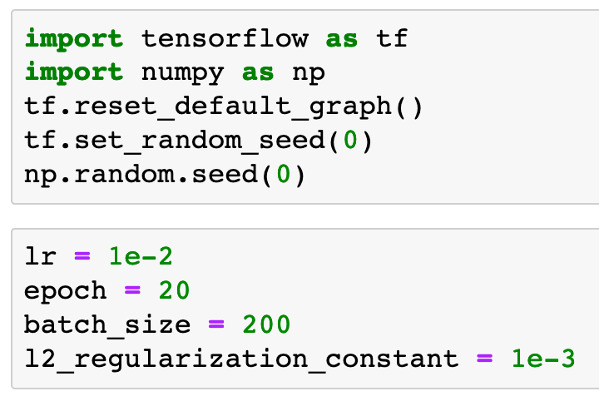

Slide 9
Part of Graph

Slide 10
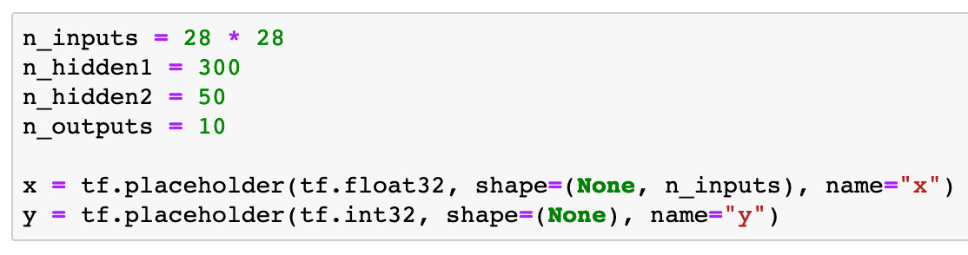

Slide 11
kernel_regularizer

Slide 12
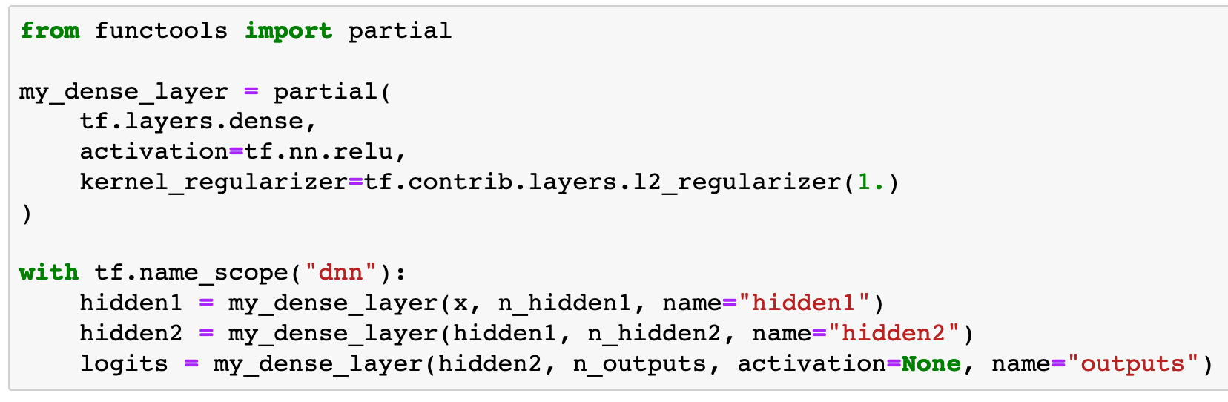

Slide 13
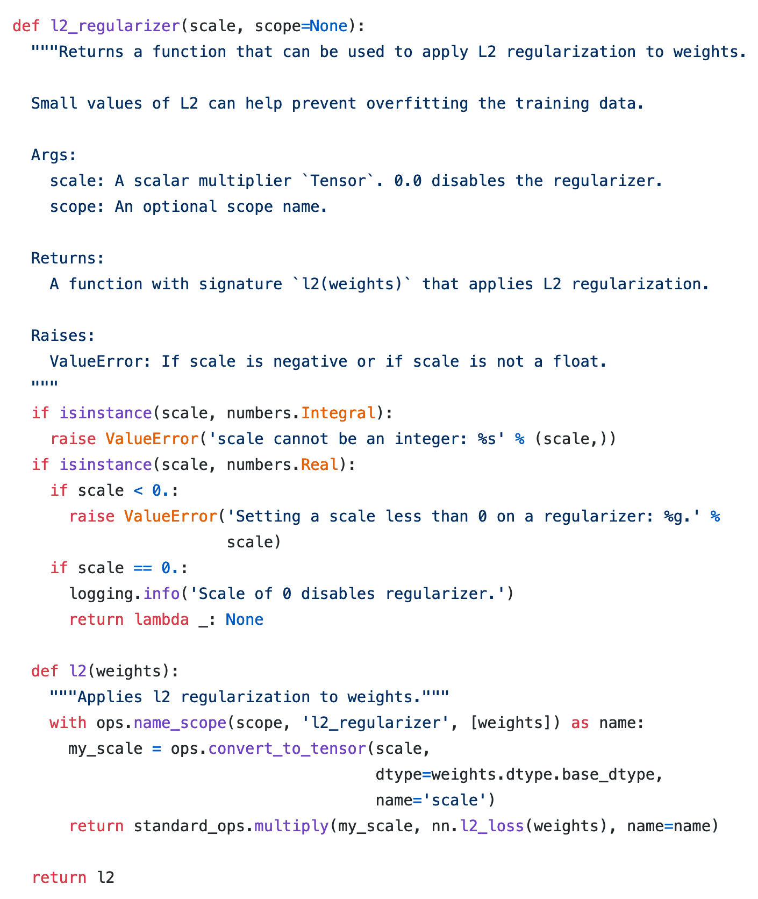
source code

Slide 14
tf.GraphKeys.REGULARIZATION_LOSSES

Slide 15
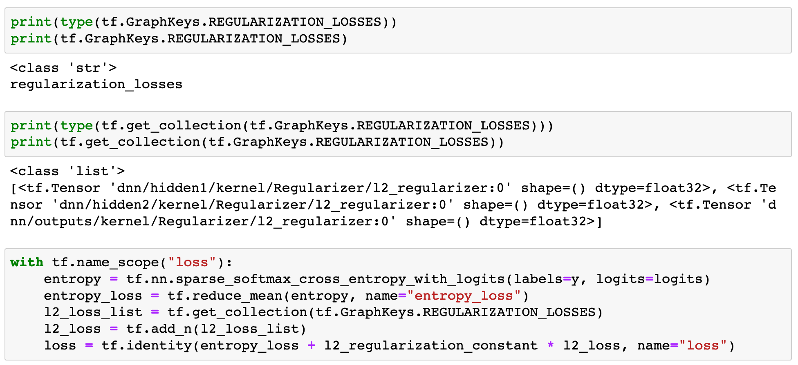

Slide 18
Continue to build Graph

Slide 19
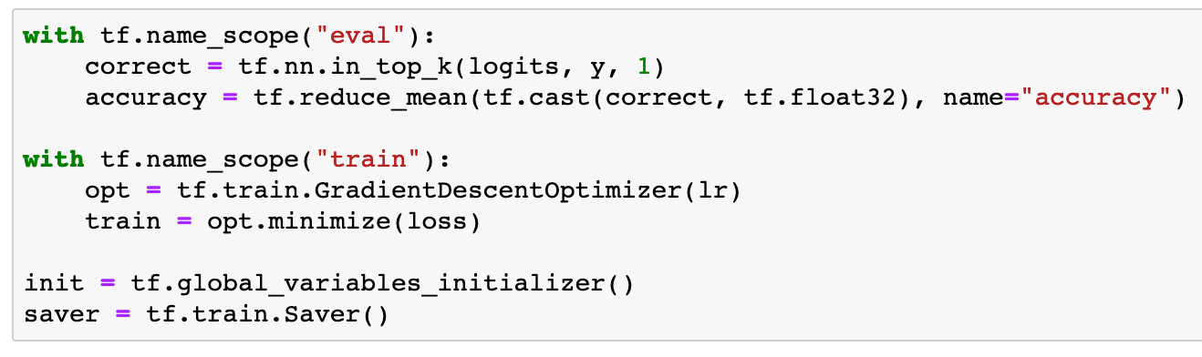

Slide 20
Session

Slide 21
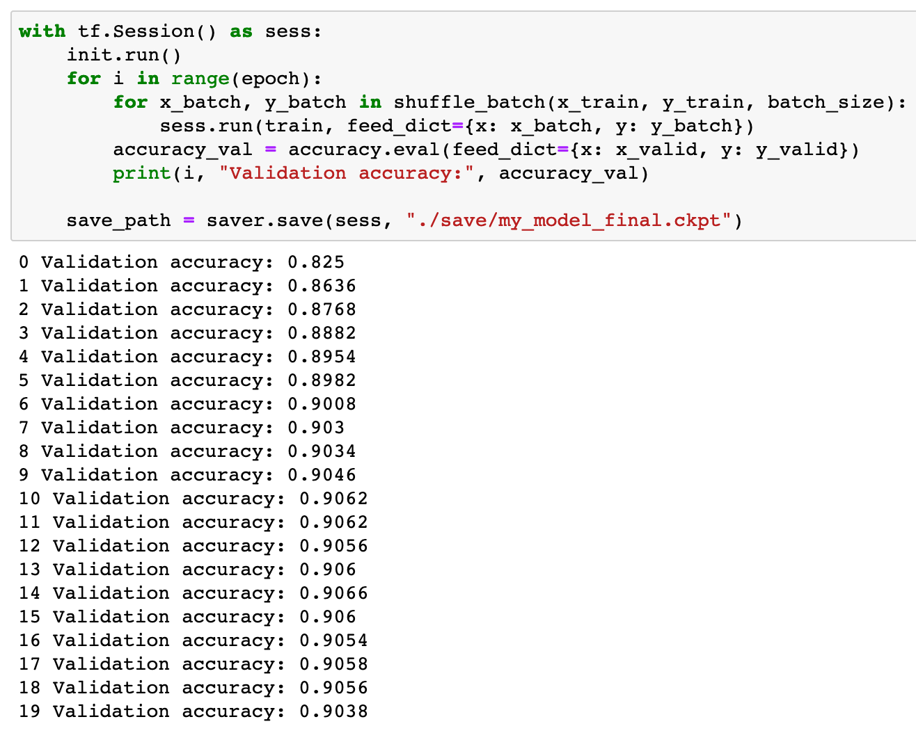

Slide 22
Now
Let’s Play with Code

