Slide 1

Transfer Learning - Freezing Lower Layer with Caching

Slide 2
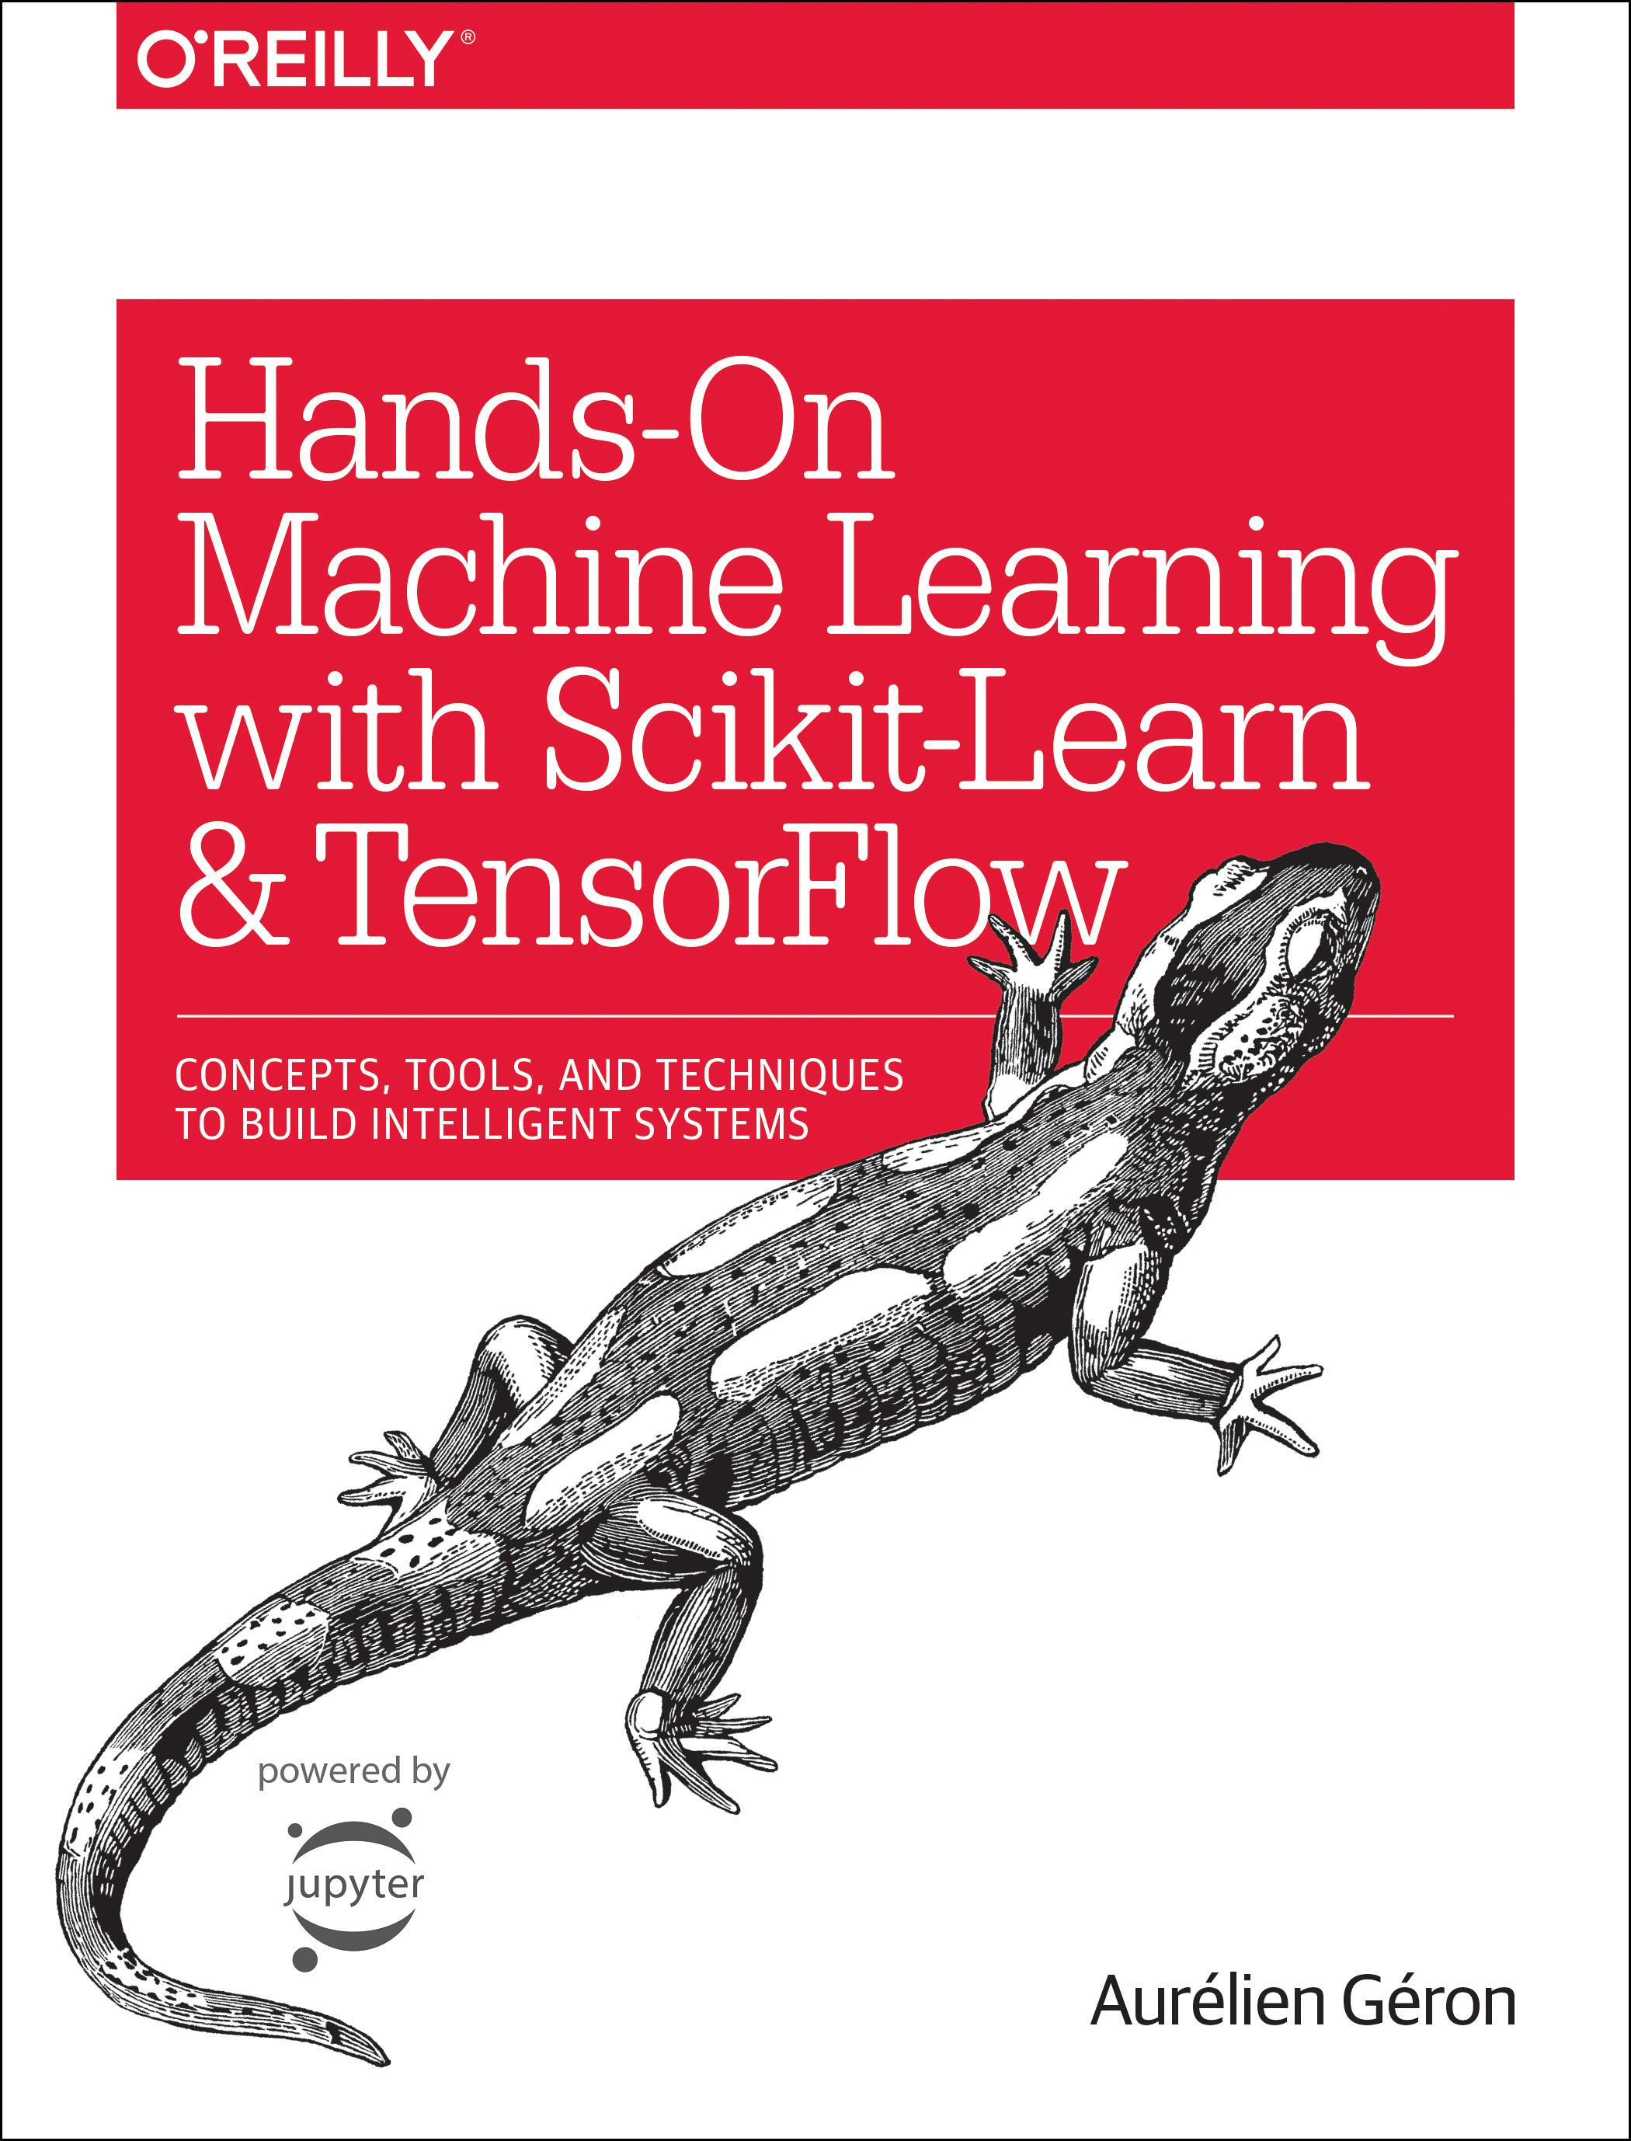
Reference
Chapter 11 (O'Reilly) of Hands-On ML
Youtube
Code

Slide 3
Data

Slide 4
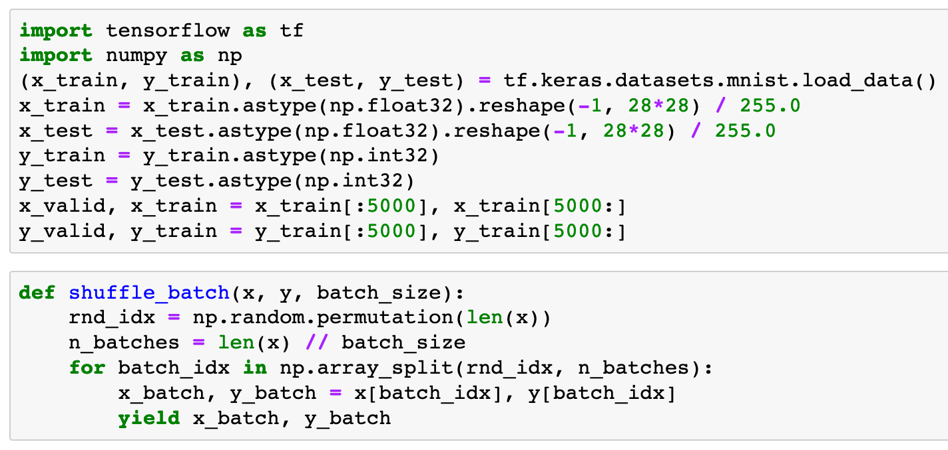


Slide 6
Graph Explicitly Given

Slide 7
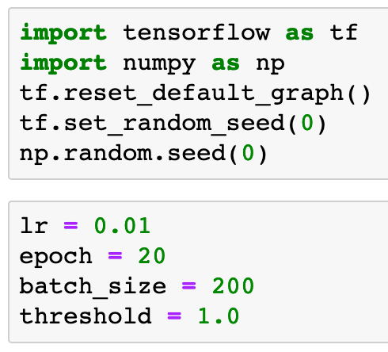

Slide 9
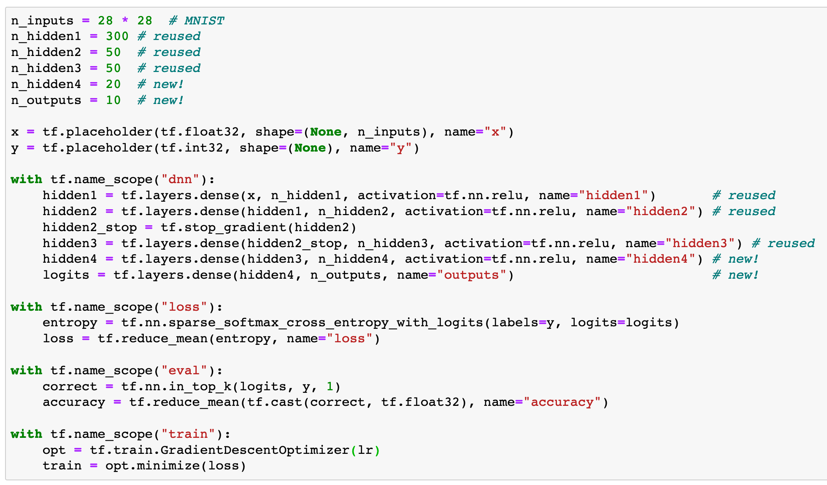

Slide 10
Make Saver Handle to Restore First Three Layers

Slide 11
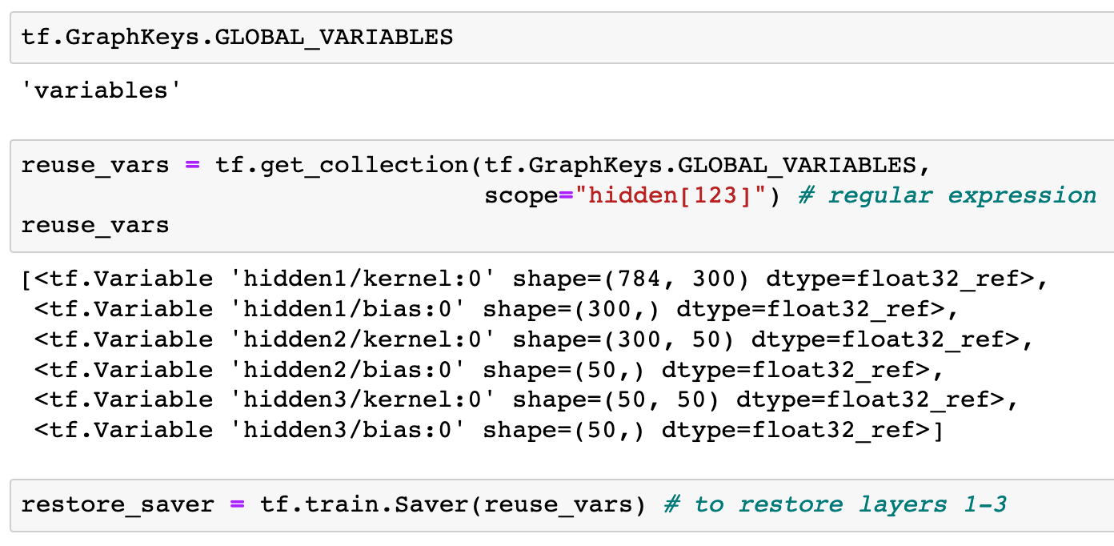

Slide 14
Make Init Handle to Initialize Variables

Slide 15


Slide 16
Make Saver Handle to Save Model

Slide 17


Slide 18
Train Last Layers

Slide 19
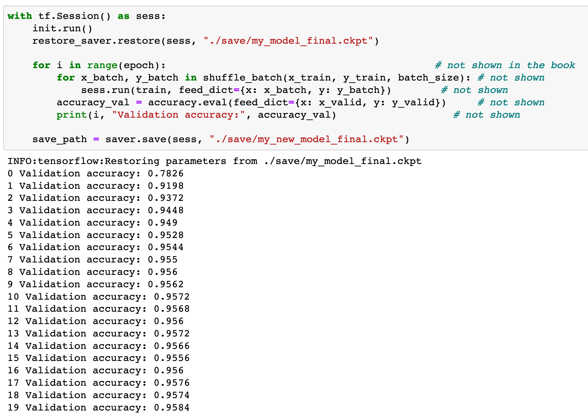
Previously

Slide 20
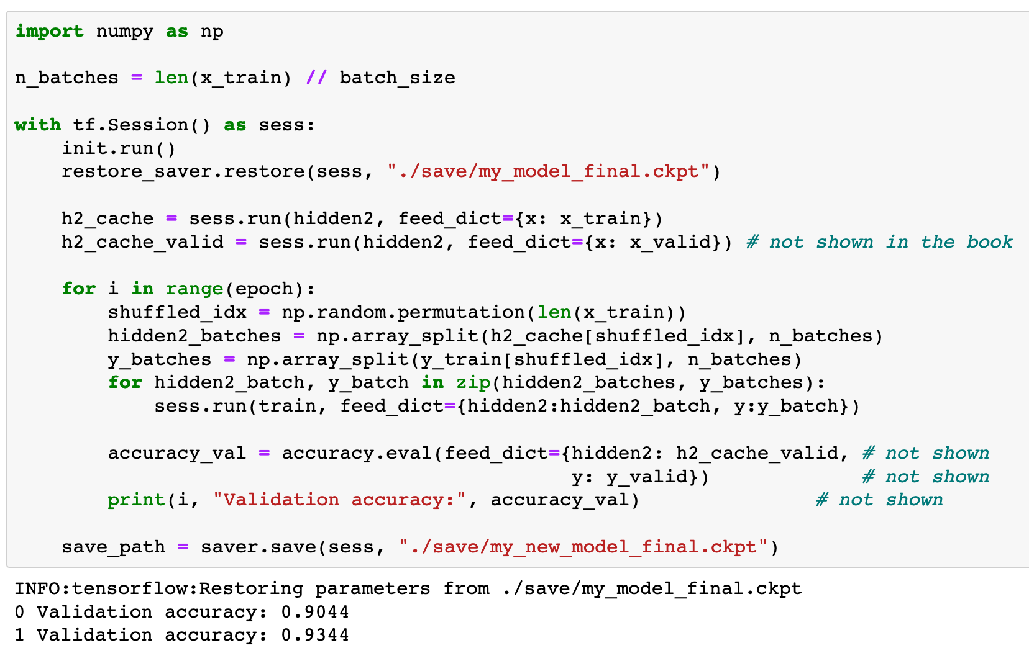
Now

Slide 21
Now
cache
cache

Slide 22
So, this is indeed transfer learning after all

Slide 23
Now
Let’s Play with Code

