Slide 1
Prediction of Customer Revisit Intention using Indoor Movements in Stores
August 16, 2016
Jae-Gil Lee, Associate Professor
Graduate School of Knowledge Service Engineering
KAIST

Slide 2

Overview
Revisit intention
Willingness of a customer to revisit a place (e.g., store)
Important marketing principle
Customer retention is always a higher priority than customer acquisition

Slide 3
Related Work
Inferred the revisit intention of a customer by his/her online reviews about that store
Focused on restaurants where many customers tend to leave online reviews (e.g., on Yelp)
Challenge: what about the retailers where customers usually don’t write online reviews
e.g., UNIQLO, ZARA

Slide 4
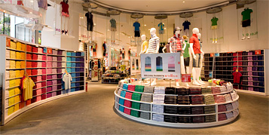
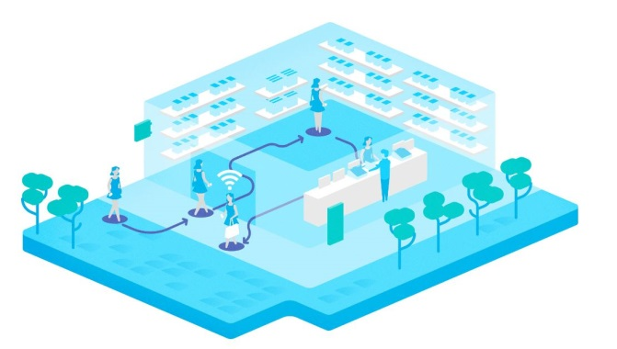
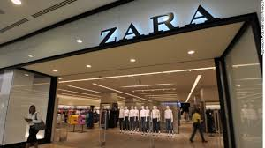
Research Goal
Can we infer the revisit intention of a customer in offline stores by using his/her indoor movement patterns?
UNIQLO
Indoor movement patterns
ZARA

Slide 5

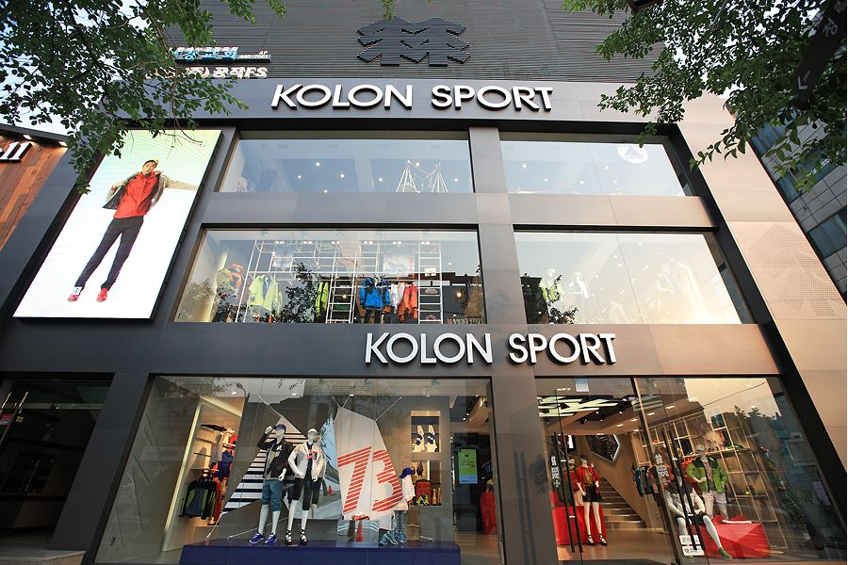
Test Data Collection
KOLON Sport (http://www.kolonsport.com/)
Munjeong-dong (Seoul) branch
Location: close to big apartment towns ← many residents nearby
Daily customer: around 100 on weekdays, around 300~400 on weekends
Period
09/01/2015~04/30/2016 (8 months)
Munjeong-dong branch

Slide 6
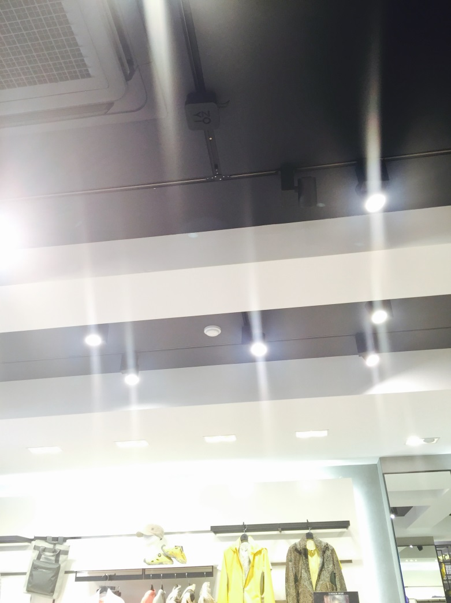
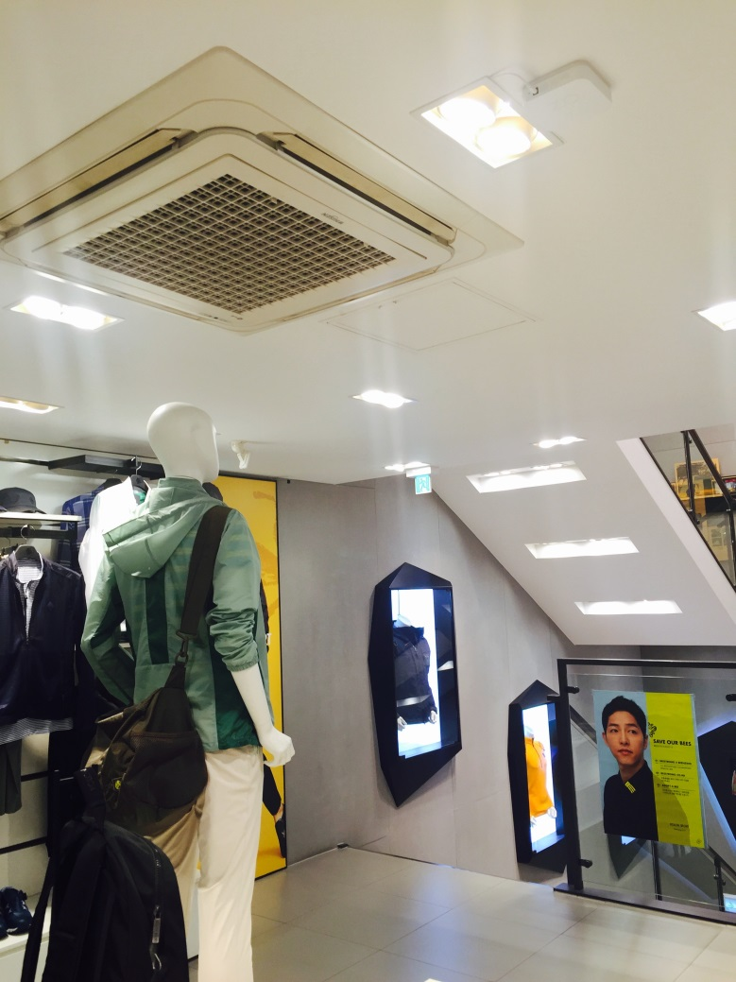
Test Data Set (1/3)
WIFI hotspot installation

Slide 7
Test Data Set (2/3)
Layout of the example store
3 regions on 1F and 2F
Only 1 region on 3F
1F (woman) 2F (man) 3F (outdoor)
Door
1F-inner
Stair
2F-inner
Stair
3F
Stair
1F-right
2F-right
1F-left
2F-left

Slide 8
Test Data Set (3/3)
Statistics
Number of log records: around 2,721,000
Number of unique customers: 39,211
Attributes
Attribute | Description
device_id | MAC address of a mobile phone
dwell_time | Dwell time at a region
area | Region in a store (see page 7)
revisit_count | Accumulate number of visits to a store
revisit_period | Days passed since the last visit
deny | Staff or customer
ts | Timestamp
Example of a log record:
device_id: “aafc10…c149e1”
dwell_time: 35
area: “1f-left”
revisit_count: 52
revisit_period: 1
deny: true
ts: 1449457815168

Slide 9



Methodology
Based on supervised learning
Indoor movements User profiles
Social media …
Feature Generation
Movement Pattern Features
User Profile Features
Supervised (Deep) Learning
Predict the revisit intention of a new customer using the model
Model

Slide 10
Challenges
How to derive useful features from the log data?
Some ideas (tentative)
Stay time, number of stay points, variance of the stay times at each stay point (e.g., stayed very long at a certain region but very short at other regions)
Transit patterns between stay points
Existence of accompanying persons, interaction with accompanying persons (e.g., the accompanying persons browsed together or separately)
…

Slide 11
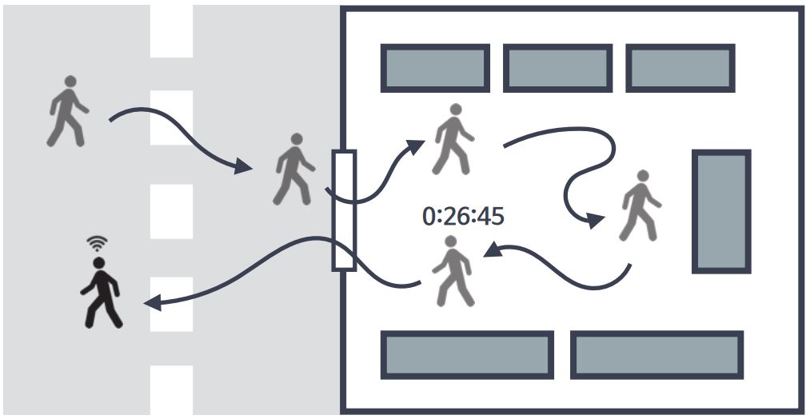
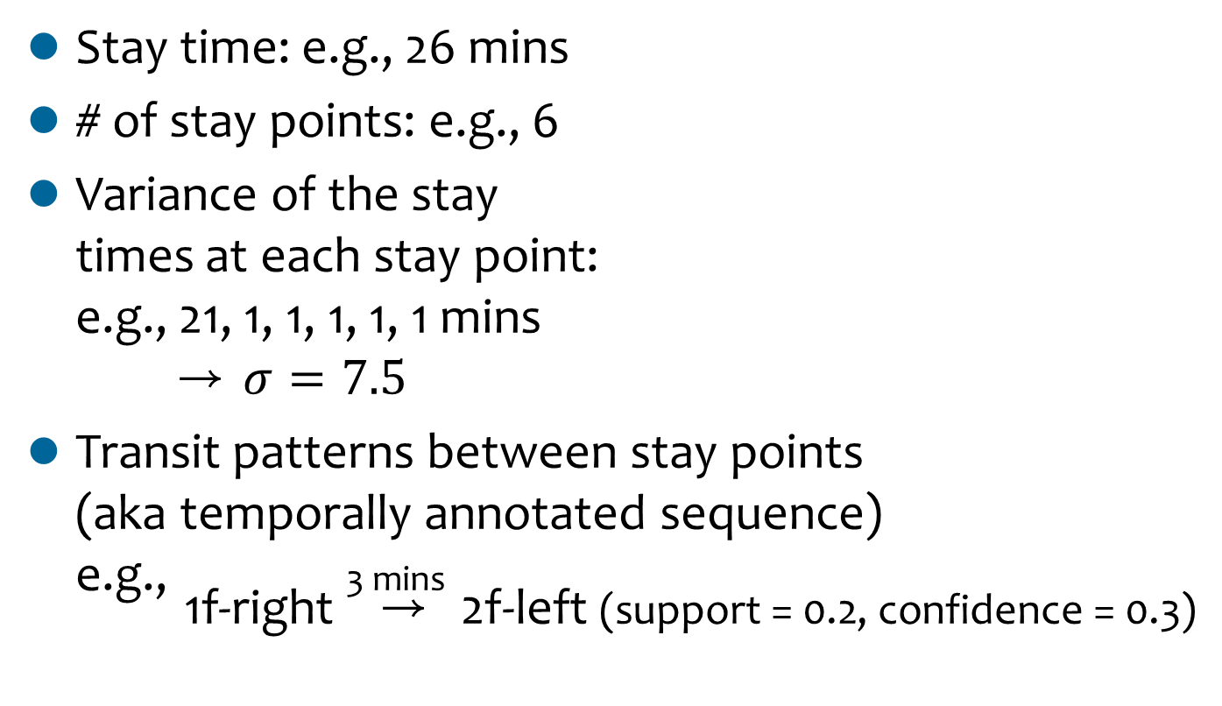
Stay Time Features
Stay time: e.g., 26 mins
# of stay points: e.g., 6
Variance of the stay times at each stay point: e.g., 21, 1, 1, 1, 1, 1 mins → $σ=7.5$
Transit patterns between stay points (aka temporally annotated sequence) e.g., 3 mins
1f-right → 2f-left (support = 0.2, confidence = 0.3)
Stay points: the regions where the customer stayed longer than a threshold

Slide 12
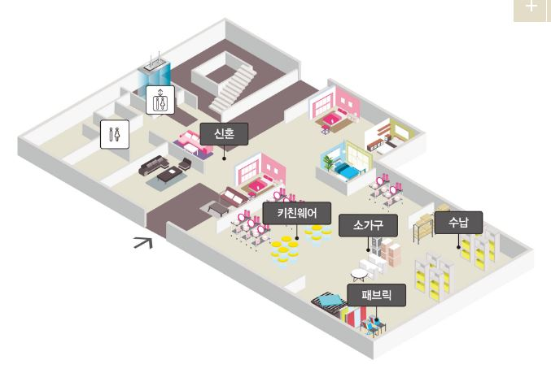


Group Movement Features
Existence of accompanying persons: e.g., 2 persons
Interaction with accompanying persons
Proportion of the time being together: e.g., 15 mins / 26 mins = 0.58
Region: wedding
Ts: 11:02:30
Region: wedding
Ts: 11:02:22

Slide 13
Issues
Using only the movement patterns might not be sufficient to precisely infer the revisit intention
However, currently, the data set does not have external data (e.g., transactions, user identities, …)
We need to negotiate with KOLON (data owner) to get additional data

Slide 14
Thank you very much!
Jae-Gil Lee (이재길, 李在吉)
Associate Professor
Graduate School of Knowledge Service Engineering / Department of Industrial and Systems Engineering, KAIST
Phone: 042-350-1617
Fax: 042-350-1610
Mobile: 010-3381-5203
E-mail: jaegil@kaist.ac.kr
Lab homepage: http://dm.kaist.ac.kr/

