Slide 1
Chicken Site review & Manage web
Yoo, J. H.
32212808
Department of Mobile Systems Engineering
Kim, K. Y.
32220393
Department of Software Engineering

Slide 2
Table of Contents
HTML CSS JavaScript combinations & Supporting platform
GitHub usage
Roles and responsibility
Topic / General presentation
Time
Collaboration
AI too usage
How did you use it?

Slide 3
HTML CSS JavaScript combinations & Supporting platform
{% load static %}
<!DOCTYPE html>
<html lang="ko">
<head>
<meta charset="UTF-8" />
<title>치킨 목록</title>
<link rel="stylesheet" href="{% static 'style.css' %}">
</head>
<body>
<!-- Omitted -->
<script src="{% static 'script.js' %}"></script>
</body>
</html>
{% for x in list %}
<p>Name: {{ x.name }}</p>
{% empty %}
<p>List is empty</p>
{% endfor %}
{% if some_number < 3 %}
<p>{{ some_number }} is smaller than 3</p>
{% elif some_number == 3 %}
<p>{{ some_number }} is 3</p>
{% else %}
<p>{{ some_number }} is larger than 3</p>
{% endif %}
We use a unique HTML
that's different from the existing HTML

Slide 4
HTML CSS JavaScript combinations & Supporting platform
/* Buttons - 그라데이션 및 호버 효과 */
.btn {
/* 핫핑크 그라데이션 */
background: linear-gradient(45deg, var(--primary), #ff40c080);
color: var(--bg);
border: 1px solid var(--primary);
}
.btn:hover {
background: linear-gradient(45deg, var(--accent), var(--primary)); /* 호버 시 색상 전환 */
transform: translateY(-2px);
box-shadow: 0 6px 10px rgba(0, 0, 0, 0.15);
}
.btn-warm {
/* 따뜻한 노란색 그라데이션 */
background: linear-gradient(45deg, var(--warm), #ffc04080);
color: var(--text);
border: 1px solid var(--warm);
}
.btn-warm:hover {
filter: brightness(1.05);
transform: translateY(-2px);
box-shadow: 0 6px 10px rgba(0, 0, 0, 0.15);
}
// Login user
function loginUser() {
const username = document.getElementById('username').value;
const password = document.getElementById('password').value;
fetch('/login/', {
method: 'POST',
headers: { 'Content-Type': 'application/x-www-form-urlencoded' },
body: `username=${encodeURIComponent(username)}&password=${encodeURIComponent(password)}`
})
.then(response => response.json())
.then(data => {
if (data.success) {
alert(data.data.message);
window.location.href = '/';
} else {
alert(data.error);
}
});
}

Slide 5
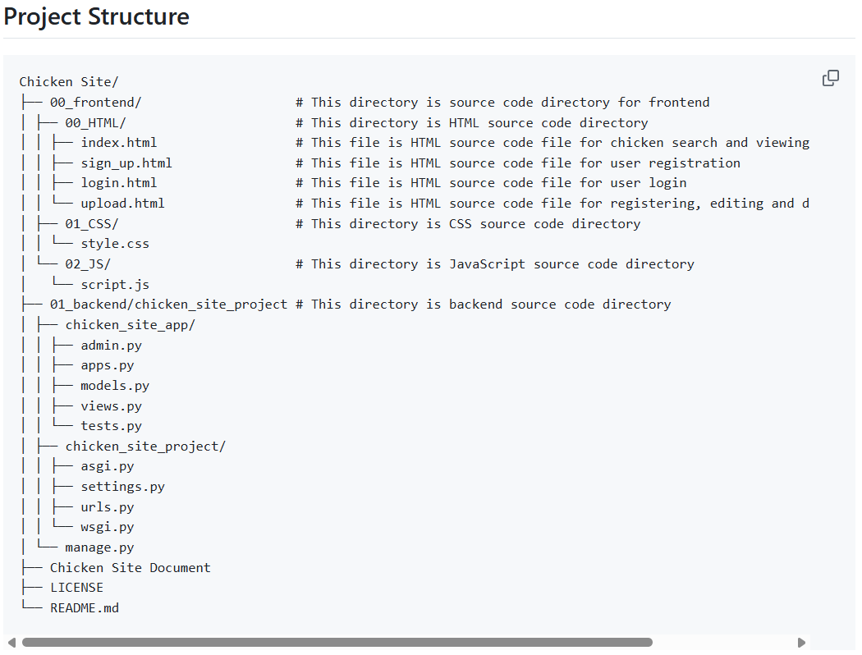
Backend - Django
Django follows the MVT pattern,
which is derived from the MVC pattern
MVC = Model View Controller
MVT = Model View Template
M = models.py
V = views.py
C = Django + urls.py
T = Templates = Frontend
We modified several files
settings.py
SQLite
Other files in Django Backend
admin.py
apps.py
tests.py
asgi.py and wsgi.py

Slide 6
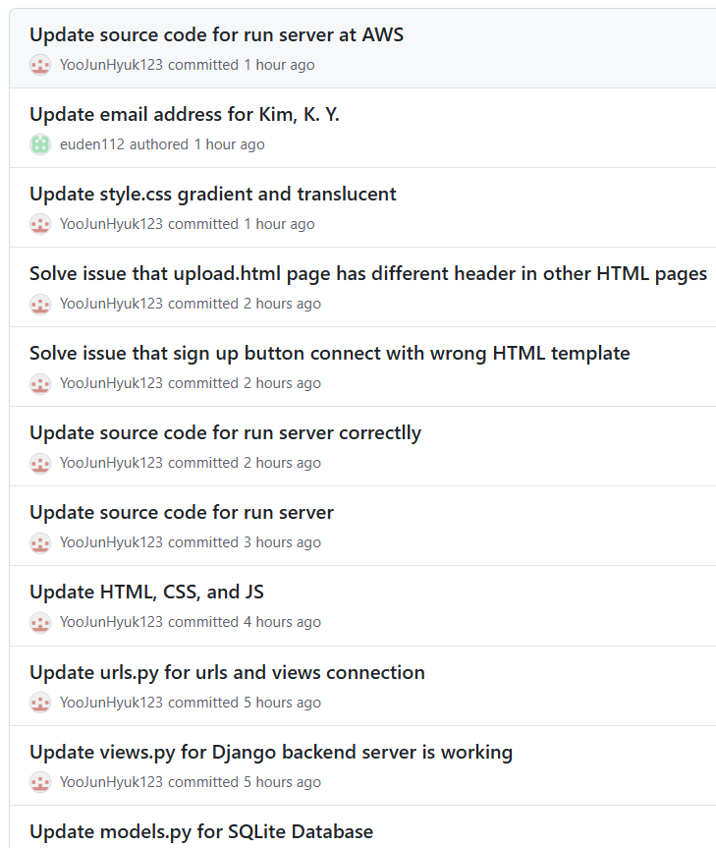
GitHub usage
# Chicken Site
This project is project that building chicken web server. This project utilizes HTML, CSS, JavaScript, Amazon Web Services(AWS), and Python Django.
## Feature
- Provides user registration, login, and logout functionality.
- Logged-in users can register, edit, and delete chicken item, including: image URL, brand, style(fried, spicy, soy sauce, mala, cheese), name, spiciness level, sweetness level, crispiness level, and a short description.
- Both logged-in and non-logged-in users can search and view all registered chicken items.
GitHub is good for manage project
Branch
Commit
Also GitHub README.md file is good
Not only person know what we are doing
But also can use README
for AI know what we are doing

Slide 7

Video

Slide 8
Roles and responsibility
 | Yoo, J. H. | Kim, K. Y.
HTML | Write Skeleton Code & Modify Django Static HTML | Write Skeleton Code & Connect with JS
CSS | Write Skeletion Code & Make aesthetically with Gemini | Write Skeleton Code
JavaScript | Write Code & Connect with Django Server | Write Skeleton Code & Implement function with GPT
Backend | Write Python Django Code | -

Slide 9
Topic / General presentation
Topic
a community based web site where users can directly register and share information about various chicken brands and menus
Main Goal
Quick search
Instant information search through brands and menu names
Standardized taste evaluation
Quantify spiciness, sweetness, and crispiness on a 5-point scale
User scenario
1. Login & Register
2. Explore & Rate
3. Edit & Manage

Slide 10
Time
Planning stage
We established a core goal: "A web service for sharing and managing chicken information."
Key features were listed, including membership registration/login, chicken card registration, and search/filter functions.
Design stage
Designed the UI configuration and data flow of the front-end pages (auth, chicken_add, chicken_list).
Implementation stage
Implemented the front-end and back-end and connected them respectively

Slide 11



Collaboration
-We use Github and google, discord

Slide 12
AI too usage
Our Prompt
“Create gradients and translucent cards in CSS to give it a sophisticated design.”
"Tell me how to connect Django, JS, and HTML all together."
“Please recommend some functions to add to the frontend”
“Separate HTML by function”
“Review the search functions for errors.”
“Please tell me how to usually implement login/logout functionality”

Slide 13
How did you use it?
Chatgpt
Function implementation
Modify some errors
Help writing Skeleton Code
Help Connecting with JS, HTML and Django Server
Gemini
CSS Decoration

Slide 14
Thank you
Q & A

