Slide 1
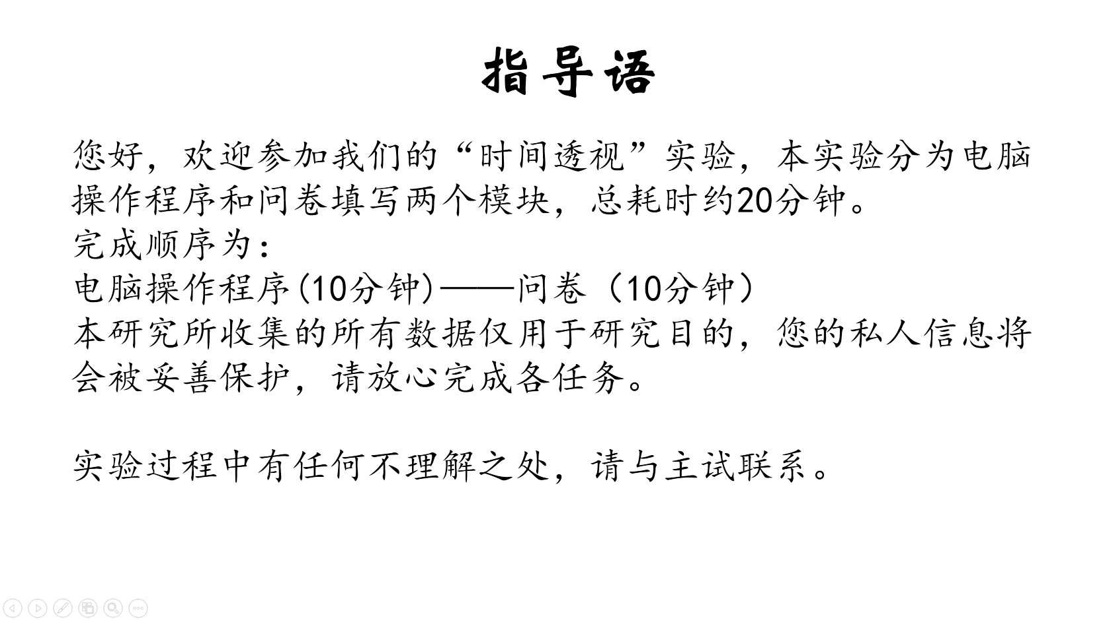
指导语
您好，欢迎参加我们的“时间透视”实验，本实验分为电脑操作程序和问卷填写两个模块，总耗时约20分钟。
完成顺序为：
电脑操作程序(10分钟)——问卷（10分钟）
本研究所收集的所有数据仅用于研究目的，您的私人信息将会被妥善保护，请放心完成各任务。
实验过程中有任何不理解之处，请与主试联系。

Slide 2
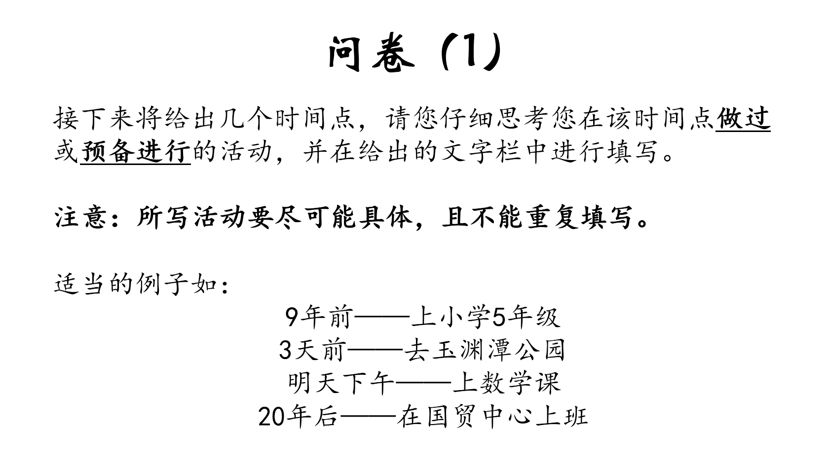
问卷（1）
接下来将给出几个时间点，请您仔细思考您在该时间点做过或预备进行的活动，并在给出的文字栏中进行填写。
注意：所写活动要尽可能具体，且不能重复填写。
适当的例子如：
9年前——上小学5年级
3天前——去玉渊潭公园
明天下午——上数学课
20年后——在国贸中心上班

Slide 3
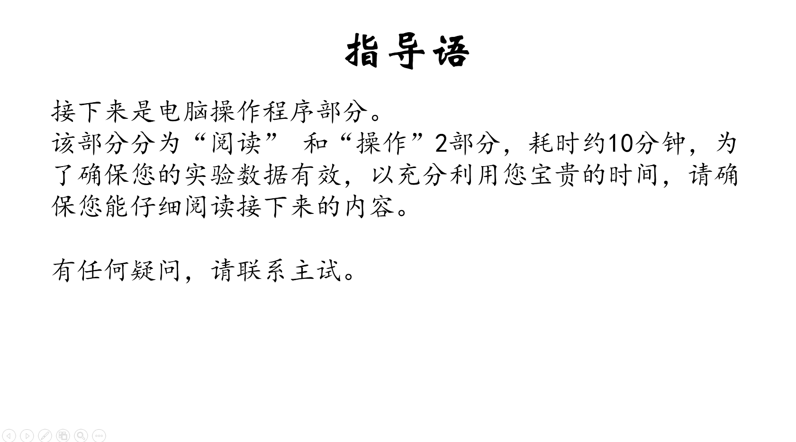
指导语
接下来是电脑操作程序部分。
该部分分为“阅读” 和“操作”2部分，耗时约10分钟，为了确保您的实验数据有效，以充分利用您宝贵的时间，请确保您能仔细阅读接下来的内容。
有任何疑问，请联系主试。

Slide 4
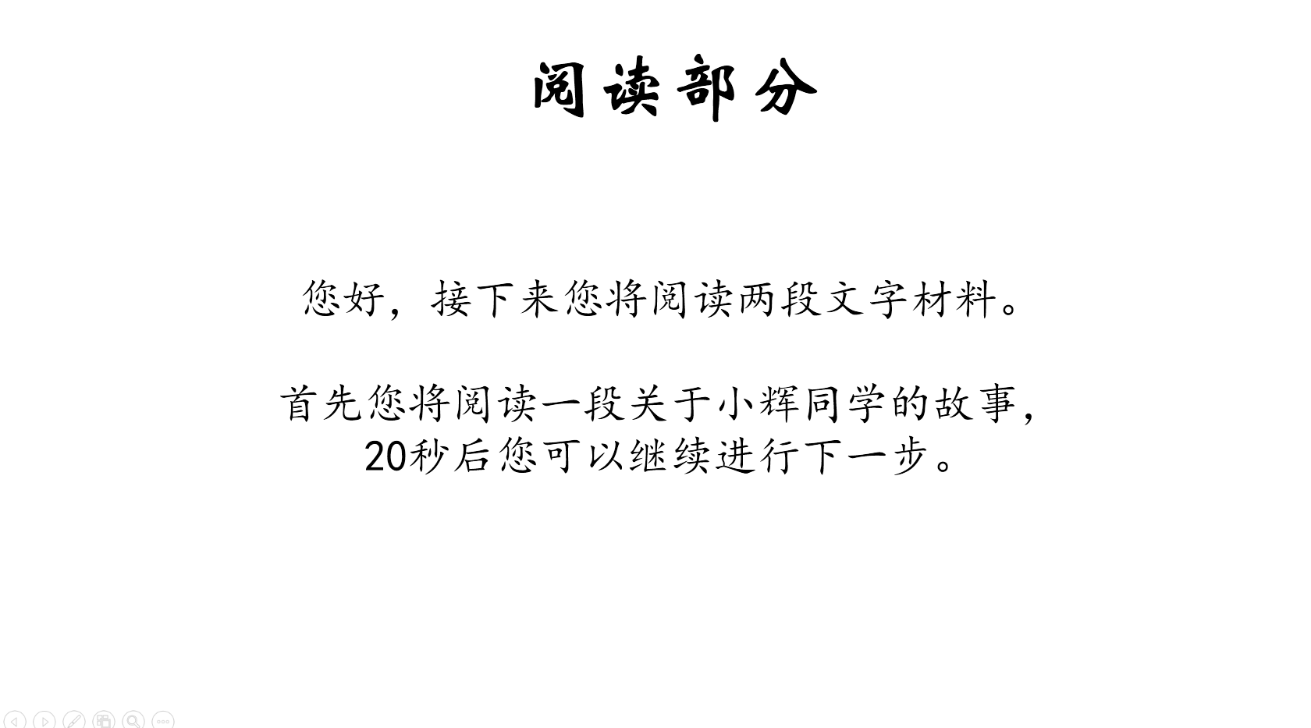
阅读部分
您好，接下来您将阅读两段文字材料。
首先您将阅读一段关于小辉同学的故事，
20秒后您可以继续进行下一步。

Slide 5
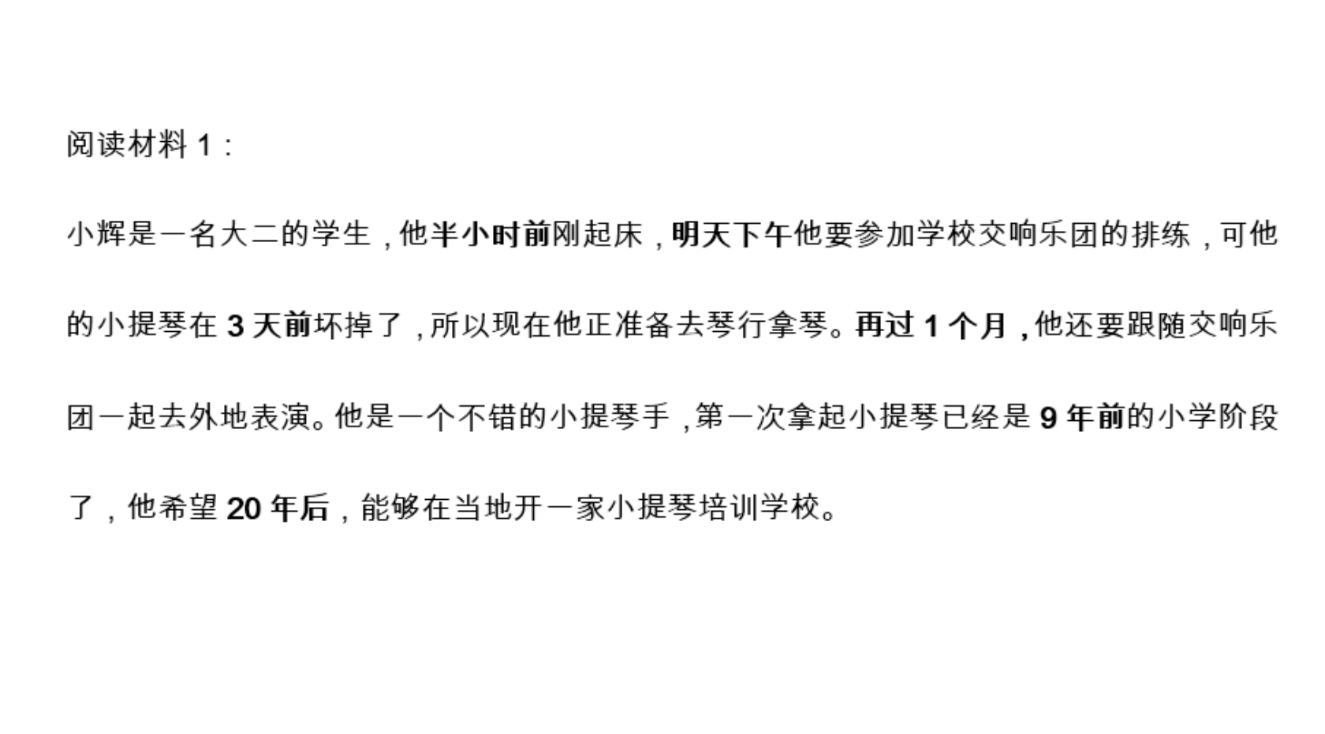
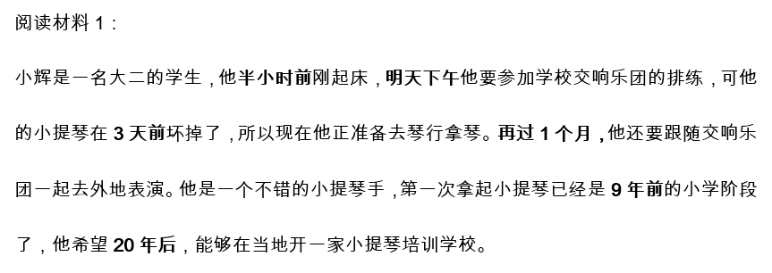

Slide 6
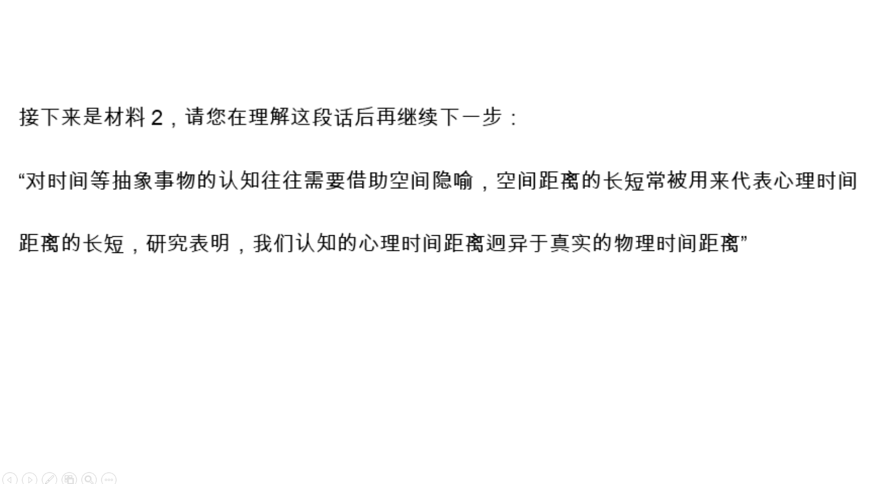
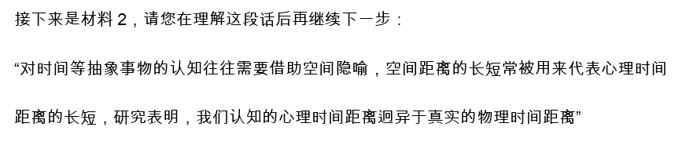

Slide 7
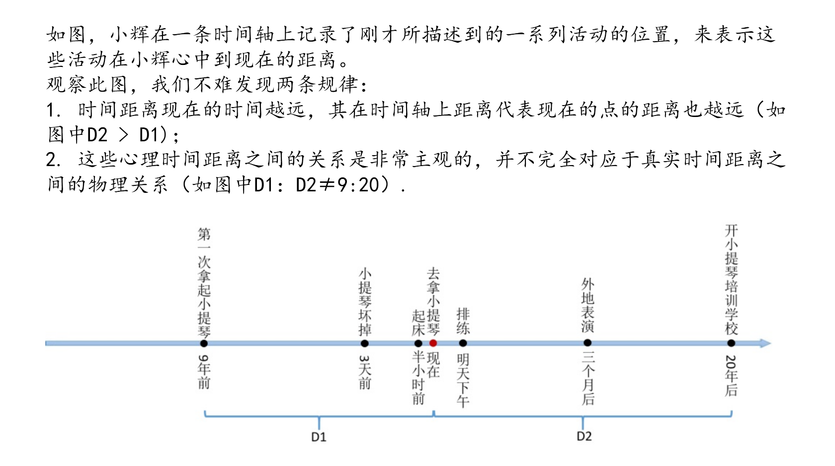
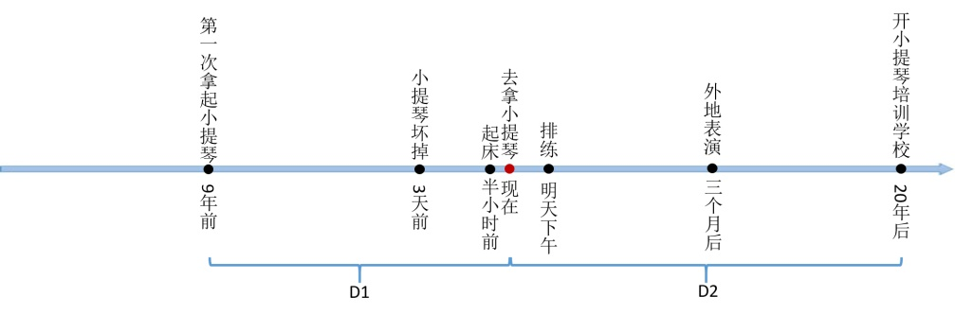
如图，小辉在一条时间轴上记录了刚才所描述到的一系列活动的位置，来表示这些活动在小辉心中到现在的距离。
观察此图，我们不难发现两条规律：
1. 时间距离现在的时间越远，其在时间轴上距离代表现在的点的距离也越远（如图中D2 > D1)；
2. 这些心理时间距离之间的关系是非常主观的，并不完全对应于真实时间距离之间的物理关系（如图中D1：D2≠9:20）.

Slide 8
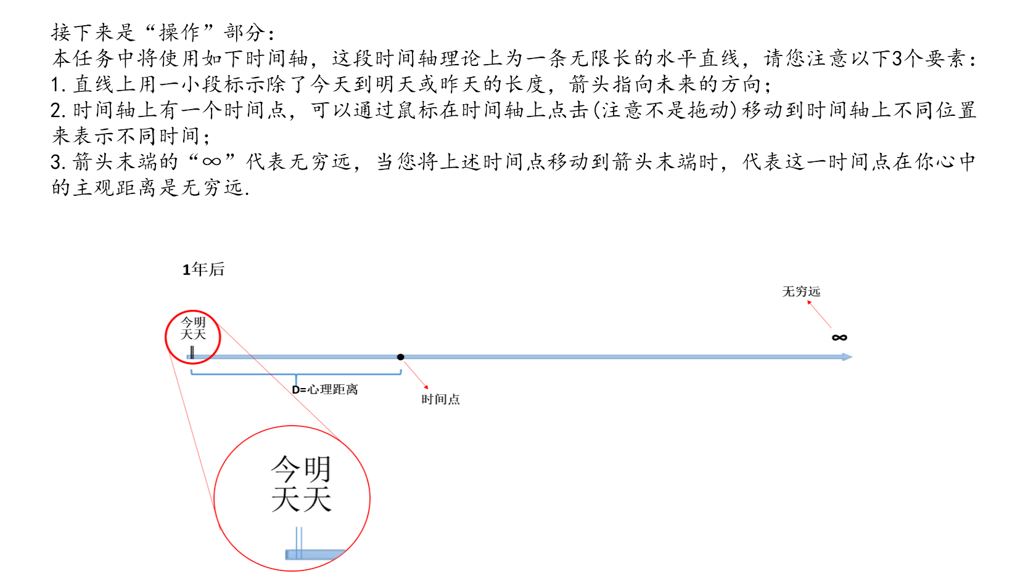
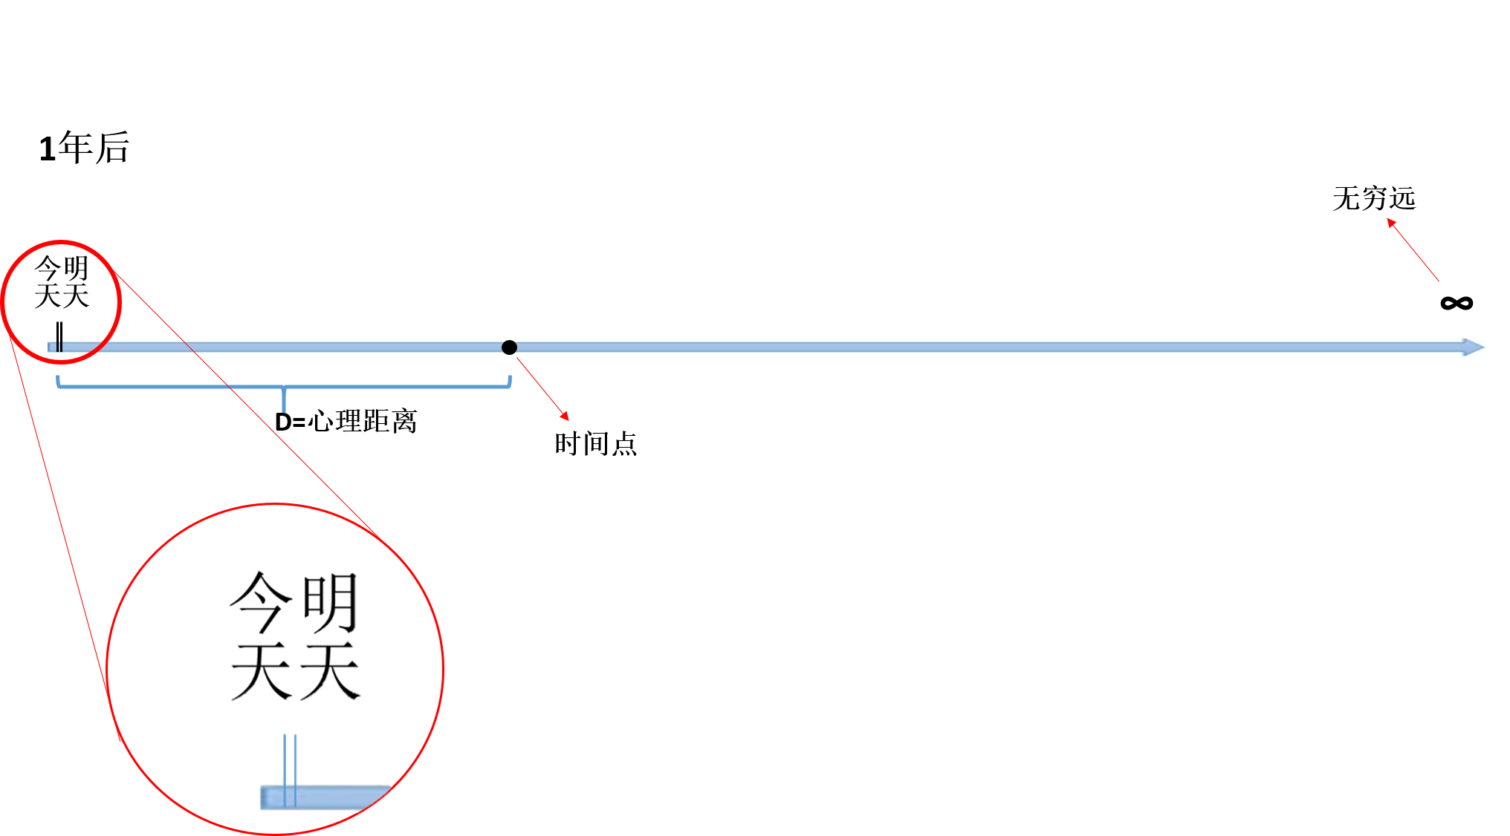
接下来是“操作”部分：
本任务中将使用如下时间轴，这段时间轴理论上为一条无限长的水平直线，请您注意以下3个要素：
1.直线上用一小段标示除了今天到明天或昨天的长度，箭头指向未来的方向；
2.时间轴上有一个时间点，可以通过鼠标在时间轴上点击(注意不是拖动)移动到时间轴上不同位置来表示不同时间；
3.箭头末端的“∞”代表无穷远，当您将上述时间点移动到箭头末端时，代表这一时间点在你心中的主观距离是无穷远.

Slide 9
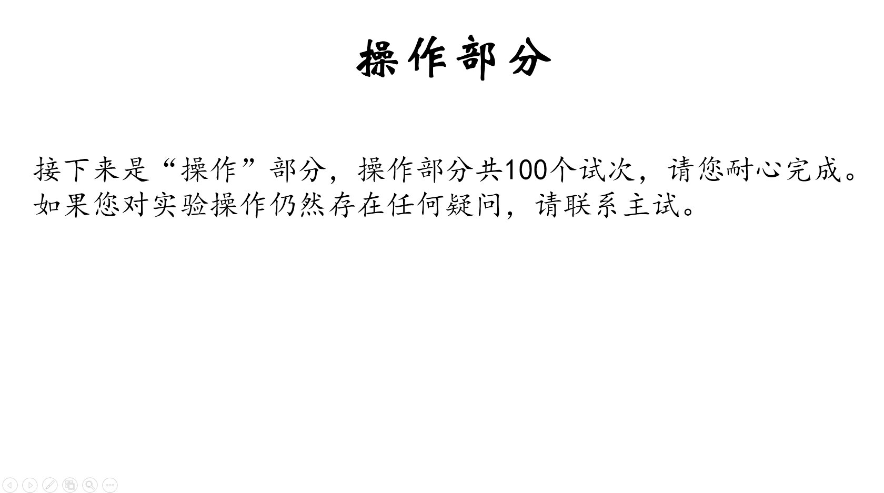
操作部分
接下来是“操作”部分，操作部分共100个试次，请您耐心完成。
如果您对实验操作仍然存在任何疑问，请联系主试。

Slide 10
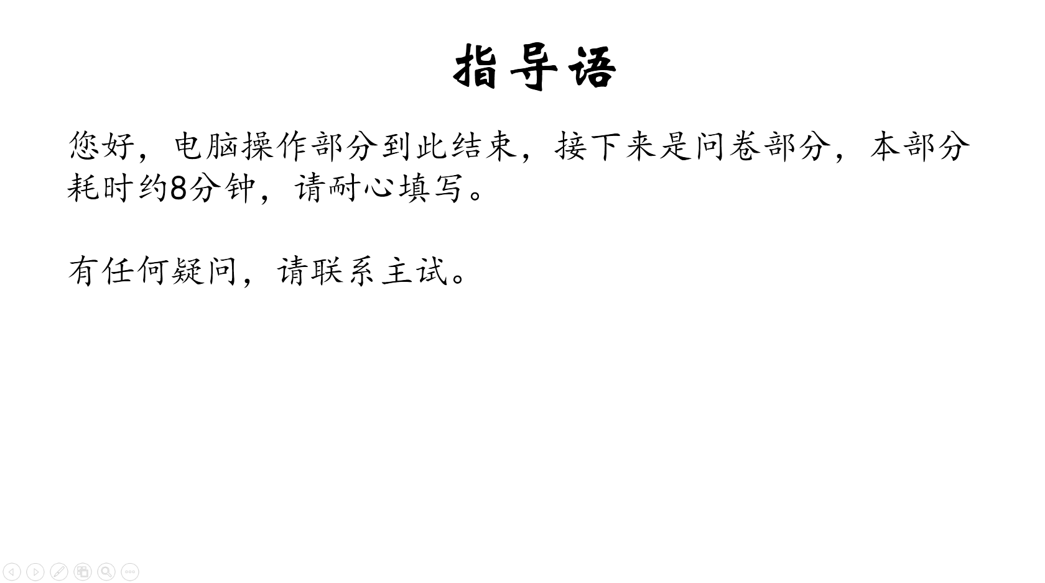
指导语
您好，电脑操作部分到此结束，接下来是问卷部分，本部分耗时约8分钟，请耐心填写。
有任何疑问，请联系主试。

Slide 11
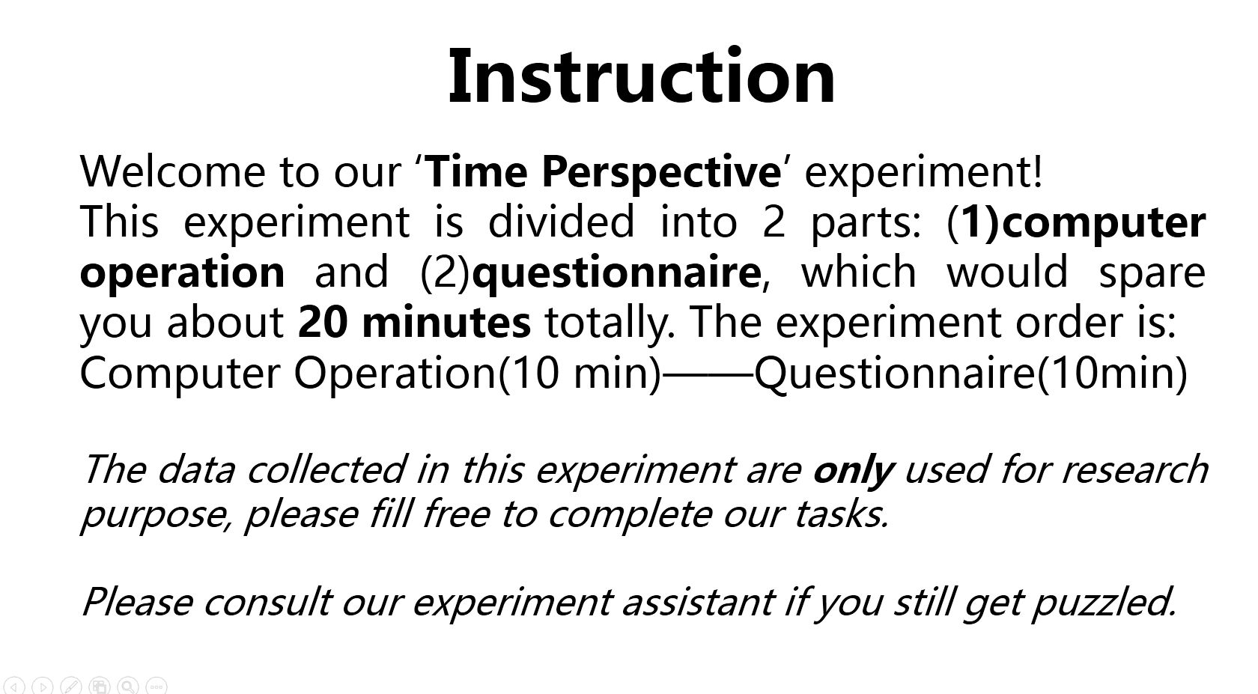
Instruction
Welcome to our ‘Time Perspective’ experiment!
This experiment is divided into 2 parts: (1)computer operation and (2)questionnaire, which would spare you about 20 minutes totally. The experiment order is:
Computer Operation(10 min)——Questionnaire(10min)
The data collected in this experiment are only used for research purpose, please fill free to complete our tasks.
Please consult our experiment assistant if you still get puzzled.

Slide 12
问卷（1）
接下来将给出几个时间点，请您仔细思考您在该时间点做过或预备进行的活动，并在给出的文字栏中进行填写。
注意：所写活动要尽可能具体，且不能重复填写。
适当的例子如：
9年前——上小学5年级
3天前——去玉渊潭公园
明天下午——上数学课
20年后——在国贸中心上班

Slide 13
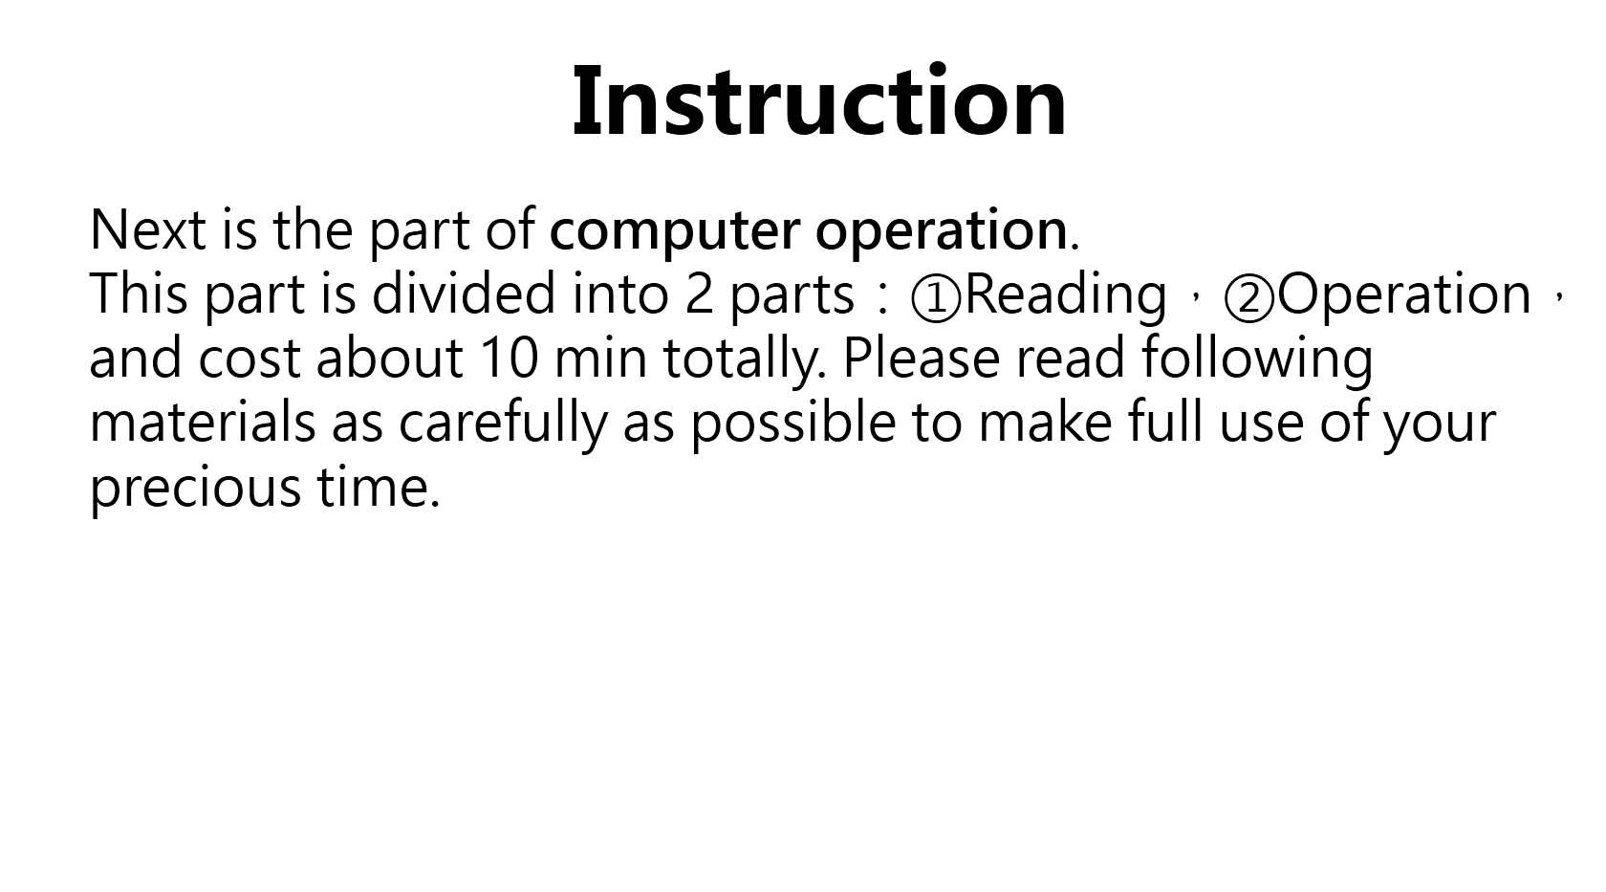
Instruction
Next is the part of computer operation.
This part is divided into 2 parts：①Reading，②Operation，and cost about 10 min totally. Please read following materials as carefully as possible to make full use of your precious time.

Slide 14
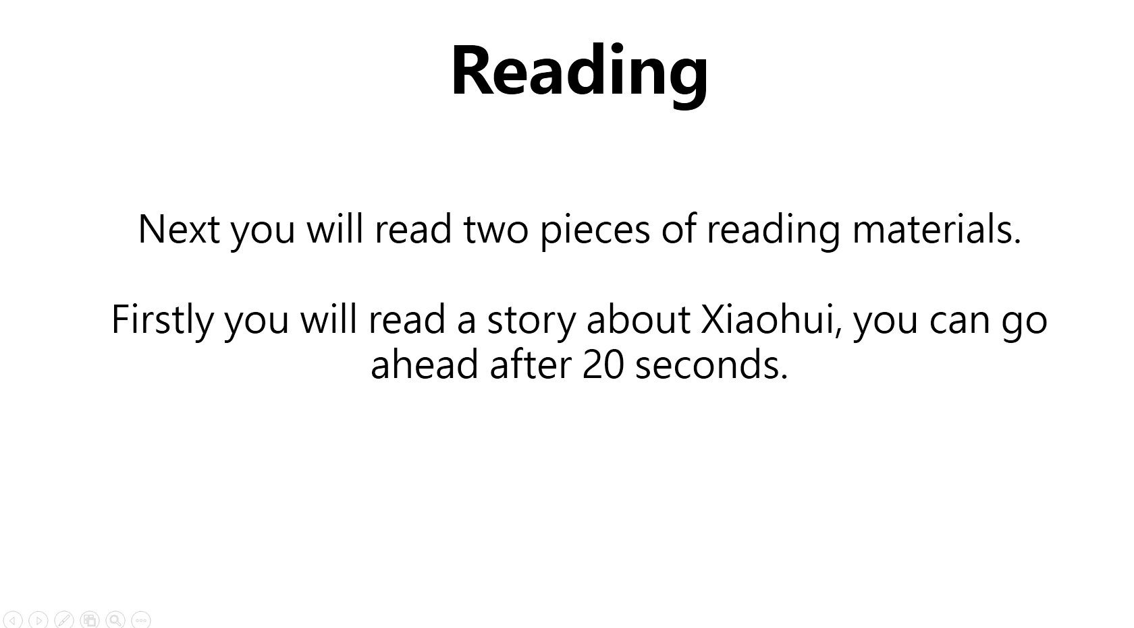
Reading
Next you will read two pieces of reading materials.
Firstly you will read a story about Xiaohui, you can go ahead after 20 seconds.

Slide 15
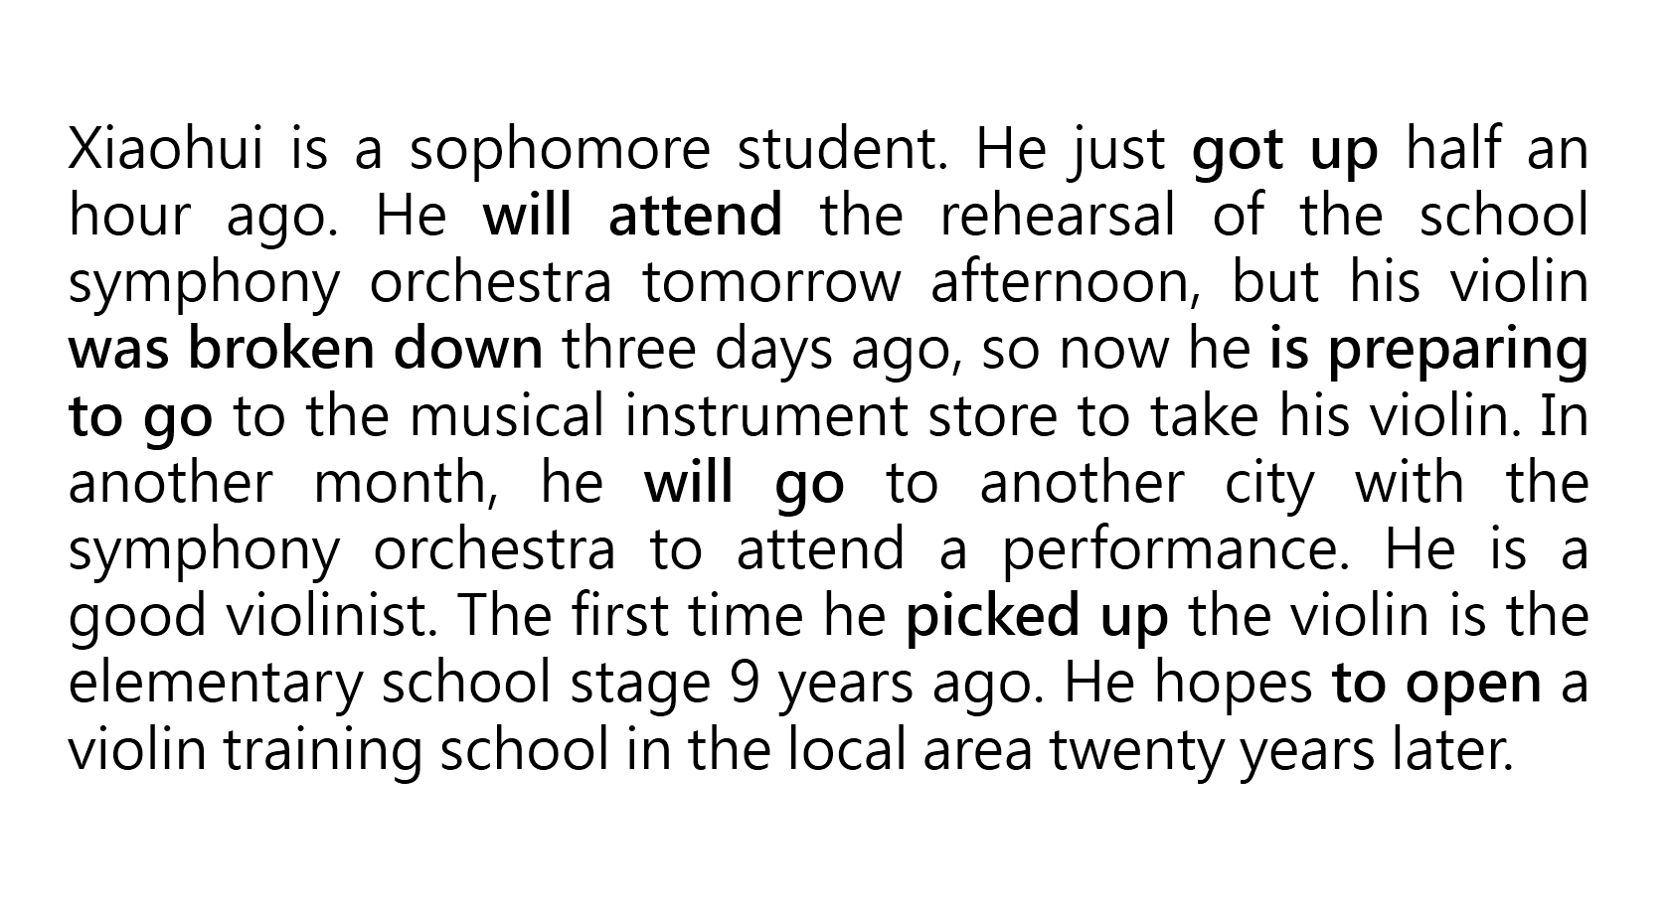
Xiaohui is a sophomore student. He just got up half an hour ago. He will attend the rehearsal of the school symphony orchestra tomorrow afternoon, but his violin was broken down three days ago, so now he is preparing to go to the musical instrument store to take his violin. In another month, he will go to another city with the symphony orchestra to attend a performance. He is a good violinist. The first time he picked up the violin is the elementary school stage 9 years ago. He hopes to open a violin training school in the local area twenty years later.

Slide 16
Xiaohui is a sophomore student. He just got up half an hour ago. He will attend the rehearsal of the school symphony orchestra tomorrow afternoon, but his violin was broken down three days ago, so now he is preparing to go to the musical instrument store to take his violin. In another month, he will go to another city with the symphony orchestra to attend a performance. He is a good violinist. The first time he picked up the violin is the elementary school stage 9 years ago. He hopes to open a violin training school in the local area twenty years later.

Slide 17
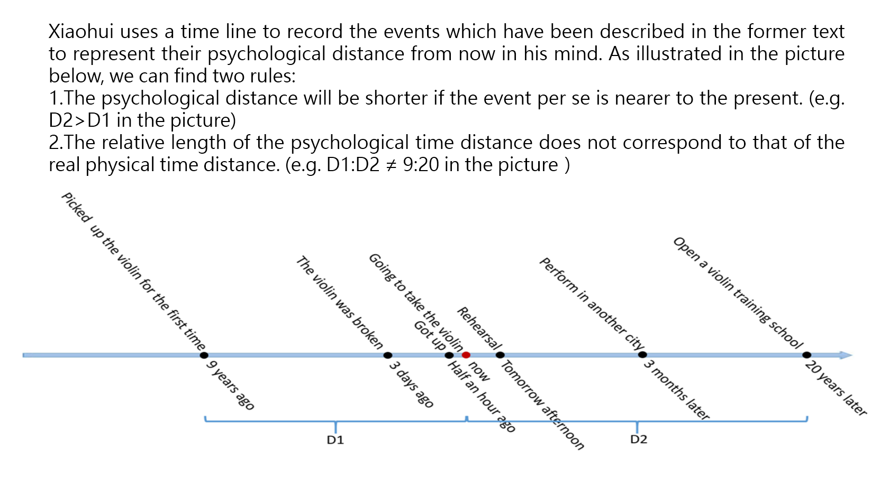
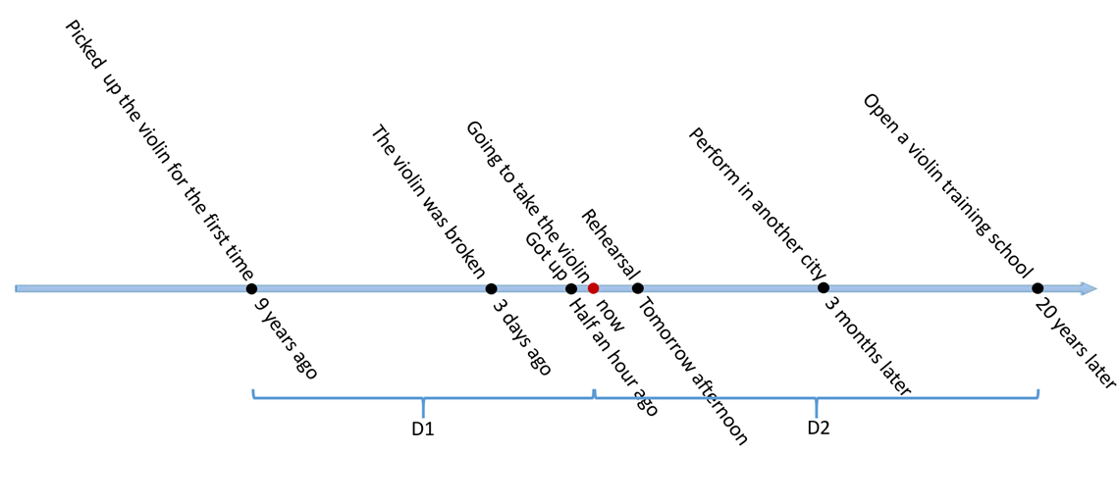
Xiaohui uses a time line to record the events which have been described in the former text to represent their psychological distance from now in his mind. As illustrated in the picture below, we can find two rules:
1.The psychological distance will be shorter if the event per se is nearer to the present. (e.g. D2>D1 in the picture)
2.The relative length of the psychological time distance does not correspond to that of the real physical time distance. (e.g. D1:D2 ≠ 9:20 in the picture）

Slide 18
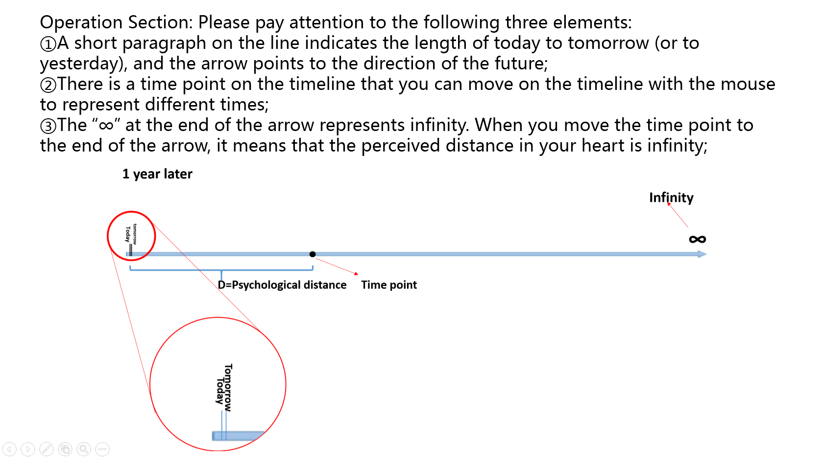
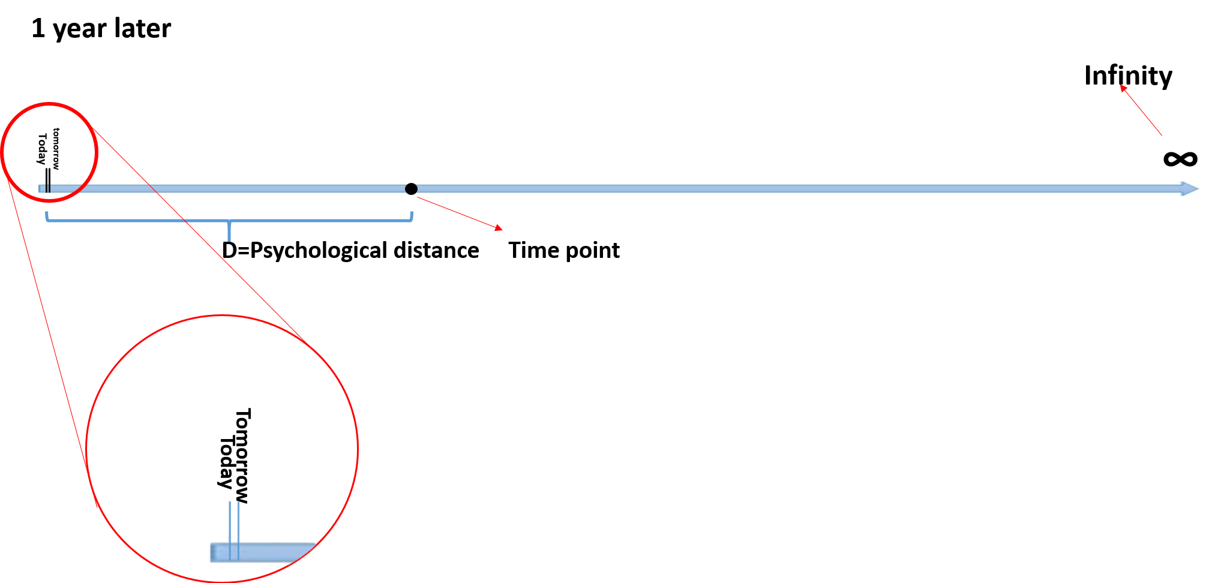
Operation Section: Please pay attention to the following three elements:
①A short paragraph on the line indicates the length of today to tomorrow (or to yesterday), and the arrow points to the direction of the future;
②There is a time point on the timeline that you can move on the timeline with the mouse to represent different times;
③The “∞” at the end of the arrow represents infinity. When you move the time point to the end of the arrow, it means that the perceived distance in your heart is infinity;

Slide 19
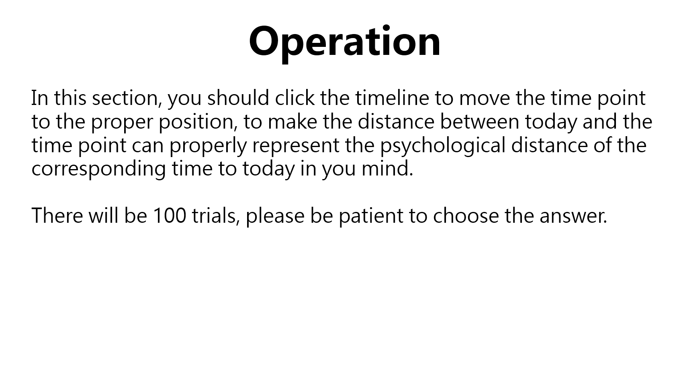
Operation
In this section, you should click the timeline to move the time point to the proper position, to make the distance between today and the time point can properly represent the psychological distance of the corresponding time to today in you mind.
There will be 100 trials, please be patient to choose the answer.

Slide 20
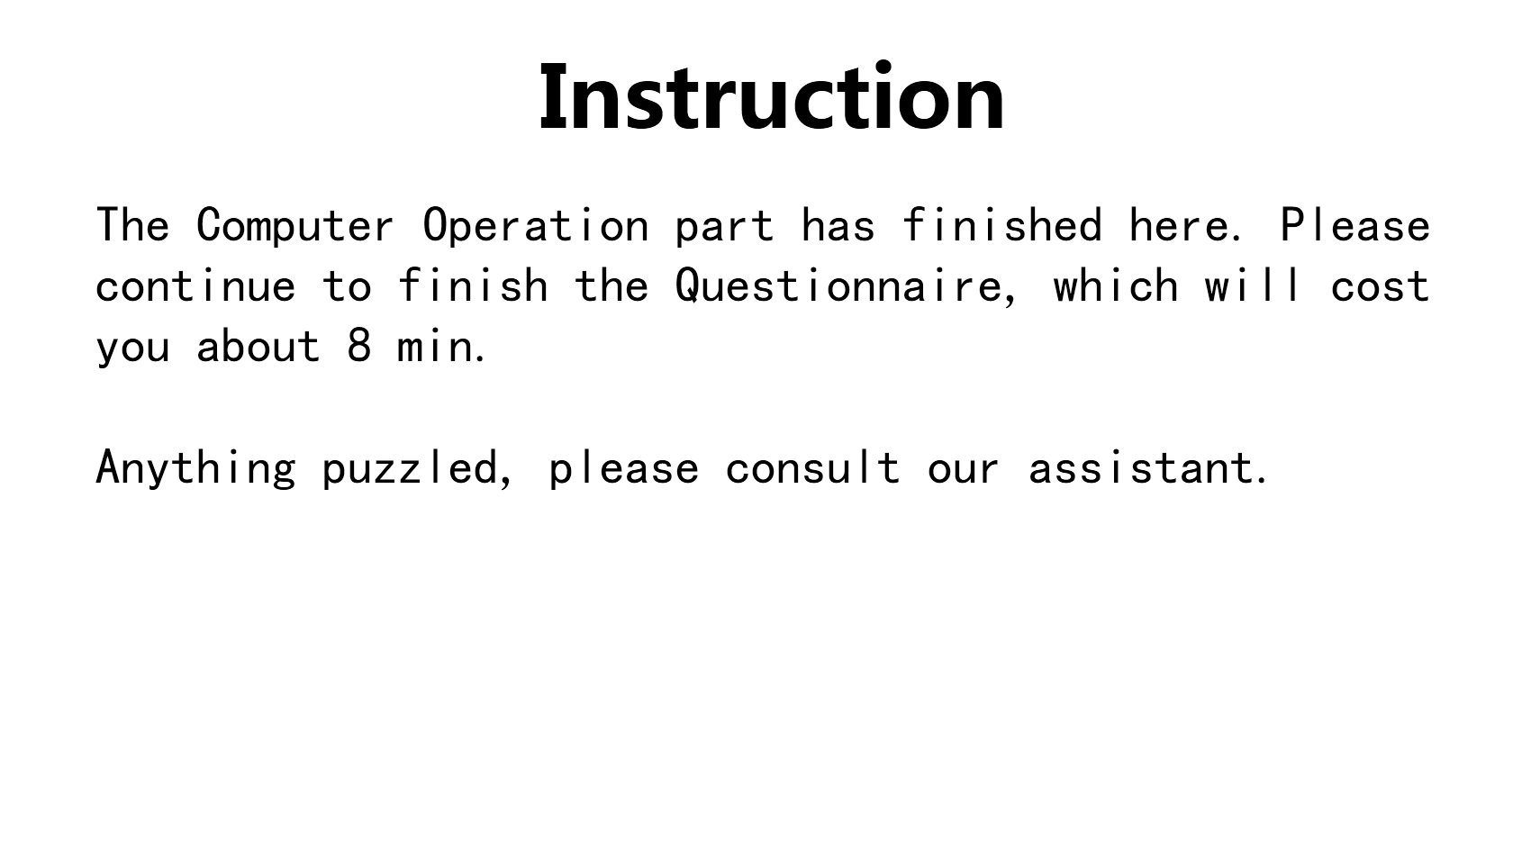
Instruction
The Computer Operation part has finished here. Please continue to finish the Questionnaire, which will cost you about 8 min.
Anything puzzled, please consult our assistant.

