Slide 1
Git Branch >
Pro Git(https://git-scm.com/book/ko/v2/)를 바탕으로 작성하였습니다.
YoonJoon Lee
SoC KAIST
Fall 2018

Slide 2
What we will take a look in this series
Git Branch >
Getting Started
Git Basics
Git Branch
Git Server - GitLab

Slide 3
What we will take a look today
Git Branch >
Getting Started
Git Basics
Git Branch
Git Server - GitLab

Slide 4
What I will talk about in this section
Git Branch >
Branches in a Nutshell
Basic Branching and Merging
Branch Management
Branching Workflows
Remote Branches
6. Rebasing

Slide 5
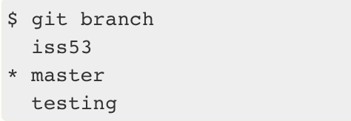
Branch Management
Git Branch > Branch Management >
The git branch command does more than just create and delete branches. If we run it with no arguments, we get a simple listing of your current branches:

Slide 6
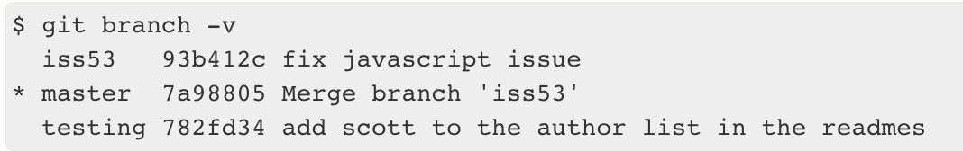
Git Branch > Branches in a Nutshell >
To see the last commit on each branch, you can run git branch -v:

Slide 7



Git Branch > Branches in a Nutshell >
The useful --merged and --no-merged options can filter this list to branches that we have or have not yet merged into the branch we’re currently on.

Slide 8
Branching Workflows
Git Branch > Branch Workflow >
We’ll cover some common workflows that this lightweight branching makes possible, so we can decide if we would like to incorporate them into our own development cycle.

Slide 9
Long-Running Branches
Git Branch > Branch Workflow >
Many Git developers have a workflow that embraces this approach, such as having only code that is entirely stable in their master branch — possibly only code that has been or will be released.
They have another parallel branch named develop or next that they work from or use to test stability — it isn’t necessarily always stable, but whenever it gets to a stable state, it can be merged into master.
It’s used to pull in topic branches (short-lived branches, like your earlier iss53 branch) when they’re ready, to make sure they pass all the tests and don’t introduce bugs.

Slide 10

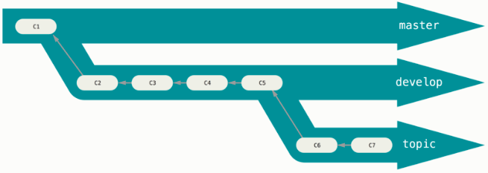
Git Branch > Branch Workflow >
It’s generally easier to think about them as work silos, where sets of commits graduate to a more stable silo when they’re fully tested.

Slide 11
Git Branch > Branch Workflow >
We can keep doing this for several levels of stability. Some larger projects also have a proposed or pu (proposed updates) branch that has integrated branches that may not be ready to go into the next or master branch.

Slide 12
Topic Branches
Git Branch > Branch Workflow >
A topic branch is a short-lived branch that you create and use for a single particular feature or related work.
We saw this with the iss53 and hotfix branches we created. We did a few commits on them and deleted them directly after merging them into our main branch.

Slide 13
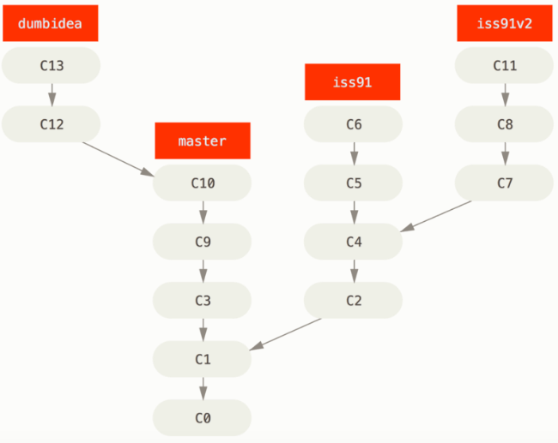
Git Branch > Branch Workflow >
Consider an example of doing some work (on master), branching off for an issue (iss91), working on it for a bit, branching off the second branch to try another way of handling the same thing (iss91v2), going back to our master branch and working there for a while, and then branching off there to do some work that we’re not sure is a good idea (dumbidea branch).

Slide 14
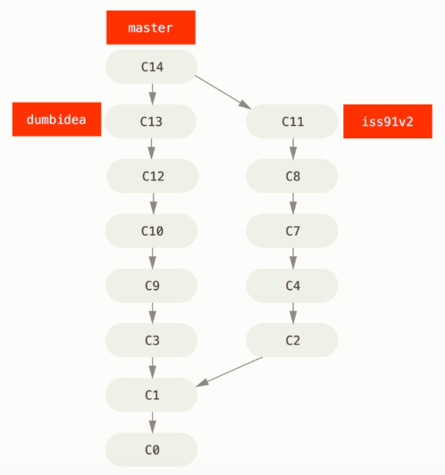
Git Branch > Branch Workflow >
Let’s say we decide we like the second solution to your issue best (iss91v2); and we showed the dumbidea branch to our coworkers, and it turns out to be genius. You can throw away the original iss91 branch (losing commits C5 and C6) and merge in the other two.

Slide 15
Remote Branches
Git Branch > Remote Branches >
Remote references are references (pointers) in your remote repositories, including branches, tags, and so on. We can get a full list of remote references explicitly with git ls-remote [remote], or git remote show [remote] for remote branches as well as more information. Nevertheless, a more common way is to take advantage of remote-tracking branches.
Remote-tracking branches are references to the state of remote branches. They’re local references that we can’t move; Git moves them for us whenever we do any network communication, to make sure they accurately represent the state of the remote repository. Think of them as bookmarks, o remind you where the branches in your remote repositories were the last time you connected to them.

Slide 16
Git Branch > Remote Branches >
Remote-tracking branches take the form <remote>/<branch>. For instance, if we wanted to see what the master branch on our origin remote looked like as of the last time we communicated with it, we would check the origin/master branch.
If we were working on an issue with a partner and they pushed up an iss53 branch, we might have our own local iss53 branch, but the branch on the server would be represented by the remote-tracking branch origin/iss53.

Slide 17
Git Branch > Remote Branches >
Let’s say we have a Git server on our network at git.ourcompany.com. If we clone from this, Git’s clone command automatically names it origin for us, pulls down all its data, creates a pointer to where its master branch is, and names it origin/master locally. Git also gives you your own local master branch starting at the same place as origin’s master branch, so we have something to work from.

Slide 18
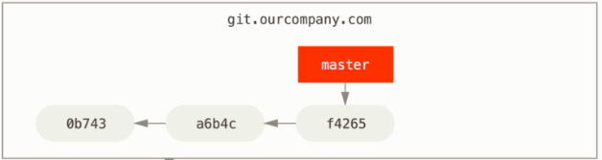

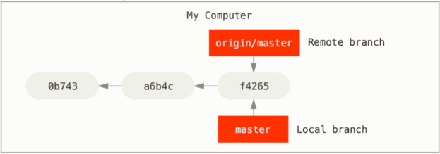
Git Branch > Remote Branches >

Slide 19
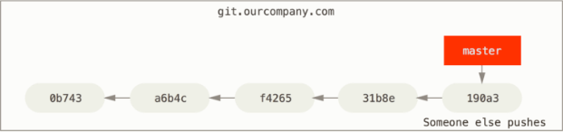
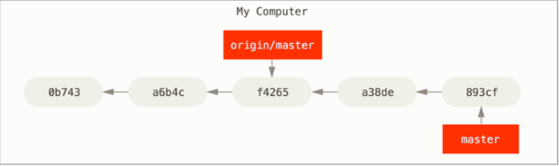
Git Branch > Remote Branches >
If we do some work on our local master branch, and, in the meantime, someone else pushes to git.ourcompany.com and updates its master branch, then our histories move forward differently. Also, as long as we stay out of contact with our origin server, our origin/master pointer doesn’t move.

Slide 20


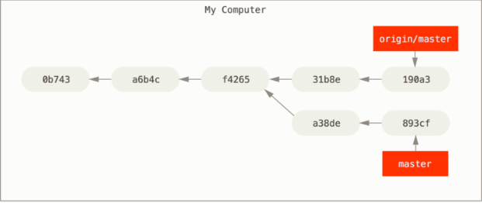
Git Branch > Remote Branches >
To synchronize our work, we run a git fetch origin command. This command looks up which server “origin” is (in this case, it’s git.ourcompany.com), fetches any data from it that we don’t yet have, and updates our local database, moving your origin/master pointer to its new, more up-to-date position.

Slide 21
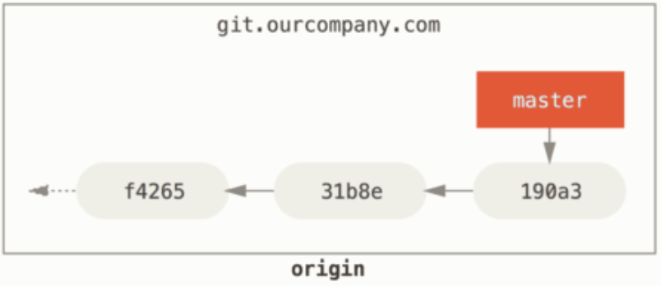
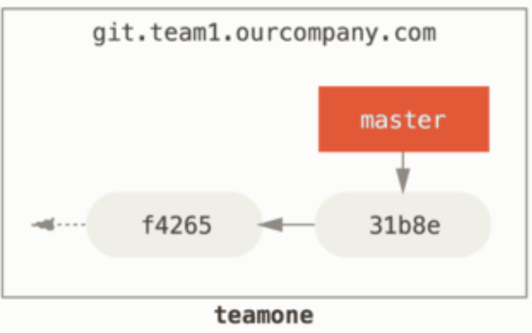
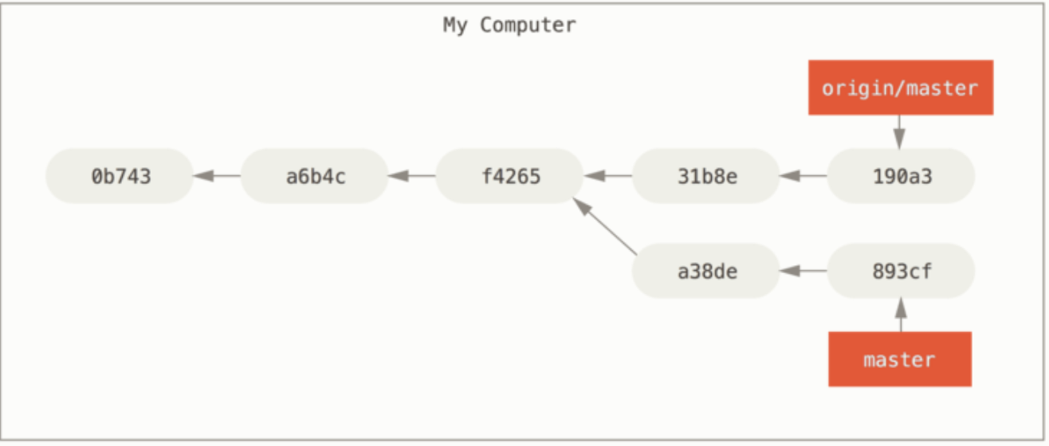
Git Branch > Remote Branches >
To demonstrate having multiple remote servers and what remote branches for those remote projects look like,

Slide 22

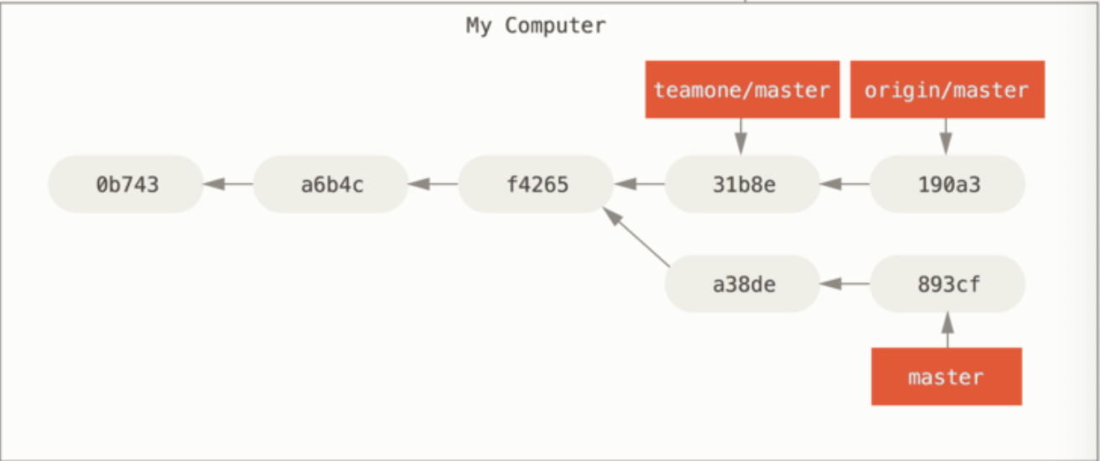
Git Branch > Remote Branches >
Now, we can run git fetch teamone to fetch everything the remote teamone server has that we don’t have yet.

Slide 23
Pushing
Git Branch > Remote Branches >
When we want to share a branch with the world, we need to push it up to a remote that we have write access to.
Our local branches aren’t automatically synchronized to the remotes we write to — we have to explicitly push the branches we want to share.
That way, we can use private branches for work we don’t want to share, and push up only the topic branches we want to collaborate on.

Slide 24
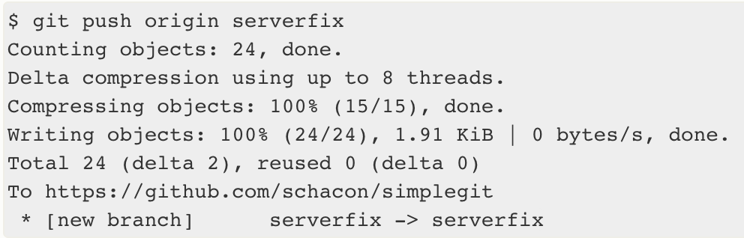
Git Branch > Remote Branches >
If we have a branch named serverfix that you want to work on with others, we can push it up the same way we pushed our first branch. Run git push <remote> <branch>:

Slide 25
Git Branch > Remote Branches >
Git automatically expands the serverfix branchname out to refs/heads/serverfix:refs/heads/serverfix, which means, “Take my serverfix local branch and push it to update the remote’s serverfix branch.”
We can also do git push origin serverfix:serverfix, which does the same thing — it says, “Take my serverfix and make it the remote’s serverfix.”
We can use this format to push a local branch into a remote branch that is named differently. If we didn’t want it to be called serverfix on the remote, we could instead run git push origin serverfix:awesomebranch to push your local serverfix branch to the awesomebranch branch on the remote project.

Slide 26
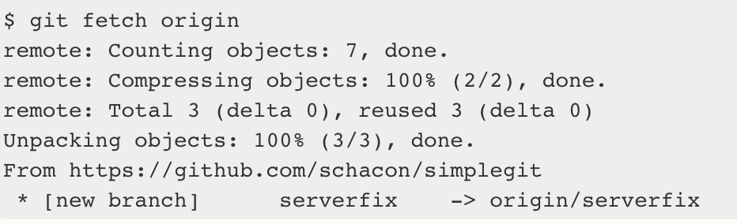
Git Branch > Remote Branches >
The next time one of our collaborators fetches from the server, they will get a reference to where the server’s version of serverfix is under the remote branch origin/serverfix:
It’s important to note that when we do a fetch that brings down new remote-tracking branches, we don’t automatically have local, editable copies of them. In other words, in this case, we don’t have a new serverfix branch — we only have an origin/serverfix pointer that we can’t modify.

Slide 27
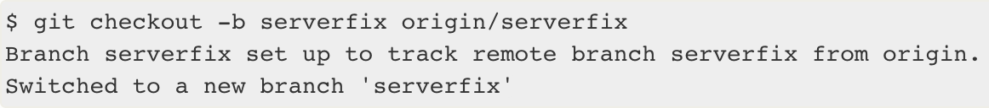
Git Branch > Remote Branches >
To merge this work into our current working branch, we can run git merge origin/serverfix. If we want our own serverfix branch that we can work on, we can base it off our remote-tracking branch:

Slide 28
Tracking Branches
Git Branch > Remote Branches >
Checking out a local branch from a remote-tracking branch automatically creates what is called a “tracking branch” (and the branch it tracks is called an “upstream branch”).
Tracking branches are local branches that have a direct relationship to a remote branch. If we’re on a tracking branch and type git pull, Git automatically knows which server to fetch from and which branch to merge in.

Slide 29
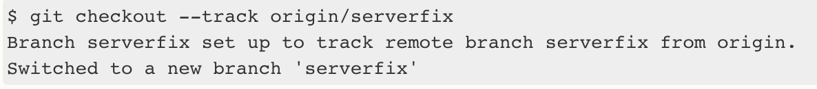
Git Branch > Remote Branches >
When we clone a repository, it generally automatically creates a master branch that tracks origin/master. However, we can set up other tracking branches if we wish — ones that track branches on other remotes, or don’t track the master branch.

Slide 30
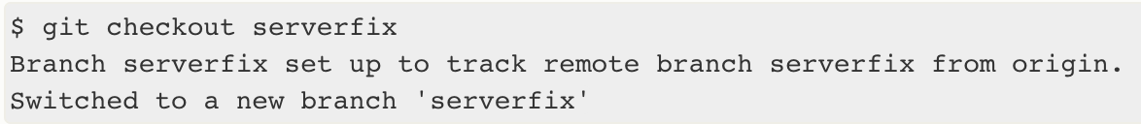
Git Branch > Remote Branches >
This is so common that there’s even a shortcut for that shortcut. If the branch name we’re trying to checkout
doesn’t exist and
exactly matches a name on only one remote,
Git will create a tracking branch for you:

Slide 31
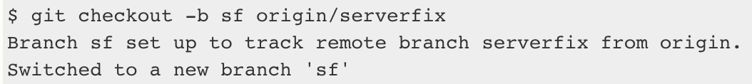
Git Branch > Remote Branches >
To set up a local branch with a different name than the remote branch, we can easily use the first version with a different local branch name:

Slide 32
Git Branch > Remote Branches >
If we already have a local branch and want to set it to a remote branch we just pulled down, or want to change the upstream branch we’re tracking, we can use the -u or --set-upstream-to option to git branch to explicitly set it at any time.

Slide 33
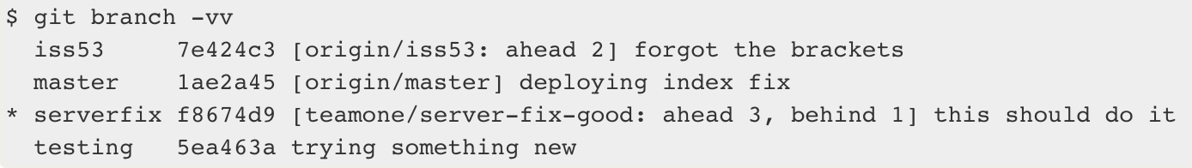
Git Branch > Remote Branches >
If we want to see what tracking branches we have set up, we can use the -vv option to git branch. This will list out our local branches with more information including what each branch is tracking and if our local branch is ahead, behind or both.
Our iss53 branch is tracking origin/iss53 and is “ahead” by two, meaning that we have two commits locally that are not pushed to the server.
Our master branch is tracking origin/master and is up to date.
Our serverfix branch is tracking the server-fix-good branch on our teamone server and is ahead by three and behind by one, meaning that there is one commit on the server we haven’t merged in yet and three commits locally that we haven’t pushed.
Finally our testing branch is not tracking any remote branch.

Slide 34
Git Branch > Remote Branches >
It’s important to note that these numbers are only since the last time we fetched from each server. This command does not reach out to the servers, it’s telling us about what it has cached from these servers locally.
If we want totally up to date ahead and behind numbers, we’ll need to fetch from all our remotes right before running this. We could do that like this:

Slide 35
Pulling
Git Branch > Remote Branches >
While the git fetch command will fetch down all the changes on the server that we don’t have yet, it will not modify our working directory at all. It will simply get the data for us and let us merge it ourself.
The command git pull which is essentially a git fetch immediately followed by a git merge in most cases.

Slide 36
Git Branch > Remote Branches >
If we have a tracking branch set up, either by explicitly setting it or by having it created for us by the clone or checkout commands, git pull will look up what server and branch our current branch is tracking, fetch from that server and then try to merge in that remote branch.
Generally it’s better to simply use the fetch and merge commands explicitly as the magic of git pull can often be confusing.

Slide 37
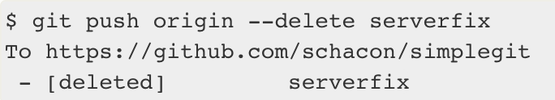
Deleting Remote Branches
Git Branch > Remote Branches >
Suppose we’re done with a remote branch – say our collaborators are finished with a feature and have merged it into our remote’s master branch (or whatever branch our stable codeline is in). We can delete a remote branch using the --delete option to git push. If we want to delete our serverfix branch from the server, we run the following:

Slide 38
Rebasing
Git Branch > Rebasing >
There are two main ways to integrate changes from one branch into another: the merge and the rebase.

Slide 39
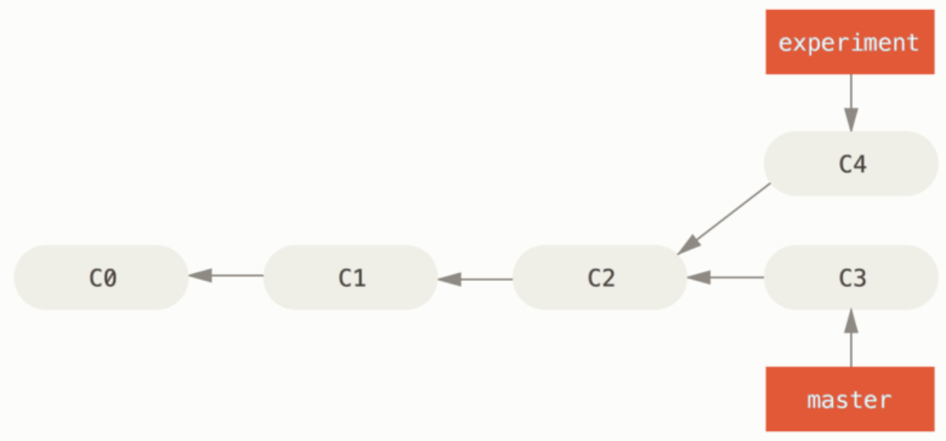
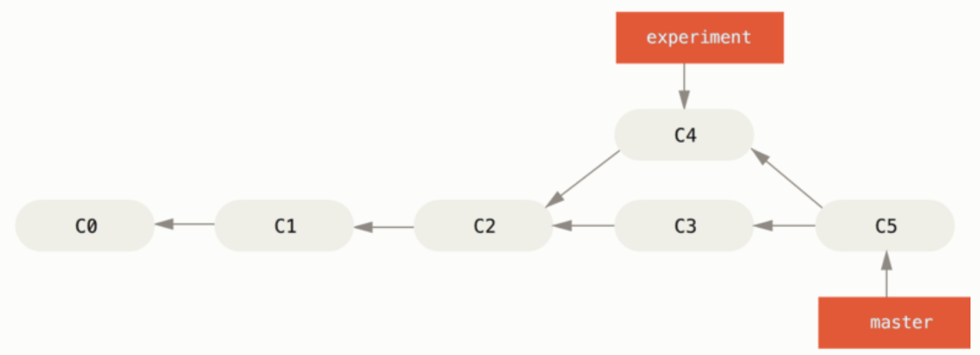
The Basic Rebase
Git Branch > Rebasing >
Basic Merging

Slide 40
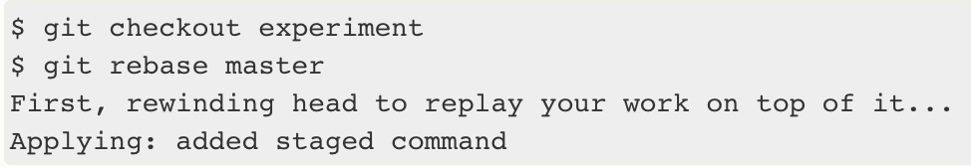
Git Branch > Remote Branches >
There is another way: we can take the patch of the change that was introduced in C4 and reapply it on top of C3. In Git, this is called rebasing. With the rebase command, we can take all the changes that were committed on one branch and replay them on another one.

Slide 41
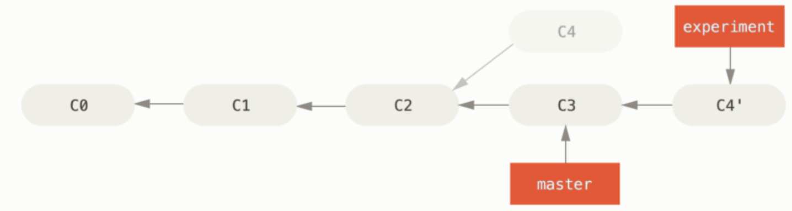
Git Branch > Remote Branches >
It works by going to the common ancestor of the two branches (the one we’re on and the one we’re rebasing onto), getting the diff introduced by each commit of the branch we’re on, saving those diffs to temporary files, resetting the current branch to the same commit as the branch we are rebasing onto, and finally applying each change in turn.

Slide 42

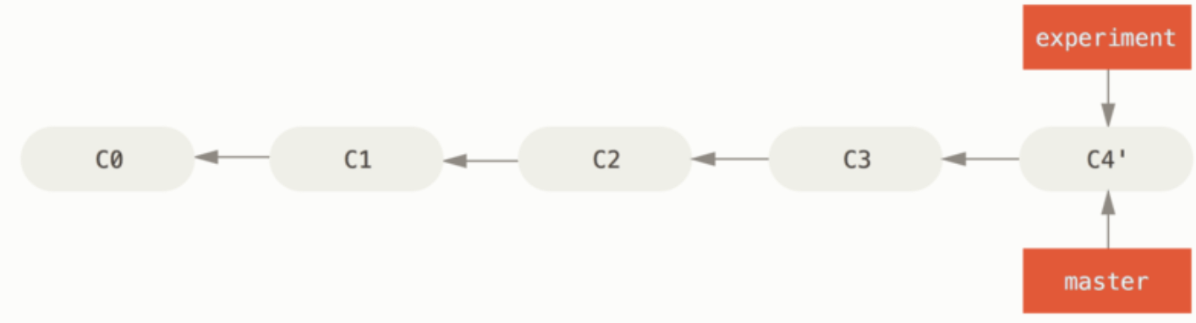
Git Branch > Remote Branches >
We can go back to the master branch and do a fast-forward merge.
The snapshot pointed to by C4' is exactly the same as the one that was pointed to by C5 in the merge example. There is no difference in the end product of the integration, but rebasing makes for a cleaner history. If we examine the log of a rebased branch, it looks like a linear history: it appears that all the work happened in series, even when it originally happened in parallel.

Slide 43
Git Branch > Remote Branches >
We’ll do rebasing to make sure our commits apply cleanly on a remote branch — perhaps in a project to which we’re trying to contribute but that we don’t maintain. In this case, we’d do our work in a branch and then rebase our work onto origin/master when we were ready to submit our patches to the main project. That way, the maintainer doesn’t have to do any integration work — just a fast-forward or a clean apply.
The snapshot pointed to by the final commit we end up with, whether it’s the last of the rebased commits for a rebase or the final merge commit after a merge, is the same snapshot – it’s only the history that is different.

Slide 44
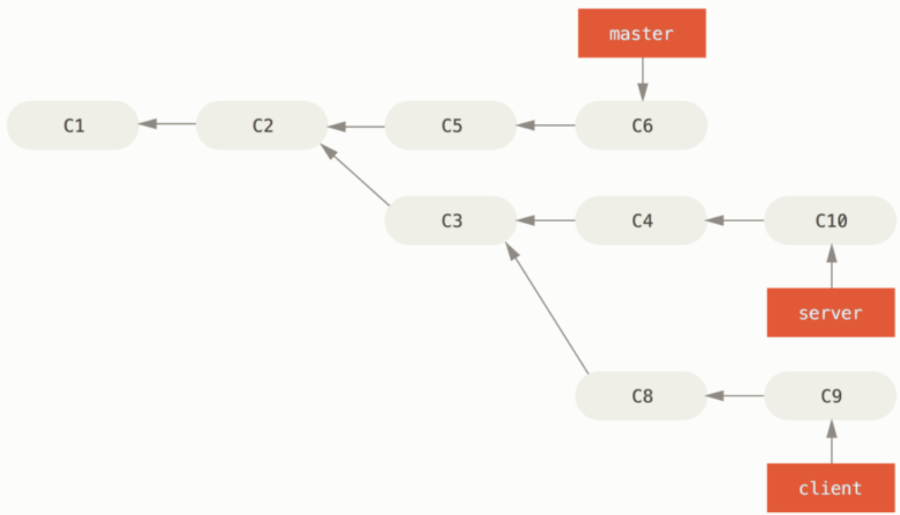
More Interesting Rebases
Git Branch > Rebasing >
We can also have our rebase replay on something other than the rebase target branch. Take a history:

Slide 45
Git Branch > Remote Branches >
Suppose we decide that we want to merge our client-side changes into our mainline for a release, but we want to hold off on the server-side changes until it’s tested further. We can take the changes on client that aren’t on server (C8 and C9) and replay them on our master branch by using the --onto option of git rebase:

Slide 46
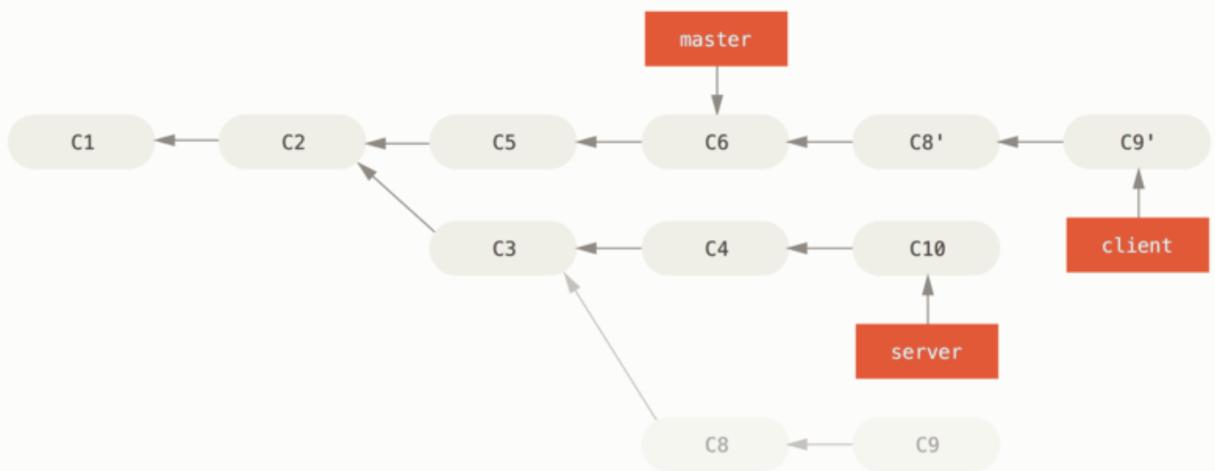
Git Branch > Remote Branches >
This basically says, “Take the client branch, figure out the patches since it diverged from the server branch, and replay these patches in the client branch as if it was based directly off the master branch instead.” It’s a bit complex, but the result is pretty cool.

Slide 47

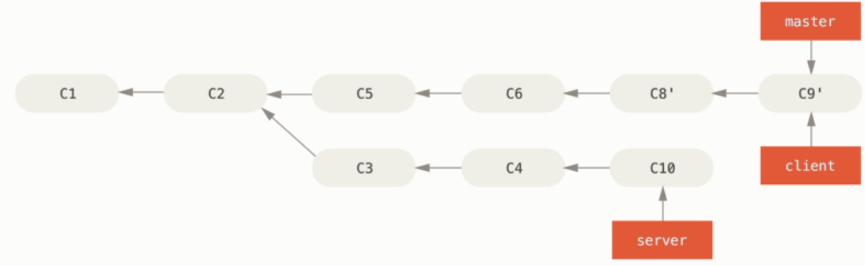
Git Branch > Remote Branches >
We can fast-forward our master branch:

Slide 48

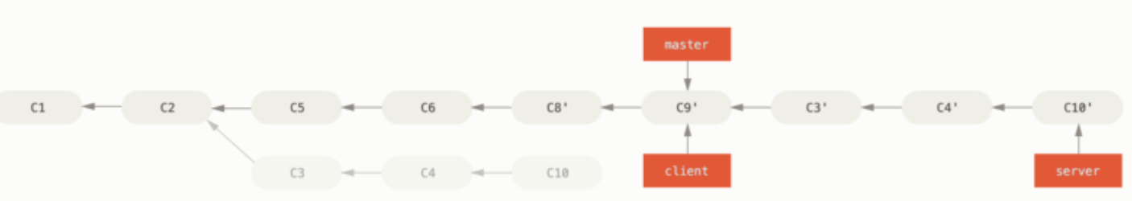
Git Branch > Remote Branches >
We decide to pull in our server branch as well. We can rebase the server branch onto the master branch without having to check it out first by running git rebase <basebranch> <topicbranch> — which checks out the topic branch (in this case, server) for us and replays it onto the base branch (master):
This replays your server work on top of your master work.

Slide 49


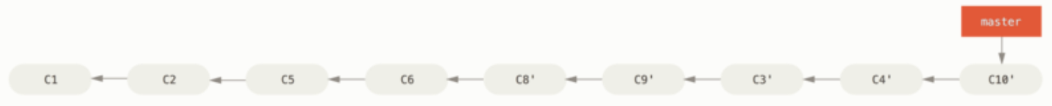
Git Branch > Remote Branches >
We can fast-forward the base branch (master):
We can remove the client and server branches because all the work is integrated and we don’t need them anymore, leaving our history for this entire process looking like Final commit history:

Slide 50
The Perils of Rebasing
Git Branch > Rebasing >
The bliss of rebasing isn’t without its drawbacks, which can be summed up in a single line:
Do not rebase commits that exist outside your repository.

Slide 51
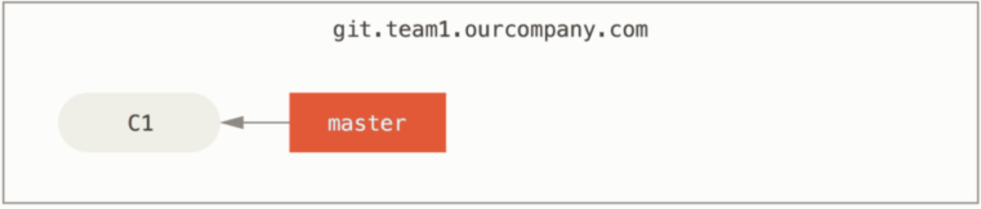
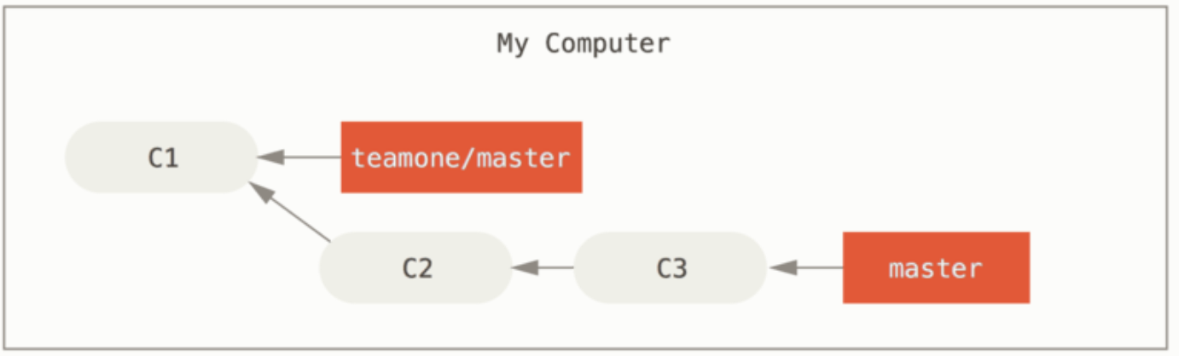
Git Branch > Remote Branches >
Let’s look at an example of how rebasing work that we’ve made public can cause problems. Suppose we clone from a central server and then do some work off that. Our commit history looks like this:

Slide 52
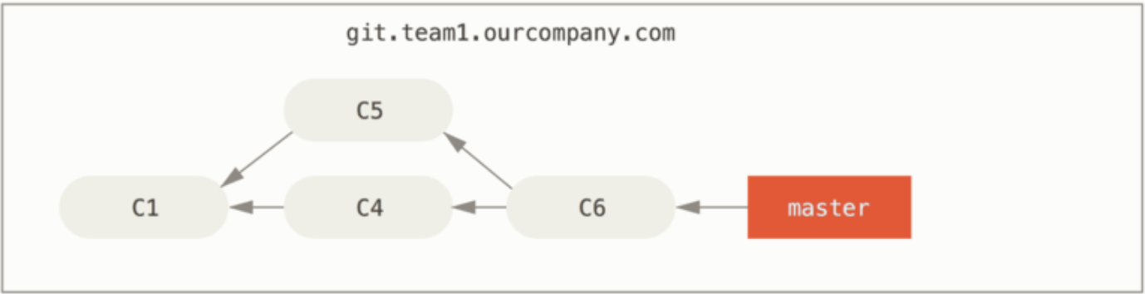
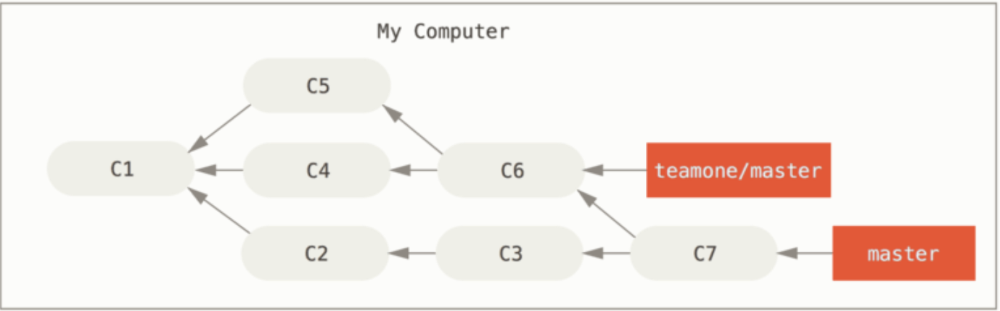
Git Branch > Remote Branches >
Someone else does more work that includes a merge, and pushes that work to the central server. We fetch it and merge the new remote branch into our work, making our history look something like this:

Slide 53
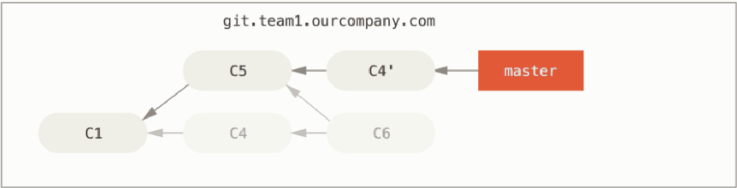
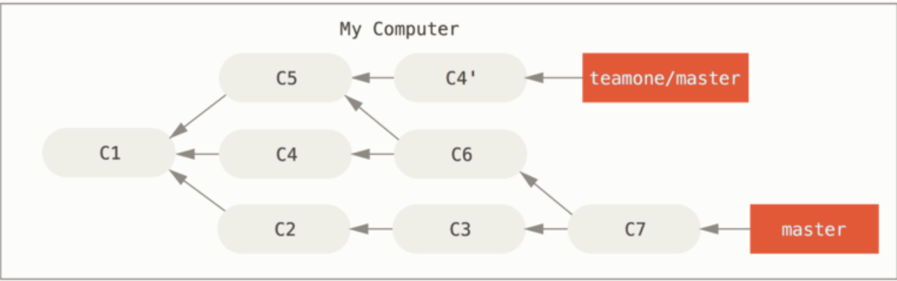
Git Branch > Remote Branches >
Next, the person who pushed the merged work decides to go back and rebase their work instead; they do a git push --force to overwrite the history on the server. We then fetch from that server, bringing down the new commits.

Slide 54
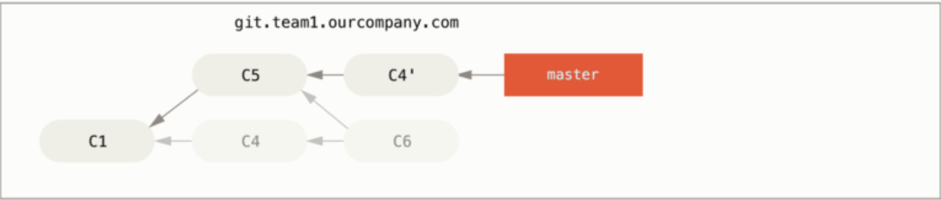
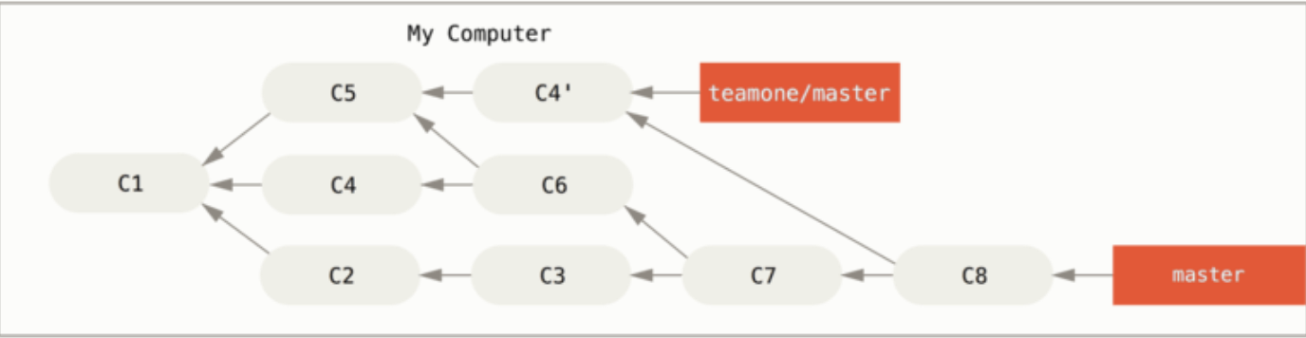
Git Branch > Remote Branches >
Now we’re both in a pickle. If we do a git pull, we’ll create a merge commit which includes both lines of history, and our repository will look like this:

Slide 55
Git Branch > Remote Branches >
If we run a git log when our history looks like this, we’ll see two commits that have the same author, date, and message, which will be confusing. Furthermore, if we push this history back up to the server, we’ll reintroduce all those rebased commits to the central server, which can further confuse people. It’s pretty safe to assume that the other developer doesn’t want C4 and C6 to be in the history; that’s why they rebased in the first place.

Slide 56
Rebase When You Rebase
Git Branch > Rebasing >
If we do find ourself in a situation like this, Git has some further magic that might help us out. If someone on our team force pushes changes that overwrite work that we’ve based work on, our challenge is to figure out what is ours and what they’ve rewritten.
It turns out that in addition to the commit SHA-1 checksum, Git also calculates a checksum that is based just on the patch introduced with the commit. This is called a “patch-id”.
If we pull down work that was rewritten and rebase it on top of the new commits from our partner, Git can often successfully figure out what is uniquely ours and apply them back on top of the new branch.

Slide 57
Git Branch > Remote Branches >
In the previous scenario, if instead of doing a merge when we’re at “Someone pushes rebased commits, abandoning commits you’ve based your work on” we run git rebase teamone/master, Git will:
Determine what work is unique to our branch (C2, C3, C4, C6, C7)
Determine which are not merge commits (C2, C3, C4)
Determine which have not been rewritten into the target branch (just C2 and C3, since C4 is the same patch as C4')
Apply those commits to the top of teamone/master

Slide 58
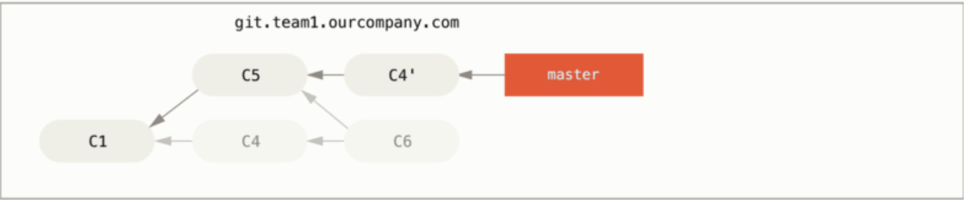
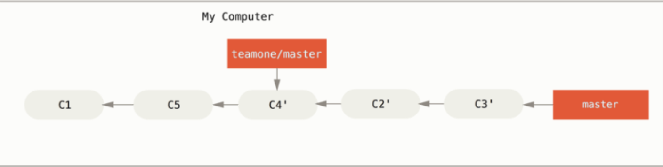
Git Branch > Remote Branches >
So instead of the result we see in “We merge in the same work again into a new merge commit”, we would end up with something more like “Rebase on top of force-pushed rebase work.”

Slide 59
Git Branch > Remote Branches >
This only works if C4 and C4' that our partner made are almost exactly the same patch. Otherwise the rebase won’t be able to tell that it’s a duplicate and will add another C4-like patch (which will probably fail to apply cleanly, since the changes would already be at least somewhat there).
We can also simplify this by running a git pull --rebase instead of a normal git pull. Or we could do it manually with a git fetch followed by a git rebase teamone/master in this case.
If we are using git pull and want to make --rebase the default, we can set the pull.rebase config value with something like git config --global pull.rebase true.

Slide 60
Git Branch > Remote Branches >
If we treat rebasing as a way to clean up and work with commits before we push them, and if we only rebase commits that have never been available publicly, then we’ll be fine. If we rebase commits that have already been pushed publicly, and people may have based work on those commits, then we may be in for some frustrating trouble, and the scorn of our teammates.
If we or a partner does find it necessary at some point, make sure everyone knows to run git pull --rebase to try to make the pain after it happens a little bit simpler.

Slide 61
Rebase vs. Merge
Git Branch > Rebasing >
We may be wondering which one is better.
Before we can answer this, let’s step back a bit and talk about what history means.

Slide 62
Git Branch > Remote Branches >
Our repository’s commit history is a record of what actually happened. It’s a historical document, valuable in its own right, and shouldn’t be tampered with. From this angle, changing the commit history is almost blasphemous; we’re lying about what actually transpired. So what if there was a messy series of merge commits? That’s how it happened, and the repository should preserve that for posterity.
The opposing point of view is that the commit history is the story of how your project was made. We wouldn’t publish the first draft of a book, and the manual for how to maintain our software deserves careful editing. This is the camp that uses tools like rebase and filter-branch to tell the story in the way that’s best for future readers.

Slide 63
Git Branch > Remote Branches >
To the question of whether merging or rebasing is better: hopefully we’ll see that it’s not that simple. Git is a powerful tool, and allows us to do many things to and with our history, but every team and every project is different. Now that we know how both of these things work, it’s up to us to decide which one is best for our particular situation.
In general the way to get the best of both worlds is to rebase local changes we’ve made but haven’t shared yet before we push them in order to clean up our story, but never rebase anything we’ve pushed somewhere.

Slide 64


출처: metachannels.com
감사합니다

