Slide 1
Git Basics >
Pro Git(https://git-scm.com/book/ko/v2/)를 바탕으로 작성하였습니다.
YoonJoon Lee
SoC KAIST
Fall 2018

Slide 2
What we will take a look in this series
Git Basics >
Getting Started
Git Basics
Git Branch
Git Server - GitLab

Slide 3
What we will take a look today
Git Basics >
Getting Started
Git Basics
Git Branch
Git Server - GitLab

Slide 4
What I will talk about in this section
Git Basics >
Getting a Git Repository
Recording Changes to the Repository
Viewing the Commit History
Undoing Things
Working with Remotes
6. Tagging
7. Git Aliases

Slide 5
Working with Remotes
Git Basics > Working with Remotes >
To be able to collaborate on any Git project, we need to know how to manage our remote repositories.
Remote repositories are versions of our project that are hosted on the Internet or network somewhere.

Slide 6
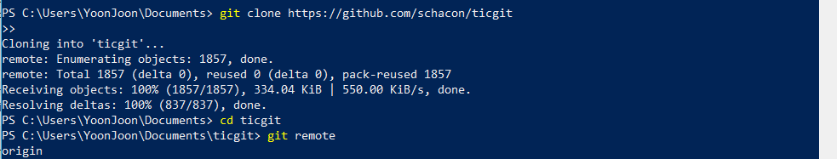
Showing Remotes
Git Basics > Working with Remotes >
To see which remote servers we have configured, we can run the git remote command.

Slide 7
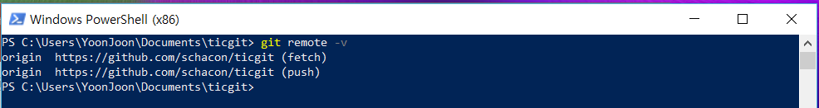
Git Basics > Working with Remotes >
We can also specify -v, which shows us the URLs that Git has stored for the shortname to be used when reading and writing to that remote:

Slide 8
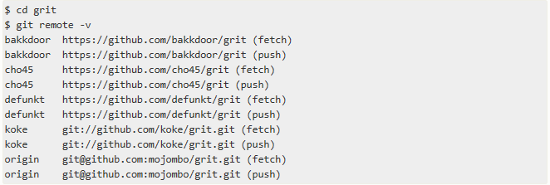
Git Basics > Working with Remotes >
If we have more than one remote, the command lists them all. For example, a repository with multiple remotes for working with several collaborators might look something like this.

Slide 9
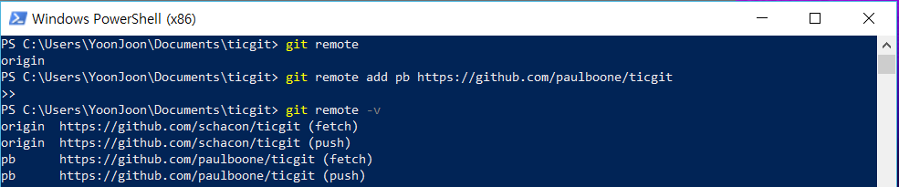
Adding Remotes
Git Basics > Working with Remotes >
We’ve mentioned and given some demonstrations of how the git clone command implicitly adds the origin remote for us.

Slide 10
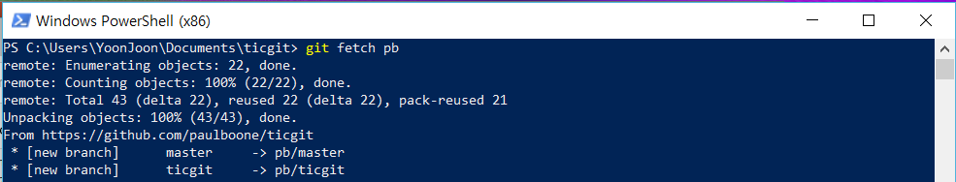
Git Basics > Working with Remotes >
Now we can use the string pb on the command line in lieu of the whole URL.
Paul’s master branch is now accessible locally as pb/master.

Slide 11
Fetching and Pulling from Remotes
Git Basics > Working with Remotes >
As we just saw, to get data from our remote projects, we can run:
The command goes out to that remote project and pulls down all the data from that remote project that we don’t have yet. After we do this, we should have references to all the branches from that remote, which we can merge in or inspect at any time.

Slide 12
Git Basics > Working with Remotes >
If we clone a repository, the command automatically adds that remote repository under the name “origin”. So, git fetch origin fetches any new work that has been pushed to that server since we cloned (or last fetched from) it.
It’s important to note that the git fetch command only downloads the data to our local repository — it doesn’t automatically merge it with any of our work or modify what we’re currently working on. We have to merge it manually into our work when we’re ready.

Slide 13
Git Basics > Working with Remotes >
If our current branch is set up to track a remote branch, we can use the git pull command to automatically fetch and then merge that remote branch into our current branch.
This may be an easier or more comfortable workflow; and by default, the git clone command automatically sets up your local master branch to track the remote master branch on the server we cloned from.
Running git pull generally fetches data from the server we originally cloned from and automatically tries to merge it into the code we’re currently working on.

Slide 14
Pushing to Remotes
Git Basics > Working with Remotes >
When we have our project at a point that we want to share, we have to push it upstream. The command for this is simple: git push <remote> <branch>.

Slide 15
Git Basics > Working with Remotes >
This command works only if we cloned from a server to which we have write access and if nobody has pushed in the meantime.
If we and someone else clone at the same time and they push upstream and then we push upstream, our push will rightly be rejected.

Slide 16
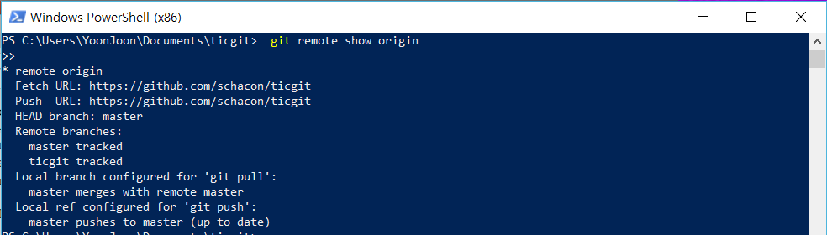
Inspecting a Remote
Git Basics > Working with Remotes >
If we want to see more information about a particular remote, we can use the git remote show <remote> command.

Slide 17
Git Basics > Working with Remotes >
It lists the URL for the remote repository as well as the tracking branch information.
The command helpfully tells us that if we’re on the master branch and we run git pull, it will automatically merge in the master branch on the remote after it fetches all the remote references.
It also lists all the remote references it has pulled down.

Slide 18
Git Basics > Working with Remotes >

Slide 19
Git Basics > Working with Remotes >
This command shows which branch is automatically pushed to when we run git push while on certain branches.
It also shows us which remote branches on the server you don’t yet have, which remote branches we have that have been removed from the server, and multiple local branches that are able to merge automatically with their remote-tracking branch when we run git pull.

Slide 20
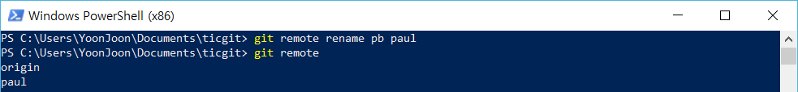
Renaming and Removing Remote
Git Basics > Working with Remotes >
We can run git remote rename to change a remote’s shortname.
It’s worth mentioning that this changes all our remote-tracking branch names, too. What used to be referenced at pb/master is now at paul/master.

Slide 21
Git Basics > Working with Remotes >
If you want to remove a remote for some reason we can either use git remote remove or git remote rm:

Slide 22
Tagging
Git Basics > Tagging >
Git has the ability to tag specific points in history as being important. Typically people use this functionality to mark release points (v1.0, and so on).

Slide 23

Listing Your Tags
Git Basics > Tagging >
Listing the available tags in Git is straightforward. Just type git tag (with optional -l or --list):

Slide 24
Creating Tags
Git Basics > Tagging >
Git supports two types of tags: lightweight and annotated.
A lightweight tag is very much like a branch that doesn’t change — it’s just a pointer to a specific commit.
Annotated tags, however, are stored as full objects in the Git database. They’re checksummed; contain the tagger name, email, and date; have a tagging message; and can be signed and verified with GNU Privacy Guard (GPG).

Slide 25
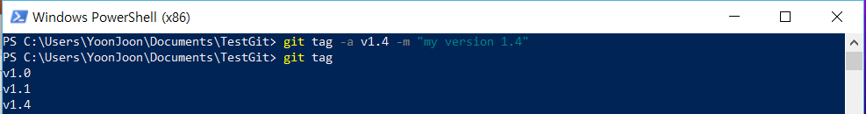
Annotated Tags
Git Basics > Tagging >
Creating an annotated tag in Git is simple. The easiest way is to specify -a when you run the tag command:
The -m specifies a tagging message, which is stored with the tag.

Slide 26
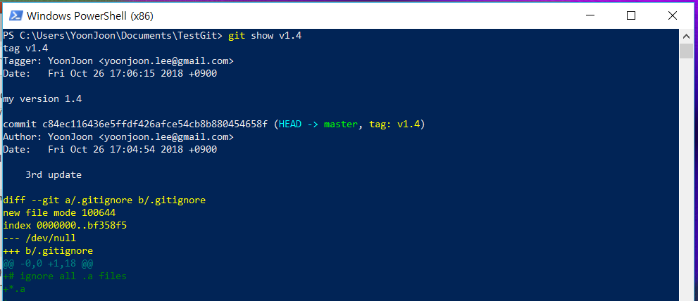
Git Basics > Tagging >
You can see the tag data along with the commit that was tagged by using the git show command:

Slide 27
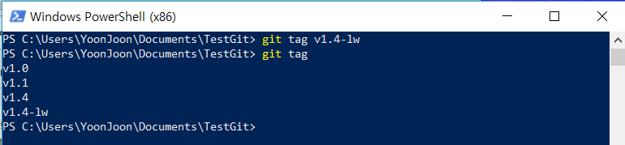
Lightweight Tags
Another way to tag commits is with a lightweight tag. This is basically the commit checksum stored in a file — no other information is kept. To create a lightweight tag, don’t supply any of the -a, -s, or -m options,
Git Basics > Tagging >
Another way to tag commits is with a lightweight tag. This is basically the commit checksum stored in a file — no other information is kept. To create a lightweight tag, don’t supply any of the -a, -s, or -m options,
Another way to tag commits is with a lightweight tag.
This is basically the commit checksum stored in a file — no other information is kept.
To create a lightweight tag, don’t supply any of the -a, -s, or -m options, just provide a tag name:

Slide 28
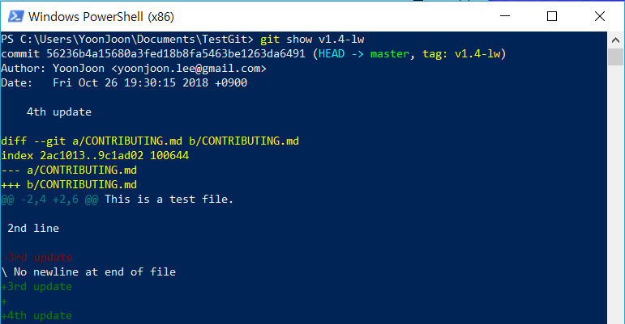
Git Basics > Tagging >
If we run git show on the tag, we don’t see the extra tag information. The command just shows the commit:

Slide 29
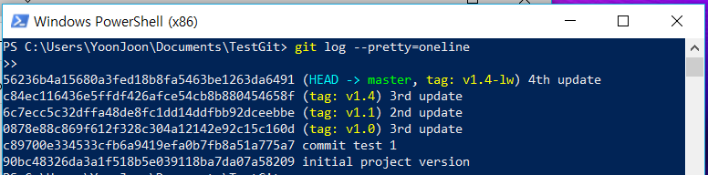
Tagging Later
Git Basics > Undoing Things >
We can also tag commits after we’ve moved past them. Suppose your commit history looks like this:

Slide 30
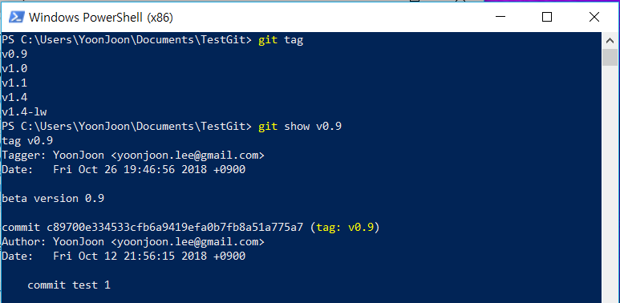
Git Basics > Tagging >
Suppose we forgot to tag the project at v0.9, which was at the “commit test 1” commit. We can add it after the fact.

Slide 31
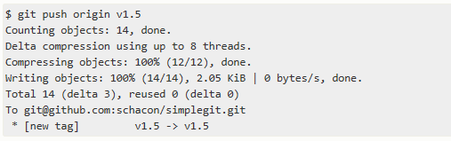
Sharing Tags
Git Basics > Undoing Things >
By default, the git push command doesn’t transfer tags to remote servers. We will have to explicitly push tags to a shared server after you have created them. This process is just like sharing remote branches — we can run git push origin <tagname>.

Slide 32
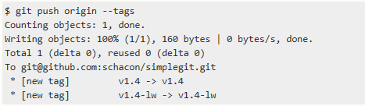
Git Basics > Tagging >
If we have a lot of tags that we want to push up at once, we can also use the --tags option to the git push command. This will transfer all of our tags to the remote server that are not already there.

Slide 33
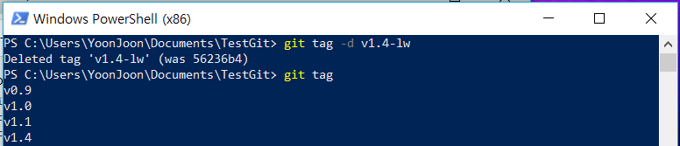
Deleting Tags
Git Basics > Undoing Things >
To delete a tag on our local repository, we can use git tag -d <tagname>. For example, we could remove our lightweight tag above as follows:

Slide 34

Git Basics > Tagging >
Note that this does not remove the tag from any remote servers. In order to update any remotes, we must use git push <remote> :refs/tags/<tagname>:

Slide 35
Checking out Tags
Git Basics > Undoing Things >
If we want to view the versions of files a tag is pointing to, we can do a git checkout, though this puts our repository in “detached HEAD” state, which has some ill side effects:

Slide 36
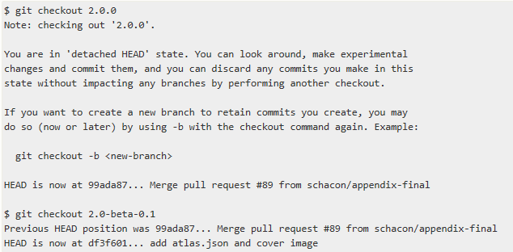
Git Basics > Tagging >

Slide 37

Git Basics > Tagging >
In “detached HEAD” state, if we make changes and then create a commit, the tag will stay the same, but our new commit won’t belong to any branch and will be unreachable, except by the exact commit hash. Thus, if we need to make changes — say we’re fixing a bug on an older version, for instance — we will generally want to create a branch:
If we do this and make a commit, our version2 branch will be slightly different than our v2.0.0 tag since it will move forward with our new changes, so do be careful.

Slide 38
Git Aliases
Git Basics > Git Aliases >
There’s just one little tip that can make our Git experience simpler, easier, and more familiar: aliases.
If we don’t want to type the entire text of each of the Git commands, we can easily set up an alias for each command using git config.

Slide 39
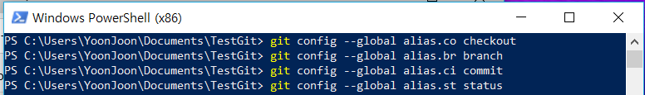
Git Basics > Git Aliases >
This means that, for example, instead of typing git commit, we just need to type git ci.

Slide 40
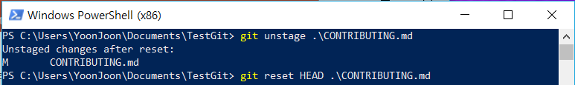
Git Basics > Git Aliases >
This technique can also be very useful in creating commands that we think should exist.
This makes the following two commands equivalent:

Slide 41
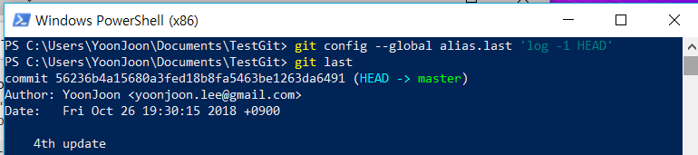
Git Basics > Git Aliases >
This seems a bit clearer. It’s also common to add a last command, like this:

Slide 42
Git Basics > Git Aliases >
Maybe we want to run an external command, rather than a Git subcommand. In that case, we start the command with a ! character. This is useful if we write our own tools that work with a Git repository. We can demonstrate by aliasing git visual to run gitk:

Slide 43
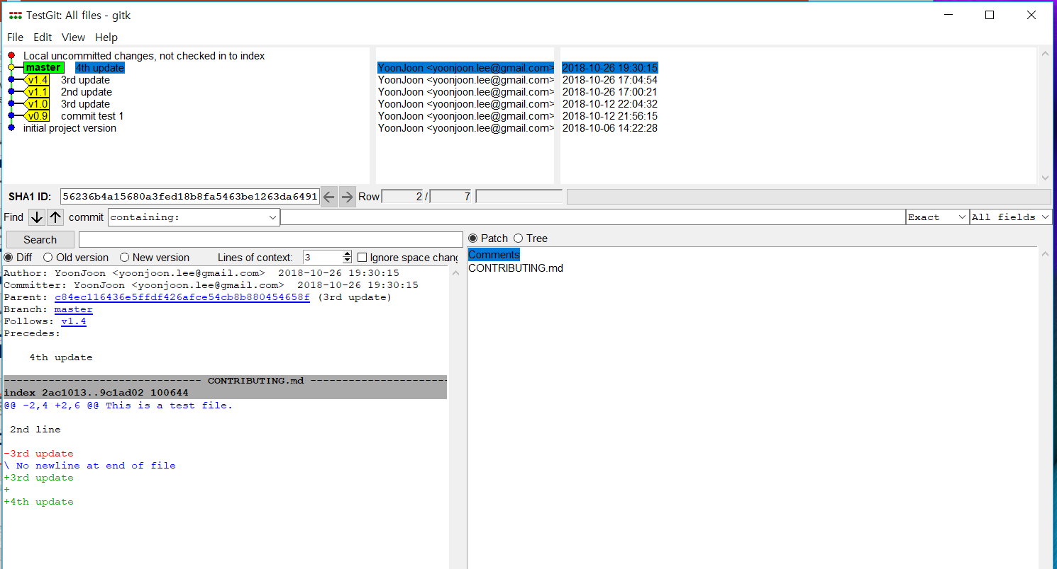
Git Basics > Git Aliases >

Slide 44

출처: metachannels.com
감사합니다

