Slide 1
Git Basics >
Pro Git(https://git-scm.com/book/ko/v2/)를 바탕으로 작성하였습니다.
YoonJoon Lee
SoC KAIST
Fall 2018

Slide 2
What we will take a look in this series
Git Basics >
Getting Started
Git Basics
Git Branch
Git Server - GitLab

Slide 3
What we will take a look today
Git Basics >
Getting Started
Git Basics
Git Branch
Git Server - GitLab

Slide 4
What I will talk about in this section
Git Basics >
Getting a Git Repository
Recording Changes to the Repository
Viewing the Commit History
Undoing Things
Working with Remotes
6. Tagging
7. Git Aliases

Slide 5
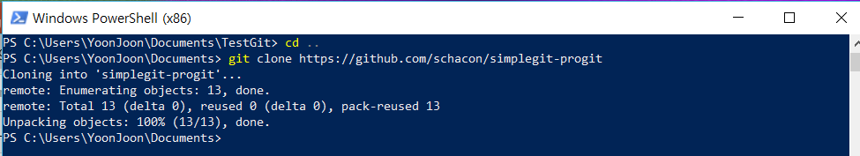
Viewing the Commit History
Git Basics > Viewing the Commit History >
After we have created several commits, or if we have cloned a repository with an existing commit history, we’ll probably want to look back to see what has happened. The most basic and powerful tool to do this is the git log command.

Slide 6
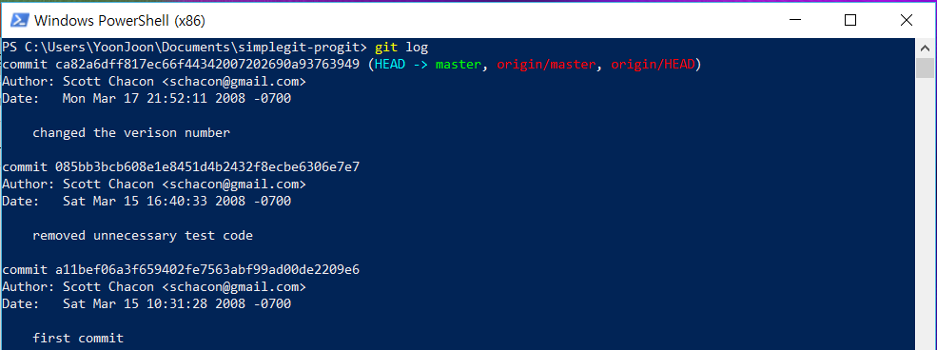
Git Basics > Viewing the Commit History >
Run git log in this project

Slide 7
Git Basics > Viewing the Commit History >
With no arguments, git log lists the commits made in that repository in reverse chronological order. This command lists each commit with its SHA-1 checksum, the author’s name and email, the date written, and the commit message.

Slide 8
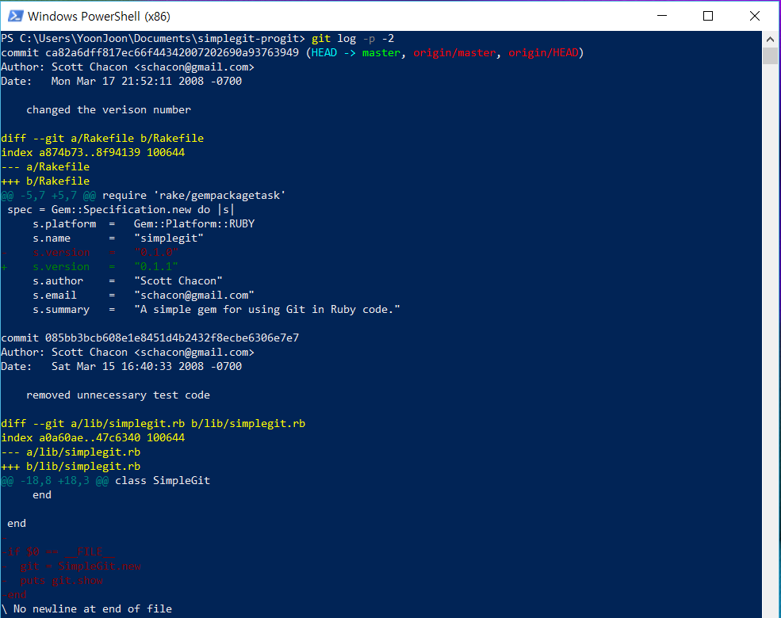
Git Basics > Viewing the Commit History >
The option -p or --patch shows the difference (the patch output) introduced in each commit. We can also limit the number of log entries displayed, such as using -2 to show only the last two entries.

Slide 9
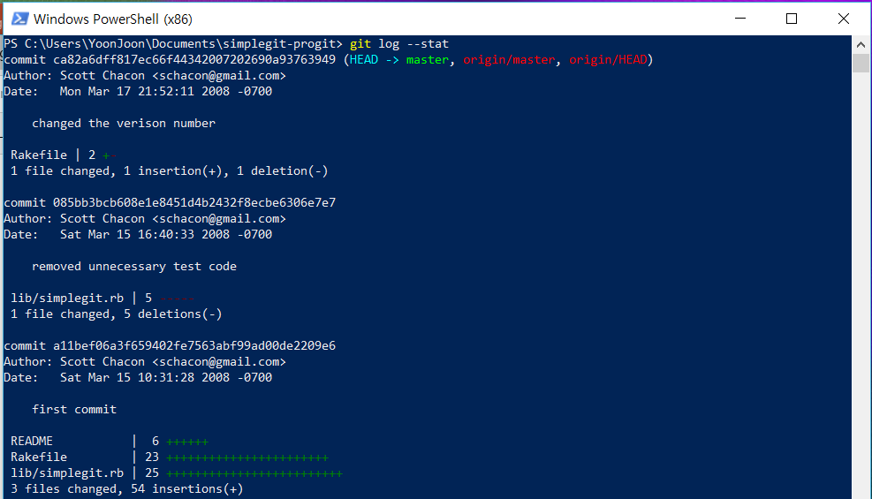
Git Basics > Viewing the Commit History >
To see some abbreviated stats for each commit, we can use the --stat option:

Slide 10
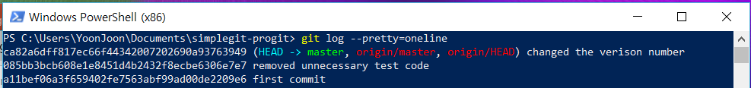
Git Basics > Viewing the Commit History >
To changes the log output to formats other than the default, we can use the --pretty option:

Slide 11
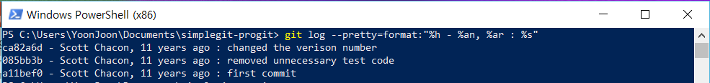
Git Basics > Viewing the Commit History >
The option is format, which allows us to specify our own log output format.

Slide 12
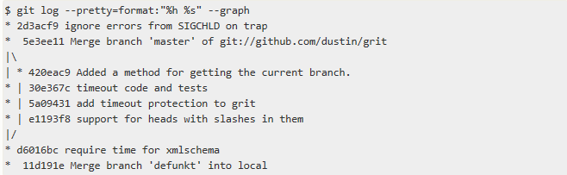
Git Basics > Viewing the Commit History >
The oneline and format options are particularly useful with another log option called --graph. This option adds a nice little ASCII graph showing your branch and merge history:

Slide 13
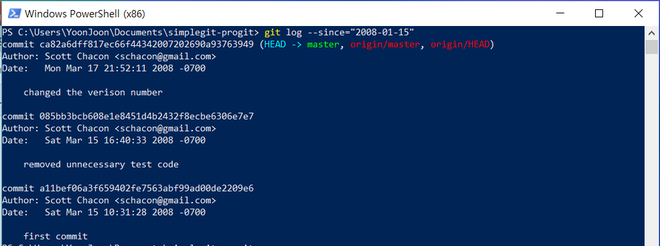
Limiting Log Output
Git Basics > Getting a Git Repository >
The time-limiting options such as --since and --until are very useful. For example, this command gets the list of commits made since 2008-01-15:

Slide 14
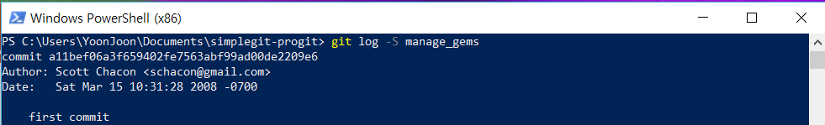
Git Basics > Viewing the Commit History >
If we wanted to find the last commit that added or removed a reference to a specific function, we could call:

Slide 15
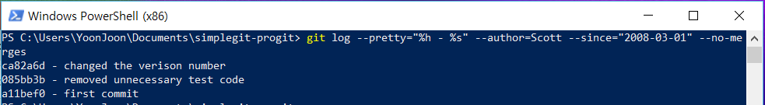
Git Basics > Viewing the Commit History >
If you want to see which commits modifying test files in the Git source code history were committed by Scott in the month of March 2008 and are not merge commits, we can run something like this:

Slide 16
Undoing Things
Git Basics > Undoing Things >
Be careful, because we can’t always undo some of these undos. This is one of the few areas in Git where we may lose some work if we do it wrong.

Slide 17
Git Basics > Undoing Things >
One of the common undos takes place when we commit too early and possibly forget to add some files, or we mess up our commit message. If we want to redo that commit, make the additional changes you forgot, stage them, and commit again using the --amend option:
This command takes your staging area and uses it for the commit. If we’ve made no changes since our last commit, then our snapshot will look exactly the same, and all we’ll change is our commit message.

Slide 18
Git Basics > Undoing Things >
If we commit and then realize we forgot to stage the changes in a file we wanted to add to this commit, we can do something like this:

Slide 19
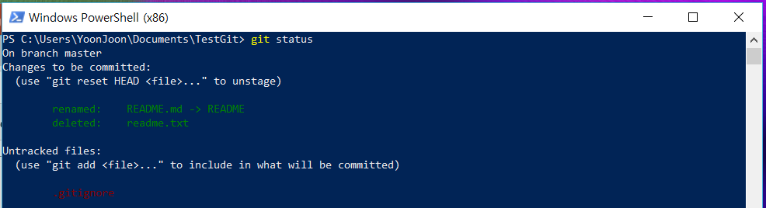
Unstaging a Staged File
Git Basics > Undoing Things >
Let’s say we’ve changed two files and want to commit them as two separate changes, but we accidentally type git add * and stage them both. How can we unstage one of the two?

Slide 20

Git Basics > Undoing Things >
The “Changes to be committed” text, it says use git reset HEAD <file>... to unstage. So, let’s use that advice to unstage the CONTRIBUTING.md file:

Slide 21
Git Basics > Recording Changes >
git add
git rm
git commit
git reset HEAD
unstaging

Slide 22
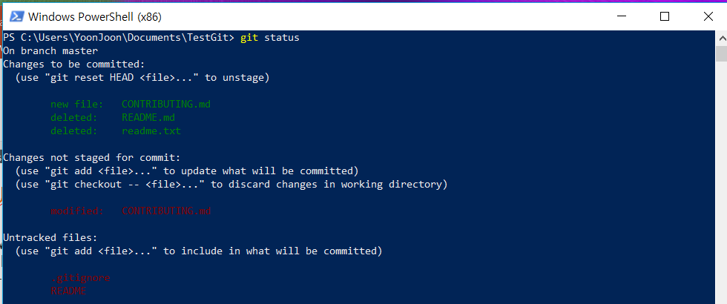
Unmodifying a Modified File
Git Basics > Undoing Things >
What if you realize that you don’t want to keep your changes to the CONTRIBUTING.md file? git status tells you how to do that, too like this:

Slide 23
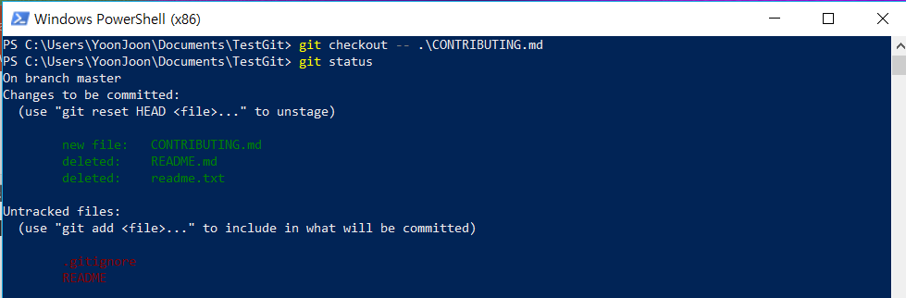
Git Basics > Undoing Things >
It tells us pretty explicitly how to discard the changes we’ve made:

Slide 24
Git Basics > Recording Changes >
git add
git rm
git commit
git reset HEAD
unstaging
git checkout
unmodifying

Slide 25

출처: metachannels.com
감사합니다

