Slide 1
Git Branch >
Pro Git(https://git-scm.com/book/ko/v2/)를 바탕으로 작성하였습니다.
YoonJoon Lee
SoC KAIST
Fall 2018

Slide 2
What we will take a look in this series
Git Branch >
Getting Started
Git Basics
Git Branch
Git Server - GitLab

Slide 3
What we will take a look today
Git Branch >
Getting Started
Git Basics
Git Branch
Git Server - GitLab

Slide 4
What I will talk about in this section
Git Branch >
Branches in a Nutshell
Basic Branching and Merging
Branch Management
Branching Workflows
Remote Branches
6. Rebasing

Slide 5
Git Branch > Branches in a Nutshell >
Branching means we diverge from the main line of development and continue to do work without messing with that main line.
Some people refer to Git’s branching model as its “killer feature,” and it certainly sets Git apart in the VCS community.
Why is it so special? The way Git branches is incredibly lightweight, making branching operations nearly instantaneous, and switching back and forth between branches generally just as fast.

Slide 6
Branches in a Nutshell
Git Branch > Branches in a Nutshell >
Git doesn’t store data as a series of changesets or differences, but instead as a series of snapshots.
When we make a commit, Git stores a commit object that contains a pointer to the snapshot of the content we staged.
This object also contains the author’s name and email address, the message that we typed, and pointers to the commit or commits that directly came before this commit (its parent or parents):

Slide 7
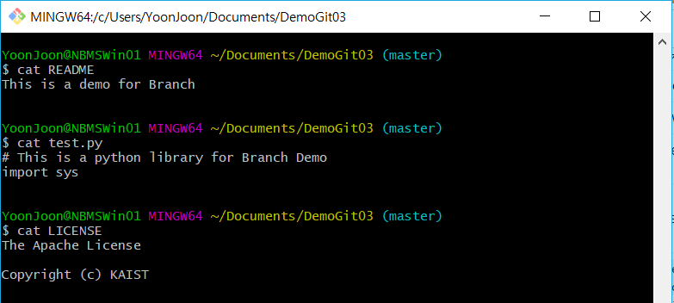
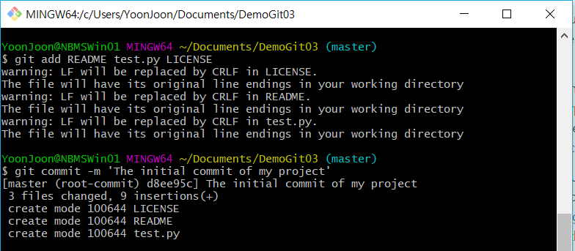
Git Branch > Branches in a Nutshell >

Slide 8
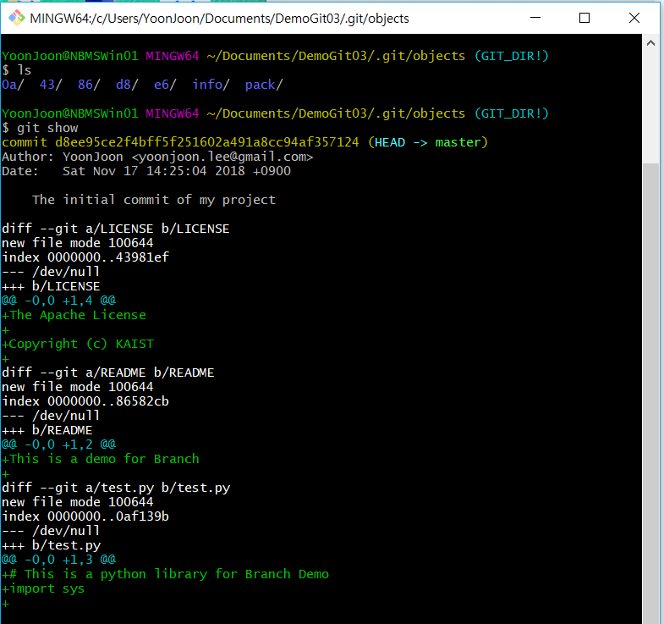
Git Branch > Branches in a Nutshell >

Slide 9
Git Branch > Branches in a Nutshell >
Git repository now contains five objects: three blobs (each representing the contents of one of the three files), one tree that lists the contents of the directory and specifies which file names are stored as which blobs, and one commit with the pointer to that root tree and all the commit metadata.
43
blob size
The Apache License …
d8
e6
commit size
Tree e6
Author YoonJoon
Committer YoonJoon
The initial commit of my project
86
tree size
blob 43 LICENSE
blob 86 README
blob 43 test.py
blob size
This is a demo for Branch
0a
blob size
# This is a python library …

Slide 10
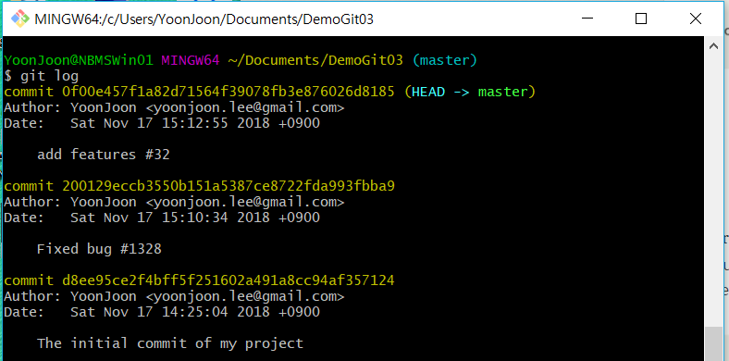
Git Branch > Branches in a Nutshell >

Slide 11
Git Branch > Branches in a Nutshell >
d8
20
0f
commit size
Tree e6
Parent
Author YoonJoon
Committer YoonJoon
The initial commit of my project
commit size
Tree 6f
Parent d8
Author YoonJoon
Committer YoonJoon
Fixed bug #1328
commit size
Tree cd
Parent 20
Author YoonJoon
Committer YoonJoon
add features #32
Snapshot A
Snapshot B
Snapshot C

Slide 12
Git Branch > Branches in a Nutshell >
A branch in Git is simply a lightweight movable pointer to one of these commits. The default branch name in Git is master. As we start making commits, we’re given a master branch that points to the last commit we made. Every time we commit, the master branch pointer moves forward automatically.
HEAD
V1.0
master
d8
20
0f
Snapshot A
Snapshot A
Snapshot A

Slide 13
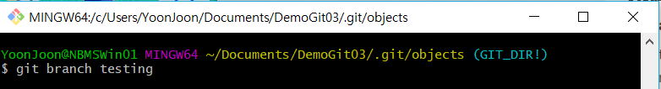
Creating a New Branch
Git Branch > Branches in a Nutshell >
master
d8
20
0f
testing

Slide 14
Git Branch > Branches in a Nutshell >
How does Git know what branch we’re currently on? It keeps a special pointer called HEAD. In Git, this is a pointer to the local branch we’re currently on. In this case, we’re still on master. The git branch command only created a new branch — it didn’t switch to that branch.
HEAD
master
d8
20
0f
testing

Slide 15
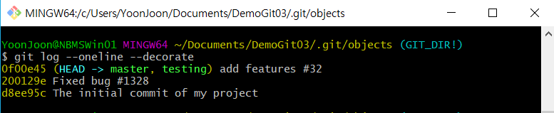
Git Branch > Branches in a Nutshell >
We can easily see this by running a simple git log command that shows us where the branch pointers are pointing. This option is called --decorate.

Slide 16
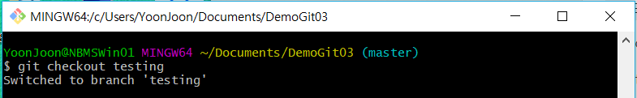
Switching Branches
Git Branch > Branches in a Nutshell >
To switch to an existing branch, we run the git checkout command. Let’s switch to the new testing branch:

Slide 17
Git Branch > Branches in a Nutshell >
HEAD
master
d8
20
0f
testing
HEAD

Slide 18
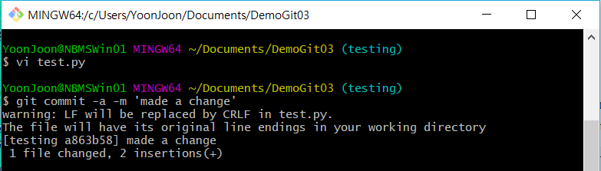
Git Branch > Branches in a Nutshell >
master
d8
20
0f
a8
testing
HEAD

Slide 19
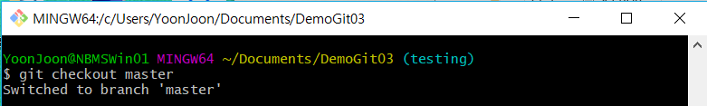
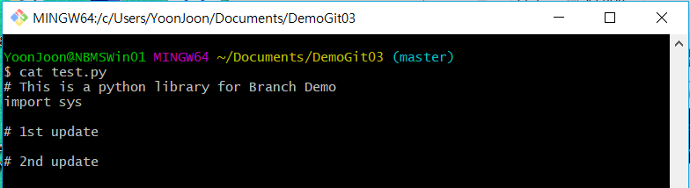
Git Branch > Branches in a Nutshell >
HEAD
master
d8
20
0f
a8
testing

Slide 20
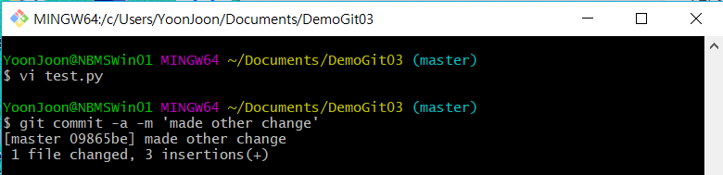
Git Branch > Branches in a Nutshell >
HEAD
master
09
d8
20
0f
a8
testing

Slide 21
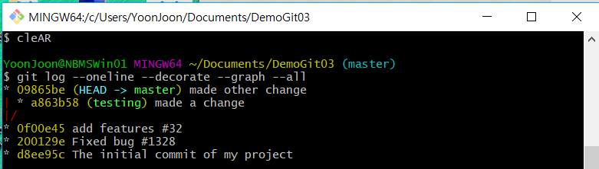
Git Branch > Branches in a Nutshell >

Slide 22
Basic Branching and Merging
Git Branch > Basic Branching and Merging >
Let’s go through a simple example of branching and merging with a workflow that we might use in the real world. We’ll follow these steps:
Do some work on a website.
Create a branch for a new story we’re working on.
Do some work in that branch.
At this stage, we’ll receive a call that another issue is critical and we need a hotfix. We’ll do the following:
Switch to our production branch.
Create a branch to add the hotfix.
After it’s tested, merge the hotfix branch, and push to production.
Switch back to our original story and continue working.

Slide 23
Basic Branching
Git Branch > Basic Branching and Merging >
First, let’s say we’re working on our project and have a couple of commits already on the master branch.
master
C0
C1
C2

Slide 24
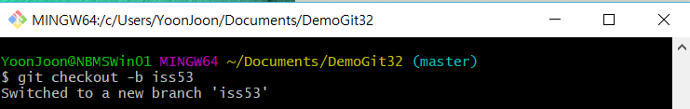

Git Branch > Basic Branching and Merging >
We’ve decided that we’re going to work on issue #53. To create a new branch and switch to it at the same time, we can run the git checkout command with the -b switch:
master
C0
C1
C2
iss53

Slide 25
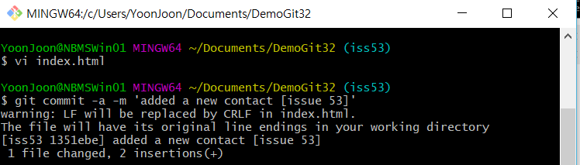
Git Branch > Basic Branching and Merging >
We work on our website and do some commits. Doing so moves the iss53 branch forward, because we have it checked out (that is, our HEAD is pointing to it):
master
C0
C1
C2
C3
iss53

Slide 26
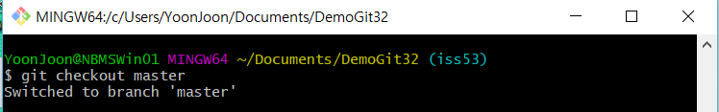
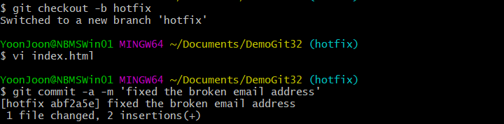
Git Branch > Basic Branching and Merging >
hotfix
master
C4
C0
C1
C2
C3
iss53

Slide 27
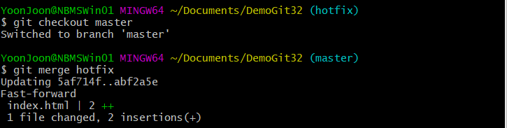
Git Branch > Basic Branching and Merging >
master
hotfix
C4
C0
C1
C2
C3
iss53

Slide 28
Git Branch > Basic Branching and Merging >
master
C4
C0
C1
C2
C3
iss53

Slide 29
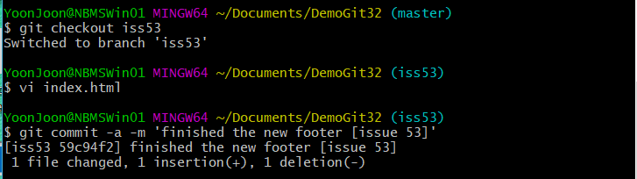
Git Branch > Basic Branching and Merging >
master
C4
C0
C1
C2
C3
C5
iss53

Slide 30
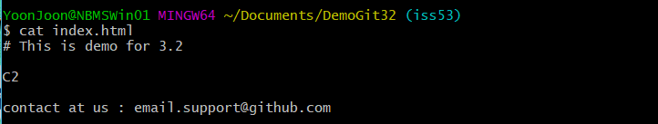
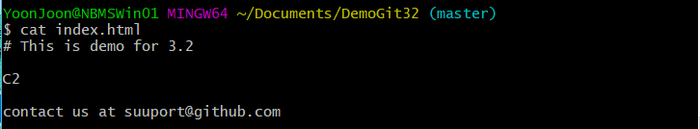
Git Branch > Basic Branching and Merging >

Slide 31
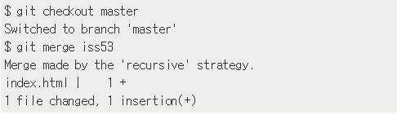
Basic Merging
Git Branch > Basic Branching and Merging >
Suppose we’ve decided that our issue #53 work is complete and ready to be merged into our master branch. In order to do that, we’ll merge our iss53 branch into master, much like we merged our hotfix branch earlier. All we have to do is check out the branch we wish to merge into and then run the git merge command:

Slide 32
Git Branch > Basic Branching and Merging >
master
Common
Ancester
Snapshot to
Merge Into
C4
Snapshot to
Merge To
C0
C1
C2
C3
C5
iss53

Slide 33
Git Branch > Basic Branching and Merging >
master
C4
C6
C0
C1
C2
C3
C5
iss53

Slide 34
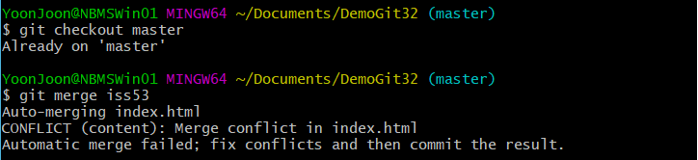
Basic Merge Conflicts
Git Branch > Basic Branching and Merging >
Occasionally, this process doesn’t go smoothly. If we changed the same part of the same file differently in the two branches we’re merging together, Git won’t be able to merge them cleanly. If our fix for issue #53 modified the same part of a file as the hotfix branch, we’ll get a merge conflict that looks something like this:

Slide 35
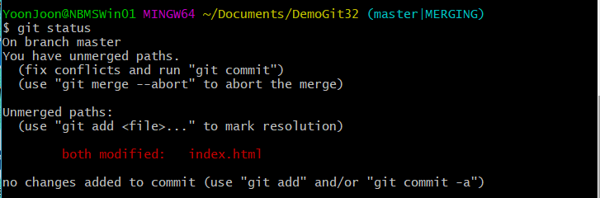
Git Branch > Basic Branching and Merging >
If we want to see which files are unmerged at any point after a merge conflict, we can run git status:

Slide 36
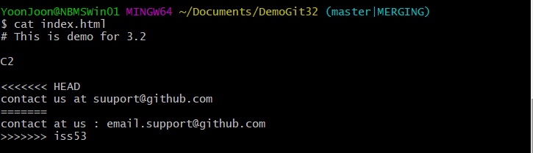
Git Branch > Basic Branching and Merging >
Our file contains a section that looks something like this:
In order to resolve the conflict, we have to either choose one side or the other or merge the contents ourselves. For instance, we might resolve this conflict by replacing the entire block with this:

Slide 37
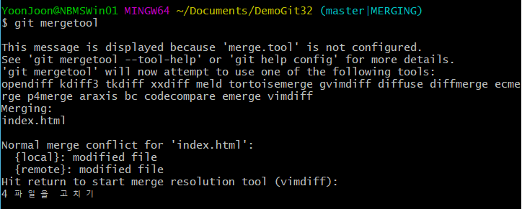
Git Branch > Basic Branching and Merging >
If we want to use a graphical tool to resolve these issues, we can run git mergetool, which fires up an appropriate visual merge tool and walks we through the conflicts:

Slide 38
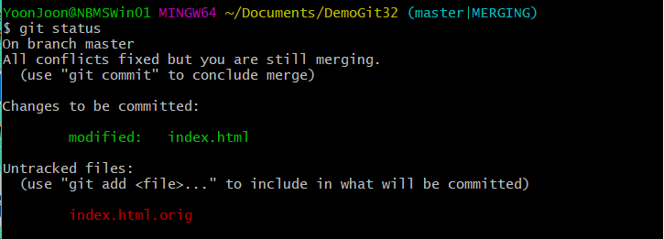
Git Branch > Basic Branching and Merging >
We can run git status again to verify that all conflicts have been resolved:

Slide 39
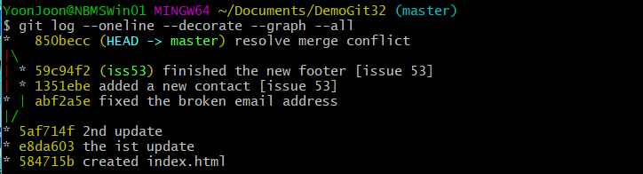
Git Branch > Basic Branching and Merging >
If we’re happy with that, and we verify that everything that had conflicts has been staged, we can type git commit to finalize the merge commit.

Slide 40


출처: metachannels.com
감사합니다

