Slide 1
Git Basics >
Pro Git(https://git-scm.com/book/ko/v2/)를 바탕으로 작성하였습니다.
YoonJoon Lee
SoC KAIST
Fall 2018

Slide 2
What we will take a look in this series
Git Basics >
Getting Started
Git Basics
Git Branch
Git Server - GitLab

Slide 3
What we will take a look today
Git Basics >
Getting Started
Git Basics
Git Branch
Git Server - GitLab

Slide 4
What I will talk about in this section
Git Basics >
Getting a Git Repository
Recording Changes to the Repository
Viewing the Commit History
Undoing Things
Working with Remotes
6. Tagging
7. Git Aliases

Slide 5
Getting a Git Repository
Git Basics > Getting a Git Repository >
Typically obtain a Git repository in one of two ways:
Take a local directory that is currently not under version control, and turn it into a Git repository, or
Clone an existing Git repository from elsewhere.

Slide 6

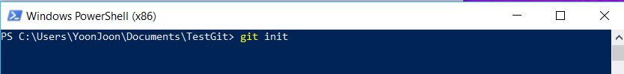
Initializing a Repository in an Existing Directory
Git Basics > Getting a Git Repository >
You have a project directory that is currently not under version control and you want to start controlling it with Git.
This creates a new subdirectory named .git that contains all of your necessary repository files — a Git repository skeleton.

Slide 7
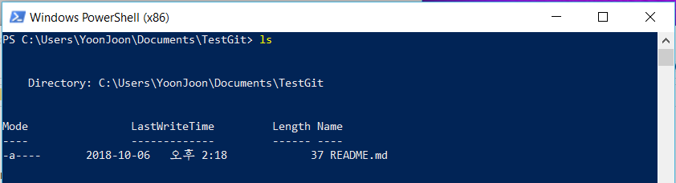
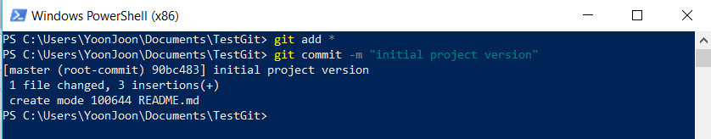
Git Basics > Getting a Git Repository >
If you want to start version-controlling existing files (as opposed to an empty directory), you should probably begin tracking those files and do an initial commit.

Slide 8
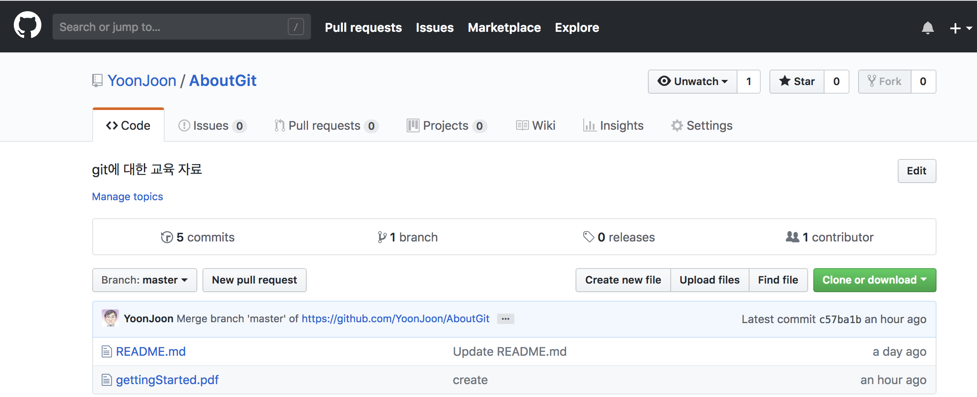
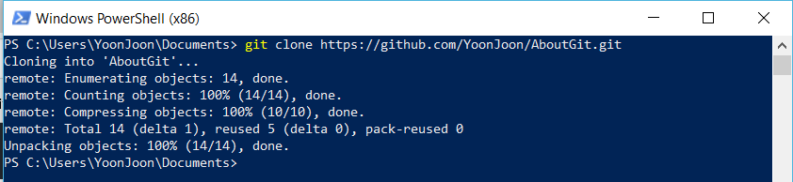
Cloning an Existing Repository
Git Basics > Getting a Git Repository >
If you want to get a copy of an existing Git repository, the command you need is git clone.

Slide 9
Recording Changes to the Repository
Git Basics > Recording Changes >
At this point, we should have a bona fide Git repository on our local machine.
Each file in the working directory can be in one of two states: tracked or untracked.
Tracked files are files that were in the last snapshot; they can be unmodified, modified, or staged.
When you first clone a repository, all of your files will be tracked and unmodified

Slide 10
Git Basics > Recording Changes >

Slide 11
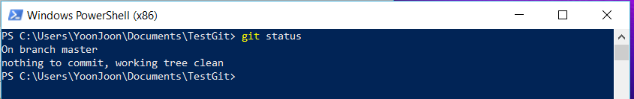
Checking the Status of Your Files
Git Basics > Recording Changes >
The git status command shows which files are in which state is
The command tells you which branch you’re on and informs you that it has not diverged from the same branch on the server. For now, that branch is always “master”, which is the default.

Slide 12
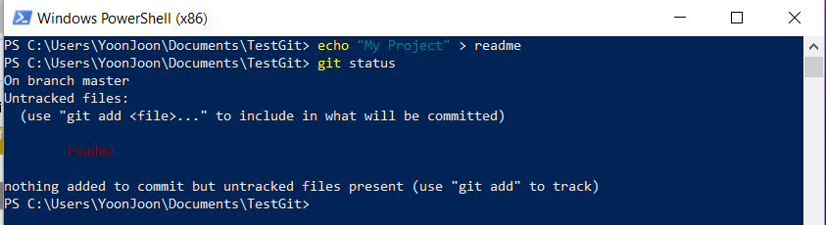
Git Basics > Recording Changes >
We add a new file to our project, a simple readme file. If the file didn’t exist before, and you run git status:
We can see that your new readme file is untracked, because it’s under the “Untracked files” heading in your status output. Untracked basically means that Git sees a file you didn’t have in the previous snapshot (commit);

Slide 13
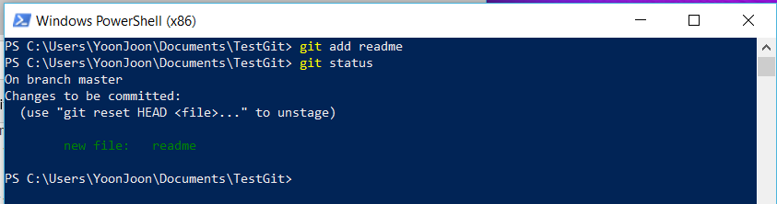
Tracking New Files
Git Basics > Recording Changes >
In order to begin tracking a new file, we use the command git add.
We can tell that it’s staged because it’s under the “Changes to be committed” heading.

Slide 14
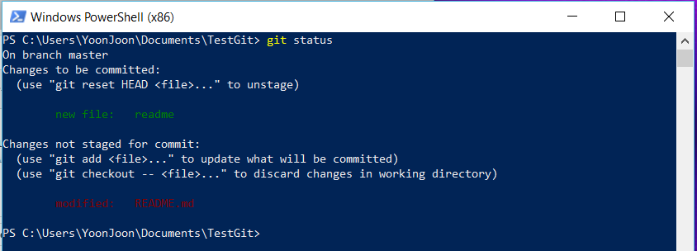
Staging Modified Files
Git Basics > Recording Changes >
Let’s change a file that was already tracked. If we change a previously tracked file called README.md and then run our git status command again,

Slide 15
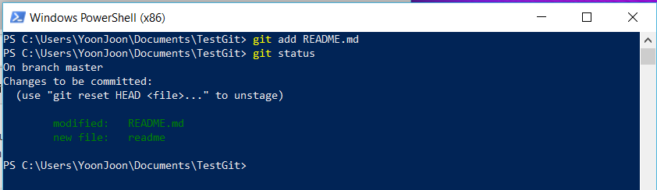
Git Basics > Recording Changes >
Let’s run git add now to stage the README.md file, and then run git status again:

Slide 16
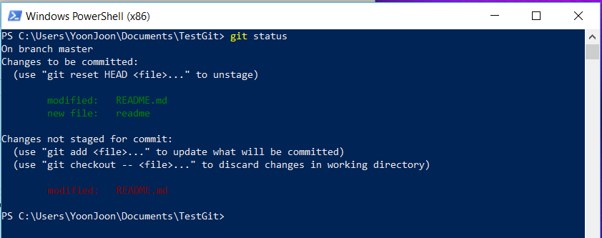
Git Basics > Recording Changes >
We want to make change in README.md before we commit it. We open it again and make that change, and we’re ready to commit. However, let’s run git status one more time:

Slide 17
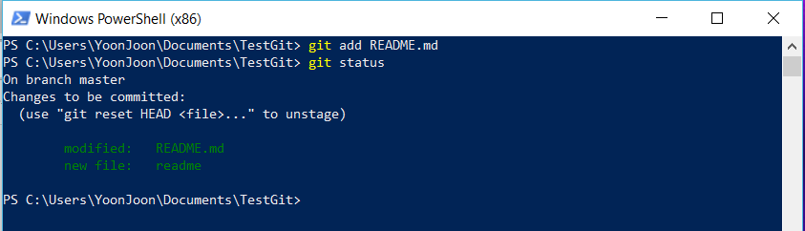
Git Basics > Recording Changes >
If we modify a file after we run git add, we have to run git add again to stage the latest version of the file:

Slide 18
Git Basics > Recording Changes >
git add

Slide 19
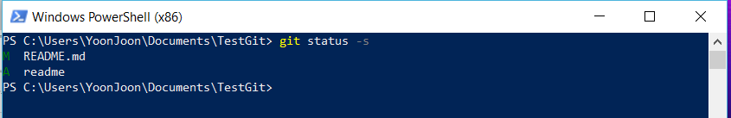
Short Status
Git Basics > Recording Changes >
Git also has a short status flag so we can see our changes in a more compact way. If we run git status -s or git status –short.
New files that have been added to the staging area have an A, modified files have an M and so on.

Slide 20
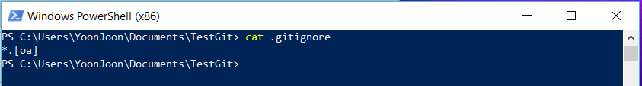
Ignoring Files
Git Basics > Recording Changes >
Often, we’ll have a class of files that we don’t want Git to automatically add or even show we as being untracked. We can create a file listing patterns to match them named .gitignore.
The first line tells Git to ignore any files ending in “.o” or “.a” — object and archive files that may be the product of building our code.

Slide 21
Git Basics > Recording Changes >
The rules for the patterns we can put in the .gitignore file are as follows:
Blank lines or lines starting with # are ignored.
Standard glob patterns work, and will be applied recursively throughout the entire working tree.
We can start patterns with a forward slash (/) to avoid recursivity.
We can end patterns with a forward slash (/) to specify a directory.
We can negate a pattern by starting it with an exclamation point (!).

Slide 22
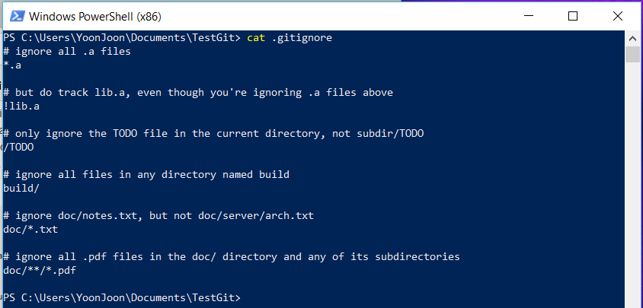
Git Basics > Recording Changes >

Slide 23
Viewing Your Staged and Unstaged Changes
Git Basics > Recording Changes >
We want to know exactly what we changed, not just which files were changed — we can use the git diff command.
What have you changed but not yet staged?
And what have you staged that you are about to commit?

Slide 24
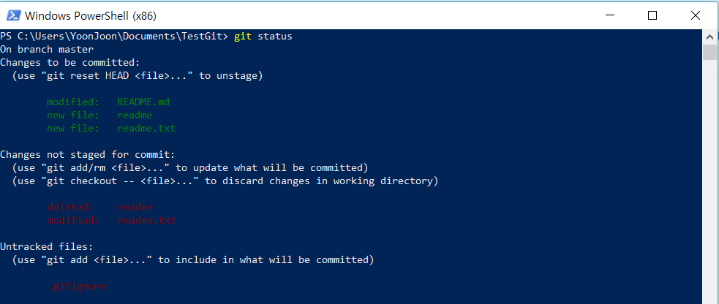
Git Basics > Recording Changes >
We edit and stage the README.md file again and
then edit the reademe.txt file without staging it.
If you run your git status command,

Slide 25
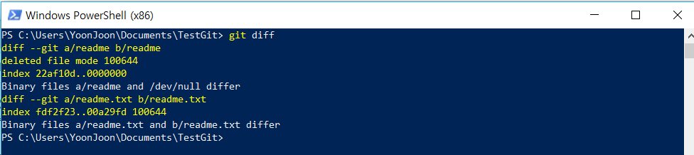
Git Basics > Recording Changes >
To see what we’ve changed but not yet staged, type git diff with no other arguments:

Slide 26
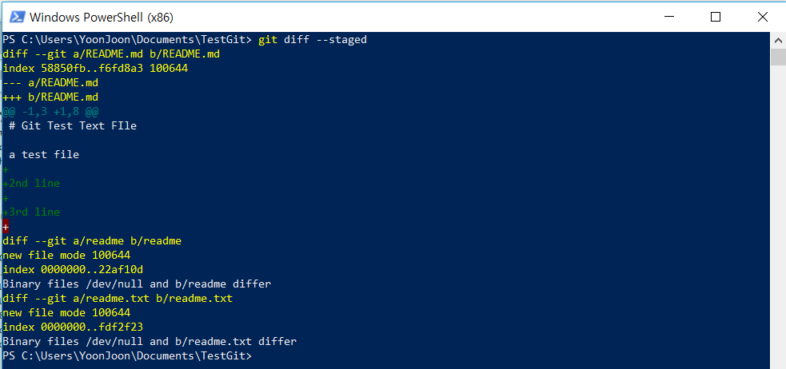
Git Basics > Recording Changes >
If you want to see what we’ve staged that will go into our next commit, we can use git diff --staged. This command compares our staged changes to your last commit:

Slide 27
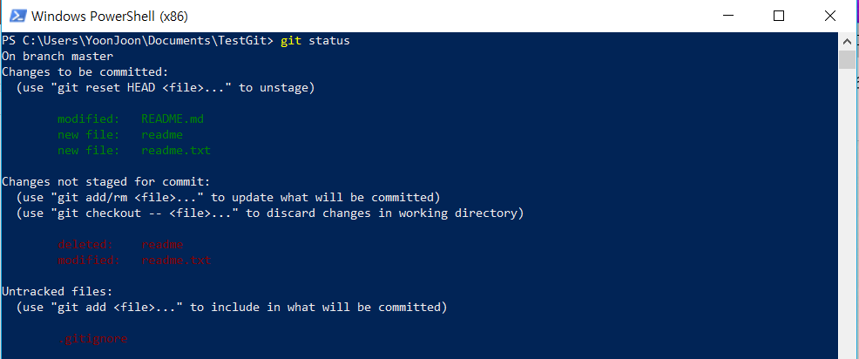
Git Basics > Recording Changes >
If we stage the readme.txt file and then edit it, you can use git diff to see the changes in the file that are staged and the changes that are unstaged.

Slide 28
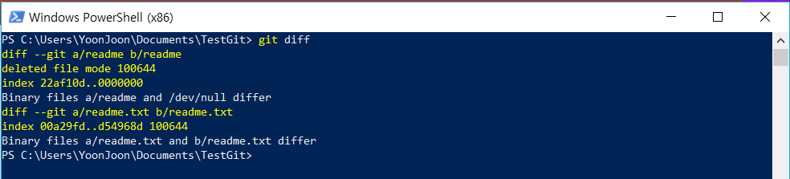
Git Basics > Recording Changes >
git diff to see what is still unstaged:

Slide 29
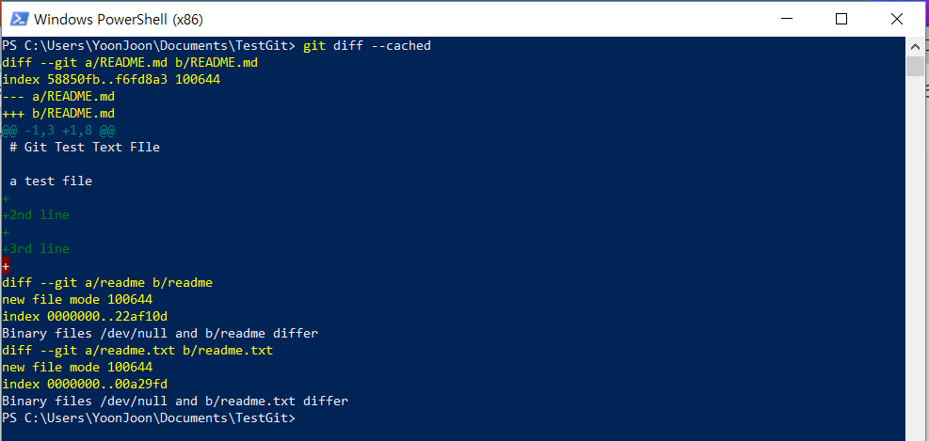
Git Basics > Recording Changes >
and git diff --cached to see what we’ve staged so far (--staged and --cached are synonyms):

Slide 30
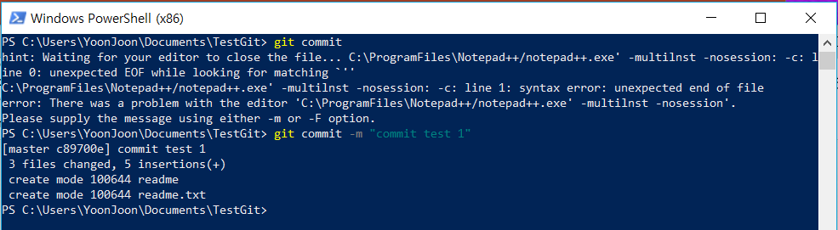
Committing Your Changes
The simplest way to commit is to type git commit:
Our staging area is set up the way you want it, you can commit your changes.
The simplest way to commit is to type git commit:

Slide 31
Git Basics > Recording Changes >
git add
git commit

Slide 32
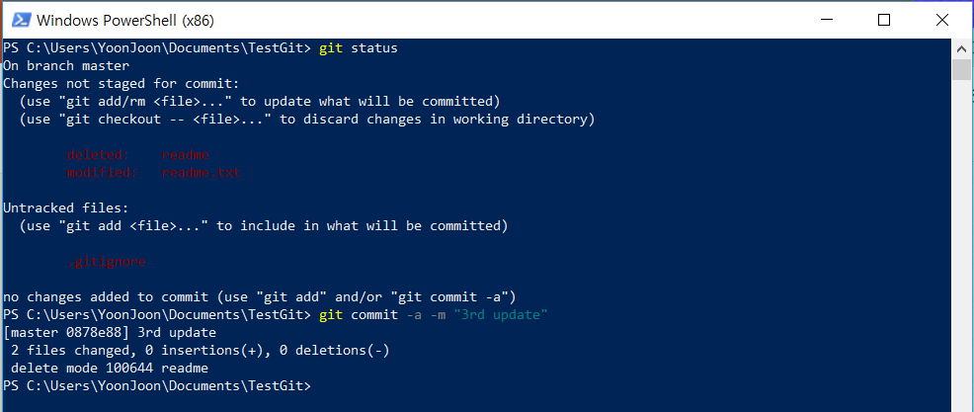
Skipping the Staging Area
Adding the -a option to the git commit command makes Git automatically stage every file that is already tracked before doing the commit, letting you skip the git add part:

Slide 33
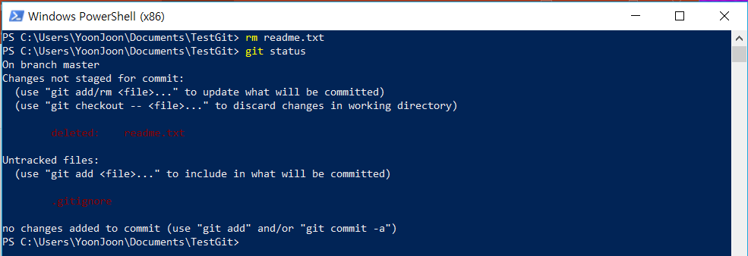
Removing Files
To remove a file from Git, we have to remove it from our tracked files (more accurately, remove it from your staging area) and then commit. The git rm command does that, and also removes the file from our working directory

Slide 34
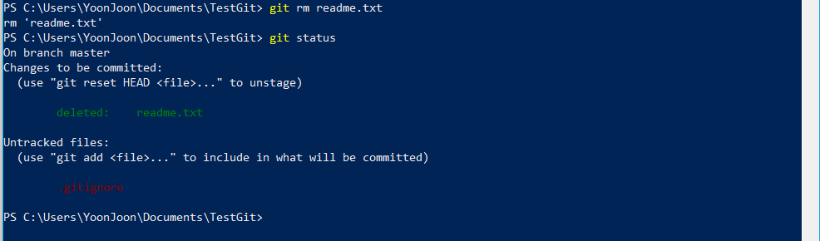
If we run git rm, it stages the file’s removal:

Slide 35
Git Basics > Recording Changes >
git add
git rm
git commit

Slide 36
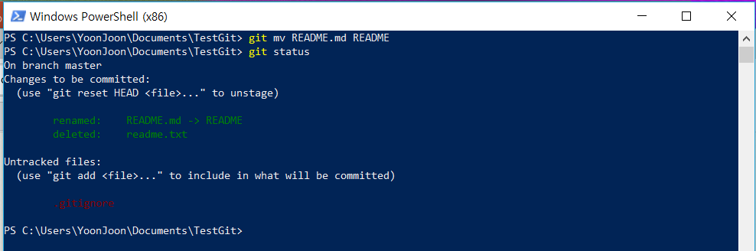

Moving Files
If we want to rename a file in Git, we can run something like:

Slide 37

출처: metachannels.com
감사합니다

