Slide 1
Database Design
DB Design >
이 윤 준
대학정보화사업본부
Fall 2018

Slide 2
Schedule*
DB Design >
0. Seminar Overview
Overview of the Relational Data Model
Why DB Design?
Development Process
Requirements
Conceptual Data Model
Generalization & Specialization
Relational Database Design
Normalization
Keys and Constraints
*subject to change without notification

Slide 3
0. Seminar Overview
Seminar Overview >
이 윤 준
대학정보화사업본부
Fall 2017

Slide 4
Schedule*
Seminar Overview >
0. Seminar Overview
Overview of the Relational Data Model
Why DB Design?
Development Process
Requirements
Conceptual Data Model
Generalization & Specialization
Relational Database Design
Normalization
Keys and Constraints
*subject to change without notification

Slide 5
“Data is the Future”
Seminar Overview >
- Chris Ré

Slide 6
The world is increasingly driven by data…
Seminar Overview >
데이터의 저장과 관리를 위한 능력 함양

Slide 7
What will be dealt with in this section
Seminar Overview >
Motivation for studying DB
Overview of coverage

Slide 8
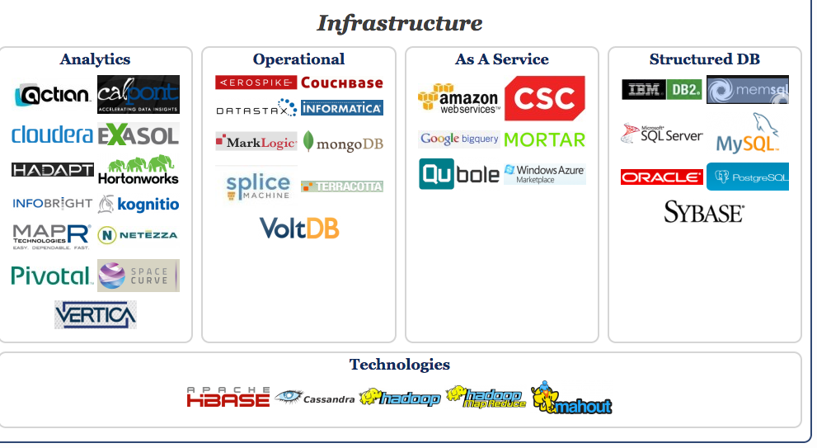
Big Data Landscape… Infrastructure is Changing
Seminar Overview > Motivation >
New tech. Same Principles.
http://www.bigdatalandscape.com/

Slide 9


Why should you study databases?
Seminar Overview > Motivation >
Mercenary- make more $$$:
Startups need DB talent right away = low employee #
Massive industry…
Intellectual:
Science: data poor to data rich
No idea how to handle the data!
Fundamental ideas to/from all of CS:
Systems, theory, AI, logic, stats, analysis….
Many great computer systems ideas started in DB.

Slide 10
What for (and not for)?
Seminar Overview > Coverage >
Discuss fundamentals of database design
How to design databases, query databases, build applications with them.
How to debug them when they go wrong!
Not how to be a DBA or how to tune Oracle 12g.
We’ll neither cover how database management systems work
Nor the principles of how to build them ☹

Slide 11
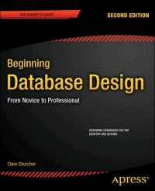
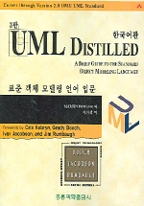
References
Seminar Overview > Coverage >
Slides cover essential material
This is your best reference.
But, you read the textbook when necessary.
Beginning Database Design from Novice to Professional, 2nd ed.,
Clare Chursher, Apress
Free e-book downloaded from http://it-ebooks.info/book/5174/
UML Distilled 3판 - 한국어판 - 표준 객체 모델링 언어 입문
마틴 파울러 (지은이), 이인섭 (옮긴이) | 홍릉과학출판사

Slide 12


출처: metachannels.com
감사합니다

