Slide 1
GUI Calculator with Java
발표자 2017314380 윤성경

Slide 2
INDEX
How Calculator works?
3 ways to get result
Use Parenthesis and Point
With easy macro
See the History
How Polymorphism works?
OOP in the Button Classes
Micro Control Available by specifying
General Control by Polymorphism

Slide 3
3 ways to get result
Use button to get result
Use keyboard to get result
Use copy and paste to get result
String operationString="";
(operationString으로 전체 계산명령을 handling)
operationString = textInterface.getText();
(Equal button을 눌렀을 때 operationString을 textInterface의 String으로 update)

Slide 4
Use Parenthesis and Point
We can use Parenthesis and Point for our Powerful calculation
Example : 3.14*3120/(58*(32+4/51)-300.42)
Parenthesis By Postfix & Stack Calculator Logic
(문자열을 Postfix로 바꿔주고 Postfix 처리 stack 계산기 사용)
Point and negative By Special Preprocess Logic
(연산자와 연산자 사이의 숫자 부분을 여러 string 조각에서 하나의 숫자 string으로 합친다)
(Example: “3”“4”“5”“.”“6”“7”를 “345.67” 로)
(Negative 조건 : { 1. [맨 앞에 - ] 2. [연산자 바로 뒤에 – ] 3. [‘(’ 바로 뒤에 - ] }
를 체크해서 숫자로 바꾸는 과정에서 음수 부호를 추가해준다. )

Slide 5
With easy macro
We can use Macro easily by switching between save and use mode
Example : always use (x)/(314.44+(x)/27.3) formula
Use macro
Use copy and paste method
(Also Implemented with ease)
This is almost everything of macro function
String macro1String="";
String macro2String="";
boolean isMacroSaveMode=true;

Slide 6
See the History
We can see the History of calculations being updated on the result dialog
You can get reference from the list of calculations you did on the another window for result
resultPanel.add(new resultLabel(result));
(새로운 resultLabel을 만들어서 result의 내용을 담고, resultPanel에 add한다)
resultPanel.revalidate();
(새로운 contents가 담긴 resultPanel을 update한다.)

Slide 7
OOP in the Button Classes
Button Classes have general : specific
hierarchy for faster and stronger code
If you want to set or change the
general look and feel or rule for button
control the general class
If you want to set or change the
specific look and feel or rule for special button
control the specific class

Slide 8
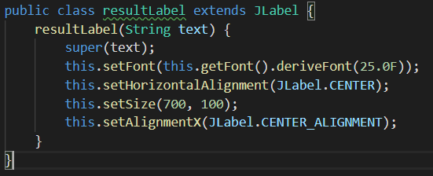
Micro Control Available by specifying
super(text);
(Initialize as usual in superclass)
this.setFont(new Font("Arial", Font.PLAIN, 30));
(operator has smaller icon than number button
-> We applied larger font for them)
We specified JLabel as resultLabel to control all specific aspect of resultLabel in the class level

Slide 9
General Control by Polymorphism
We can control all the general buttons at once
by using polymorphism
CalcButton [] idAddingButtonCollector = new CalcButton[20];
(idAddingButtonCollector is Hero!)
int numOfCollectedButton=0;
(numOfCollectedButton is the best supporter!)
Let’s see How they work in the code!!!

Slide 10
Thank you !

