Slide 1
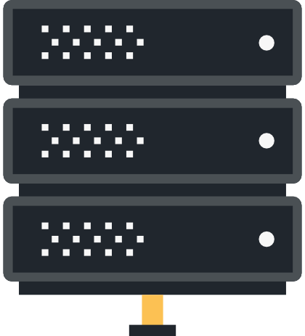
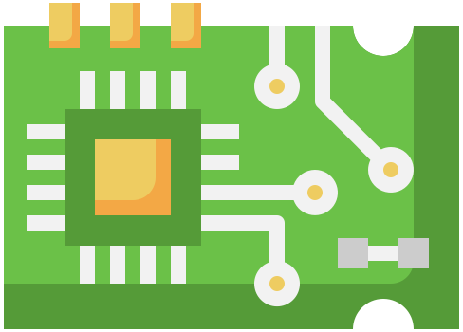

Slide 2
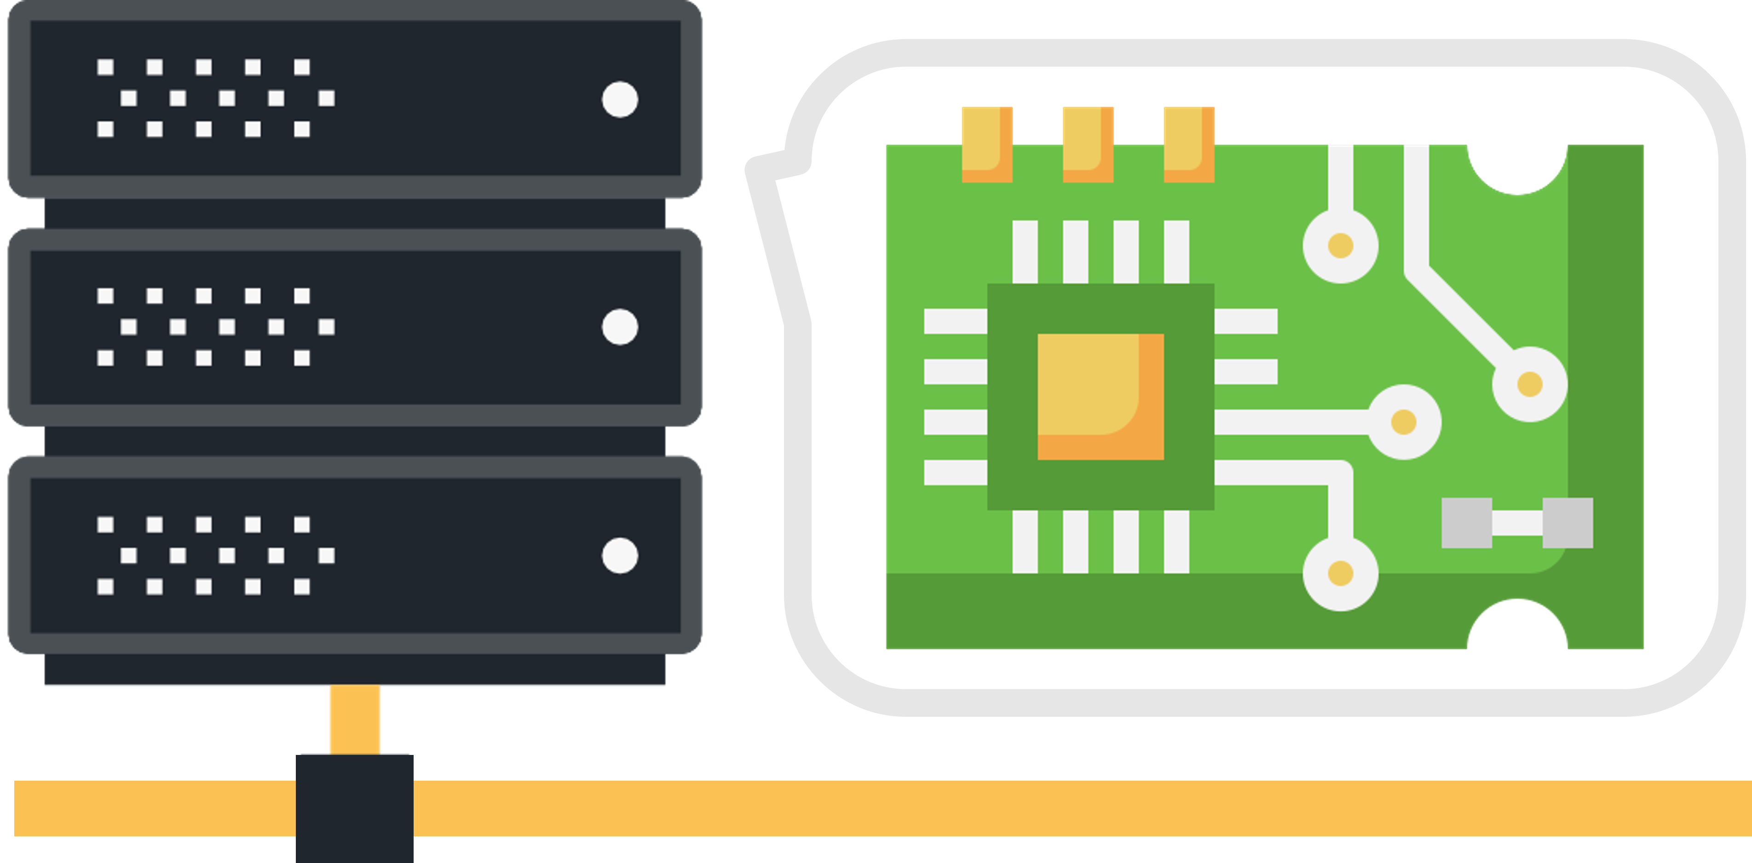
Dex
Embedded Server Practice Image
Based on Raspberry Pi & Ubuntu & Docker

