Slide 1
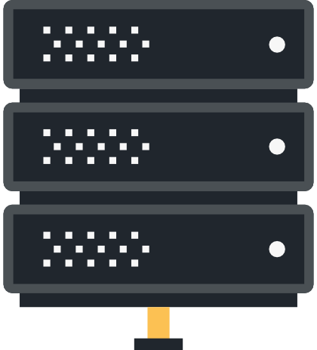
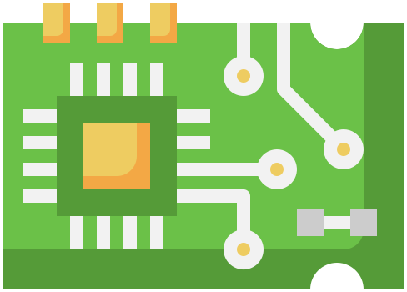

Slide 2
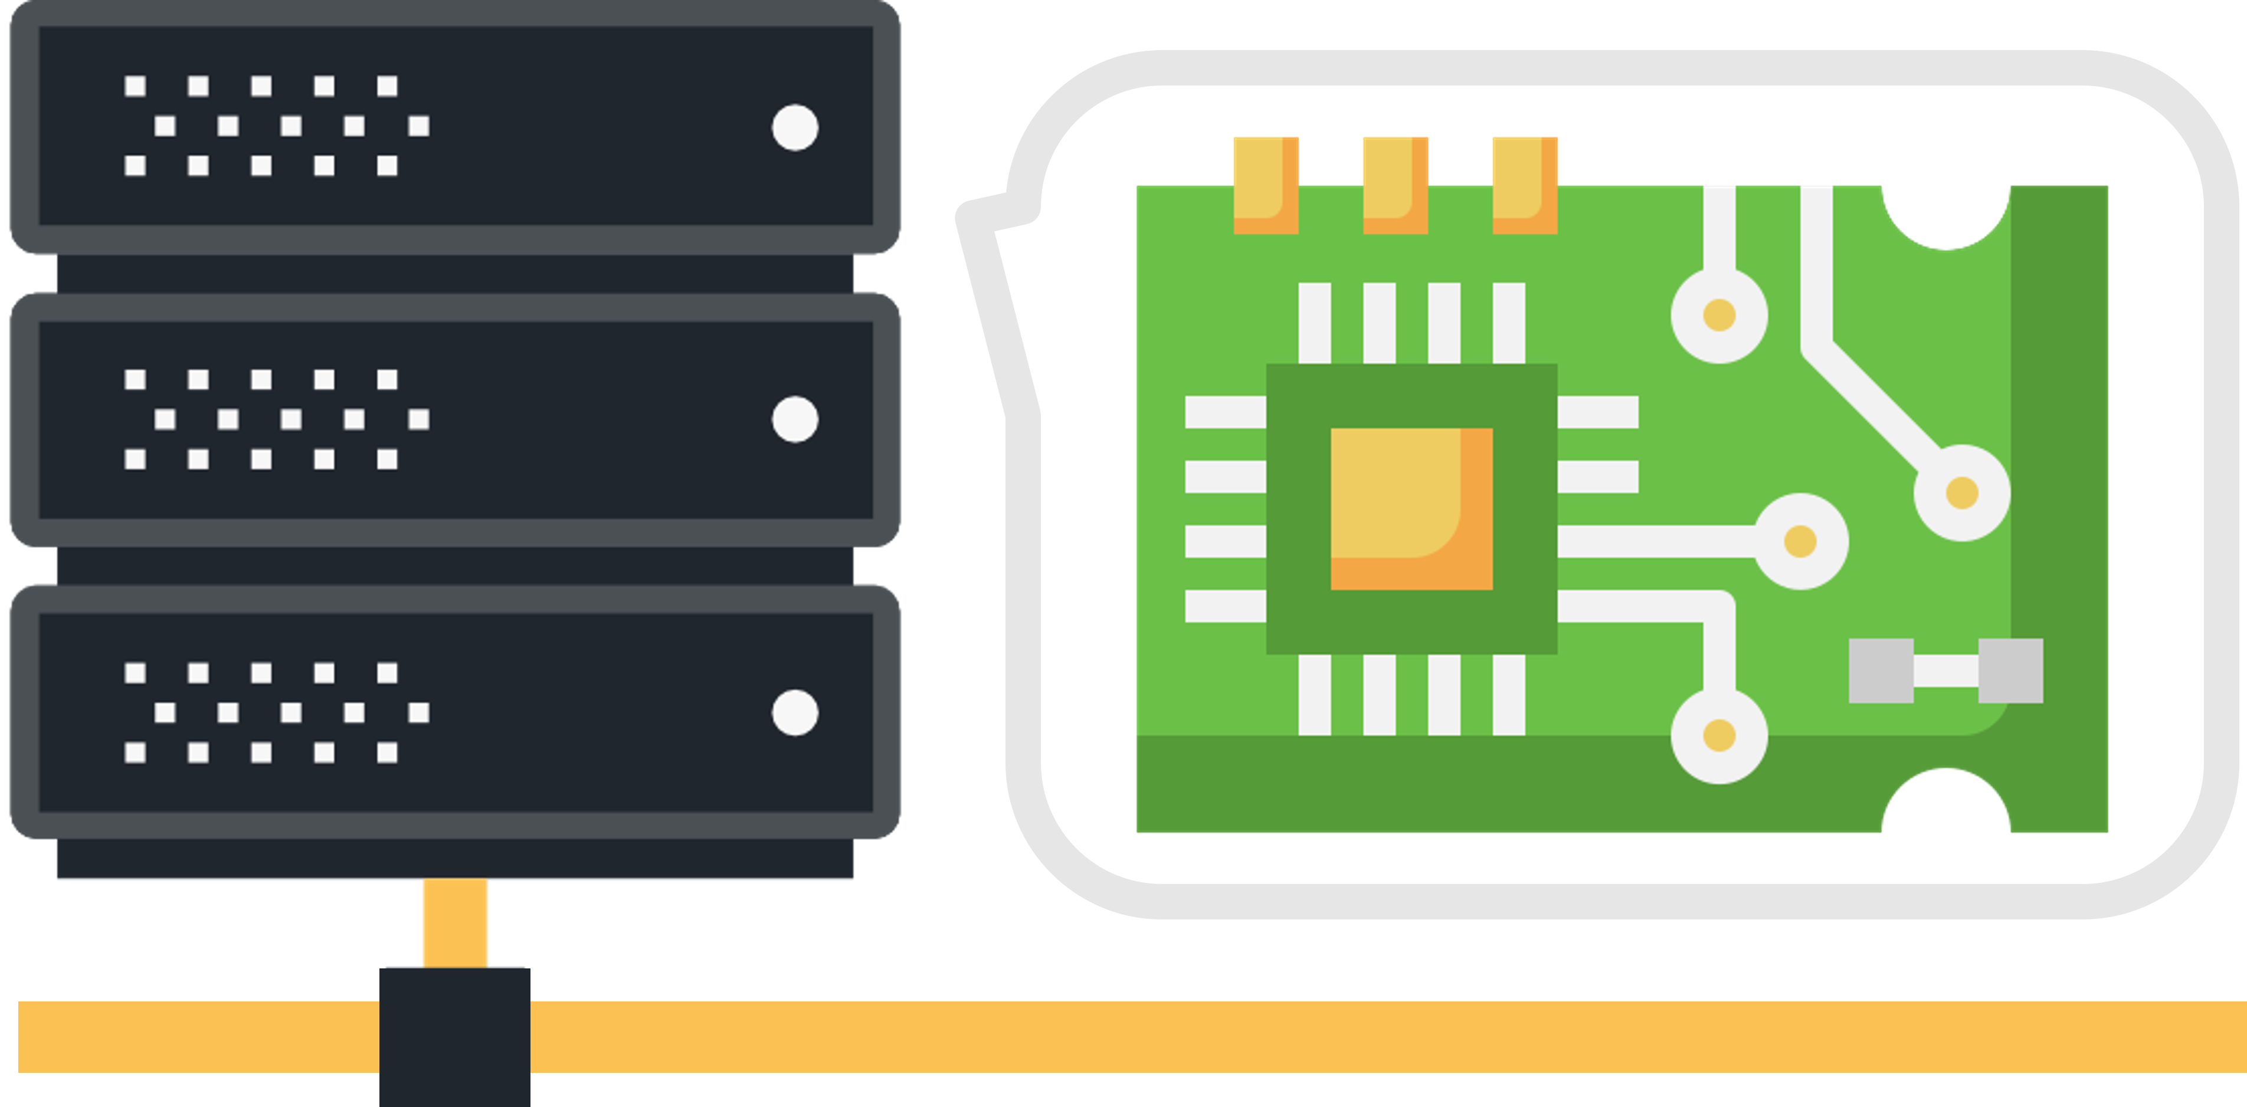
Dex
Embedded Server Practice
Based on Raspberry Pi & Ubuntu

