Slide 1
Digital Citizens
Notes:
Introduce what is the BUILDS program

Slide 2
Objectives
Recognize the elements of digital citizenship.
Acknowledge the different cyber laws and etiquettes.
Identify potential educational platforms and websites.
Explore online learning communities and resources.

Slide 3
Digital Natives
Digital Immigrants
Digital Citizens
Digital Pioneers

Slide 4
Digital Citizenship
‘‘Digital citizenship’’ is the ability to participate in society online (Mossberger, et al., 2008)
Digital citizenship can be described as the norms of appropriate, responsible behavior with regard to technology use (Ribble and Bailey, 2007)
Notes:
Mossberger, K., et al. (2008). Digital Citizenship: The Internet, Society, and Participation. Massachusetts Institute of Technology.
Ribble, M. and Bailey, G. (2007). Digital citizenship in schools. International Society for Technology in Education

Slide 5
9 Elements of Digital Citizenship
This is elaborated in the Chapter 2 of the Digital Citizenship in School (Ribble and Bailey, 2007)
The resource could be requested at the library for your reference

Slide 6
1. Digital Access
(Full electronic participation in society)
Educator
-Encourage the use of technology by using it in the classroom -Be mindful of the divide, the divide between ‘haves and have nots’. -In technology integration, consider access as a factor.
Learner
-Always meet your teachers halfway. -Understand that they too are also adjusting. -Find ways or alternatives to have access and not settle to “I just can’t have it or access it”
Notes:
Keywords: digital divide, equal access, meeting halfway, a two-way initiative or adjustment

Slide 7
Before integrating digital technologies, such as requirements and activities that involve devices and internet connectivity, assess your learners’ privileges.

Slide 8
2. Digital Commerce
(The buying and selling of goods online)
Educator
-Must take the role of teaching responsibility in online consumerism -When it comes to educational resources like e-books, partner with your school or college librarians regarding purchasing resources.
Learner
-Consult adults or experts through reviews, recommendations, comments, ratings and feedbacks, -We all have our part in creating a good guide to future consumers.
Notes:
Keywords: responsible consumerism, talk about those selling e-books online, some books could be requested or scanned at the library for free, some selling google drive access might contain malwares

Slide 9
Everyone is socially obliged to leave reviews, comments, ratings, feedbacks, or experiences on digital products.

Slide 10
3. Digital Communication
(The electronic exchange of information)
Educator
-Take advantage of these platforms, like the chat, messaging, blogging, and content creation. -Instill the values of respecting time and appropriateness (schedules of consultation or when not to use communication devices)
Learner
-Students are always being warned about how communication through online is unsafe. -Understand that it does not always respect rights, privacy, and you as a person. -Read, think, before you share.
Notes:
Keywords: there should be an agreed set of ethical way of communication, mention how this could be discussed further in cyber ethics

Slide 11
Educators must establish house-rules, protocols, and etiquettes to be practiced in communication platforms.

Slide 12
4. Digital Literacy
(The capability to use digital technology and knowing when to use it)
Educator
-Update skills and try exploring digital technology software (image and video processing, audio-visual editing, material enhancement, file format conversion, word-processing, learning management systems). -Educate students on how to locate, evaluate, and use.
Learner
-Learn how to locate, evaluate, and use information. -Digital society and information society made things easy but also complicated. -Take advantage of learning resources and guides made available for your online.
Notes:
Keywords: explain the difference of information, media, digital, technological, and metaliteracy

Slide 13
Everyone must equip themselves with digital literacies to be properly integrate themselves in the digital world.

Slide 14
5. Digital Etiquette
(The standards of conduct expected by other digital technology users)
Educator
-Encourage the use of digital technologies that have positive impact or effect to others. -Educate students on how to be respectful, how to address themselves, how to express intentions online, and the basic dos and don’ts.
Learner
-Work with their teachers to understand what information can be shared from their handheld device and when it is appropriate to do so. -Learn rules and know enough information before engaging in a conversation.
Notes:
Keywords: mention how a while ago was only about communication, this also go about information consumption, data handling and etc.

Slide 15
Think of boundaries in physical world and try to at least mimic them in the cyberspace.

Slide 16
6. Digital Law
(The legal rights and restrictions governing technology use)
Educator
-Teach copyright, fair use, plagiarism, data privacy and other legal issues that involves information and digital technologies. -This also includes piracy, stealing, spreading fake news, and accountability in the contents we are sharing.
Learner
-Be aware that all of these offenses can be detected and are punishable under the student code of conduct. -Cyber libel and slander could be committed due to irresponsibility and rash actions.
Notes:
Keywords: what moderates and dictates the ethics discussed earlier

Slide 17
Be mindful that there are now laws punishing those who violate laws.

Slide 18
7. Digital Rights and Responsibility
(The privileges and freedoms extended to all and the behavioral expectations that come with them)
Educator
-Explain the concepts and how they apply on the classroom and outside -Right to freedom of expression -Right to information -Bill of rights -Human Rights
Learner
- Learn that every right has a responsibility. Acknowledge that privileges also come with a cost. Be warned that these rights and privileges are easier waived in the digital world.

Slide 19
Always read Terms and Conditions, Terms of Service, Terms of Use, and EULA.

Slide 20
8. Digital Health and Wellness
(The elements of physical and psychological well-being related to digital technology use)
Educator
-Understand bandwidth and students workload. -Practice ergonomic use of computers. -Also take a break from time to time. -Social media detox.
Learner
-Time management and scheduling. -Practice ergonomic use of computers. -Also take a break from time to time. -Social media detox.

Slide 21
Short disclaimer: I will be sharing few videos that might help explain some of the things discussed. These materials are educational while lifting some scriptural insights.

Slide 22
9. Digital Security
(The precautions that all technology users must take to guarantee their personal safety and security of their network)
Educator and Educators
-Update passwords. -Use authentic verification accounts. -Have separate personal (social) and corporate (student or work) emails. -Do not click suspicious links. -Install anti-virus and protection. -Avoid installing crack versions of applications. -Do not download from malicious websites. -Beware of phishing, pharming, and smishing.

Slide 23
Teaching Students Digital Citizenship
Stages
Awareness
Guided practice
Modelling and demonstration
Feedback and analysis

Slide 24


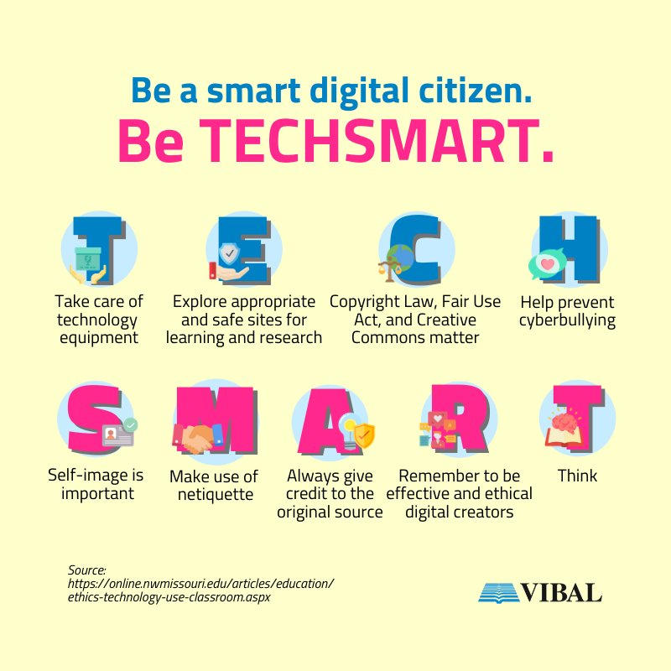

Social, Ethical, and Legal Responsibilities
Summarized by TECHSMART
z

Slide 25

Take care of technology equipment.
With malware and viruses running rampant, students must learn to watch what they download, click and share.

Slide 26

Explore appropriate and safe sites for learning and research.
Many websites contain inaccurate or false information. Teachers can provide a list of approved websites. Students need to learn how to evaluate websites and assess whether they can trust the content.

Slide 27

Copyright law, Fair Use Act and Creative Commons matter.
Students learn how to copy and paste without realizing the copyright implications. Understanding copyright and related laws will help ensure students follow the rules in using and sharing content.

Slide 28

Help prevent cyberbullying.
The anonymity of the internet and not seeing faces makes it easy to “say” things one would not utter in person. Teaching students about cyberbullying requires discussing not only its definition but also how hurtful and damaging it can be. Give examples of cyberbullying and encourage students to report any cyberbullying incident to teachers, counselors, administrators or their parents.

Slide 29
Self-image is important.
Without seeing faces, people can easily overshare in a digital world. Kids need to learn how future employers look up candidates’ social media accounts to see how they represent themselves in public.

Slide 30
Make use of netiquette.
Netiquette comprises the rules of an online community. Sloppy writing in online forums, device distraction while in conversation, and sending of unsolicited emails are a few examples of poor netiquette. Learners need to understand what makes good and bad netiquette and why.

Slide 31
Always give credit to original source.
Like citing references in term papers, students learn about the importance of using online citations to respect copyright laws and eschew plagiarism.

Slide 32
Remember to be effective, thoughtful and ethical digital creators.
Teachers can incorporate assignments that use digital tools in the classroom. This allows students to learn how to use technology responsibly with teacher oversight.

Slide 33
Think.
Teachers can integrate TECH SMART into their lesson plans and encourage students to think about technology’s purpose in all digital interactions.

Slide 34
Netiquette or Cyber Ethics
1. Make Real People a Priority
  The cyberspace is not an alternate reality where we shall soon fall or belongs. Still maintain real relationships from real people. Better to maintain the same personality online and in-person.

Slide 35
Netiquette or Cyber Ethics
2. Use Respectful Language
  Be respectful, address person using their real name, their titles, and professional distinctions. Express emotions and feelings as is, and no need to add profanity and insults.

Slide 36
Netiquette or Cyber Ethics
3. Protect your data, privacy, and act with discretion
  Be careful not to disclose sensitive, intimate, personal, data or information. Protect your private life from scammers, identify thieves, and hackers.

Slide 37
Netiquette or Cyber Ethics
4. Respect others’ privacy and rights in return
  Return the favor of respect. But remember that respect begets respect is flawed. Respect other people despite they haven’t showed you respect.
  HOWEVER, always draw a line between tolerance and abuse.

Slide 38
Netiquette or Cyber Ethics
5. Be friends only with your friends offline
  Create a safe bubble in your online space that only those you know could interact with you. There are privacy options you could explore online. But better to stay away from online strangers.

Slide 39
Netiquette or Cyber Ethics
6. Fact check before you interact
  Do the CLICKERS test!
    Check your own biases
    Look before sharing
    Is it a joke?
    Consider the source
    Know beyond
    Experts approved?
    Research if others agree
    Supporting sources

Slide 40
Netiquette or Cyber Ethics
7. Respond to Emails and Texts Promptly
  If unable to respond or reply immediately, apologize. Also be sure to update and follow up persons regarding the emails. Explain reasons in detail.

Slide 41
Netiquette or Cyber Ethics
8. There is freedom of expression BUT …
  Exercise freedom of expression but not every page is a freedom wall. If what you will say is not true and not good, keep it to yourself unless your opinion is sought.

Slide 42
Netiquette or Cyber Ethics
9. Confront and resolve issues privately …
  The world is a stage… but it shouldn’t always be drama. Resolve conflicts in private. Do not resort in gathering online sympathy.

Slide 43
Netiquette or Cyber Ethics
10. How to deal with online arguments
  Read
  Validate not invalidate
  Educate not preach
  Share strong supporting facts
  Either end by concluding or admitting your mistake
  Block or report

Slide 44
Cyberbullying
Cyberbullying can take many forms, including mean text messages or e-mails, rumors sent by e-mail or posted on social networking sites, and embarrassing pictures, videos, websites, or fake profiles.

Slide 45
Cyberbullying messages and images can be posted anonymously and distributed quickly to a very wide audience. It can be difficult, sometimes impossible, to trace the source, especially if the inappropriate or harassing messages, texts, and pictures have been deleted after being viewed.

Slide 46
What to do?
Grow up! Be matured enough to:
  say something when you see something.
  say something but not to take part in bullying.
  to block or report.
  guide persons towards help.
  take evidences.
  take a break.

Slide 47
Educational Platforms
Education.com for classroom management
Menti, Slack, Slido for lecture interaction
Quizizz, Kahoot, Blooket for quizzes
Puzzel.org for quizzes, jigsaw puzzles, memory games and more
Wix, Wordpress, LinkedIn, Blogger for website hosting
pbskids.org/games/ for educational games
funbrain.com/games/ and kids.nationalgeographic.com/games/ for educational games
littlealchemy.com for fun science game
Wordbook Online for reading materials and resources

Slide 48
Online Communities of Learning
The goal of educators nowadays is to create a learning community, online.
When we say community, what comes into your mind?
Menti Time!
Go to menti.com and enter the code 6346 0522

Slide 49
Make Sure Online Learning Happens
According to Bonk and Reynolds (1997), to promote higher-order thinking on the Web, online learning must create challenging activities that enable learners to link new information to old; acquire meaningful knowledge; and use their metacognitive abilities; hence, it is the instructional strategy, not the technology, that influences the quality of learning.

Slide 50
Educators must not settle on just creating online versions of their lessons but to mimic the learning experience with:
  the use of the Internet to access learning materials;
  to interact with the content, instructor, and other learners;
  to obtain support during the learning process, in order to acquire knowledge, to construct personal meaning, and to grow from the learning experience

Slide 51
Design a Learning Approach
Base the design on various schools of thought:
  Behaviorist Perspective
  Cognitivist Perspective
  Constructivist Perspective
  Connectivist Theory Perspective

Slide 52
Behaviorist
    This is inspired by Thorndike, Pavlov, and Skinner, - this school of thought posits that learning is a change in observable behavior caused by external stimuli in the environment.
    Change in behavior is manifestation that learning occurred.

Slide 53
So what?
Your learning objectives must be measureable by observable parameters.
Your activities must have engagement, interaction and mostly targeting psychomotor and affective spheres.

Slide 54
Assessment AS and OF Learning
Learners should be told the explicit outcomes of the learning so they can set expectations and judge for themselves whether or not they have achieved the outcome of the online lesson.
Learners must be tested to determine whether or not they have achieved the learning outcome. Online testing or other forms of testing and assessment should be integrated into the learning sequence to check individual learner’s achievement level and provide appropriate feedback.

Slide 55
BLOOM’S TAXONOMY
The learning materials must be sequenced appropriately to promote learning. The sequencing could take the form of simple to complex, known to unknown, and knowledge to application.
Learners must be provided with feedback so that they can monitor how they are doing and take corrective action if required.

Slide 56
Cognitivist
Cognitivists see learning as an internal process that involves memory, thinking, reflection, abstraction, motivation, and metacognition. Cognitive psychology looks at learning from an information processing point of view, where the learner uses different types of memory during learning

Slide 57
So what?
Online learning strategies must present the materials and use strategies that enable students to process the materials efficiently.
It involves long term and short term memories. And in order to attain retention, short term must be processed by the brain before it is lost.

Slide 58
Dale’s cone
Strategies used should allow learners to perceive and attend to the information so that it can be transferred to working memory. Learners use their sensory systems to register the information in the form of sensations.

Slide 59
Strategies used should allow learners to retrieve existing information from long-term memory to help make sense of the new information. Learners must construct a memory link between the new information and some related information already stored in long term memory.

Slide 60
PCK TPCK (simplification of complex concepts)
Information should be chunked to prevent overload during processing in working memory (use charts, infographics, diagrams)
Other strategies that promote deep processing should be used to help transfer information to long-term storage. To make the transfer to long-term memory more effective, strategies should be used that require learners to apply, analyze, synthesize, and evaluate promote higher-level learning.

Slide 61
A variety of learning strategies should be included in online instruction to accommodate individual differences and learning styles.
Information should be presented in different modes to facilitate processing and transferring it to long-term memory. Where possible, textual, verbal, and visual information should be presented to encourage encoding.

Slide 62
Learners should be motivated to learn. It does not matter how effective the online materials are, if learners are not motivated, they will not learn. The issue is whether to use intrinsic motivation (driven from within the learner) or extrinsic motivation (instructor- and performance-driven).
Encourage learners to use their metacognitive skills to help in the learning process.

Slide 63
Online strategies that facilitate the transfer of learning should be used to encourage application in different and real-life situations. Simulation of the real situation, using real-life cases, should be part of the lesson.

Slide 64
Constructivist
Constructivists see learners as active rather than passive. Knowledge is not received from the outside or from someone else; rather, the individual learner interprets and processes what is received through the senses to create knowledge.
So if cognitivist thinks they light the fire, for constructivists the can start the fire.

Slide 65
So what?
Educators must either provide information, learning materials, or others for the learner to figure out, or leave free spaces that allows students to think for themselves.
Learning should be an active process. Keeping learners active doing meaningful activities results in high-level processing, which facilitates the creation of personalized meaning.

Slide 66
Learners should construct their own knowledge, rather than accepting that given by the instructor. Knowledge construction is facilitated by good interactive online instruction, since the students have to take the initiative to learn and to interact with other students and the instructor, and because the learning agenda is controlled by the student. A.S.
Learning should be interactive to promote higher-level learning and social presence, and to help develop personal meaning. S.U.

Slide 67
Collaborative and cooperative learning should be encouraged to facilitate constructivist learning
Learners should be given control of the learning process. R.
Learners should be given time and the opportunity to reflect. E.
Learning should be made meaningful. Learning materials should include examples that relate to the learners so that they can make sense of the information.

Slide 68
Connectivist
According to Siemens (2004), connectivist theory is for the digital age, where individuals learn and work in a networked environment. As a result, we do not have control over what we learn since others in the network continually change information, and that requires new learning, unlearning old information, and/or learning current information.

Slide 69
Because of the information explosion, learners should be allowed to explore and research current information.
Some information and procedures become obsolete because of changes in the field and innovation; learners must therefore be able to unlearn old information and mental models and learn current information and mental models. The information that is valid today may not be valid tomorrow.

Slide 70
The rapid increase of information available from a variety of sources means that some information is not as important or genuine as other information.
Learners must have the ability to recognize what knowledge is no longer valid so they can acquire the new knowledge for a discipline.
Because of globalization, information is not location-specific, and with the increasing use of telecommunication, technologies experts and learners from around the world can share and review information.

Slide 71
The world is connected by telecommunication technology. Hence, information for learning should not be taken from one source but should be assembled from many sources to reflect the networked world and the diversity of thinking.
The field of computer systems is altering the learning process.
Because of the information explosion, learners of the future must be willing to acquire new knowledge on an ongoing basis.

Slide 72
The Internet is expanding education into a global classroom, with learners, teachers, and experts from around the world. As a result, learners must network with other students and experts to make sure that they are continually learning and updating their knowledge.
Because of innovation and our increasing use of technology, learning is becoming more multidisciplinary. Learners must be exposed to different fields so that they can see the connections between the information in the fields.

Slide 73
So what?
Many people can now be a part of the learning community of one learner.
It is part of teacher’s responsibility to introduce their students to these circles.

Slide 74
Student Organizations
Most student organizations are now forgetting their role and function. Holistic learning should always be kept in mind by student leaders.
  A good examples is the student organization of Veterinary Medicine Students.

Slide 75
Teachers
The whole faculty could be part of the students’ learning circle. Referral or consultation; it doesn’t have to be under their advisory or class. Teachers could still provide resources, advices and more. Indirectly, they could serve as model or as examples.

Slide 76
Political Figures
They could show examples also of high credentials, achievement, and productivity for the youth. They could also provide access to internet connections, educational resources, and provision of Free Education. Some, to an extent, provides scholarships.

Slide 77
*Private Business
Some could provide employment opportunities and scholarships.

Slide 78
*Celebrities and Influencers
They shouldn’t be looked up as role models but could serve as inspiration. Educators should also be aware of these not just to be aware of the up-and-coming trends but to further understand their students; to somehow relate to them.
  What are the contents they follow?
  Who are their favorite artists?
  Which genre or art styles grabs their attention the most?

Slide 79
Family
The main support system of the students nowadays. But often, some are not very supportive or circumstances could not really allow them to be supportive.

Slide 80
Content creators
Educational content or even just blogs or vlogs.

Slide 81
Now these are the circles of the learning community. And in an online learning community there are various mediums where these could be accessed.

Slide 82
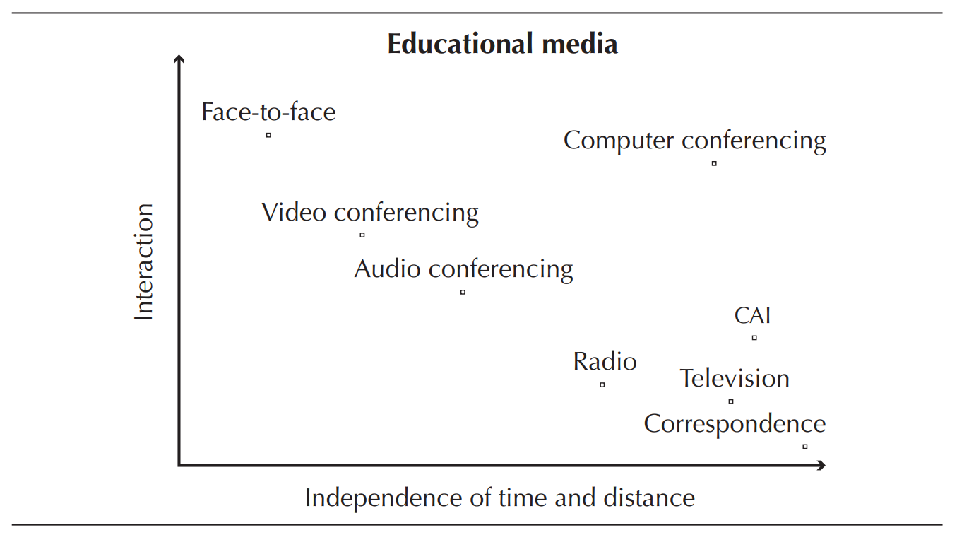

Slide 83
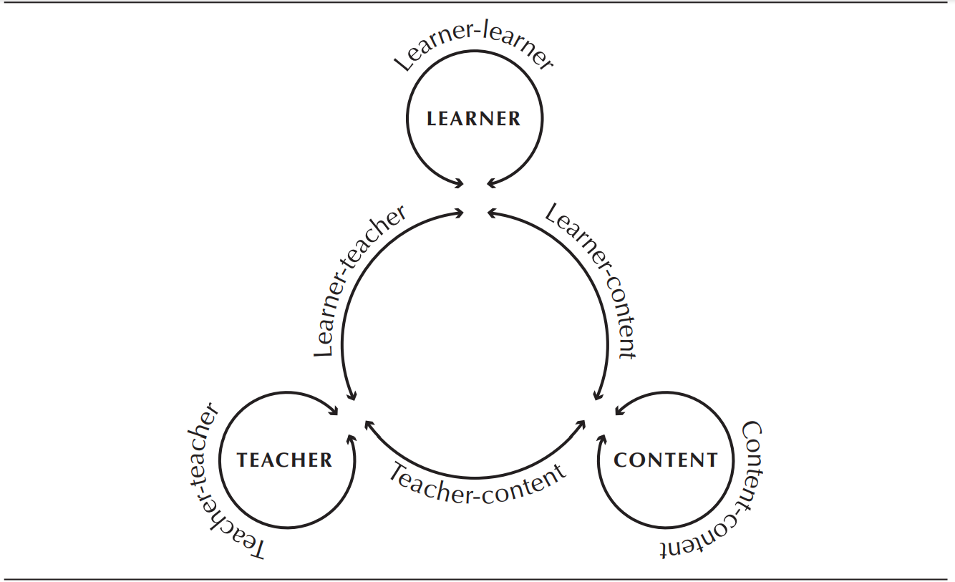
With these medium, there will be different interactions

Slide 84
For the references, please request for the following e-books at the library
This is for further (extensive) reading about digital citizenship and digital literacy.
  Digital Citizenship: The Internet, Society, and Participation.
  Digital citizenship in schools.
  The Theory and Practice of Online Learning

