Slide 1
Digital Citizenship
An Overview of the Nine Elements to Becoming a Good Citizen
Dr. Clara Bannister, PhD.
Franklin Military Academy

Slide 2
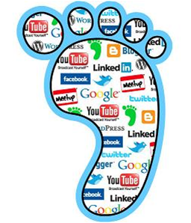
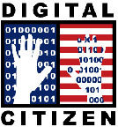
What Is Digital Citizenship?
Digital citizenship can be defined as the norms of appropriate, responsible behavior with regard to technology use.
http://www.digitalcitizenship.net/nine-elements.html

Slide 3

Let’s Watch a Brief Video Clip that Explains digital citizenship by Inctrl
Living in a Digital World
http://www.teachinctrl.org/videos/livingdigitalworld-student.php

Slide 4
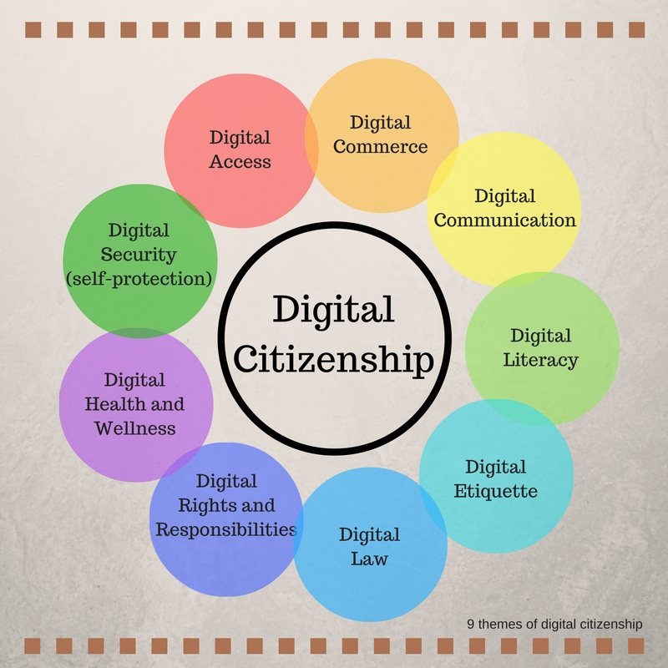
The Nine Elements of
Digital Citizenship
http://www.bing.com

Slide 5

The Nine Elements of
Digital Citizenship
1. Digital Access:
full electronic participation in society.
Technology users need to be aware that not everyone has the same opportunities when it comes to technology. Working toward equal digital rights and supporting electronic access is the starting point of Digital Citizenship.
http://www.digitalcitizenship.net/nine-elements.html

Slide 6

The Nine Elements of
Digital Citizenship
2. Digital Commerce:
electronic buying and selling of goods.
Technology users need to understand that a large share of market economy is being done electronically. Legitimate and legal exchanges are occurring, but the buyer or seller needs to be aware of the issues associated with it. Users need to learn about how to be effective consumers in a new digital economy.
http://www.digitalcitizenship.net/nine-elements.html

Slide 7

The Nine Elements of
Digital Citizenship
3. Digital Communication:
electronic exchange of information.
One of the significant changes within the digital revolution is a person’s ability to communicate with other people. In the 21st century, communication options have exploded to offer a wide variety of choices (e.g., e-mail, cellular phones, instant messaging). The expanding digital communication options have changed everything because people are able to keep in constant communication with anyone else. Now everyone has the opportunity to communicate and collaborate with anyone from anywhere and anytime. Unfortunately, many users have not been taught how to make appropriate decisions when faced with so many different digital communication options.
http://www.digitalcitizenship.net/nine-elements.html

Slide 8

The Nine Elements of
Digital Citizenship
4. Digital Literacy:
process of teaching and learning about technology and the use of technology.
A renewed focus must be made on what technologies must be taught as well as how it should be used. New technologies are finding their way into the work place that are not being used in schools (e.g., Videoconferencing, online sharing spaces such as wikis). In addition, workers in many different occupations need immediate information (just-in-time information). This process requires sophisticated searching and processing skills (i.e., information literacy). Learners must be taught how to learn in a digital society. In other words, learners must be taught to learn anything, anytime, anywhere. As new technologies emerge, learners need to learn how to use that technology quickly and appropriately. Digital Citizenship involves educating people in a new way— these individuals need a high degree of information literacy skills.
http://www.digitalcitizenship.net/nine-elements.html

Slide 9

The Nine Elements of
Digital Citizenship
5. Digital Etiquette:
electronic standards of conduct or procedure.
Technology users often see this area as one of the most pressing problems when dealing with Digital Citizenship. We recognize inappropriate behavior when we see it, but before people use technology they do not learn digital etiquette (i.e., appropriate conduct). Many people feel uncomfortable talking to others about their digital etiquette. Often rules and regulations are created or the technology is simply banned to stop inappropriate use. It is not enough to create rules and policy, we must teach everyone to become responsible digital citizens in this new society.
http://www.digitalcitizenship.net/nine-elements.html

Slide 10
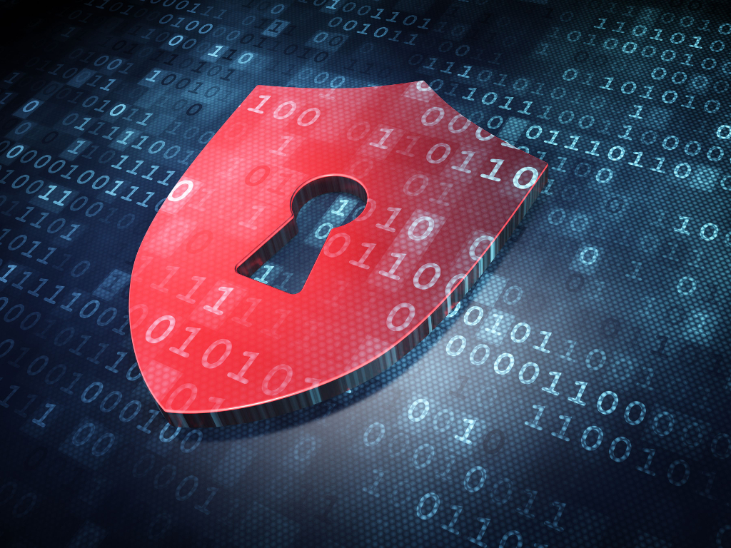
The Nine Elements of
Digital Citizenship
6. Digital Law:
electronic responsibility for actions and deeds
Digital law deals with the ethics of technology within a society. Unethical use manifests itself in form of theft and/or crime. Ethical use manifests itself in the form of abiding by the laws of society. Users need to understand that stealing or causing damage to other people’s work, identity, or property online is a crime. There are certain rules of society that users need to be aware in a ethical society. These laws apply to anyone who works or plays online. Hacking into others information, downloading illegal music, plagiarizing, creating destructive worms, viruses or creating Trojan Horses, sending spam, or stealing anyone’s identify or property is unethical.
http://www.digitalcitizenship.net/nine-elements.html

Slide 11

The Nine Elements of
Digital Citizenship
7. Digital Rights & Responsibilities:
those freedoms extended to everyone in a digital world.
Just as in the American Constitution where there is a Bill of Rights, there is a basic set of rights extended to every digital citizen. Digital citizens have the right to privacy, free speech, etc. Basic digital rights must be addressed, discussed, and understood in the digital world. With these rights also come responsibilities as well. Users must help define how the technology is to be used in an appropriate manner. In a digital society these two areas must work together for everyone to be productive.
http://www.digitalcitizenship.net/nine-elements.html

Slide 12

The Nine Elements of
Digital Citizenship
8. Digital Health & Wellness:
physical and psychological well-being in a digital technology world.
Eye safety, repetitive stress syndrome, and sound ergonomic practices are issues that need to be addressed in a new technological world. Beyond the physical issues are those of the psychological issues that are becoming more prevalent such as Internet addiction. Users need to be taught that there are inherent dangers of technology. Digital Citizenship includes a culture where technology users are taught how to protect themselves through education and training.
http://www.digitalcitizenship.net/nine-elements.html

Slide 13
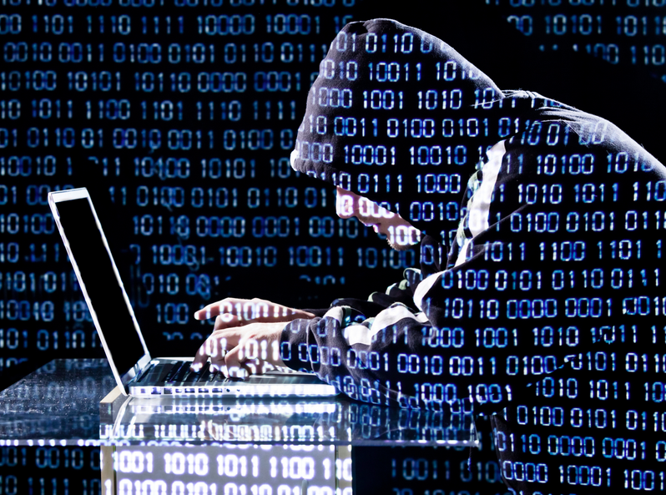
The Nine Elements of
Digital Citizenship
9. Digital Security (self-protection):
electronic precautions to guarantee safety.
In any society, there are individuals who steal, deface, or disrupt other people. The same is true for the digital community. It is not enough to trust other members in the community for our own safety. In our own homes, we put locks on our doors and fire alarms in our houses to provide some level of protection. The same must be true for the digital security. We need to have virus protection, backups of data, and surge control of our equipment. As responsible citizens, we must protect our information from outside forces that might cause disruption or harm.
http://www.digitalcitizenship.net/nine-elements.html

Slide 14
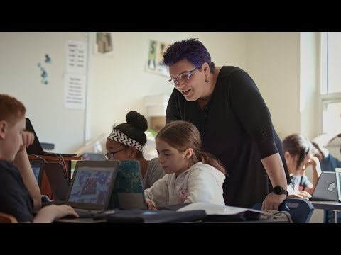
Let’s watch this video clip on a new and engaging resource tool to help you stay safe by Google
Be Internet Awesome with Google
https://beinternetawesome.withgoogle.com/

Slide 15
Student Interactive Activities
Interland
You Can Play the Game Interland by Google
This is a fun game for teaching you how to be safe on the Internet
https://beinternetawesome.withgoogle.com/resources

Slide 16
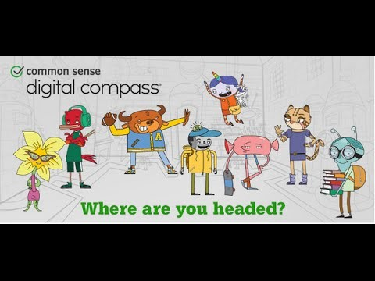
Student Interactive Activities
Digital Compass
https://www.brainpop.com/games/digitalcompass/
Digital Compass will help you to understand the different aspects of digital citizenship through 8 animated characters and real world scenarios.
When you play this game, you will determine the fate of the different characters.
First, let’s take a peek at the introduction video to the game.
https://youtu.be/6opdfUvdETg

Slide 17
Student Interactive Activities
Brain Pop
has wonderful videos that will help you to understand the different concepts of digital citizenship.
https://www.brainpop.com/
Username: rpfranklinmilitary Password: bpop
Instructions:
1. Click on Digital Citizenship
2. Watch the videos on the following topics listed below and take the quiz for each video and
email your results to Dr. Bannister at cbannist@rvaschools.net.
Cyberbullying
Conflict Resolution
Digital Etiquette
Media Literacy
Online Safety

Slide 18
Digital Citizenship Resources
Most Credible and Reliable Sources on the Internet for Students
https://www.commonsense.org/education/top-picks/most-reliable-and-credible-sources-for-students
Evaluating Web Resources : The CRAAP Test
http://libguides.library.ncat.edu/c.php?g=778558&p=5584082
How to Distinquish Fake News from Real News
https://docs.google.com/document/d/10eA5-mCZLSS4MQY5QGb5ewC3VAL6pLkT53V_81ZyitM/edit
Be Internet Awesome Pledge
https://beinternetawesome.withgoogle.com/pdfs/Google_BeInternetAwesome_Pledge.pdf

Slide 19
All images in the presentation are
Common Creative Images from www.bing.com

