Slide 1
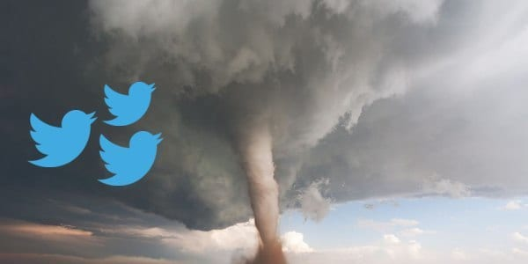
Natural Language Processing
with Disaster Tweets
By Team 10

Slide 2
Background
Objective
Dataset Overview
Project Life Cycle
Model Summary
Findings and Suggestions
Conclusion
Overview

Slide 3
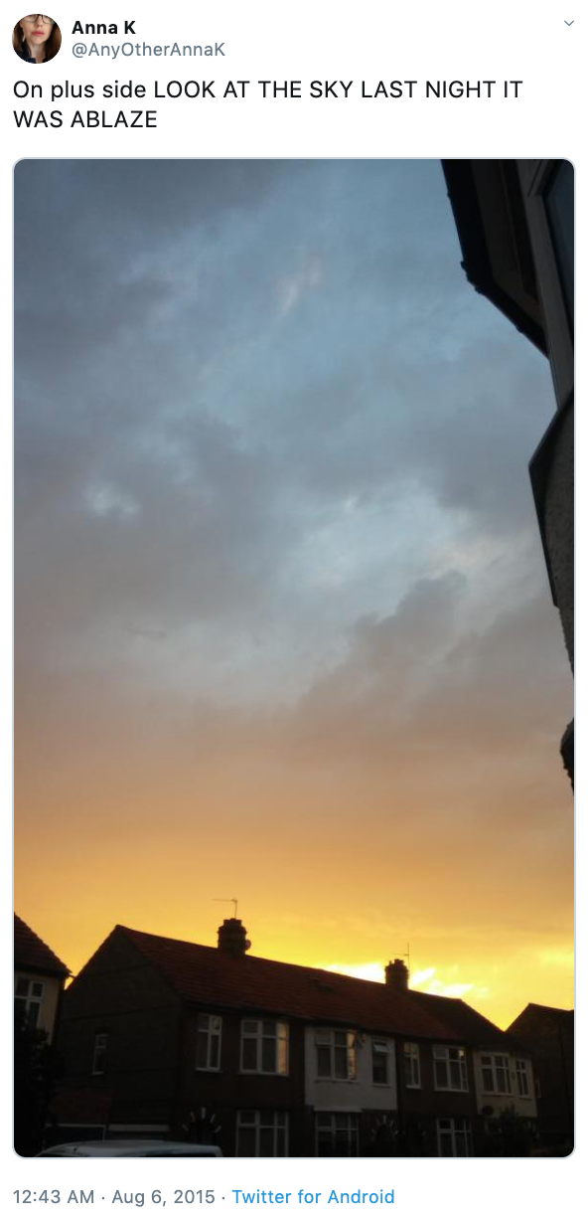
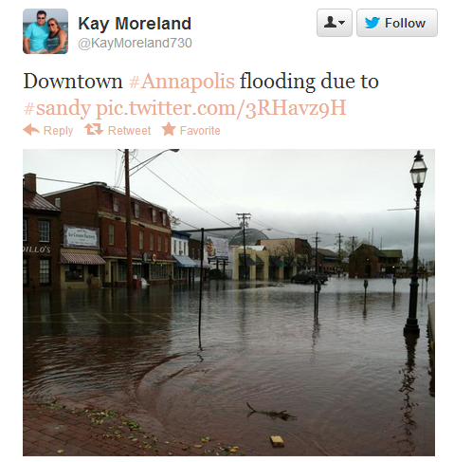
What is Disaster Tweets?
A important medium for expressing immediate responses of warning, evacuation, or rescue, providing immediate assistance, assessing damage, continuing assistance, and the immediate restoration or construction of infrastructure.
Non-disaster Tweet Disaster Tweet

Slide 4
Objective
The objective is to predict whether tweets indicates to disaster.
Analyze different word embeddings and classification algorithms, evaluate each models, find best combination of models, and choose the best model based on performance metrics - Precision, Recall, F1 Score, Accuracy, ROC/AUC value
There are demands for companies to utilize tweets, we can recommend diverse combination of models.

Slide 5
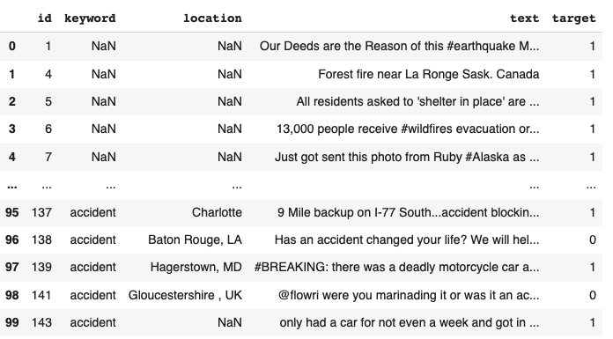
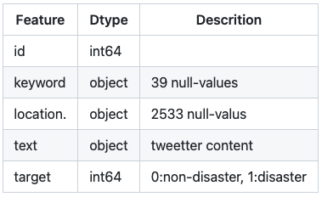
Dataset Overview

Slide 6
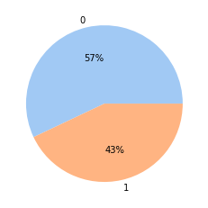
Dataset Overview

Slide 7
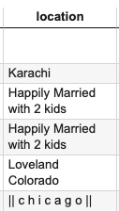
Feature Selection
Drop

Slide 8
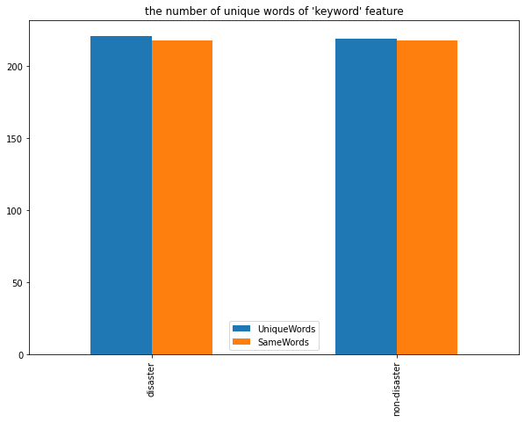
Feature Selection
Drop
Disaster : 221 keywords
Non - Disaster : 219 keywords

Slide 9
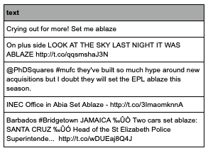
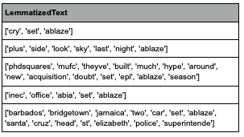
Natural Language Normalization

Slide 10
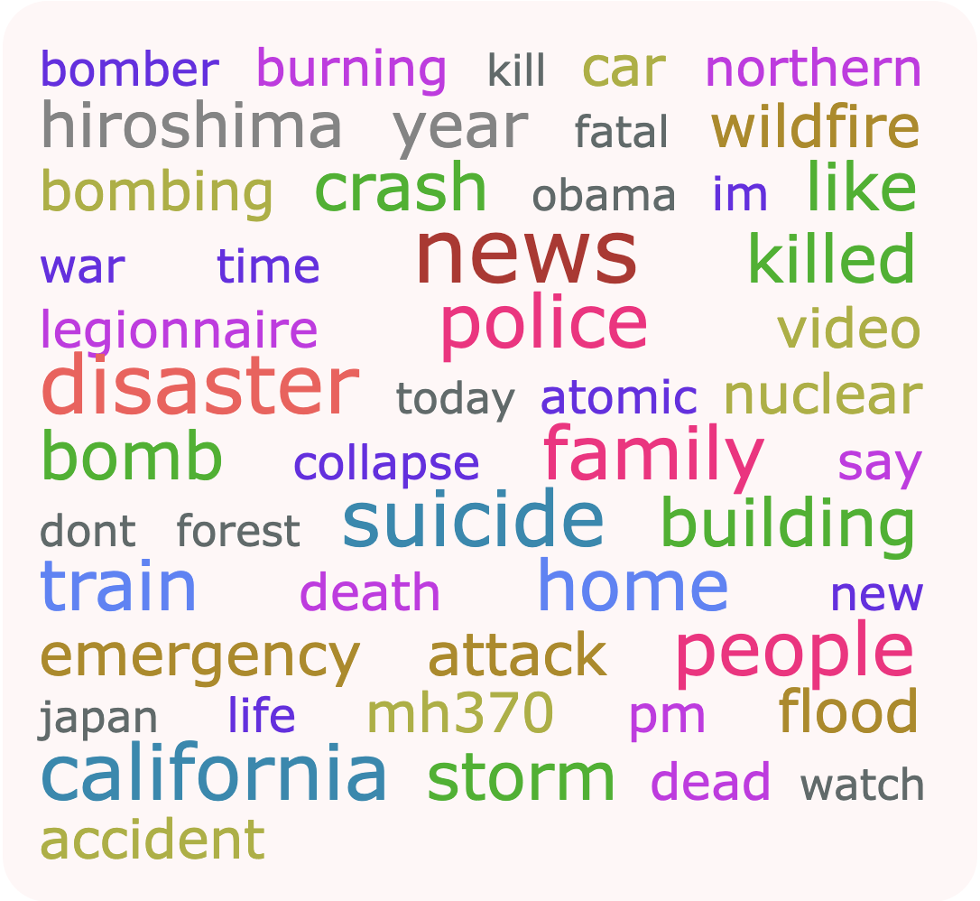
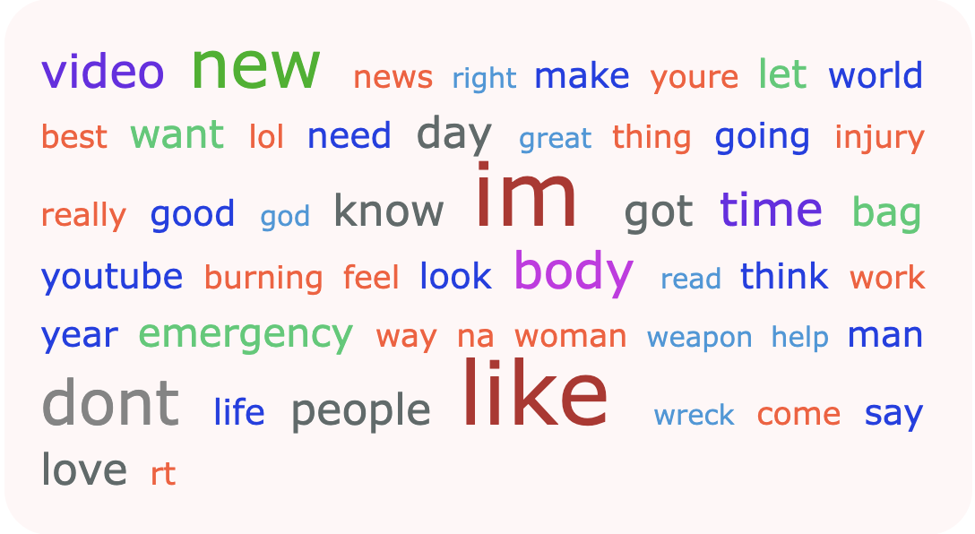
Visualization - Word Cloud
Disaster Tweets
Non- Disaster Tweets

Slide 11
Project Life Cycle
Hyperparameter tuning
Training Model
Predict
Raw data
Feature
Selection
Natural Language Preprocessing
Finding Word Embeddings
Models
Testing
Model

Slide 12
Project Life Cycle
Finding Combination of classifier with one of word Embeddings
Count
Vectorizer
Tf-Idf
Word2Vec
Word2Vec
+
PCA
Word2Vec
Glove
Non Deep Learning Classifier
Deep Learning(Sequential) Classifier - LSTM

Slide 13
Model Summary
Below models were trained on different feature vector sets and generate comparison between their performance done based on metrics - Precision, Recall, Accuracy, F1 Score, and ROC/AUC.
1
2
3
4
5
6
7
Logistic
Regression
+
Count
Vectorizer
SVM
+
Count
Vectorizer
Decision Tree
+
Tf-Idf
Random
Forest
+
Count
Vectorizer
XGboost
+
Word2Vec
+
PCA
LSTM
+
Glove
Ensemble

Slide 14
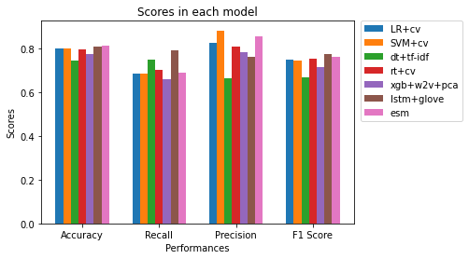
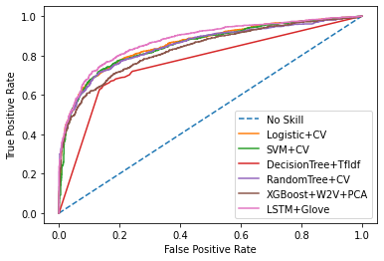
Results

Slide 15
Findings and Suggestions
Based on the analysis, we found that LSTM with glove model has the best accuracy among respective models.
Other models(Logistic Regression or SVM) can yield enough performance given that difference with LSTM is slight(around 1%)
Ensemble model has improved rather than individual models.
Bag Of Words is comparative to other word embeddings.
Recommendations
Use ensemble model with diverse combinations of prediction models.

Slide 16
Conclusion, Limitations & Future work
In this analysis we experienced four prominent word embeddings and seven classification techniques of using a Figure-Eight Company data set. LSTM with glove have good performance among individual models. Ensemble model has the best performance in this experiment.
Limitations & Future Work:
Reliability of raw data
More Comparison on all word embeddings to models
Hyperparameter tuning on LSTM

